Slide 1
Modeling Meeting 2 25 November 2025
Jordan Gunn

Slide 2
Today’s Focus
Current goal:
Use retrieved-context models (CMR/eCMR) to account for the selective interference effect in trauma-film + Tetris paradigms.
We previously agreed to anchor initial modelling on:
Lau-Zhu et al. 2019 and 2021 trauma-film / Tetris experiments.
Today’s focus:
Zoom in on the 2021 associative-cue experiment.
Ask what it looks like through a CMR/RCT lens.
Use that to refine our modelling plan.
Notes:
Our big aim for now in the project is still to see whether a retrieved-context model can account for the selective interference effect in these trauma-film plus Tetris paradigms.”
“Last time we agreed that Lau-Zhu 2019 and 2021 would be our primary empirical anchors.”
“Since our last meeting, I started to zoom in on the 2021 associative-cue experiment and ask: what does this look like to CMR, and how much do we want to lean into that reading in our modelling plan?”
Unforunately, my simulation work is in the early stages. And yet, I think I’ve made important conceptual progress that might help update our thinking about this project and how we’l tackle it.
“My hope is that this helps us get more concrete about how retrieved-context fits this domain, clarify our research goals, and sharpen our simulations going forward.”

Slide 3
Key Questions for Today
How does a retrieved-context model naturally interpret the 2021 VIT and recognition tasks?
Given that interpretation, what should we count as a “successful” CMR account of the selective interference effect on this paradigm?
How central do we want this experiment to be in the modelling story, relative to other available paradigms?
Notes:
“I’ve started adapting CMR/eCMR to these trauma-film paradigms, but unfortunately I haven’t finished. Before we get too invested in tuning parameters, I wanted to use the 2021 experiment as a conceptual checkpoint.”
“Rather than give a status report, I’d like to organise the rest of the talk around three questions.”
“First: if we take CMR seriously, what does it say is happening in the VIT and in the modified recognition task in 2021?”
“Second: given that reading, what would we actually want a CMR simulation to explain about the selective interference pattern here?”
“Third: depending on the answers, how central do we want this experiment to be in our modelling narrative versus, say, the free recall work in 2019 or ongoing matched-cue experiments in the lab?”

Slide 4
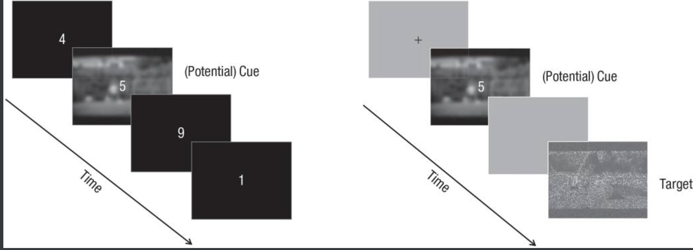
2021 Study: Task Features That Matter for CMR
Vigilance–Intrusion Task
Go/no-go digits; blurred backgrounds every few trials.
Occasionally: trauma-film stills (or foils) as extra backgrounds.
Participant just does the digit task; presses if a film image intrudes.
Modified Recognition Task
Same style of stills used as cues, including mixed film or foil stills
Each cue followed by a blurred target still (film or foil).
Task: decide yes/no ”from the trauma film or not”.
Some trials: cue and target from same film; some mismatched.
Notes:
“Just to have the structure fresh in our minds, here are the two main tasks in 2021.”
“On the left is the VIT: essentially a go/no-go task with blurred backgrounds and occasional film or foil stills, where participants report intrusions.”
“On the right is the modified recognition task: each trial starts with a cue still, then a blurred target still, and people decide whether the target came from the trauma film.”
“The key difference is how those stills are linked to the response: in VIT they’re background triggers; in recognition background cues precede an explicit probe–target decision.”

Slide 5
Lau-Zhu 2021: what they were trying to fix
Earlier trauma studies:
Intrusions arise in some triggering situation or scene
Voluntary memory: single-item recognition, stills tested more or less in isolation
Possible explanation:
Interference might mainly disrupt how scenes are tied to the broader event context
2021 idea:
Add similar film vs foil cues to both VIT and recognition tasks.
Key question:
With that alignment in place, does interference still look selective for intrusions?
?
Notes:
“My understanding is that they saw a mismatch in how context was handled across tasks in the earlier work.”
“Intrusions almost always happen in some triggering situation, whereas the early recognition tests used single stills without much structure around them.”
“That leaves open a story where interference mainly damages how scenes are embedded in the wider event, which would hurt intrusions more than single-item recognition.”
“So in 2021 they try to fix that by putting film versus foil cues in front of both tasks, so that both VIT and recognition can, in principle, benefit from having the current context aligned with the film. Then they ask: under that setup, does interference still look selective?”

Slide 6
Lau-Zhu 2021: what they were trying to fix
VIT and diary:
Reminder+Tetris group shows fewer intrusions than reminder-only.
Trauma-film cues > foil cues overall.
No strong evidence that cue type moderates the interference effect.
Recognition:
Accuracy above chance across conditions.
Trauma cues give a slight overall benefit.
No clear group effect; no cue × group interaction.
Clear reproduction of selective interference effect!
Notes:
“Very briefly, this is the pattern they found that we might to explain.
“Reminder plus Tetris reduces intrusions in the VIT and the diary, and trauma-film cues generally increase intrusions.”
“On the recognition side, accuracy is comfortably above chance, trauma-film cues help a bit, but there’s no obvious difference between interference and control groups, and no interaction with cue type.”
“So we get what they call ‘selective interference’: intrusions hit, recognition spared, even in this associative, cue-rich setup.”

Slide 7
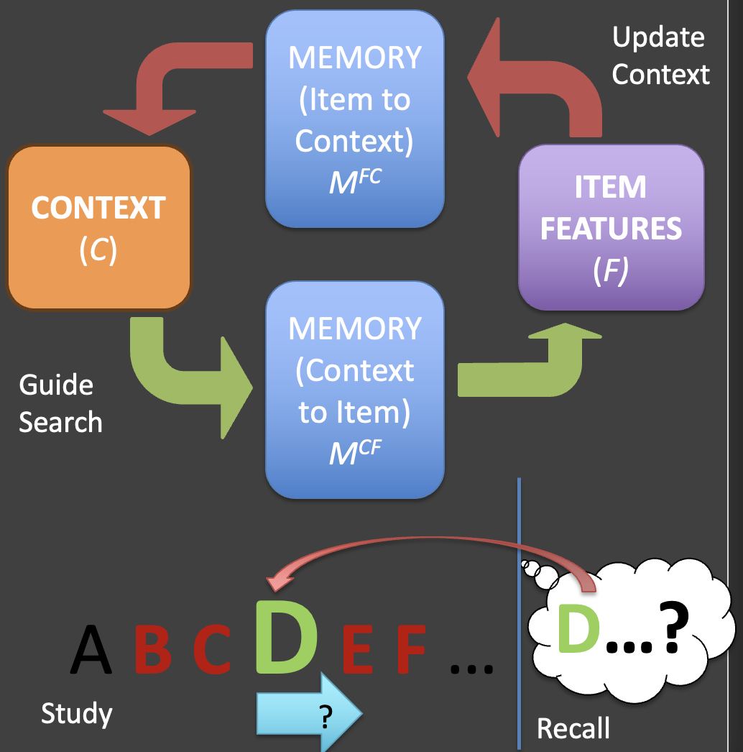
CMR’s Perspective on its Home Turf
Classic domain: free recall of studied lists.
Key ingredients:
A drifting temporal context that updates with each study item.
Item–context bindings laid down at encoding.
At test, retrieval is driven by current context, and recalled items update context again.
Signature prediction:
Temporal contiguity – transitions tend to go to neighbours in the original sequence.
Similar logic extends to other tasks that rely on context-driven retrieval.
Notes:
Objective
Remind everyone (briefly) what CMR actually does well in its canonical setting — context-driven free recall with temporal contiguity — so that treating VIT/diary as a low-intentionality cousin of free recall feels natural, not like a stretch.
What you might say
“Before I plug CMR into the trauma-film tasks, I just want to remind us what it thinks it’s explaining in its home territory.”
“The classic use case is free recall of lists: a drifting temporal context that gets updated with each study item, item–context bindings at encoding, and then at test, retrieval is driven by whatever context is currently active.”
“As you recall items, they in turn reinstate their associated context, which tends to bring along near neighbours — that’s where the temporal contiguity effect comes from.”
“The important point for today is that any task where context is the main driver of what comes to mind — not just list recall — is, in principle, living in the same part of the model’s space. That’s why it’s natural to treat the VIT and the intrusion diary as cousins of free recall within this framework.”

Slide 8
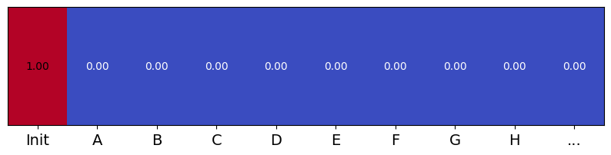
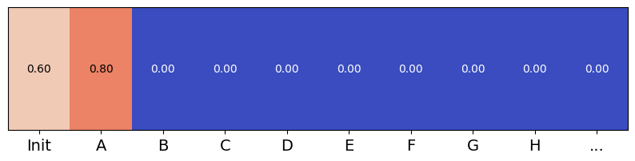
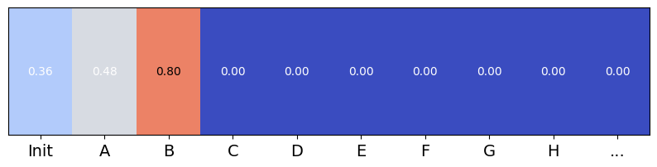
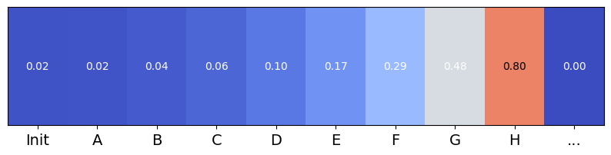
CMR’s Perspective on its Home Turf
MEMORY
(Item to Context)
M^{FC}
Update Context
CONTEXT
(C)
ITEM FEATURES (F)
MEMORY
(Context to Item)
M^{CF}
Guide Search
…
Each study event blends associated features into a context state that evolves over time, creating a recency-weighted record.
At study, states of temporal context are associated with items in memory traces
At retrieval, temporal context is the primary cue, targeting items studied in similar contexts

Slide 9
CMR perspective: VIT and diary as ambient, context-driven analogue to free recall
VIT/diary ≈ low-intentionality, context-driven
Context is shaped by:
The ongoing task (digits, lab environment).
Occasional trauma-film or foil stills in the background.
An intrusion is counted only when a trauma-film item wins the competition and is strong enough to be noticed and reported.
Reminder + Tetris:
Reactivate trauma context.
Then add many new visuospatial items perhaps more strongly bound into that same context region.
C1 C2 C3 C4
Item Item Item tetris
Key idea:
Strongly associate NEUTRAL experiences with same context units as TRAUMA experiences, so later they successfully compete for retrieval when context recurs.
Notes:
Objective Show that reduced intrusions can arise naturally from adding competitors to the trauma context in a standard CMR framework.
Things you might say
“In a CMR frame, the VIT and the diary are both asking: what pops up when context happens to wander near the trauma-film region?”
“The reminder+Tetris block effectively litters that region with extra items that share context with the film but aren’t themselves ‘film intrusions’.”
“That makes it less likely that a film hotspot wins the race at any given moment, so we count fewer intrusions.”

Slide 10
CMR perspective: modified recognition as item-driven retrieval of contexts
Each recognition trial:
Cue still nudges context toward trauma or foil episode.
Target still then acts as a strong item probe.
In a retrieved-context model:
The probe retrieves its associated context.
The decision compares updated context to reference to judge ‘film vs non-film’.
Tetris traces share films' context features. But since they but don't share films’ item features, there’s no interference!
Key idea: Interfering events disrupt Context->Item but not Item->Context associations!
Item to Context Associations
C1 C2 C3 C4
Item Item Item tetris
Context to Item Associations
C1 C2 C3 C4
Item Item Item tetris
Notes:
“In contrast, the modified recognition task is explicitly probe-driven.”
“The cue still is there to roughly align context with the film or with unseen material, but the key driver for the decision is the blurred target still.”
“In a CMR-style model, that probe item retrieves its associated context and we compare that to a reference ‘film’ context, or use it in a film-vs-foil decision rule.”
“The Tetris items share the trauma context region, but they don’t get strongly activated by a particular film still in the same way, so their ability to interfere is much weaker here.”

Slide 11
What “Selective Interference” Looks Like Inside CMR
For VIT/diary (ambient retrieval):
Trauma context region becomes crowded with Tetris traces.
Trauma items win the race less often.
→ Fewer trauma-film intrusions, with and without cues.
For recognition (probe-driven):
Film probes still directly activate their own traces.
Extra neighbours in the trauma context have modest impact.
→ Recognition accuracy changes little, even with film cues.
Under this story, the 2021 pattern is close to what a single retrieved-context system would predict!

Slide 12


Recognition vs Free Recall
MEMORY
(Item to Context)
M^{FC}
Update Context
CONTEXT
(C)
ITEM FEATURES (F)
MEMORY
(Context to Item)
M^{CF}
Guide Search
…
Each study event blends associated features into a context state that evolves over time, creating a recency-weighted record.
At study, states of temporal context are associated with items in memory traces
At retrieval, temporal context is the primary cue, targeting items studied in similar contexts

Slide 13
Two ways to treat the 2021 experiment in our project
Design-Limitation Reading
2021 compares two quite different retrieval regimes (ambient vs probe-driven).
Given that, CMR’s ability to show selective interference here is not very diagnostic for dual vs single trace.
Use 2021 mainly as a consistency check: CMR should not contradict it.
Modified Recognition Task
Treat 2021 as a clear case where retrieval regime matters for interference.
Use CMR to spell out a single-system explanation of the pattern.
Explicitly contrast that explanation with the dual-representation interpretation.
Notes:
“I see two main ways we could position this experiment in our project.”
“One is to say: given how different the retrieval regimes are, this was never going to be a clean test of dual vs single trace, so we mainly want CMR not to do anything implausible here.”
“The other is to treat it as a useful case study: a place where we can make CMR’s single-system explanation of selective interference very explicit, and set that next to the dual-representation reading.”
“Where we fall between these will affect what we ask the model to do and how central this experiment is in the write-up.”

Slide 14
Implications for what we ask CMR to do
At minimum, CMR should:
Reproduce the qualitative pattern: intrusions reduced, recognition largely spared, with trauma-film cues helping both tasks.
Do so via a principled interference mechanism (e.g., extra learning in trauma context), not ad hoc task-specific tweaks.
“Beyond that, we can choose how strong a claim we make:
Conservative: 2021 is a confirmation test; more discriminative tests come from other paradigms.
Stronger: 2021 is a showcase of how a single retrieved-context system handles selective interference effect in an influential measurement scheme
Notes:
Translate the interpretive discussion into concrete expectations for the simulations: what they must do, and what is optional depending on how bold you want to be.
What you might say
“Whatever interpretive stance we take, there’s a baseline we should hit: CMR ought to be able to produce the qualitative 2021 pattern via a reasonably simple interference story.”
“We don’t want that to require completely different mechanisms for intrusions and recognition; the whole point is to keep them in one system.”
“On top of that, we can decide how much we want to lean on 2021 in our narrative: is it mostly there as a check that CMR behaves sensibly, or do we want to present it as a central worked example?”

Slide 15
Implications for selecting experiments to model
2021 is one lens on selective interference; there are others.
2021 VIT + recognition
Tightly controlled, explicitly manipulates film vs foil cues in both tasks.
Limitation: contrasts contextual vs item-driven retrieval, so less diagnostic for dual vs single trace in CMR.
Other selective-interference paradigms
Free recall + intrusion diary (e.g., earlier trauma-film work, 2019).
Ongoing lab work with more closely matched cueing across tasks.
External data?
Goal: something closer to CMR’s ‘home turf’ of context-driven recall, or matched focus on item-driven context reinstatement
Key idea: 2021 is a useful consistency target, but we may want a different paradigm as the flagship test for more discriminative modelling.
Notes:
“Everything I’ve said so far has been about the 2021 experiment, but of course that’s only one way the selective interference effect has been measured.”
“The 2021 design is strong on cue control and gives us both intrusions and recognition in one package, but from a retrieved-context perspective it’s also quite asymmetric: ambient retrieval on one side, probe-driven on the other.”
“Other paradigms – like the free-recall plus diary work, and the ongoing lab study that matches cueing more closely across tasks – live closer to CMR’s natural habitat, where both measures are strongly context-driven.”
“So one implication is: 2021 is an important consistency target for the model, but we may want to treat a different paradigm as the flagship test when we get to stronger single-vs-dual-trace claims.”

Slide 16
Circling Back: Key Questions for Today
1. How does retrieved-context fit this domain?
Question: Does a single CMR-like system give us the 2021 selective interference pattern in a natural way?
My take: Yes: if interference is extra learning in the trauma context, CMR predicts big effects on ambient, context-driven intrusions and much smaller effects on probe-driven recognition, even with film cues.
2. What does that mean for our research goals?
Question: Is 2021 mismatched to our objectives, or a case where we sharpen a single-system story?
My take coming in: Treat 2021 as a useful case study for how retrieval regime shapes interference in a single system, and look to other paradigms (e.g. free recall + diary, matched-cue studies) for stronger dual vs unitary tests.
3. How should we sharpen our simulations?
Question: What do we want the first CMR/eCMR simulations to actually demonstrate?
My take coming in:
At minimum: qualitatively reproduce the 2021 pattern via a principled trauma-context interference mechanism.
Next: target a more context-matched paradigm as the flagship test for discriminating predictions.
Notes:
“At the start I said I hoped this would help us get more concrete about how retrieved-context fits this domain, clarify our goals, and sharpen simulations. Let me try to summarise where I currently am on each of those.”
“First, on fit: my reading is that a single CMR-like system gives you the 2021 selective interference pattern quite naturally, if you treat Tetris as adding competitors in the trauma context.”
“Second, for our goals: that makes me think 2021 is better used as a worked example of a single-system account, with other paradigms doing more of the heavy lifting for dual vs unitary.”
“Third, for simulations: I’d like the first set to show that CMR can qualitatively capture 2021 with a principled interference mechanism, and then pivot to a more context-matched paradigm as the flagship discriminative test.”
“I’m very happy to adjust any of those ‘my take’ bullets – this slide is really meant as a starting point for that discussion.”

