Slide 1
Assessing neurocognitive hypotheses using likelihood-based models
Jordan Gunn
Notes:
Hi, my name is Jordan Gunn and I am a postdoc in Deborah Talmi's group in the Psych department who started here just this past September. This is a tutorial style talk about using cognitive models and likelihood to think about neural and behaviour relationships. From afar, cognitive modelling can look like an opaque, overcomplicated exercise in parameter tuning that somehow always fits everything but clarifies very little. When brain data enters the picture, it can be even harder to see how neural signals relate to the mechanisms in the model.
I want to use one concrete example to sketch a more constructive picture where cognitive models help clarify what our data can and cannot say about mechanisms, rather than adding an extra layer of obfuscation.

Slide 2
What I want you to get from this talk
Why build cognitive models as well as statistical models.
  How they let us ask questions about process (encoding, retrieval, competition) rather than just “does this signal predict recall”.
What it means to fit a model by likelihood.
  How we connect a generative model to trial-by-trial data, and why that is worth more effort than just matching one curve.
How to turn verbal hypotheses into models.
  How to go from “maybe the EEG signal does X” to a small set of concrete model variants we can actually fit and compare.
How to compare those models and read the result.
  How to see which stories are clearly ruled out, which are supported, and which remain underdetermined by the data.
Notes:
“There are four things I’m hoping you’ll take away.”
“First, why we sometimes want cognitive models in addition to statistical models. Regressions are great for telling us that a neural signal or other factor predicts some behavioral outcome, but they don’t tell us where in the process that effect lives. Models give us a place to put those ideas.”
“Second, what it actually means to fit a model by likelihood. I’ll show you how we treat the model as a generator of trial-by-trial behaviour and use that to define a loss function, and why that’s more informative than just making one summary curve line up.”
“Third, how to go from vague hypotheses like ‘maybe the EEG signal is boosting encoding’ to a small set of explicit models that embody different stories. We’ll see that formalising those stories is already informative.”
“And fourth, how to compare those models in a way that lets us say which stories are clearly ruled out, which are supported, and where the data simply don’t distinguish between them. That, in my mind, is one of the key reasons to do cognitive modelling.”
“I’ll use one emotional memory EEG dataset as a running example so we’re not talking in the abstract, but I’ll keep circling back to these four questions rather than the specifics of that experiment.”

Slide 3
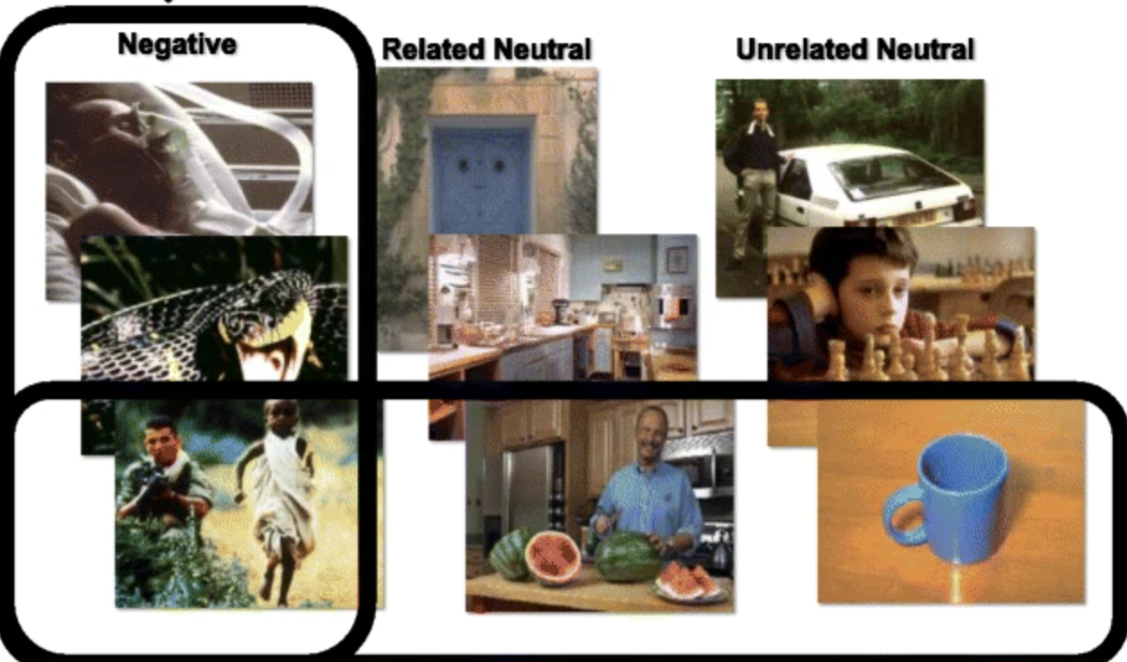
Our running example: emotional memory, LPP, and free recall
Data from Zarubin et al. 2020, Affective Science
N = 38; Negative and neutral images shown intermixed in 9 lists.
Measured a widely used ERP index of attention, the Late Positive Potential (LPP)
For each item: emotion label, mean early-window LPP at encoding, recall status (recalled/not recalled)
Encoding
22 images
2s image display
4s seconds ITI
Math Distractor Task
1 minute
Retrieval
Up to 3 minutes
EEG Recording
Zarubin et al. 2020, Affective Science
Notes:
We use data from a study by Zarubin et al. (2020). In this experiment, participants studied lists of negative and neutral images, then did a short math distractor task, and then freely recalled as many images as they could. This procedure was repeated nine times with twenty-two images per list.
For the modelling, the key point is that for each list we know, for each item, its emotion label, its Early-LPP amplitude at encoding, and whether it was later recalled. Important for later, we do not know recall order. And in the original analysis the first two studied items on each list were treated as buffers and their recall data were dropped, to control for primacy. So we treat each trial as a twenty-item list with a recalled set rather than a full recall sequence.

Slide 4
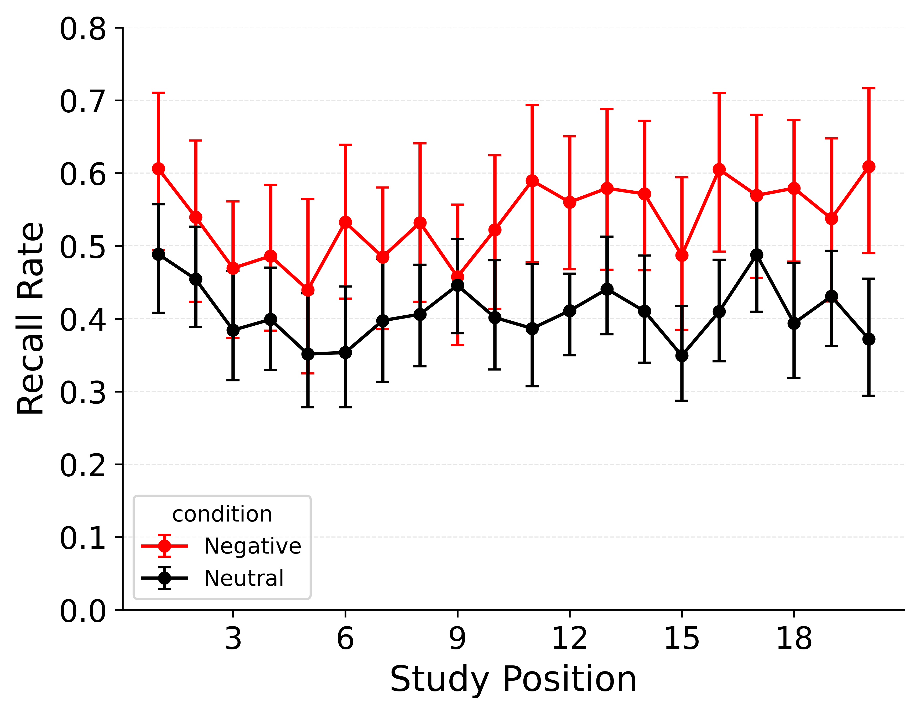
Key Behavioral Result:
The Emotional Enhancement of Memory (EEM)
Negative items are recalled more often than neutral items across positions.
Notes:
“Behaviourally in this dataset, we see the familiar emotional enhancement of memory: negative items are more likely to be recalled than neutral ones across serial position.”
“Any model we use later will at least have to capture this basic pattern.

Slide 5
Key Behavioral Result:
The Emotional Enhancement of LPP
Negative items are recalled more often than neutral items across positions.
Notes:
“Behaviourally in this dataset, we see the familiar emotional enhancement of memory: negative items are more likely to be recalled than neutral ones across serial position.”
“Any model we use later will at least have to capture this basic pattern.

Slide 6
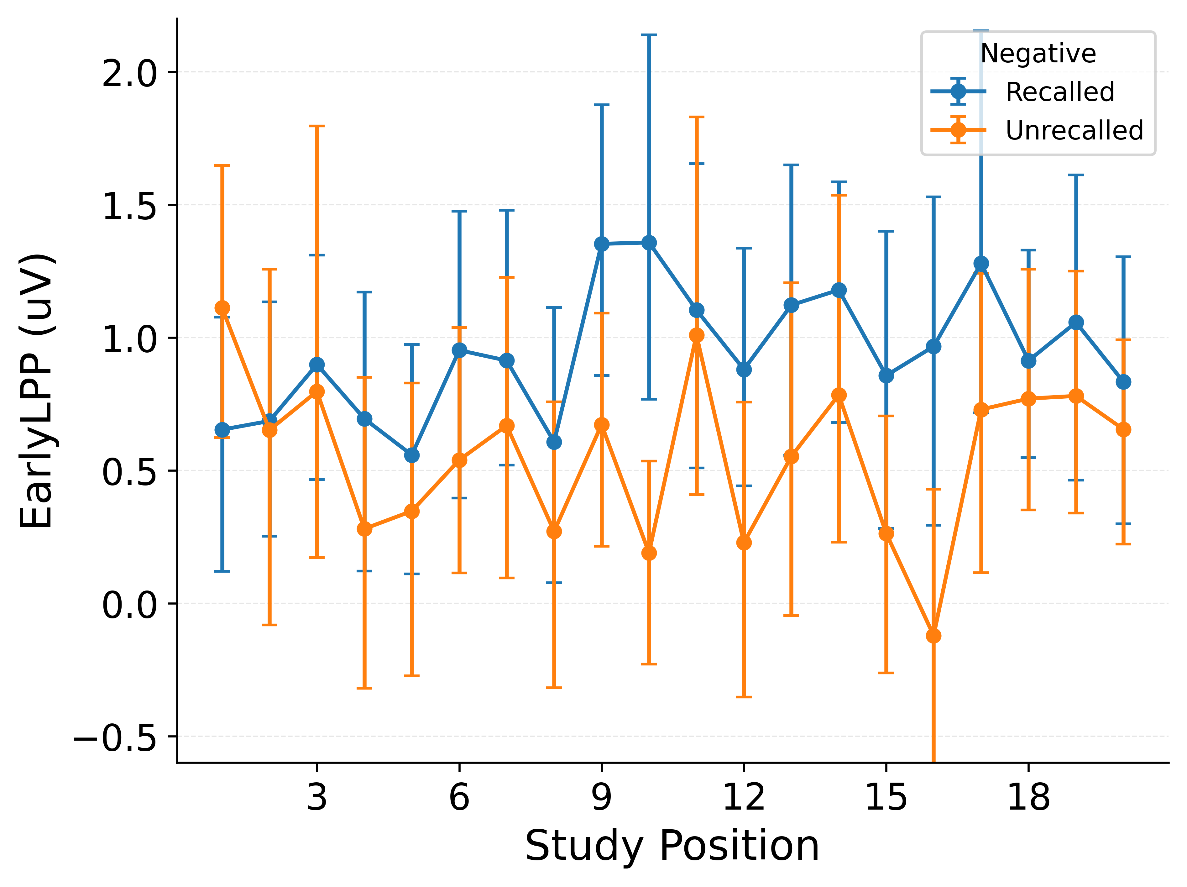
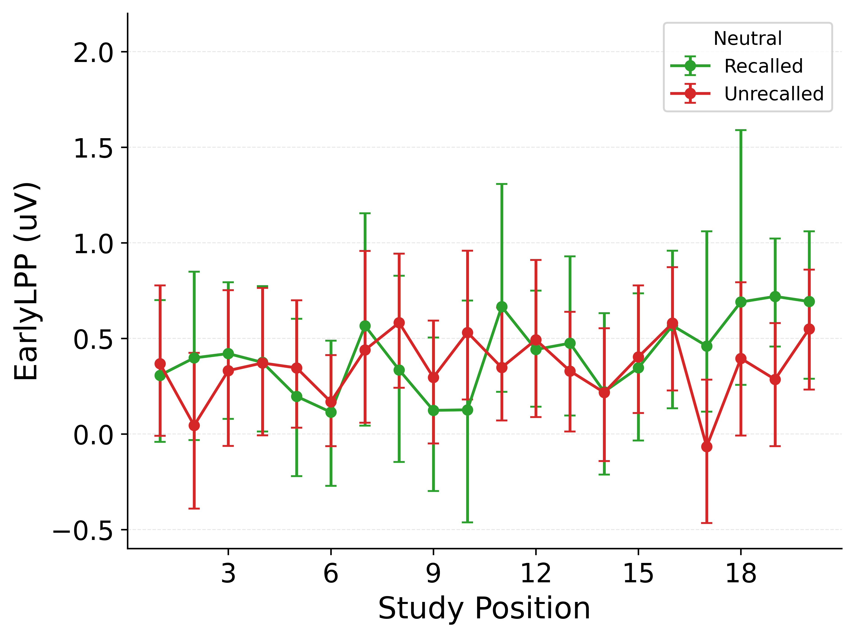
LPP Predicts Recall More Strongly for Emotional Items
LPP by recall status and item type
split by NEGATIVE items (LEFT) and NEUTRAL items (RIGHT).
Notes:
“If we look at the EEG, we see that Early LPP tends to be larger for negative items that are later recalled than for negative items that are not recalled.”
“Within neutral items, the difference between recalled and unrecalled is much smaller.”
“So even before fitting any model, we have this descriptive picture: LPP seems more strongly tied to recall for negative items than for neutral ones.”

Slide 7
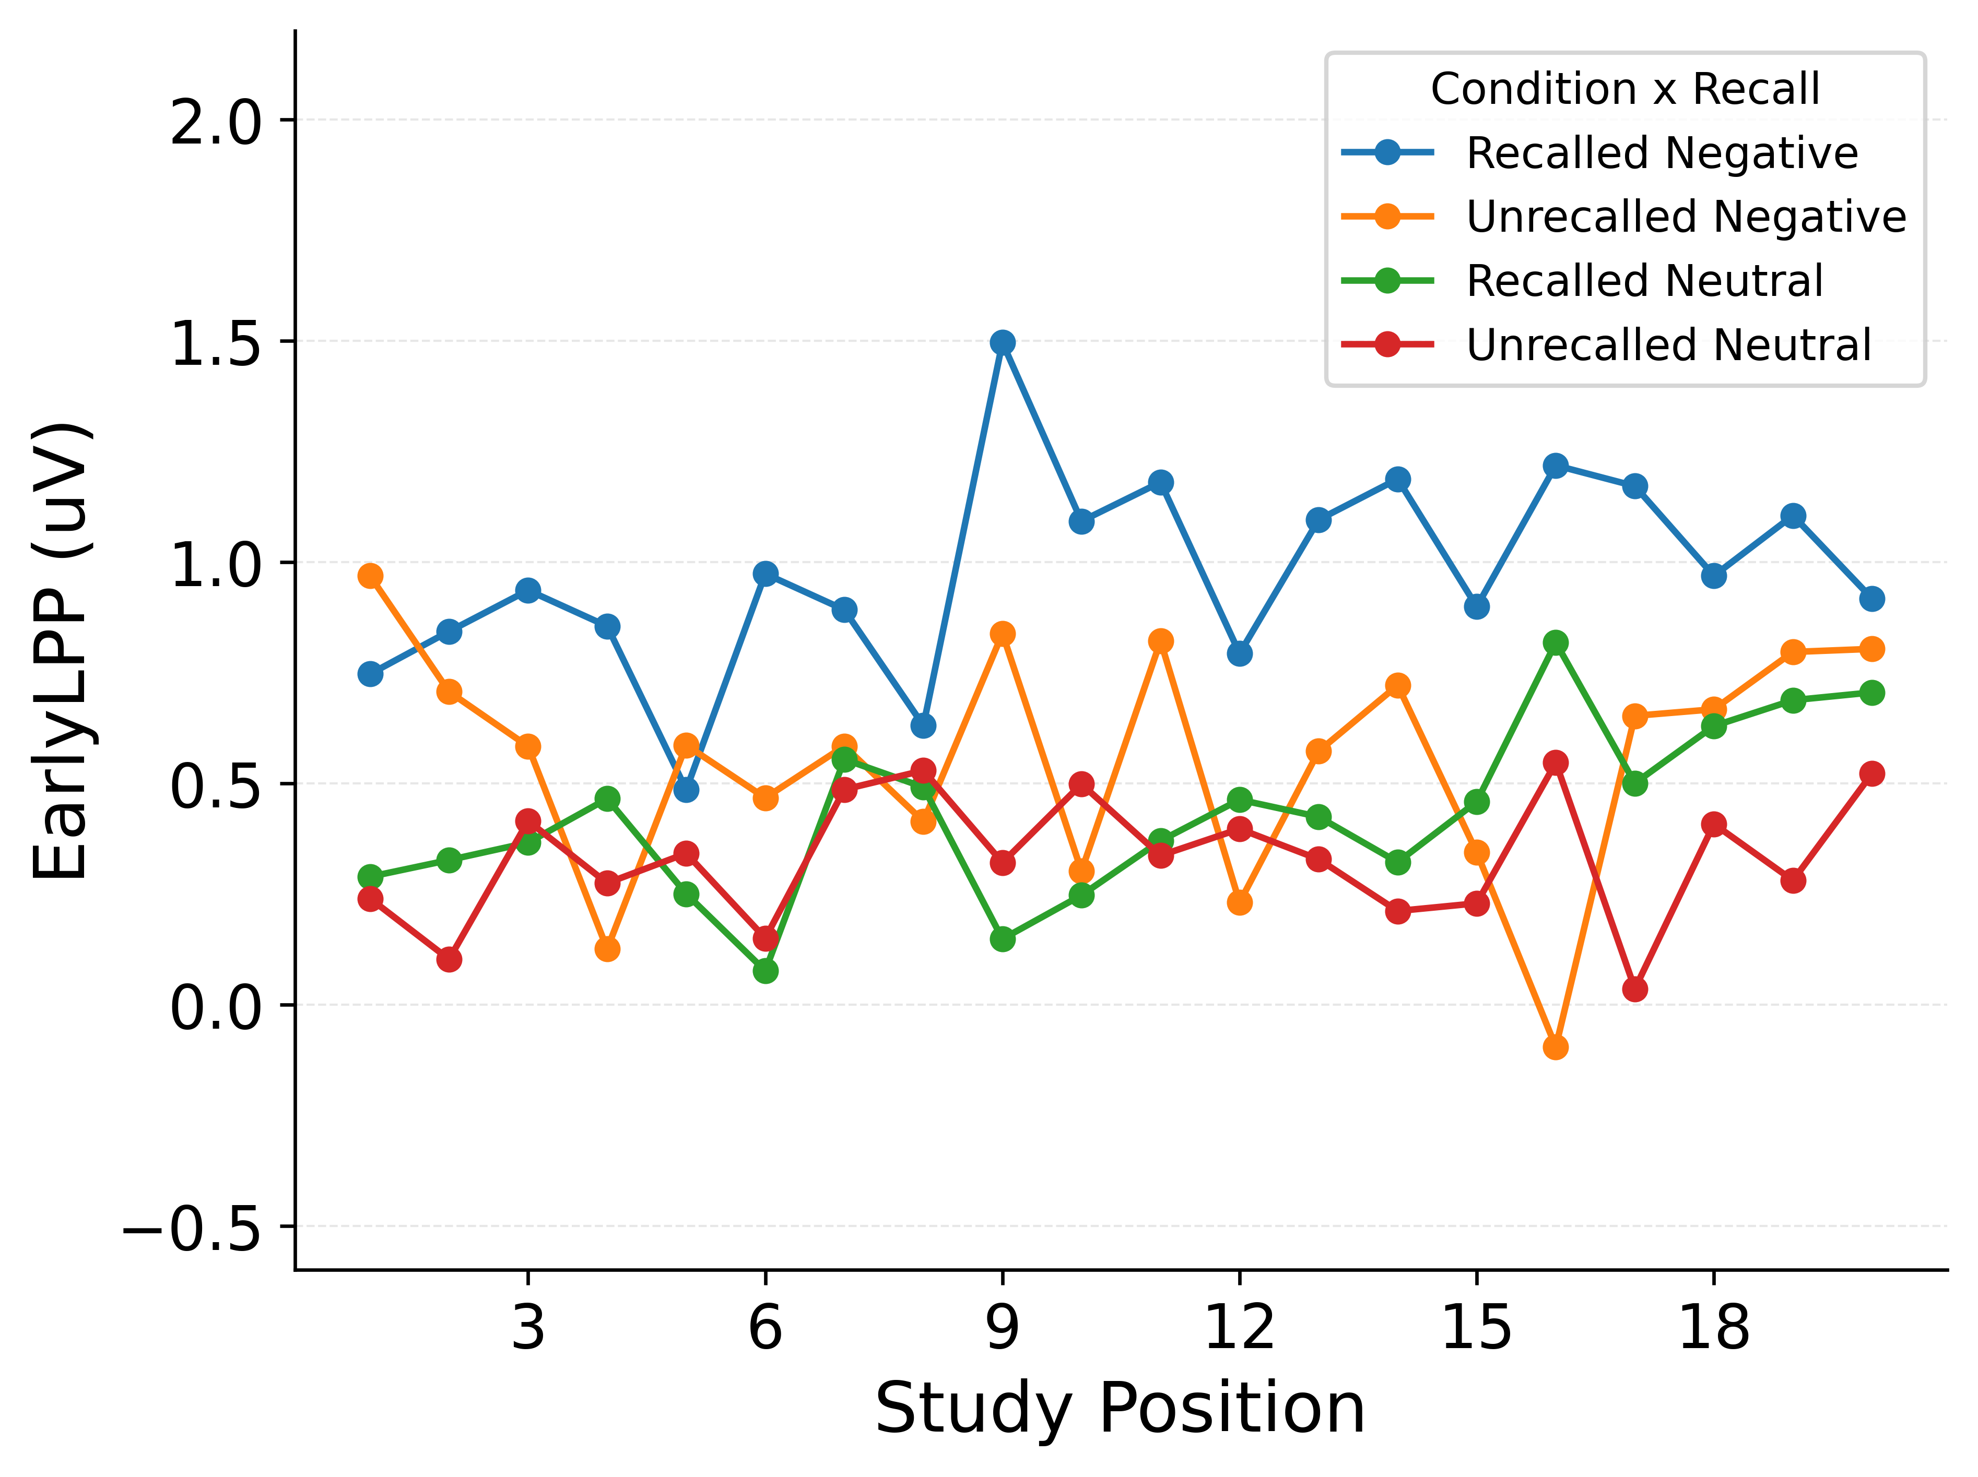
LPP a Poor Index of Emotionality or Recall Alone
Early LPP by recall status and item type.
CIs omitted for clarity; data pooled across participants.
Notes:
Here, we superimpose Early-LPP curves to highlight joint structure. Recalled emotional items have the highest Early LPPs. Unrecalled emotional items overlap with both recalled and unrecalled neutral items. Two simple linking stories are inconsistent with this pattern. First, if LPP simply reflected item type, recalled and unrecalled items of the same type would have similar LPPs; instead, recall status clearly separates Early LPP within the emotional condition. Second, if LPP simply reflected recall probability, recalled items across item types would align; instead, recalled emotional items have higher LPPs than recalled neutral items. Neither pattern holds, convincing us that each factor has separable consequences for memory.

Slide 8
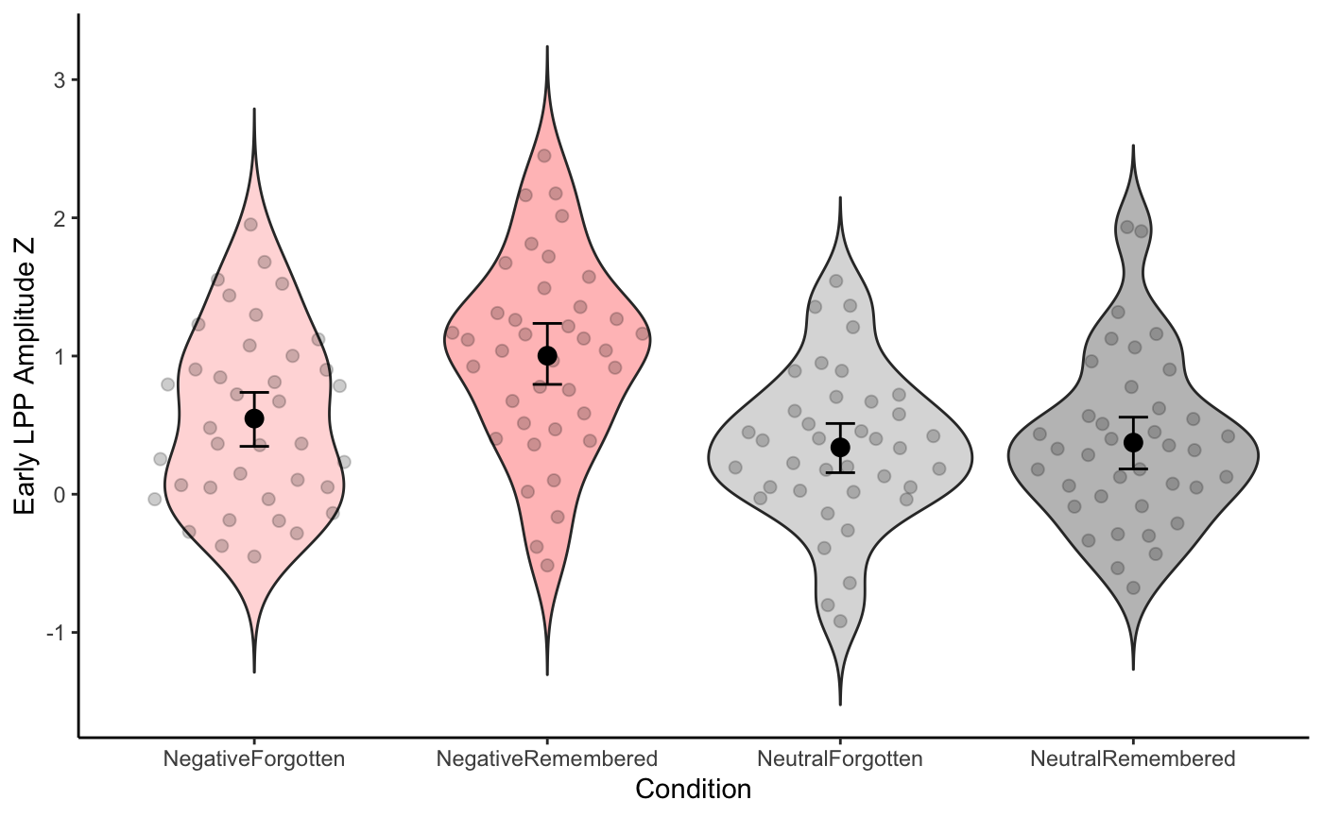
LPP Predicts Recall More Strongly for Emotional Items
Logistic mixed effects model predicting recall:
  Negative items recalled more than neutral (emotion main effect, p < .05)
  Higher LPP predicts higher recall probability (LPP main effect, p < .05)
  LPP–recall relationship steeper for negative than neutral items (interaction, p<.05).
Notes:
“We can formalise the descriptive patterns with a logistic mixed model that predicts recall from emotion, Early LPP, and their interaction.”
“All three terms are significant: negative items are recalled more often than neutral ones; higher LPP is associated with higher recall probability; and the LPP–recall slope is steeper within negative items than within neutral ones.”
“It’s very natural to read this as ‘LPP has a special, extra impact on the encoding of negative items; the learning rule must have an explicit emotion-by-LPP interaction’.”
“The modelling part of the talk is going to ask a more careful question: given this regression result, how many different process-level stories are actually compatible with it? Can we, for example, rule out a simpler story where LPP and emotion have purely additive effects at encoding and the interaction in recall emerges downstream from the way items compete during retrieval?”

Slide 9
Two ways to fit a model
Fit to summary curves
Fit to trial-level behaviour (likelihood)
pick curves, pick weights, tune parameters so curves line up.
treat the model as generating trial behaviour and score how probable the actual recall sets are.
A B C D E F
D…?
?
Study
Study
Recall
Notes:
“One way to connect a model to data is to pick a few summary curves – a serial-position curve, maybe a binned LPP–recall curve – and tune parameters so those curves line up.”
“That approach is very common and often useful, but it forces you to choose which summaries matter and how to weight them, and it ignores a lot of the trial-by-trial structure the model actually predicts.”
“Because we care about relatively subtle differences between models in how they treat LPP, we’re going to use a likelihood-based approach instead: treat the model as a generator of recall sets and ask, for each parameter setting, how probable the actually observed recall sets are.”

Slide 10
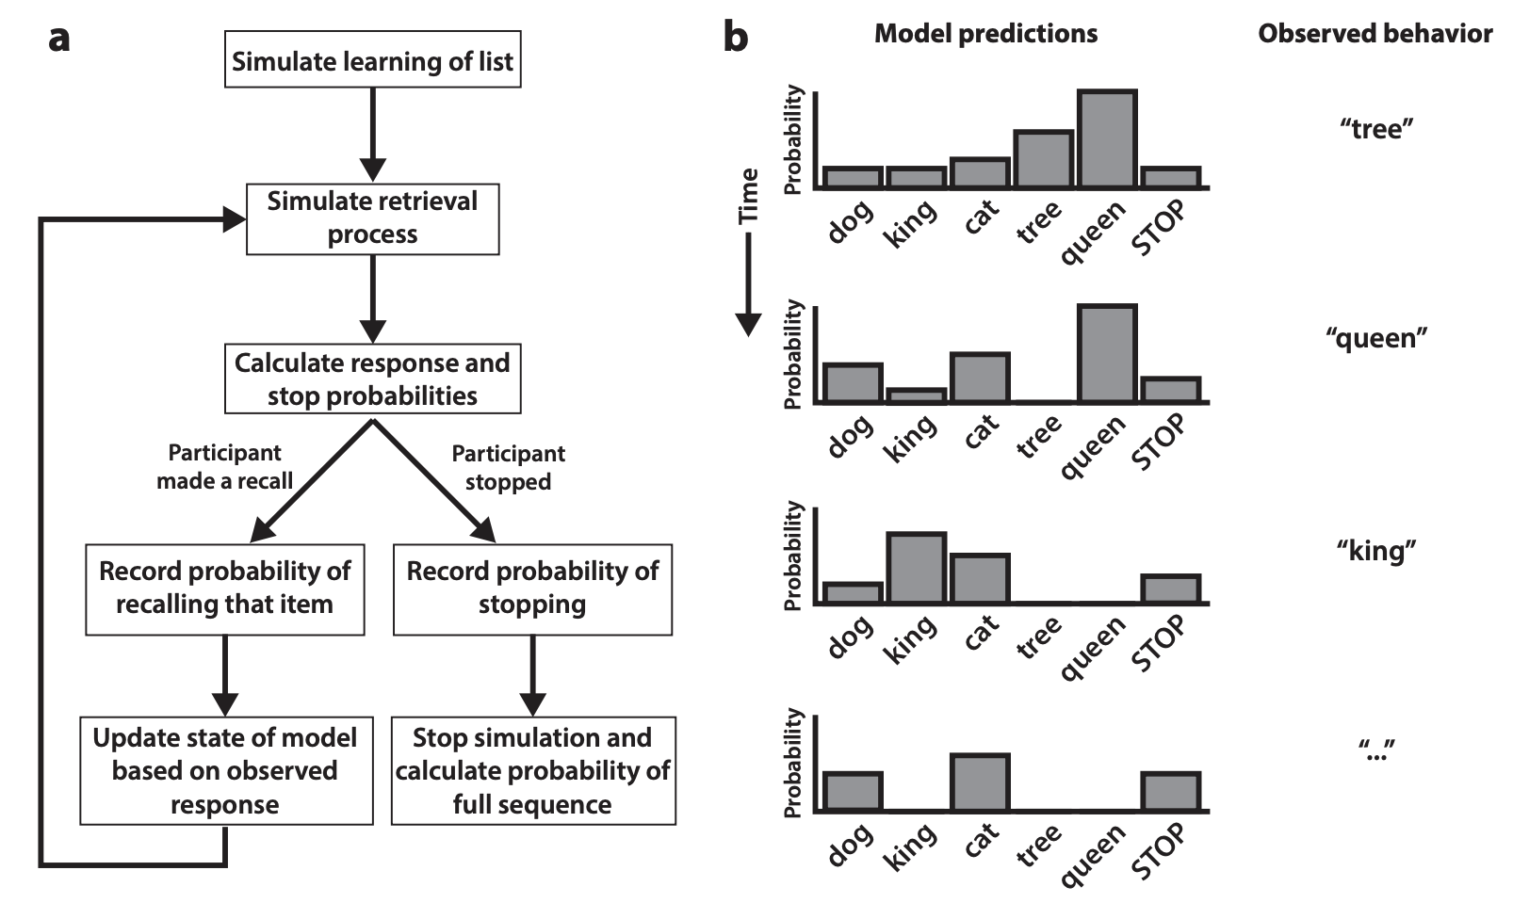
Ideal likelihood if we had full recall sequences: p(sequence_t | model, θ) per trial.
Morton & Polyn, 2016. Journal of memory and language.
Notes:
“If we did have full recall sequences, this is the sort of likelihood we’d like to compute. In the flow chart on the left, the model simulates study and then simulates the retrieval process one response at a time. At each step it assigns probabilities to all possible responses, including a STOP response, and we look up the probability of whatever the participant actually did – recalling ‘tree’, then ‘queen’, then ‘king’, and so on, as shown on the right.
By multiplying those probabilities across the whole sequence, we get the likelihood of that recall sequence under the current parameter setting. Fitting the model by likelihood would then mean adjusting the parameters so that the sequences we actually observed are as probable as possible under this generative process.”

Slide 11
Our data: recall sets, not sequences
In Zarubin et al., for each list we know, for each item: emotion label, Early LPP at encoding, and whether it was recalled.
We do not know the order of recalls, and buffer items are dropped.
So for modelling, each trial is a 20-item list with a recalled set Sₜ, not a full recall sequence.
We look at all the sequences that would result in that recalled set – different orders – and we aggregate their probabilities under the model
In practice, Monte Carlo approximation
Notes:
“In this dataset, we don’t have full recall sequences; we only know, for each list, which items were recalled.”
The question then becomes: how do we adapt the ideal sequence likelihood to this situation, where what we observe is just the set S sub t for each list?”
“To adapt the idea of likelihood, we define a likelihood over sets. For each trial, we look at the sequences that would result in that recalled set – different orders, maybe repeats – and we aggregate their probabilities under the model.
“In practice, we approximate that sum by sampling random permutations of the recalled set and averaging their sequence probabilities. It’s a Monte Carlo approximation, but it respects the generative structure and gives us a log likelihood for each trial and model.”

Slide 12
Why we chose likelihood
Uses all the information in which items are recalled on which lists, not just averages or one curve.
Respects the encoding + retrieval structure: same parameters generate and score behaviour.
Gives a principled log-likelihood we can later turn into a model-comparison score (AIC), rather than eyeballing.
Notes:
“So why go to the trouble of defining this set-based likelihood rather than just matching an SPC and an LPP–recall curve?”
“First, it means we are evaluating models on the full trial-level pattern of which items are recalled, not just on one or two summary curves we chose.”
“Second, it forces us to use the same encoding and retrieval parameters to both generate and score behaviour, which is important if we care about where in the process the effect lives.”
“Third, once we have these log likelihoods per subject and model, we can convert them into a simple model-comparison score that accounts for parameter count – AIC – which I’ll come back to later. That will let us say, in a principled way, which of our models are clearly ruled out by the behaviour and where two different process stories are effectively tied.”

Slide 13
GLMM: emotion, LPP, and LPP × emotion interaction in recall.
  Story A: additive encoding + competition
    Emotion and LPP each contribute to encoding strength.
    Any LPP × emotion interaction in recall emerges from nonlinear competition at retrieval.
  Story B: explicit encoding interaction
    Encoding strength includes an explicit Emotion × LPP term.
    Emotional items get an extra LPP-dependent boost in the learning rule.
Notes:
Objective
Make Q3 concrete in words: show that there are at least two mechanistic ways to read the GLMM interaction, and that these will become your competing model variants.
Key things to say
“The mixed model told us that recall depends on emotion, Early LPP, and their interaction: LPP is more strongly related to recall within negative items than within neutral items.”
“The natural story is to say: LPP must have a special, extra impact on the encoding of negative items. That’s Story B, the explicit encoding interaction story.”
“But there is another possibility. In Story A, emotion and LPP each add to encoding strength, and the way those strengths feed into a nonlinear competitive recall process creates an effective LPP × emotion interaction at the level of recall probabilities, even without an explicit interaction term in the learning rule.”
“Both stories are compatible with the GLMM. The modelling question is whether the full pattern of recall sets forces us towards one of them, or whether, for this dataset, they remain equally plausible.”

Slide 14
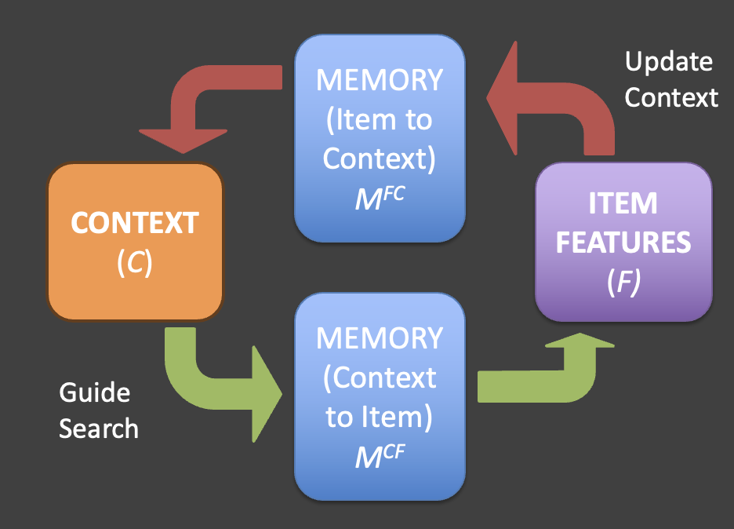
Our recall model: encoding and competition
Encoding: maps item features (emotion, LPP) to context with an encoding strength Sᵢ.
Retrieval: context cue → activations (similarity × strength) → competitive choice → Update cue → …
c1
Item
Notes:
“To test these stories we embed them in a simple recall model with two main stages.”
“At study, items are encoded with a strength Sᵢ and linked to a context representation. At test, a cue drives a context state that activates items based on their similarity to the cue and their strength, and a competitive choice rule produces recalls or a STOP decision.”
“Across all the models I’ll show you, the retrieval stage – context dynamics, similarity, and competition – is the same.”
“What we’re going to manipulate is the encoding rule: how emotion and LPP are allowed to feed into the encoding strength Sᵢ.”

Slide 15
Three models: emotion-only, EEG main effects, EEG interaction
Model 0 – Emotion-only
  Encoding: Sᵢ depends on emotion label only (neg vs neutral); LPP is ignored.
  Retrieval: as in Slide 2.
Model 1 – EEG main-effects
  Encoding: Sᵢ = f(emotion, LPP) with additive contributions (no explicit Emotion × LPP term).
  Story: any LPP × emotion interaction in recall must emerge from the retrieval competition (Story A).
Model 2 – EEG interaction
  Encoding: Sᵢ = f(emotion, LPP, emotion × LPP); explicit interaction term.
  Story: the interaction is present in the learning rule itself (Story B).
Notes:
“The emotion-only model, Model 0, never sees LPP. It just implements a generic emotional boost at encoding plus the standard retrieval dynamics.”
“Model 1, the EEG main-effects model, lets emotion and LPP each influence encoding strength Sᵢ additively. In this model, any LPP × emotion interaction in recall has to come from the nonlinearity in the competitive retrieval process.”
“Model 2, the EEG interaction model, adds an explicit Emotion × LPP term in the encoding rule, so the interaction is literally in the trace: emotional items with high LPP get a special boost at encoding.”
“These three models are the formal counterparts of the stories we just outlined: emotion-only, main-effects plus competition, and explicit encoding interaction.”

Slide 16
Choosing models: general principles
Change one mechanistic ingredient at a time (here: how LPP and emotion enter encoding).
Include a psychologically meaningful baseline (here: an emotion-only model).
Ensure each model corresponds to a verbal story you can explain in a couple of sentences.
Aim to ask whether the data clearly disfavor a given ingredient, clearly favor it, or leave it underdetermined.
Notes:
“Stepping away from this dataset, what are some general rules of thumb for choosing models to compare?”
“First, you want models to differ in focused ways: ideally one mechanistic ingredient at a time. Here, the ingredient we’re playing with is where and how LPP and emotion enter the encoding rule.”
“Second, you want a baseline that is psychologically meaningful, not just an obviously bad model. In our case, an emotion-only recall model that never sees LPP is a reasonable baseline.”
“Third, you want each model to correspond to a verbal story you could explain to someone in a couple of sentences, because the point is to ask whether that story is clearly ruled out, clearly supported, or simply left underdetermined by the data.”
“In the rest of the talk, we’ll see one example of each: an emotion-only model that is clearly ruled out once we look at the fits, and two EEG-aware models where, for this dataset, the behaviour effectively ties them.”

Slide 17
From likelihood to AIC: scoring models
Set-based log likelihood per subject and model -> AIC_{s,m}
AIC_{s,m} = 2 * k_{m} - 2 * logL_{s,m}
Lower AIC ~ better expected predictive performance for that subject (fit - complexity penalty).
Notes:
Objective
Explain how you turn the log-likelihoods you just defined into a comparison score that accounts for parameter count. This answers Q4’s “how do we compare models?” at a high level.
What you say
“For each participant and each model we have a log likelihood from the set-based fit: how probable their recall sets are under that model at its best-fitting parameters.”
“We use AIC to turn that into a model score. It rewards high log likelihood but penalises models with more free parameters.”
“Formally, AIC is 2 times the number of parameters minus 2 times the log likelihood; the important part is that lower AIC means better expected predictive performance for that participant, after accounting for model complexity.”

Slide 18
Main-effects vs interaction: effectively tied on this dataset
Comparison Mean ΔAIC [95% CI]
Emotion-only minus EEG main-effects : 2.22 [1.17, 3.27]
Emotion-only minus EEG interaction: 2.73 [1.56, 3.89]
EEG main-effects minus EEG interaction: 0.51 [-0.43, 1.44]
Point plot?
Notes:
Objective
Deliver the more nuanced conclusion: within the EEG-aware family, the data do not provide a clear preference for the explicit encoding interaction over the main-effects-only model. This is where you demonstrate “under-determination” explicitly.
What you say
“Now we look at the AIC difference between the EEG main-effects model and the explicit interaction model. Here ΔAIC is AIC main-effects minus AIC interaction, so negative values would favour the interaction model; positive values would favour the main-effects model.”
“On average, the interaction model has slightly lower AIC – about half a unit – but the confidence interval crosses zero and sits entirely inside our ±2-unit practical-equivalence band.”
“In other words, for this dataset, the two EEG-aware models are effectively tied in AIC terms. The current data do not justify a strong claim that the LPP × emotion effect has to be implemented as an explicit interaction in the learning rule rather than emerging from the nonlinear competition at retrieval.”
“From a mechanistic point of view, we’ve learned two things: EEG clearly matters beyond emotion labels, but the GLMM interaction does not uniquely pin down where in the process that effect lives. Both an explicit encoding interaction and a main-effects-plus-competition story are equally compatible with the recall patterns within this model class.”

Slide 19
What modelling bought us (and what it didn’t)
Why cognitive models vs stats?
The GLMM told us there is an Emotion x LPP interaction in recall; the models showed that an emotion-only process is inadequate, but also that multiple process-level stories are consistent with that interaction.
What does likelihood-based fitting mean and why bother?
We used a set-based likelihood over recall sets to evaluate models on the full trial-level pattern, then converted that into AIC scores per subject that balance fit and complexity.
How did we choose models?
We built an emotion-only baseline and two EEG-aware models that differed only in where they put the LPP x emotion structure: additive encoding plus competition versus explicit encoding interaction.
How did we compare them and what did we learn?
AIC differences showed that adding EEG clearly improves the model over emotion-only, and that within the EEG models the extra interaction term does not buy enough improvement to be clearly preferred; that aspect remains underdetermined by these data.
Notes:
“Coming back to the four questions I started with, this example shows both what modelling can and cannot do for us.”
“First, it sharpened a regression result into a process-level statement: models that incorporate trial-wise LPP clearly outperform an emotion-only model, which we can now talk about in terms of encoding strength and competition in a recall model.”
“Second, it helped us see where our intuitions were not warranted. The GLMM interaction by itself does not tell us whether the effect lives in the learning rule or emerges from retrieval dynamics, because both implementations fit essentially equally well under a principled loss.”
“More generally, the modelling workflow we walked through – pick a generative model, choose a loss that matches it to the data, formalise competing mechanistic stories as model variants, and compare them carefully – is something you can apply in other tasks and with other signals to see which aspects of your favourite stories are actually constrained, and which remain underdetermined.”

Slide 20
Thanks!!
Robin Hellerstedt, Universidad Politecnica de Madrid
Vanessa Zarubin, Northwestern University
Katherine R. Mickley Steinmetz, Wofford College
Nathaniel D. Daw, Princeton University
Deborah Talmi, University of Cambridge
Notes:
Finally I want to thank my collaborators
Robin Hellerstedt
Vanessa Zarubin
Katherine Mickley Steinmetz
Nathaniel Daw
Deborah Talmi
And I also want to thank you for listening

