Slide 1
Assessing neurocognitive hypotheses using likelihood-based models
Jordan Gunn
Notes:
Hi, my name is Jordan Gunn and I am a postdoc in Deborah Talmi's group in the Psych department. This is a tutorial style talk about using cognitive models and likelihood to think about relationships between brain signals and behavior.
From a distance cognitive modeling can look like an elaborate parameter-tuning exercise that always seems to fit something. Adding brain data into the mix can make it even harder to tell whether a model is doing any explanatory work, or just putting a computational gloss on a story we already wanted to tell.
Here, I want to use one concrete example to offer a more constructive view of models: as tools for clarifying and testing mechanistic ideas against data.

Slide 2
What I want you to get from this talk
Why build cognitive models as well as statistical models.
How they let us ask questions about process (encoding, retrieval, competition) rather than just “does this signal predict recall”.
What it means to fit a model by likelihood.
How we connect a generative model to trial-by-trial data, and why that is worth more effort than just matching one curve.
How to turn verbal hypotheses into models.
How to go from “maybe the EEG signal does X” to a small set of concrete model variants we can actually fit and compare.
How to compare those models and read the result.
How to see which stories are clearly ruled out, which are supported, and which remain underdetermined by the data.
Notes:
“There are four things I’m hoping you’ll take away.”
“First, why we sometimes want cognitive models in addition to statistical models. Regressions are great for telling us that a neural signal or other factor predicts some behavioral outcome, but they don’t tell us where in the process that effect lives. Models give us a place to put those ideas.”
“Second, what it actually means to fit a model by likelihood. I’ll show you how we treat the model as a generator of trial-by-trial behaviour and use that to define a loss function,.
“Third, how to go from vague hypotheses like ‘maybe the EEG signal is boosting encoding’ to a small set of explicit models that embody different stories.
“And fourth, how to compare those models in a way that lets us say which stories are clearly ruled out, which are supported, and where the data simply don’t distinguish between them.
“I’ll use one emotional memory EEG dataset as a running example so we’re not talking in the abstract, but I’ll keep circling back to these four questions rather than the specifics of that experiment.”

Slide 3
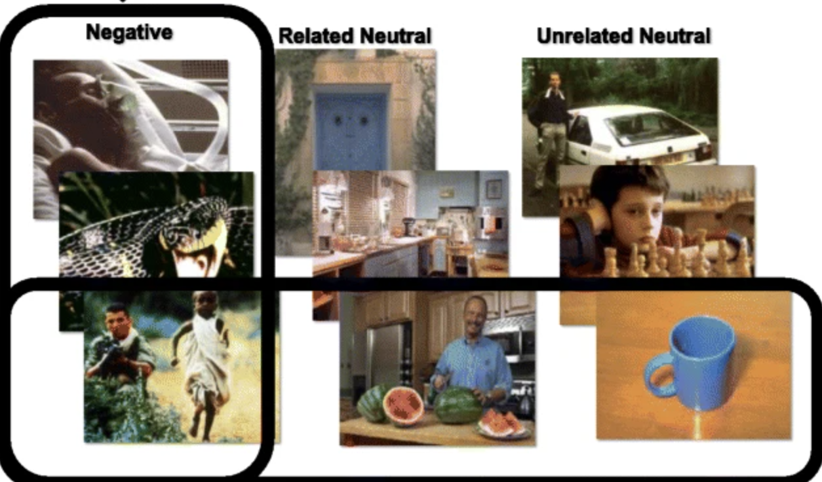
Our running example: emotional memory, LPP, and free recall
Data from Zarubin et al. 2020, Affective Science
N = 38; Negative and neutral images shown intermixed in 9 lists.
Measured a widely used ERP index of attention, the Late Positive Potential (LPP)
For each item: emotion label, mean early-window LPP at encoding, recall status (recalled/not recalled)
Encoding
22 images
2s image display
4s seconds ITI
Math Distractor Task
1 minute
Retrieval
Up to 3 minutes
EEG Recording
Zarubin et al. 2020, Affective Science
Notes:
We use data from a study by Zarubin et al. (2020). In this experiment, participants studied lists of negative and neutral images. Some neutral items are related to one other and some aren’t, but we don’t focus on that detail here.
After study, participants then did a short distractor task, and then freely recalled as many images as they could. This procedure was repeated by 38 participants nine times with twenty-two images per list.
During encoding we recorded an ERP component called the Late Positive Potential, or LPP. In this paradigm negative pictures tend to elicit a larger LPP than neutral pictures, so it is often treated as a neural marker of emotional attention.
For the modelling, the key point is that for each list we know, for each item, its emotion label, its Early-LPP amplitude at encoding, and whether it was later recalled. Important for later, we do not know recall order. And response data for the first two items was dropped outright by the authors to control for primacy. For a modeling project, it’s a bit modest in size and a little noisy, but that’s often the kind of data we have, making it a useful example here.

Slide 4
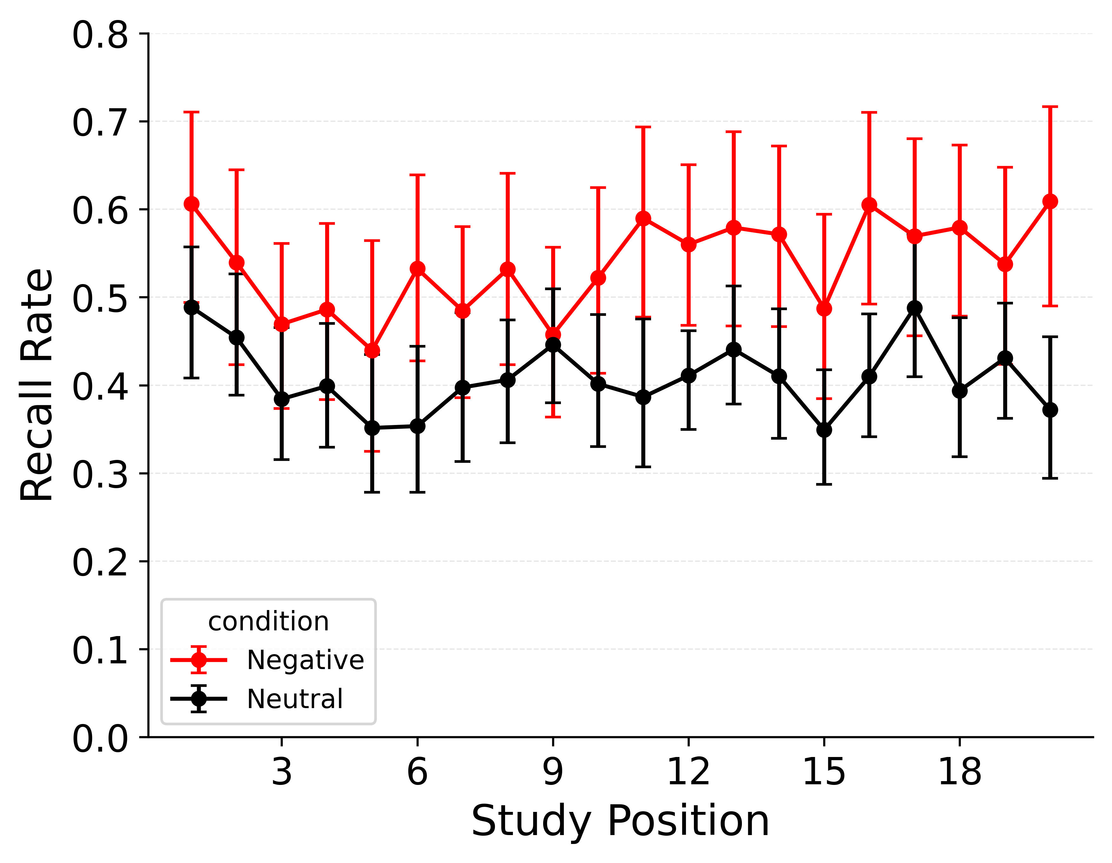
Key Behavioral Result: The Emotional Enhancement of Memory (EEM)
Negative items are recalled more often than neutral items across positions.
Error bars reflect 95% bootstrap confidence intervals over subjects
Notes:
The focal behavioral benchmark exhibited by this dataset is the emotional enhancement of memory: negative items are more likely to be recalled than neutral ones across serial position.”
The error bars are 95% bootstrap confidence intervals across subjects, and I’ll use the same convention on the other plots.

Slide 5
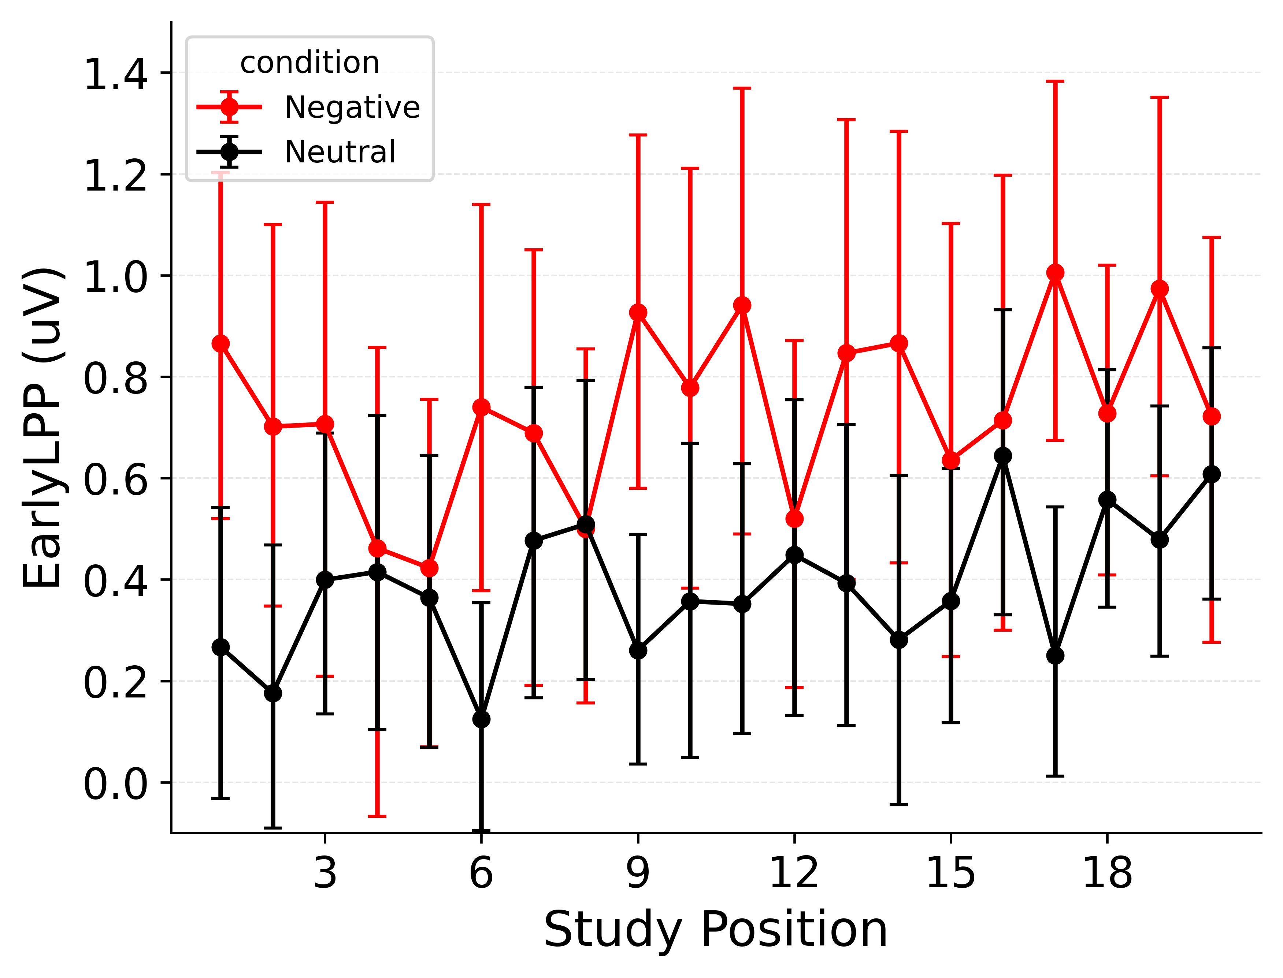
Key Neural Result: Early LPP is Higher for Emotional Items
Early-window LPP is on average higher for negative than neutral items across positions.
Substantial overlap and variability: LPP is a noisy, graded correlate of emotion.
Notes:
If we look at the EEG data, we see a parallel pattern: Early LPP is, on average, higher for negative than for neutral items across serial position, although there is substantial overlap and variability. So LPP behaves like a noisy, graded index of emotional attention that any neurally informed model will need to respect.”

Slide 6
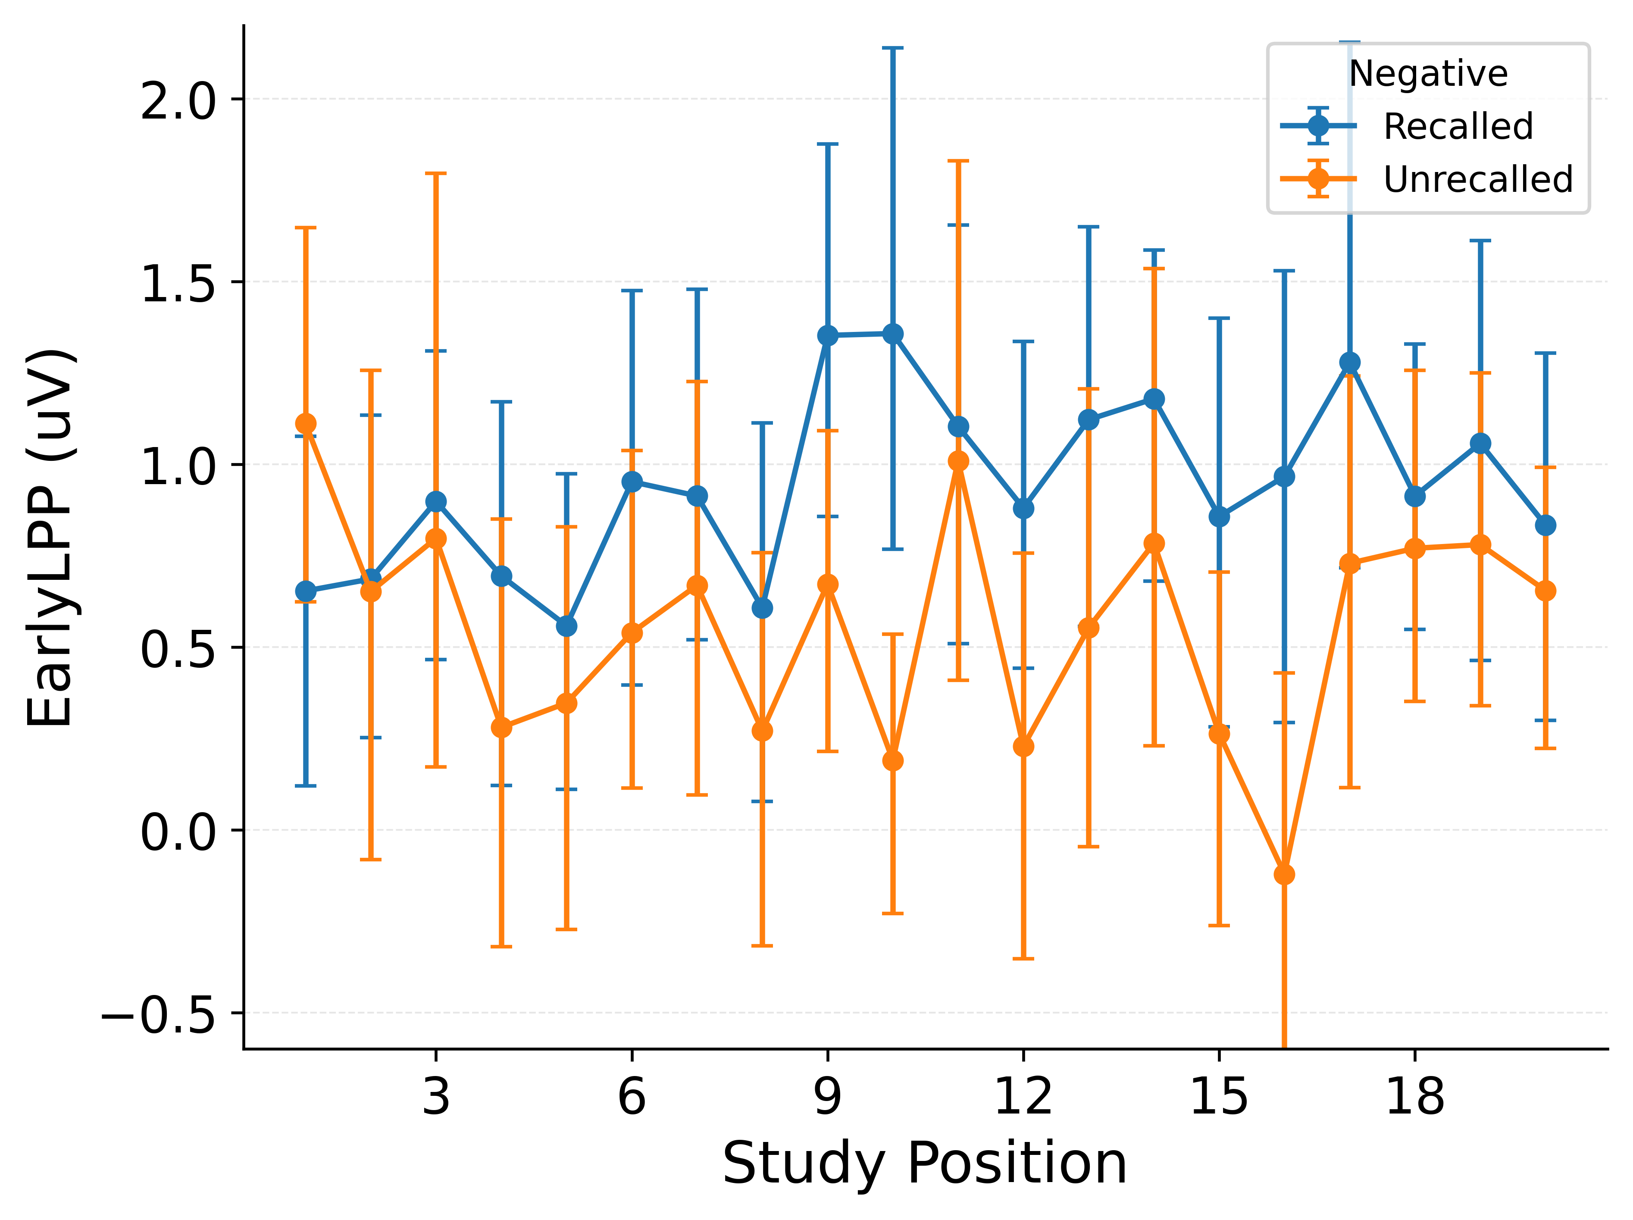
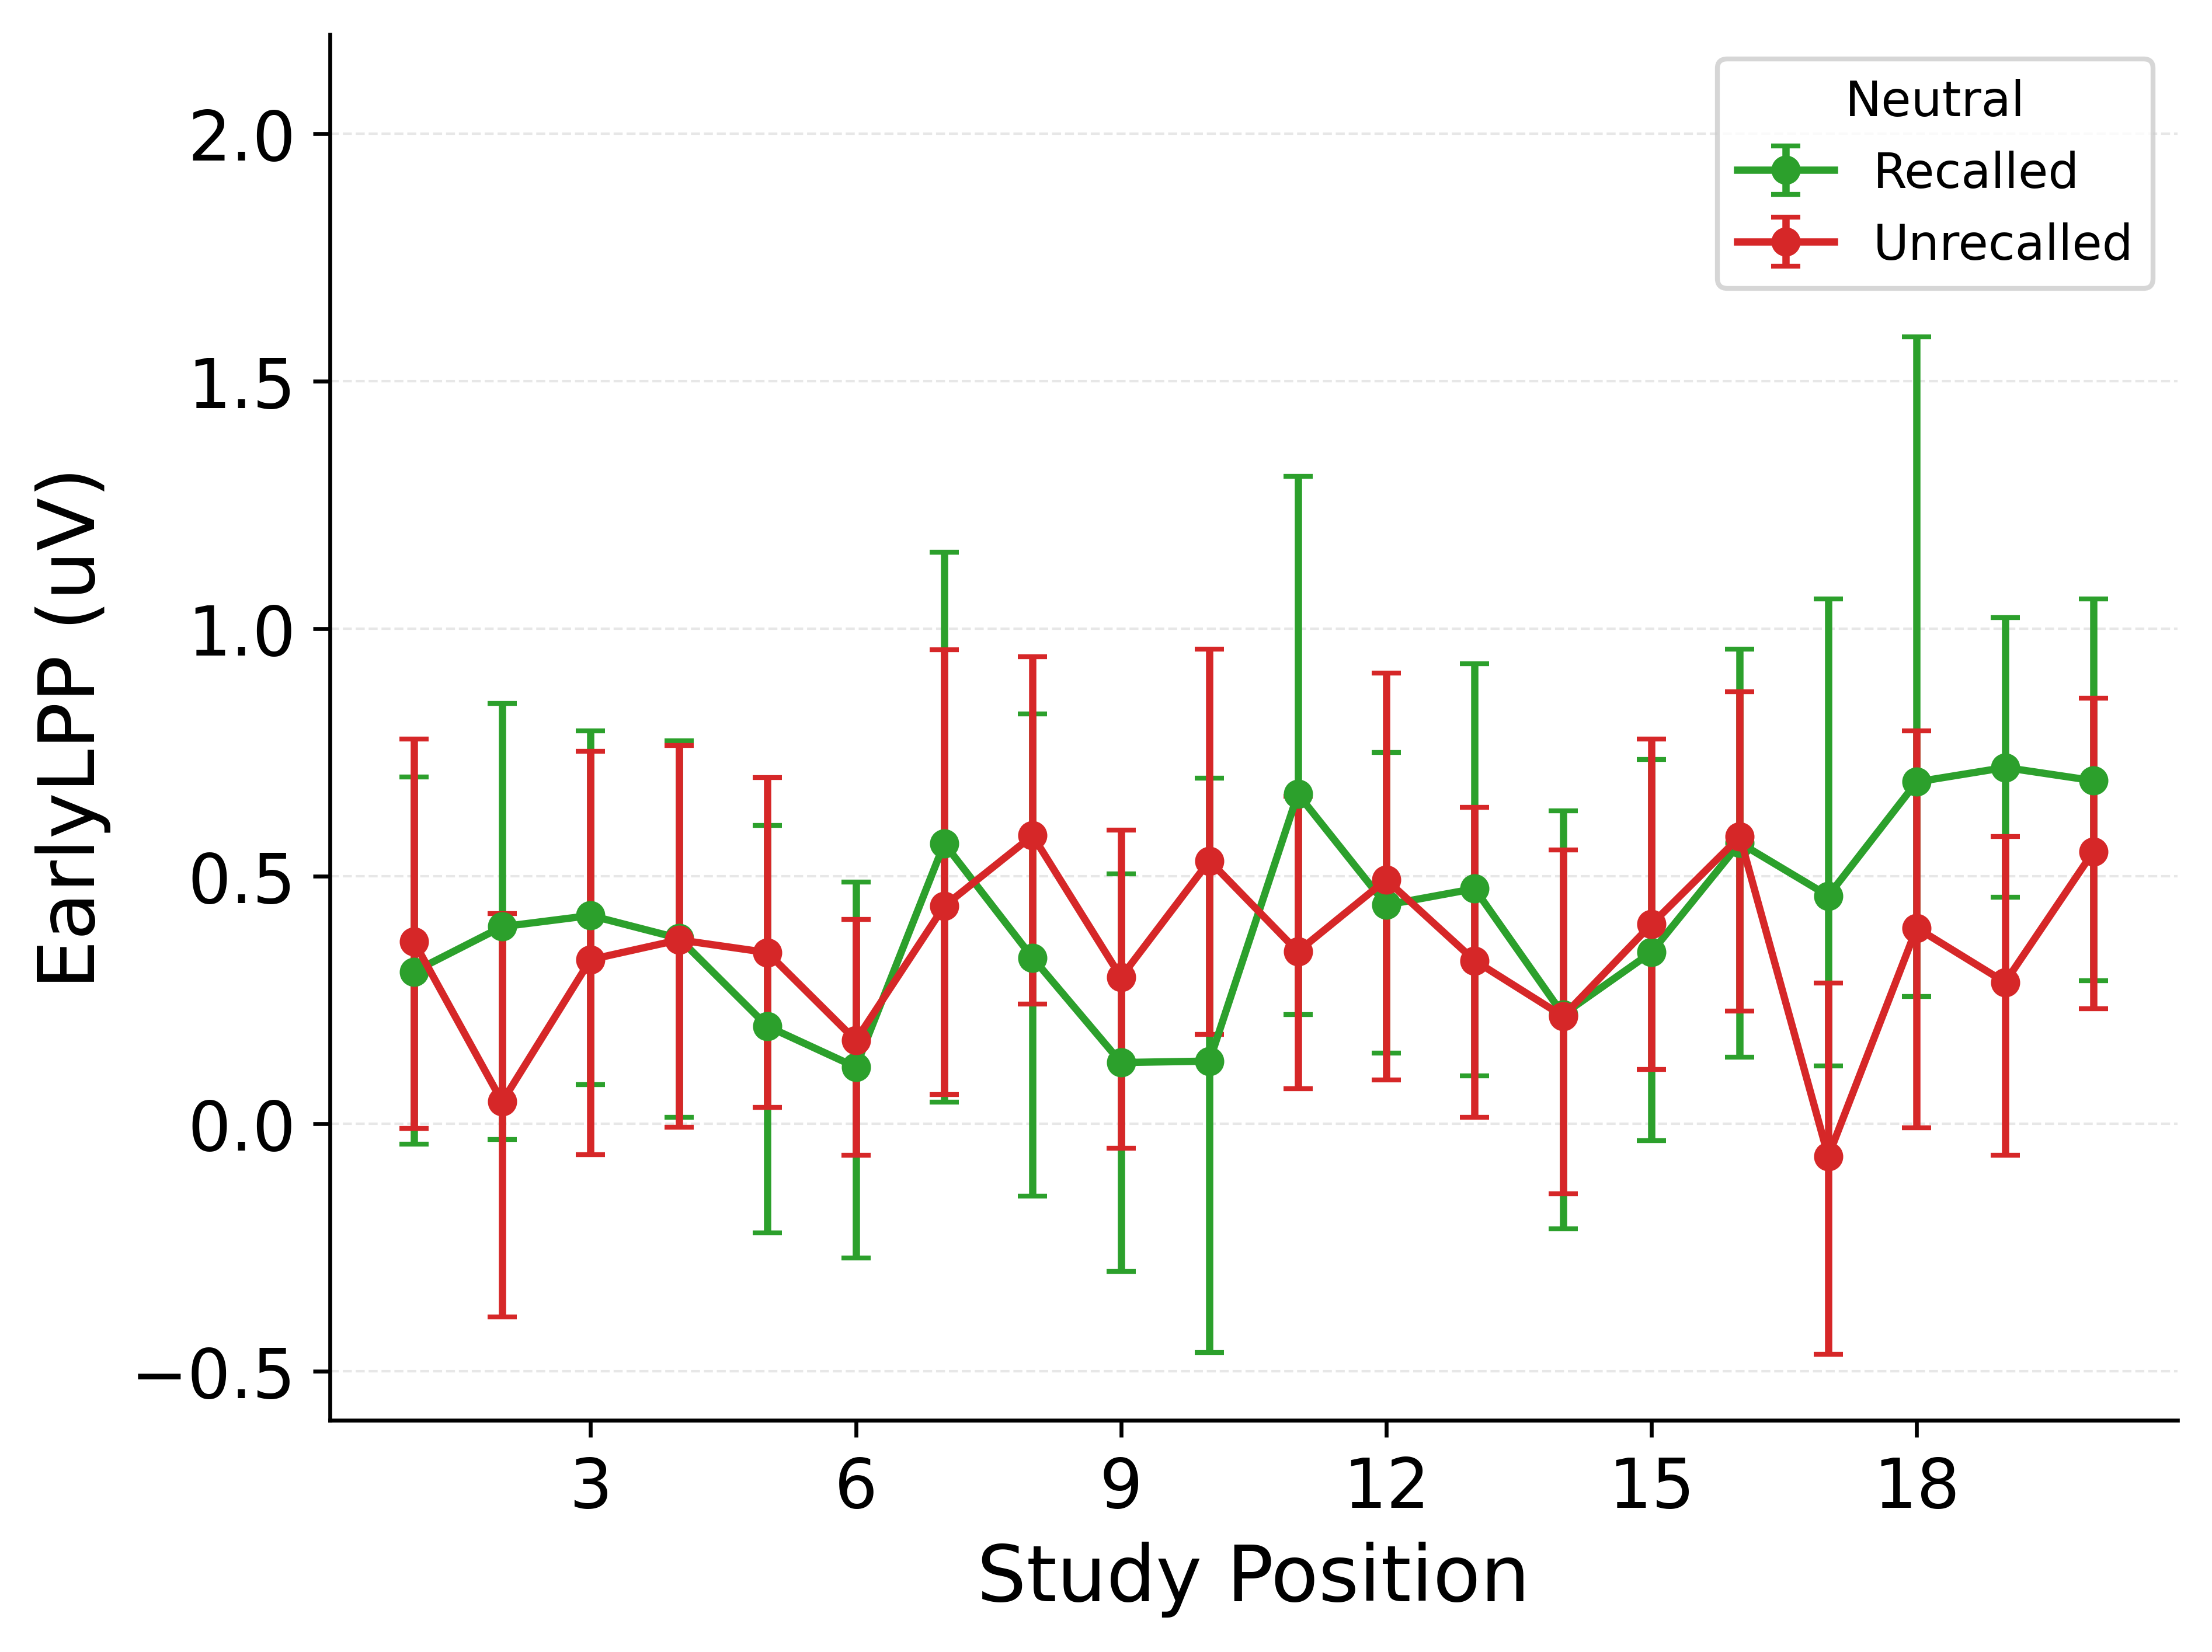
LPP Predicts Recall More Strongly for Emotional Items
LPP by recall status and item type
split by NEGATIVE items (LEFT) and NEUTRAL items (RIGHT).
Notes:
“If we further split by subsequent recall, we see that Early LPP tends to be larger for negative items that are later recalled than for negative items that are not later recalled.”
“Within neutral items, the difference between recalled and unrecalled is much smaller.”
“So even before fitting any model, we have this descriptive picture: LPP seems more strongly tied to recall for negative items than for neutral ones, though again with plenty of noise.

Slide 7
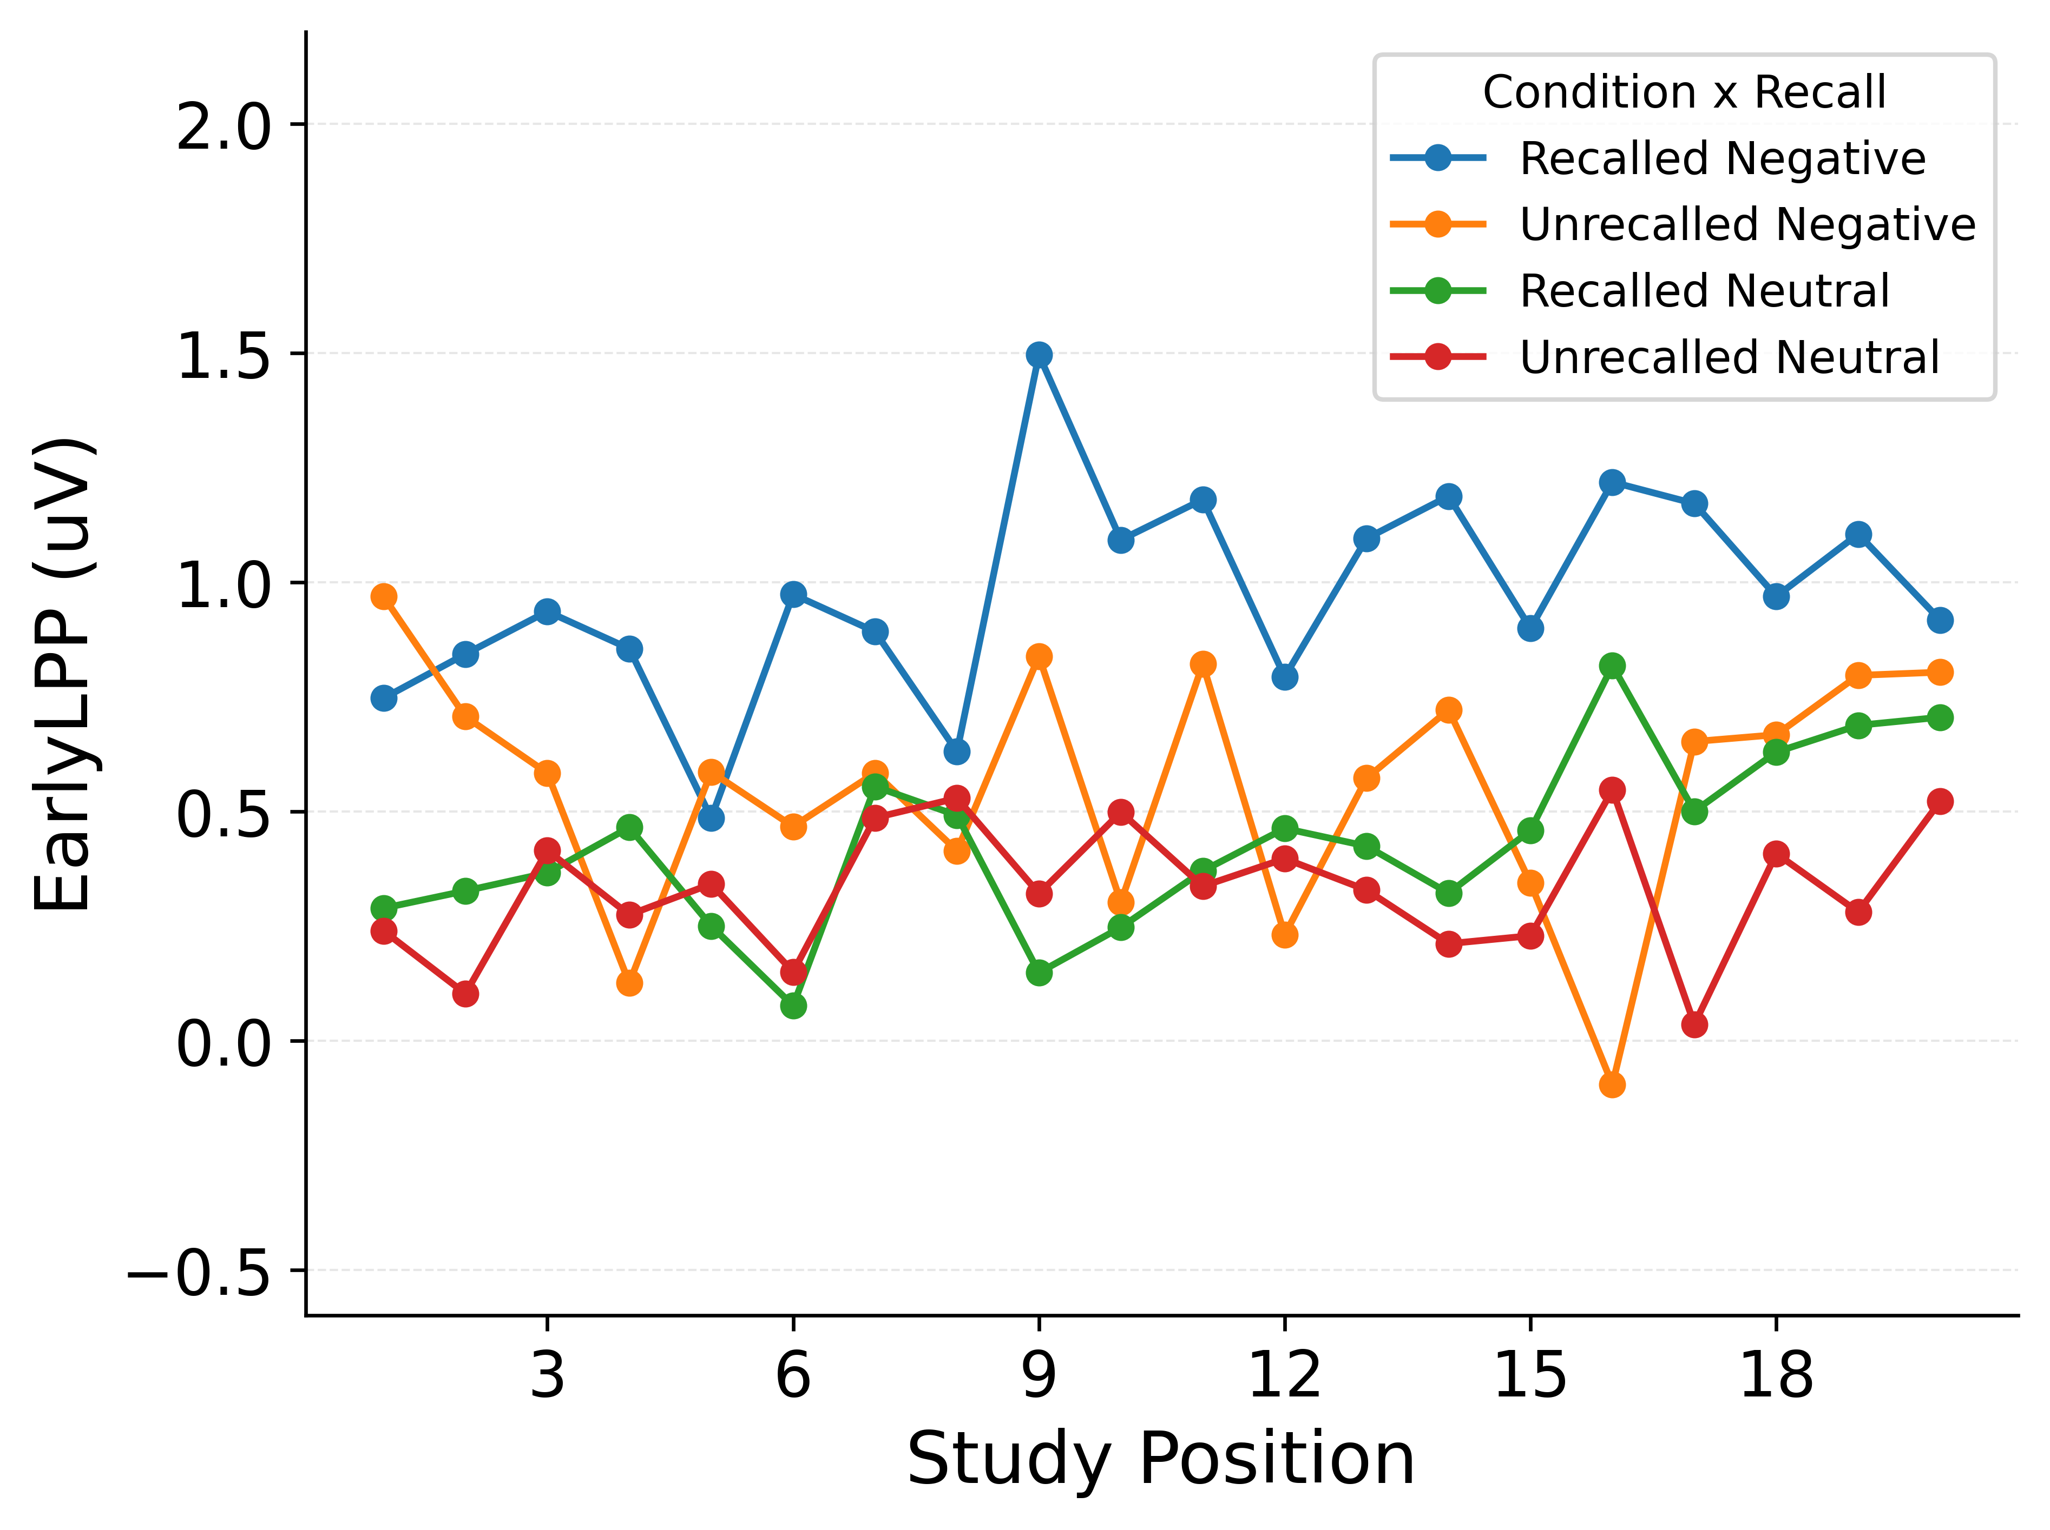
LPP Reflects Both Emotion and Later Recall
Early LPP by recall status and item type.
CIs omitted for clarity; data pooled across participants.
Notes:
Here, we superimpose Early-LPP curves to highlight joint structure. Recalled emotional items have the highest Early LPPs. Unrecalled emotional items sit lower and substantially overlap with both recalled and unrecalled neutral items. So Early LPP clearly reflects both emotion and later recall, but it is not a pure tag for either one on its own. That combination – a systematic shift by emotion, plus an extra boost for items that will be recalled – is exactly the sort of mixed signal that will matter for how we think about modelling this dataset later.

Slide 8
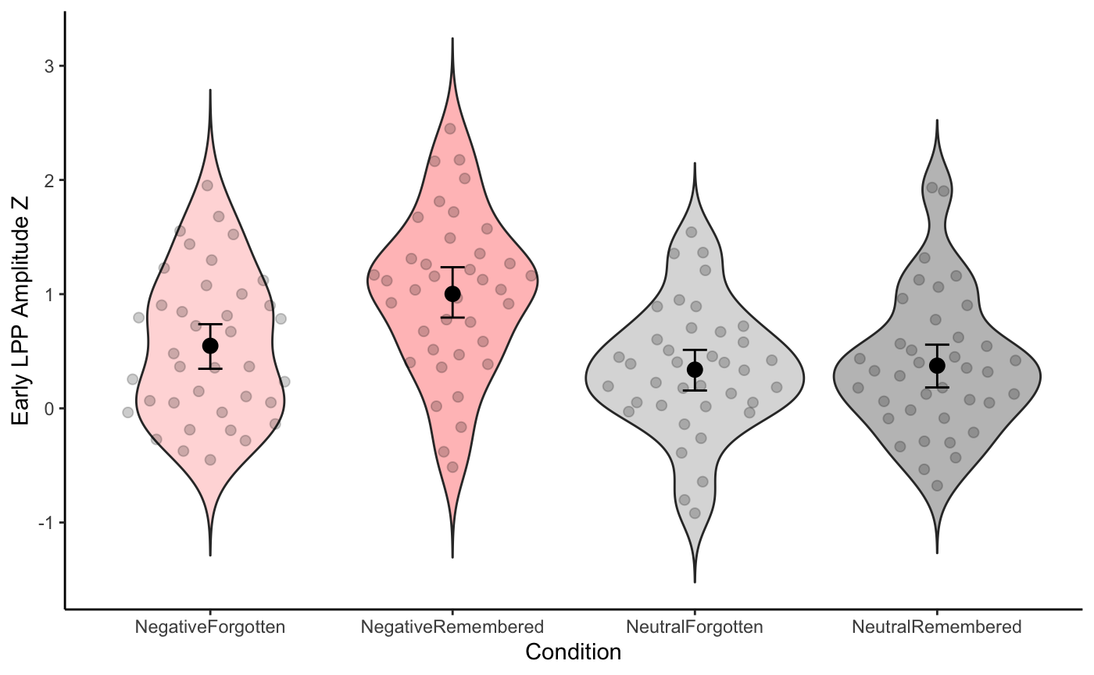
LPP Predicts Recall More Strongly for Emotional Items
Logistic mixed effects model predicting recall:
Negative items recalled more than neutral (emotion main effect, p < .05)
Higher LPP predicts higher recall probability (LPP main effect, p < .05)
LPP–recall relationship steeper for negative than neutral items (interaction, p<.05).
Notes:
“We can summarise these patterns with a logistic mixed-effects model that predicts recall from emotion, Early LPP, and their interaction.
All three terms are reliable: negative items are recalled more often than neutral, items with higher LPP are more likely to be recalled, and the LPP–recall slope is steeper for negative than for neutral items.
So statistically, both the emotion label and LPP carry unique information, and LPP’s relationship with recall depends on emotion.
What this analysis doesn’t tell us is how those factors enter the recall process. That’s where the cognitive modelling comes in: we’ll ask whether different ways of using emotion labels and LPP in an encoding rule can all reproduce this pattern, or whether some mechanistic stories can be ruled out.”

Slide 9
Two ways to fit a model
Fit to summary curves
Fit to trial-level behaviour (likelihood)
pick curves, pick weights, tune parameters so curves line up.
treat the model as generating trial behaviour and score how probable the actual recall sets are.
A B C D E F
D…?
?
Study
Study
Recall
Notes:
One way to connect a model to data is to pick a few summary curves – a serial-position curve, maybe a binned LPP–recall curve – and tune parameters so those curves line up.
That approach is very common and often useful, but it forces you to choose which summaries matter and how to weight them, and it ignores a lot of the trial-by-trial structure the model actually predicts.
If there are patterns in your data not contacted by your summaries, your evaluation totally sidesteps them, providing an incomplete picture of how well your model explains the data.
Because we care about relatively subtle differences in how models treat LPP and want all our data’s structure to contribute to evaluation, we’re going to use a likelihood-based approach instead: treat the model as a generator of recall sets and ask, for each parameter setting, how probable the actually observed recall sets are under that model.

Slide 10
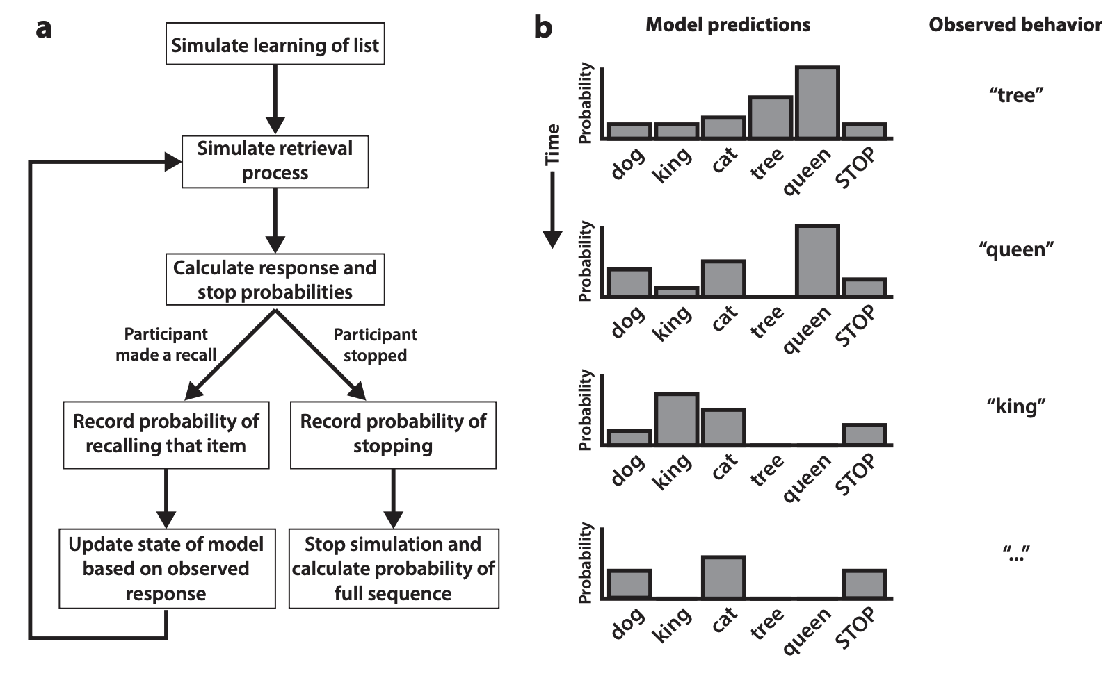
Ideal likelihood if we had full recall sequences: p(sequence_t | model, θ) per trial.
Morton & Polyn, 2016. Journal of memory and language.
Notes:
“If we did have full recall sequences, this is the sort of likelihood we’d like to compute. In the flow chart on the left, the model simulates study and then simulates the retrieval process one response at a time. At each step it assigns probabilities to all possible responses, including a STOP response, and we look up the probability of whatever the participant actually did – recalling ‘tree’, then ‘queen’, then ‘king’, and so on, as shown on the right.
By multiplying those probabilities across the whole sequence, we get the likelihood of that recall sequence under the current parameter setting. Fitting the model by likelihood would then mean adjusting the parameters so that the sequences we actually observed are as probable as possible under this generative process.”

Slide 11
Our data: recall sets, not sequences
In this dataset, for each list and item we know: emotion label, Early LPP at encoding, and whether it was recalled.
We do not know the order of recalls, and buffer items are dropped.
So for modelling, each trial is a 20-item list with a recalled set, not a full recall sequence.
To keep using a generative recall model, we look at all the sequences that would result in that recalled set – different orders – and we aggregate their probabilities under the model
In practice, Monte Carlo approximation
Notes:
“In this dataset, we don’t have full recall sequences; we only know, for each list, which items were recalled.”
The question then becomes: how do we adapt the ideal sequence likelihood to this situation, where what we observe is just the set of recalled items for each list?”
To adapt the ideal likelihood idea, we define a likelihood over sets: under a given parameter setting, how probable is it that the model would eventually recall exactly that set of items, in some order. In practice we approximate that by sampling different orders of the recalled set, computing the sequence probability for each, and averaging them. It’s a Monte Carlo hack, but it lets us keep using the full generative model despite only having recall sets in the data.”

Slide 12
Why we chose likelihood
Uses all the information in which items are recalled on which lists, not just averages or one curve.
Respects the encoding + retrieval structure: same parameters generate and score behaviour.
Gives a principled log-likelihood we can later turn into a model-comparison score (AIC), rather than eyeballing.
Notes:
“So why go to the trouble of defining this set-based likelihood rather than just matching an SPC and an LPP–recall curve?”
“First, it means we are evaluating models on the full trial-level pattern of which items are recalled, not just on one or two summary curves we chose.”
Second, it forces us to use the same encoding and retrieval parameters to both generate and score behaviour. If we claim that LPP boosts encoding strength, that same encoding rule has to explain all the recall patterns in the likelihood; we can’t quietly use one set of parameters to match the SPC and a different set to match the LPP effect. That is what I mean by ‘respecting the generative structure’.
Third, once we have log likelihoods per subject and model, we can turn them into a simple model-comparison score that penalises extra parameters – I’ll use AIC – so we can say, in a principled way, which mechanistic stories are clearly ruled out by the behaviour and where two stories are effectively tied.”

Slide 13
Choosing models: general principles
Change one mechanistic ingredient at a time (here: how LPP and emotion enter encoding).
Include a psychologically meaningful baseline (here: an emotion-only model).
Ensure each model corresponds to a verbal story you can explain in a couple of sentences.
Aim to ask whether the data clearly disfavor a given ingredient, clearly favor it, or leave it underdetermined.
Notes:
“Stepping away from this dataset, what are some general rules of thumb for choosing models to compare?”
“First, you want models to differ in focused ways: ideally one mechanistic ingredient at a time. Here, the ingredient we’re playing with is where and how LPP and emotion enter the encoding rule.”
“Second, you want a baseline that is psychologically meaningful, not just an obviously bad model. In our case, an emotion-only recall model that never sees LPP is a reasonable baseline.”
“Third, you want each model to correspond to a verbal story you could explain to someone in a couple of sentences, because the point is to ask whether that story is clearly ruled out, clearly supported, or simply left underdetermined by the data.”
“In the rest of the talk, we’ll see one example of each: an emotion-only model that is clearly ruled out once we look at the fits, and two EEG-aware models where, for this dataset, the behaviour effectively ties them.”

Slide 14
What could ‘LPP as a stand-in for emotion’ mean?
Our statistical model and plots so far tell us:
Emotion label and Early LPP each predict recall; both matter.
LPP is higher on average for negative items, and highest for recalled negatives.
“LPP as stand-in for emotion” can mean at least two things:
Strong version: drop the emotion label; LPP alone drives the “emotional” mechanism.
Weaker version: LPP is the graded input to an emotional channel in the model, but condition labels may still carry extra information (e.g., list-level or semantic effects).
Our analyses against the strong “LPP replaces emotion label” story, but do not tell us whether a model that only sees LPP can behave like one that gets explicit emotion labels as an input.
Notes:
Now let’s shift to model specification. We’ve been circling around a basic question about LPP: could it work as a stand-in for emotion in our model?
Statistically, what we’ve seen so far is that both the emotion label and Early LPP predict recall. Negative items are recalled more often than neutral even after controlling for LPP, and LPP is highest for recalled negatives and lower for the other groups. LPP is clearly related to emotion and to later recall, but it’s not a pure tag for either one.
When we talk about LPP ‘standing in’ for emotion in the model, that could mean a strong claim – drop the emotion labels entirely and let LPP drive the emotional mechanism – or a weaker claim, where LPP is the graded input to that mechanism but the condition labels still carry extra information. The GMM patterns give us reasons to doubt the strong, ‘LPP replaces the label’ story, because emotion still explains variance beyond LPP, but they don’t tell us how a recall model that only sees LPP would actually behave compared to one that also sees the labels. That’s the modelling question we’re going to formalise on the next slide.

Slide 15
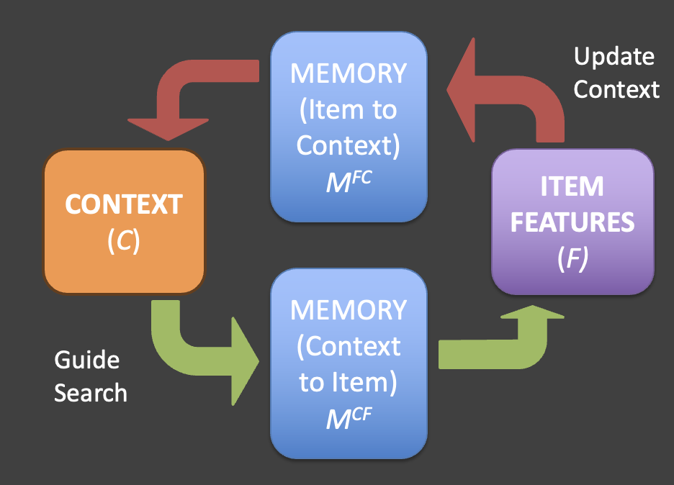
Our recall model: encoding and competition
Encoding: maps item features (emotion, LPP) to context with an encoding strength Sᵢ.
Retrieval: context cue → activations (similarity × strength) → competitive choice → Update cue → …
c1
Item
Notes:
“To test these stories we embed them in an established emotional free recall model called the emotional context maintenance and retrieval model, or eCMR.
We don’t need to get into its details, but it has two main stages.”
“At study, items are encoded with a strength Sᵢ and linked to a context representation. At test, a cue drives a context state that activates items based on their similarity to the cue and their strength, and a competitive choice rule produces recalls or a STOP decision.”
“Across all the models I’ll show you, the retrieval stage – context dynamics, similarity, and competition – is the same.”
“What we’re going to manipulate is the encoding rule: how emotion and LPP are allowed to feed into the encoding strength S sub i.”

Slide 16
Three encoding models we’ll test
Model 0 – Emotion-only
Encoding: Sᵢ depends only on whether the item is negative or neutral
LPP is ignored.
Model 1 – LPP only
Encoding: Sᵢ depends only on the item’s Early LPP amplitude
Emotion labels are ignored
Model 2 – EEG interaction
Encoding: Sᵢ depends only on the item’s Early LPP amplitude
Model sees a binary emotion factor and graded neural signal
Retrieval dynamics (context & competition) are identical in all three models; only the encoding rule changes.
Notes:
o make those ideas concrete, we’re going to look at three ways of letting the model use emotion and LPP at encoding.
Model 0 is an emotion-only model: the encoding strength $S_{i}$depends only on whether an item is negative or neutral, and LPP is ignored. This is our baseline, where emotion labels are the only ‘emotional’ input.
Model 1 is an LPP-only model: encoding strength depends only on the item’s Early LPP amplitude, and the model never sees the category labels. This is the strong ‘LPP stands in for emotion’ idea we just talked about.
Model 2 is an emotion-plus-LPP model: encoding strength depends on both the condition label and LPP, so the model has a binary emotion factor and a graded neural signal. This corresponds to the weaker stand-in idea, where LPP is the graded input to an emotional channel but labels can still carry extra information.
Across all three models, the retrieval dynamics – context drift, cue–item similarity, competition – are exactly the same; only the encoding rule changes.

Slide 17
From likelihood to AIC: scoring models
logL_{s,m}: set-based log likelihood for subject s under model m
k_{m}: number of free parameters in model m
AIC_{s,m} = 2 * k_{m} - 2 * logL_{s,m}
Lower AIC ≈ better expected predictive performance for that subject (fit - complexity penalty).
Notes:
“For each participant and each model we have a log likelihood from the set-based fit: how probable their recall sets are under that model at its best-fitting parameters.”
“We use AIC to turn that into a model score. It rewards high log likelihood but penalises models with more free parameters.”
“Formally, AIC is 2 times the number of parameters minus 2 times the log likelihood.
Under some mild assumptions, this simple combination gives an estimate of how well the model would predict new data from the same task. Lower AIC means better expected out-of-sample predictive performance, so we’ll use it as a single score to compare our models for each subject.”

Slide 18
Emotion+LPP clearly best; LPP-only clearly worst
Comparison: Mean ΔAIC [95% CI]
Emotion+LPP vs Emotion-only: −3.98 [−5.71, −2.25]
Emotion+LPP vs LPP-only: −6.69 [−9.31, −4.07]
Emotion-only vs LPP-only: −2.71 [−5.55, 0.13]
When bootstrap interval is entirely below zero and comfortably beyond ±2 band, that’s our cue that the left model really is better for most subjects, not just on average.
Notes:
“Here are the AIC differences between the three encoding options. ΔAIC here is AIC for the row model minus AIC for the column model, computed separately for each subject. We then bootstrap across subjects to get a confidence interval on the mean ΔAIC. Negative values favour the row model; positive values favour the column. As a rough rule of thumb, differences smaller than about two AIC units are negligible; larger, consistent differences suggest a real advantage in expected predictive performance.
For Emotion+LPP versus Emotion-only, the mean ΔAIC is around minus four and the bootstrap interval sits below zero. That means that, across subjects, the combined model reliably predicts better than the emotion-only model – letting the model see LPP on top of the labels helps.
For Emotion+LPP versus LPP-only, the differences are even more negative, so the strong ‘LPP-only’ stand-in idea is in trouble. And when we compare Emotion-only to LPP-only, the differences lean in favour of Emotion-only but the interval straddles zero, so we can’t claim a clear win – the LPP-only model is certainly not better than using the labels, and within this class it is clearly worse than the Emotion+LPP model.”

Slide 19
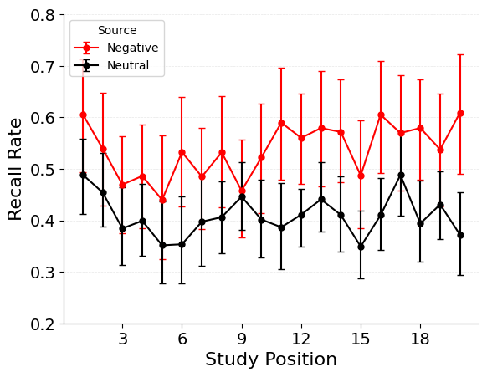
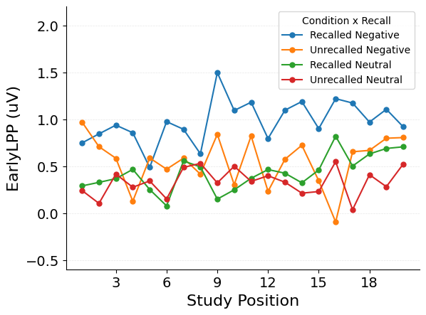
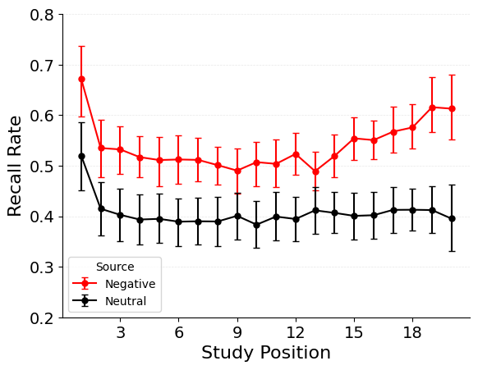
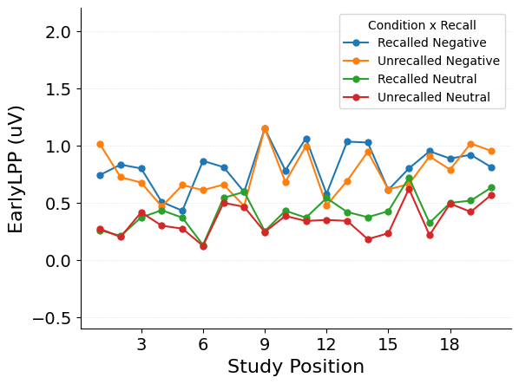
Interpretation by Simulation: Emotion-Only Model Cannot Capture LPP Patterns
Top: Data
Bottom: Simulations
Emotion-only model captures much of the emotional enhancement of memory, but cannot capture LPP effects
You can’t explain LPP-recall relationship with emotion and model dynamics alone!
Notes:
Top row is the data; bottom row is the emotion-only model. It captures the emotional enhancement of memory on the left, but on the right all four simulated LPP curves overlap. So its AIC disadvantage comes from failing to reproduce the LPP–recall structure, not from basic recall rates.

Slide 20
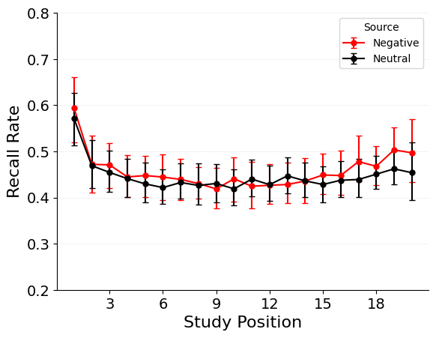
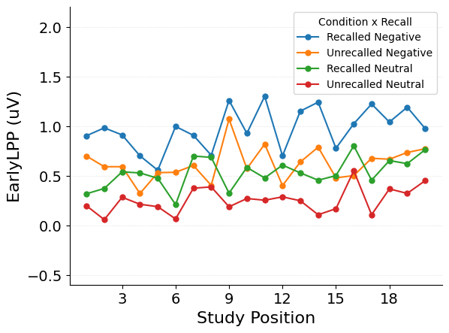
Interpretation by Simulation: LPP-Only Model Cannot Stand-In For Emotion
Top: Data
Bottom: Simulations
LPP-only model captures none of the emotional enhancement of memory, and only some LPP patterns
Can’t give extra subsequent recall boost to emotional items!

Slide 21
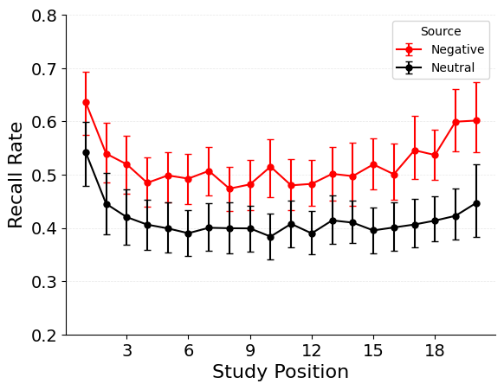
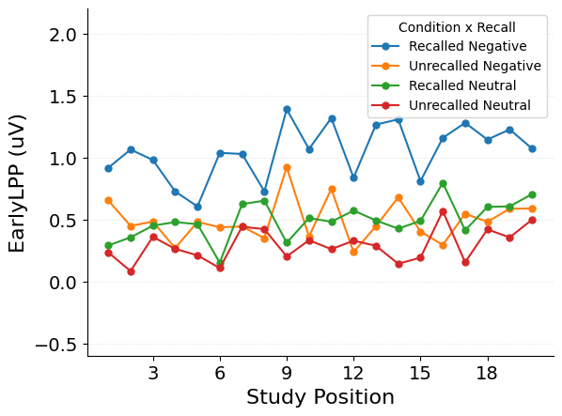
Interpretation by Simulation: Emotion+LPP Model Helps Capture Both!
Top: Data
Bottom: Simulations
Emotion+LPP model predicts emotion-dependent encoding boost from LPP
Improves prediction of emotional enhancement of memory AND emotion x LPP interaction effect

Slide 22
What modelling bought us (and what it didn’t)
Why cognitive models vs stats? The GLMM told us there is an Emotion × LPP interaction in recall and that both factors matter; the models showed that an emotion-only process and an LPP-only process are both inadequate in this recall framework.
What does likelihood-based fitting mean and why bother? We used a set-based likelihood over recall sets to evaluate models on the full trial-level pattern, then converted that into AIC scores per subject that balance fit and complexity.
How did we choose models? We built three encoding variants that differed only in which signals drive encoding strength: an emotion-only baseline, an LPP-only “strong stand-in” model, and an emotion+LPP model corresponding to the weaker stand-in idea; retrieval dynamics were held fixed.
How did we compare them and what did we learn? AIC differences showed that the emotion+LPP model clearly outperforms emotion-only and LPP-only, that the LPP-only model is clearly inferior to emotion+LPP and never better than emotion-only, and that the strong “LPP can fully replace the emotion label” story is not supported in this model class.
Notes:
Coming back to the four questions I started with, this example shows both what modelling can and cannot do for us.
First, it sharpened the regression result into a process-level statement: in this recall model, the encoding rule that sees both emotion labels and LPP clearly does better than either emotion-only or LPP-only, so LPP helps as a graded signal but cannot replace the labels.
Second, it reminded us to be modest: many other ways of combining emotion and LPP at encoding, and many choices about retrieval, would look very similar on a dataset of this size, so modelling narrows the space of stories but does not identify a unique mechanism.
More generally, the workflow we walked through – pick a generative model, choose a loss that matches it to the data, formalise competing mechanistic ideas as model variants, and compare them carefully – is something you can reuse in other tasks to see which aspects of your favourite stories are actually constrained, and which remain underdetermined.

Slide 23
Thanks!!
Robin Hellerstedt, Universidad Politecnica de Madrid
Vanessa Zarubin, Northwestern University
Katherine R. Mickley Steinmetz, Wofford College
Nathaniel D. Daw, Princeton University
Deborah Talmi, University of Cambridge
Notes:
Finally I want to thank my collaborators
Robin Hellerstedt
Vanessa Zarubin
Katherine Mickley Steinmetz
Nathaniel Daw
Deborah Talmi
And I also want to thank you for listening

