Slide 1
20MX21 - Object Oriented Programming using JAVA Java Virtual Machine (JVM) Architecture (CO-1)
Dr. Ilayaraja N
PSG Tech

Slide 2
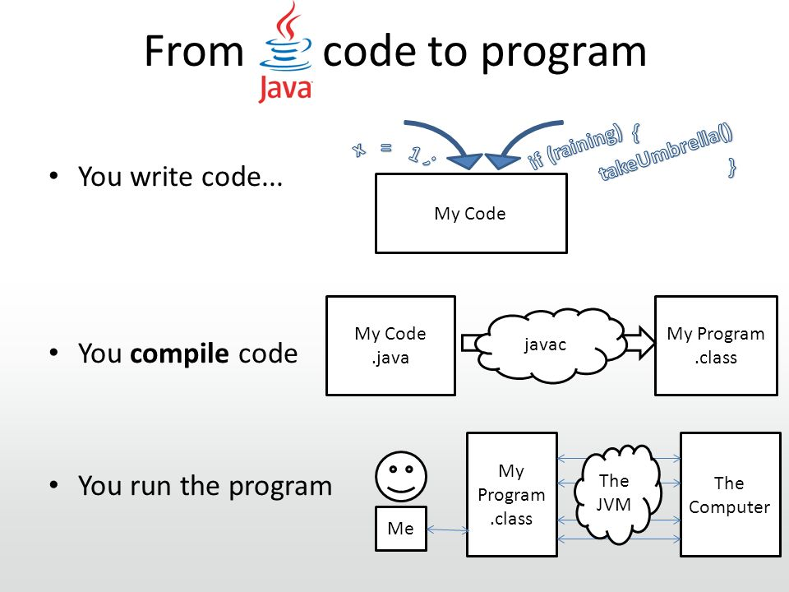

Slide 3
Bytecode or .class file
Bytecode is program code that has been compiled from source code into low-level code like object file (not ready to run directly)designed for a software interpreter.
It may be executed by a virtual machine (such as a JVM) or further compiled into machine code, which is recognized by the processor.
Java is known as a "portable language" because Java code can execute on all major platforms.
This bytecode is sent to Java virtual machine (JVM) which resides in the RAM of any operating system.

Slide 4
Java Virtual Machine
JVM recognizes the platform it is on and converts the bytecodes into native machine code.
Hence java is called platform independent language.

Slide 5
Java Virtual Machine
Java Virtual Machine or JVM is a Java run-time system. It is a virtual machine environment that helps drive/run a Java code.
Unlike other programming languages, whenever we compile a Java program, it never generates a standalone machine code(not ready for direct execution).
In Spite of that the Java compiler produces Bytecode for the Java Virtual Machine.

Slide 6
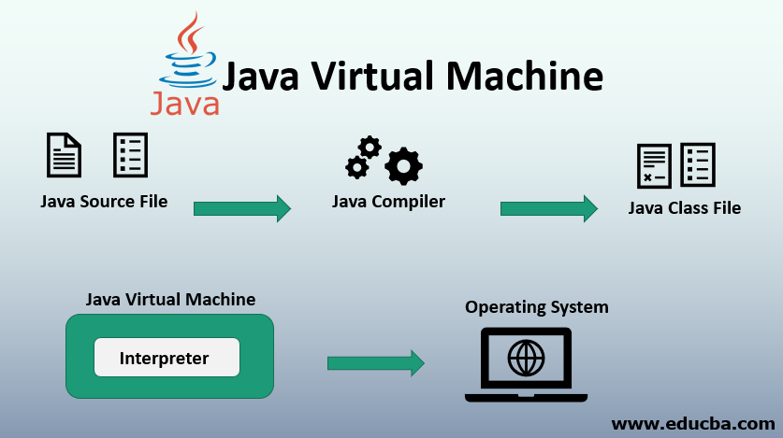

Slide 7
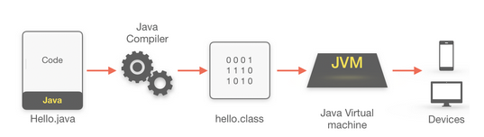
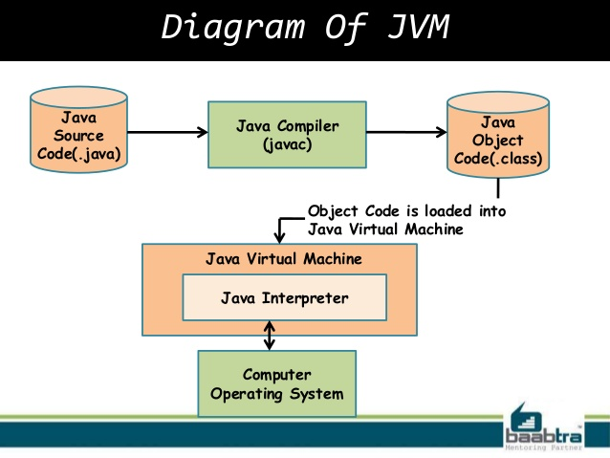
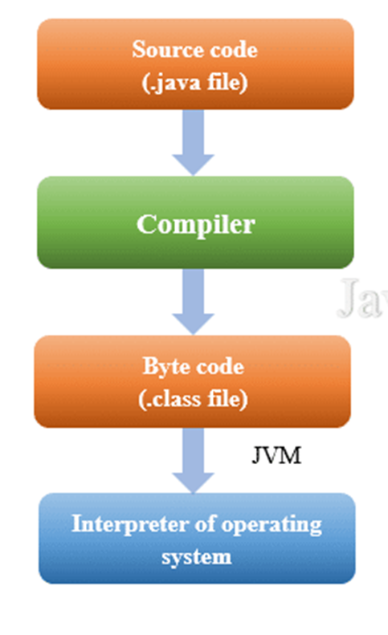

Slide 8
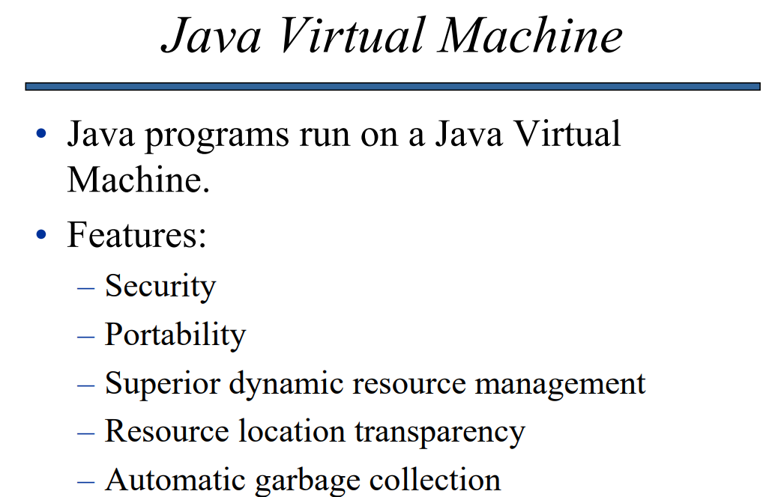

Slide 9
JVM allows us to achieve both portability and security problems:
Platform Independence:
Platform represents the environment in which a program runs.
Being platform-independent simply means a program can be easily executed on different platforms without rewriting and recompiling.
This is possible only because of translating a Java program ->bytecode makes it easier to execute a program in different environments because only JVM needs to be implemented for each platform.
Although the JVM will differ from platform to platform, the same Java bytecode is understood by them.
This makes Java a platform-independent technology and also justifies WORA(Write Once Run Anywhere).

Slide 10
Security:
JVM plays an important role in security.
The Java program being executed by JVM also helps to make it secure because the JVM is in charge of the execution environment, it can contain the program and prevent the problems arising outside of the system.
This is because the bytecode has been highly optimized, bytecode allows the JVM to run programs faster.
JVM also verifies the bytecode which ensures further safe operation of the program.

Slide 11
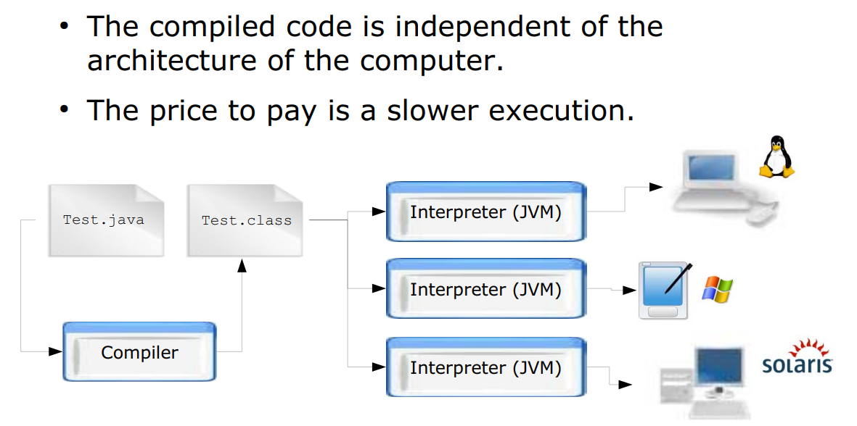

Slide 12

Dependency
Windows
Windows
Compiler
App.exe
Mac
X
Linux
X
App.c
code
Mac
Windows
X
Compiler
App.dmg
Mac
Linux
X

Slide 13
Independency
Windows JVM
JIT
Windows
App.java
code
compiler
byte code
App.class
Linux JVM
JIT
Linux

Slide 14
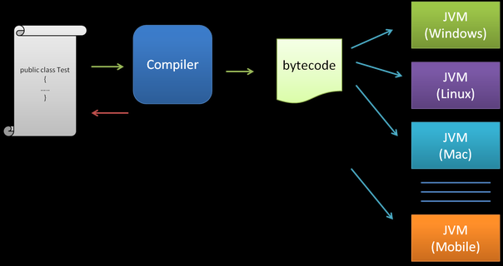
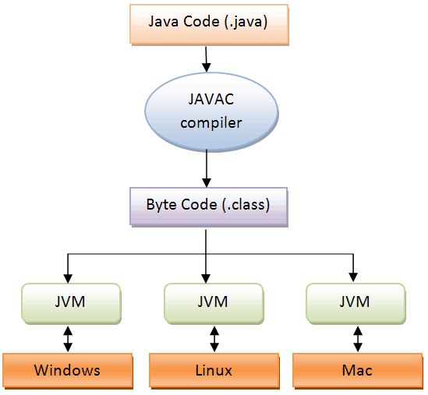

Slide 15
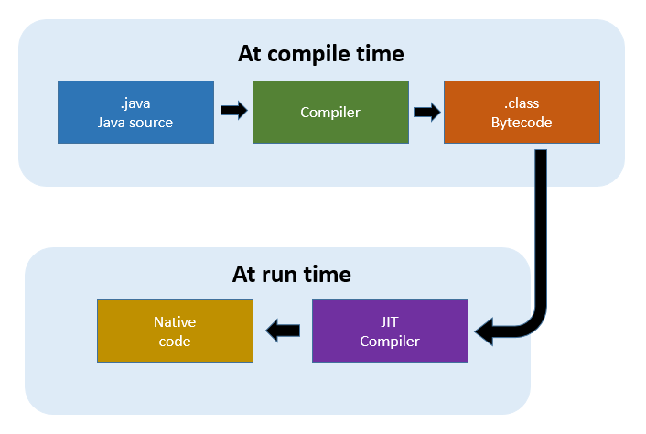

Slide 16
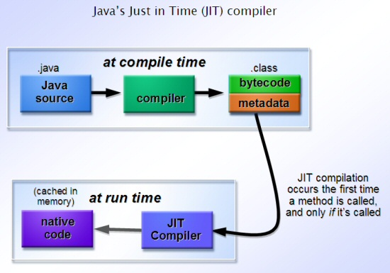

Slide 17
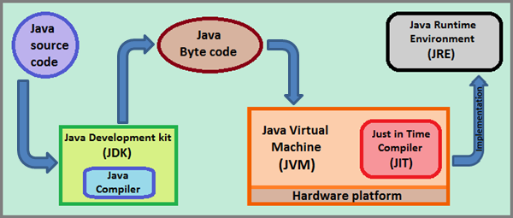

Slide 18
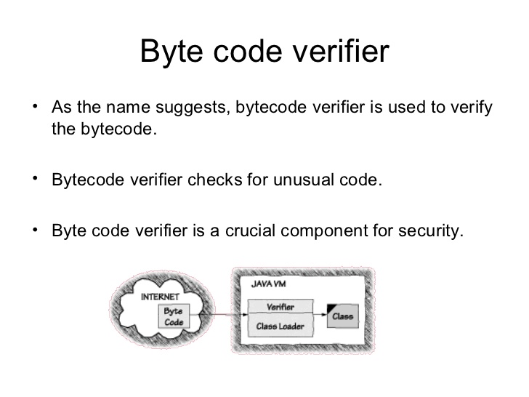

Slide 19
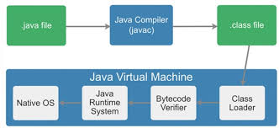

Slide 20
JDK (Java Development Kit)
JDK (Java Development Kit) is a superset of JRE (Java Runtime Environment), it contains everything that JRE has along with development tools such as compiler, debugger, etc.
JRE (Java Runtime Environment)
JRE (Java Runtime Environment) provides the environment in which the JVM (Java Virtual Machine) runs. JRE contains JVM, class libraries, and other files excluding development tools such as compiler and debugger.
It means, you can run the code in JRE but you can’t develop and compile the code in JRE.

Slide 21
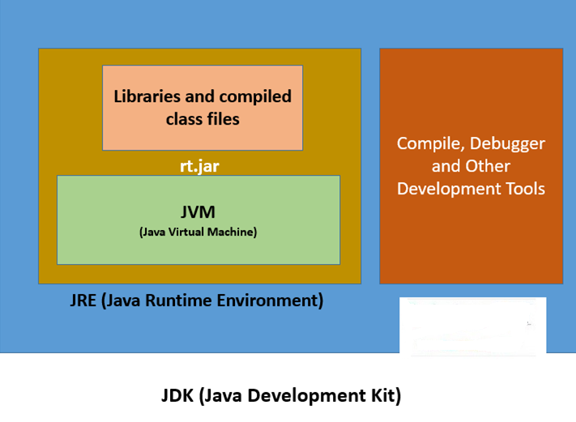

Slide 22
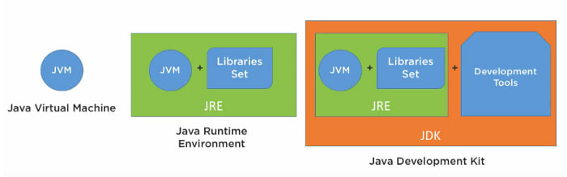
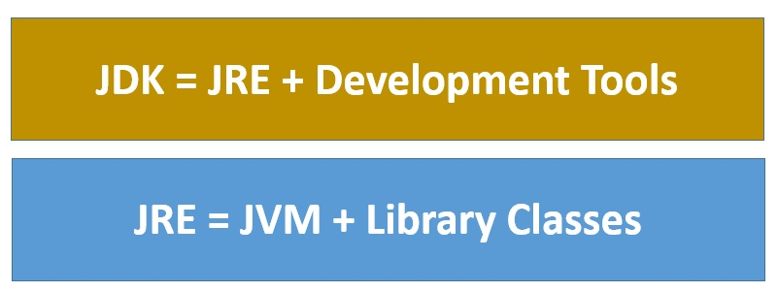

Slide 23
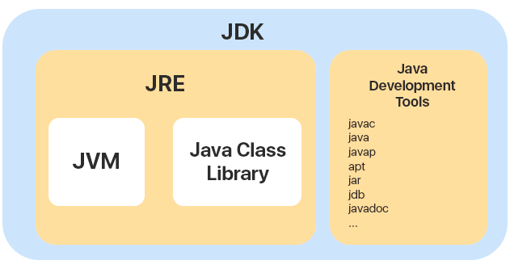
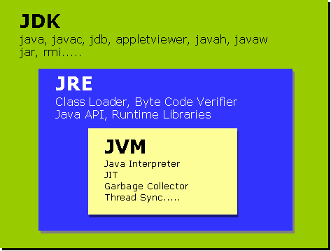
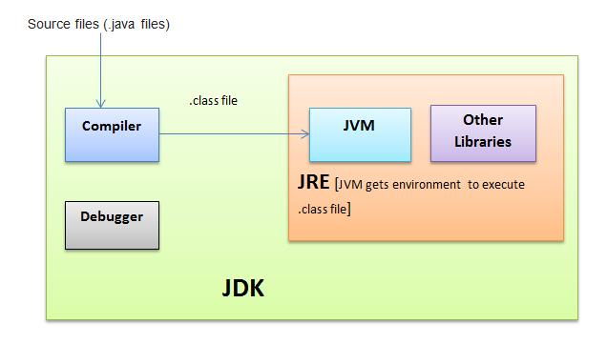

Slide 24
Components of a JVM
Memory Areas
Execution
Engine
Method
Area
Heap
Area
.class
Class Loader Subsystem
Stack
Area
PC
Registers
Java Native
Interface
JNI
Native
Method
Stacks
Native Method
Libraries

Slide 25
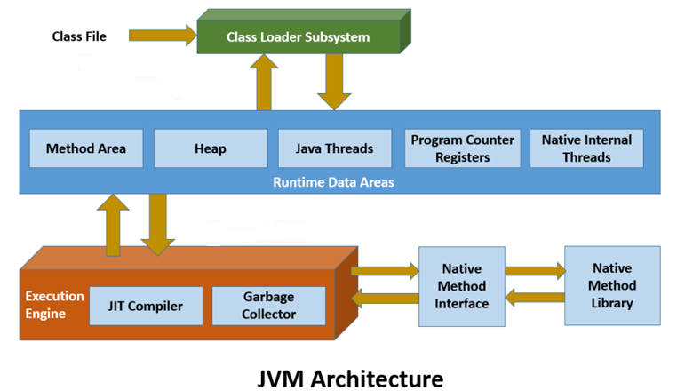

Slide 26
ClassLoader
The class loader initializes the class file at runtime. It dynamically loads the class and reads the .class file and also saves the bytecode created in the method area.
It’s three main functions are Loading, Linking and Initialization.
There are three main types of the class loader:
Bootstrap ClassLoader: The bootstrap class loader is responsible for loading the java.lang.ClassLoader. It is an important part of JVM which loads the JDK internal classes from the locations rt.jar. It is also known as a primordial class loader.
Extension ClassLoader: The extension class loader loads the classes from JDK extension library.
System Class Loader: The main function of system class loader is to load the classes from the currently set classpaths.

Slide 27
Method Area
There is one method area for each JVM. Method area holds class level information of .class file. Method area stores all the class level data such as class name, methods, static variables, non-static variables, fields etc
Heap
Heap is a JVM memory part where objects are allocated. JVM creates an object for each .class Class file.
Stack
The stack is JVM memory part but unlike Heap, it is used for storing temporary variables i.e method parameters.
PC Registers
PC Registers use to keeps the track of which instruction has been executed and which one is going to be executed. Because instructions are executed by threads, each thread has a separate PC register.

Slide 28
Native Method Stack
A native method used to access the runtime data areas of the virtual machine.
Native Method interface
It enables java code to call or be called by native applications written in C or C++. Native applications are programs in low-level language that is specific to the hardware and OS of a system.

Slide 29
Execution Engine
Execution engine executes the bytecode line by line. It contains three main components.
Interpreter
A very important member of the JVM is the interpreter. The interpreter converts bytecode instructions according to the underlined platform instruction as well as the run state and executes the code.
Just-In-Time Compiler (JIT)
The JIT compiler compiles the code as it is need during the execution. Only the code that will benefit from the compilation is compile. The remaining code is simply interpret. In this way, the Just-In-Time compiler provides a kind of performance boost and also increases the efficiency of the interpreter.
It used when a method is called. The JIT compiles the bytecode of that called method into native machine code.
When a method has been compiled in native machine code, the JVM calls the compiled code of that method directly instead of interpreting it.

Slide 30
Garbage Collector
Garbage Collection use for automatic memory management by JVM.
It destroys unreferenced objects from Heap so that allocates more memory for new objects.
The technique used to accomplish is refer garbage collection.
In garbage collection, when an unreference object exists, the memory claim by this object can be reclaim by another object.

Slide 31


