Slide 1
Building Java Programs
Object Behavior (Methods) and Constructors
N Ilayaraja

Slide 2
Why objects?
Primitive types don't model complex concepts well
  Cost is a double. What's a person?
  Classes are a way to define new types
  Many objects can be made from those types
Values of the same type often are used in similar ways
  Promote code reuse through instance methods
  public class Point {
  int x;
  int y;
  }
  Point p1 = new Point();
  Point[] p = new Point[10];

Slide 3
Recall: Instance methods
instance method (or object method): Exists inside each object of a class and gives behavior to each object.
  public type name(parameters) {
  statements;
  }
  same syntax as static methods, but without static keyword
  Example:
  public void shout() {
  System.out.println("HELLO THERE!");
  }

Slide 4
Point objects w/ method
Each Point object has its own copy of the distanceFromOrigin method, which operates on that object's state:
  Point p1 = new Point();
  p1.x = 7;
  p1.y = 2;
  Point p2 = new Point();
  p2.x = 4;
  p2.y = 3;
  p1.distanceFromOrigin();
  p2.distanceFromOrigin();
p1
public double distanceFromOrigin() {
// this code can see p1's x and y
return Math.sqrt(x * x + y * y);
}
x | 7 | y | 2
public double distanceFromOrigin() {
// this code can see p2's x and y
return Math.sqrt(x * x + y * y);
}
x | 4 | y | 3
p2

Slide 5
The implicit parameter
implicit parameter:
The object on which an instance method is called.
  During the call p1.distanceFromOrigin();
  the object referred to by p1 is the implicit parameter.
  During the call p2.distanceFromOrigin();
  the object referred to by p2 is the implicit parameter.
  The instance method can refer to that object's fields.
    We say that it executes in the context of a particular object.
    distanceFromOrigin can refer to the x and y of the object it was called on.

Slide 6
Kinds of methods
accessor: A method that lets clients examine object state.
  Examples: distance, distanceFromOrigin
  often has a non-void return type
mutator: A method that modifies an object's state.
  Examples: setLocation, translate

Slide 7
Object initialization: constructors

Slide 8
What is a constructor?
a class provides a special type of methods, known as constructors, which are invoked to construct objects from the class
It is a member function which initializes a class.
A constructor has:
(i) the same name as the class itself
(ii) no return type

Slide 9
Initializing objects
Currently it takes 3 lines to create a Point and initialize it:
  Point p = new Point();
  p.x = 3;
  p.y = 8; // tedious
We'd rather specify the fields' initial values at the start:
  Point p = new Point(3, 8); // desired;
  We are able to this with most types of objects in Java.

Slide 10
Constructors, cont.
A constructor with no parameters is referred to as a no-arg constructor.
· Constructors must have the same name as the class itself.
· Constructors do not have a return type—not even void.
· Constructors are invoked using the new operator when an object is created. Constructors play the role of initializing objects.

Slide 11
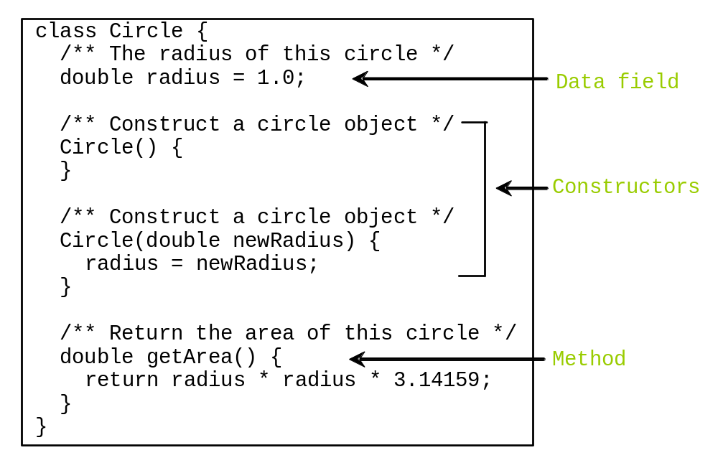
Classes

Slide 12
Creating Objects Using Constructors
new ClassName();
Example:
new Circle();
new Circle(10);
new Circle(25);
new Circle(125);

Slide 13

Objects
An object has both a state and behavior. The state defines the object, and the behavior defines what the object does.

Slide 14
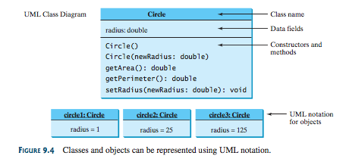
Unified Modeling Language (UML) Class Diagram
In the class diagram, the data field is denoted as
dataFieldName: dataFieldType
The constructor is denoted as:
ClassName(parameterName: parameterType)
The method is denoted as
methodName(parameterName: parameterType): returnType

Slide 15
Default Constructor
A class may be defined without constructors. In this case, a no-arg constructor with an empty body is implicitly defined in the class. This constructor, called a default constructor, is provided automatically only if no constructors are explicitly defined in the class.

Slide 16
Comments on constructors
A constructor is called automatically whenever a new instance of a class is created.
You must supply the arguments to the constructor when a new instance is created.
If you do not specify a constructor, the compiler generates a default constructor for you (expects no parameters and has an empty body).

Slide 17
Constructors
constructor: Initializes the state of new objects.
  public type(parameters) {
  statements;
  }
  runs when the client uses the new keyword
  no return type is specified;
  it implicitly "returns" the new object being created
  If a class has no constructor, Java gives it a default constructor with no parameters that sets all fields to 0 for numeric, null for char/string.

Slide 18
Declaring Object Reference Variables
Objects are accessed via the object’s reference variables, which contain references to the objects.
To reference an object, assign the object to a reference variable.
A class is a reference type, which means that a variable of the class type can reference an instance of the class.
To declare a reference variable, use the syntax:
ClassName objectRefVar;
Example:
Circle myCircle;

Slide 19
Declaring/Creating Objects in a Single Step
ClassName objectRefVar = new ClassName();
Example:
Circle myCircle = new Circle();
Assign object reference
Create an object

Slide 20
Accessing Object’s Members
Referencing the object’s data is done using the dot operator or object member access operator:
objectRefVar.data
e.g., myCircle.radius
Invoking the object’s method:
objectRefVar.methodName(arguments)
e.g., myCircle.getArea()

Slide 21
Trace Code
Declare myCircle
Circle myCircle = new Circle(5.0);
Circle yourCircle = new Circle();
yourCircle.radius = 100;
myCircle
no value

Slide 22

Trace Code, cont.
Circle myCircle = new Circle(5.0);
Circle yourCircle = new Circle();
yourCircle.radius = 100;
myCircle
no value
Create a circle

Slide 23
Trace Code, cont.
Circle myCircle = new Circle(5.0);
Circle yourCircle = new Circle();
yourCircle.radius = 100;
myCircle
reference value
Assign object reference to myCircle

Slide 24
Trace Code, cont.
Circle myCircle = new Circle(5.0);
Circle yourCircle = new Circle();
yourCircle.radius = 100;
myCircle
reference value
yourCircle
no value
Declare yourCircle

Slide 25
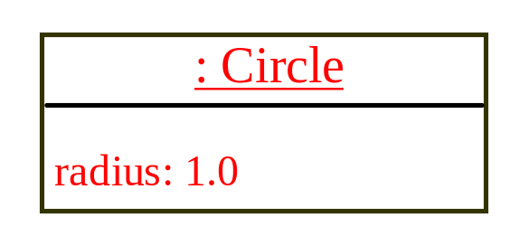
Trace Code, cont.
Circle myCircle = new Circle(5.0);
Circle yourCircle = new Circle();
yourCircle.radius = 100;
myCircle
reference value
yourCircle
no value
Create a new Circle object

Slide 26

Trace Code, cont.
Circle myCircle = new Circle(5.0);
Circle yourCircle = new Circle();
yourCircle.radius = 100;
myCircle
reference value
yourCircle
reference value
Assign object reference to yourCircle

Slide 27

Trace Code, cont.
Circle myCircle = new Circle(5.0);
Circle yourCircle = new Circle();
yourCircle.radius = 100;
myCircle
reference value
yourCircle
reference value
Change radius in yourCircle

Slide 28
Constructor example
  public class Point {
  int x;
  int y;
  // Constructs a Point at the given x/y location.
  public Point(int initialX, int initialY) {
  x = initialX;
  y = initialY;
  }
  public void translate(int dx, int dy) {
  x = x + dx;
  y = y + dy;
  }
  ...
  }

Slide 29
Tracing a constructor call
What happens when the following call is made?
  Point p1 = new Point(7, 2);
public Point(int initialX, int initialY) {
x = initialX;
y = initialY;
}
public void translate(int dx, int dy) {
x += dx;
y += dy;
}
p1
x |  | y

Slide 30
Reference Data Fields
The data fields can be of reference types. For example, the following Student class contains a data field name of the String type.
public class Student {
String name; // name has default value null
int age; // age has default value 0
boolean isScienceMajor; // isScienceMajor has default value false
char gender; // c has default value '\u0000'
}

Slide 31
The null Value
If a data field of a reference type does not reference any object, the data field holds a special literal value, null.

Slide 32
Default Value for a Data Field
The default value of a data field is null for a reference type, 0 for a numeric type, false for a boolean type, and '\u0000' for a char type.
However, Java assigns no default value to a local variable inside a method.
public class Test {
public static void main(String[] args) {
Student student = new Student();
System.out.println("name? " + student.name);
System.out.println("age? " + student.age);
System.out.println("isScienceMajor? " + student.isScienceMajor);
System.out.println("gender? " + student.gender);
}
}

Slide 33
Example
Java assigns no default value to a local variable inside a method.
public class Test {
public static void main(String[] args) {
int x; // x has no default value
String y; // y has no default value
System.out.println("x is " + x);
System.out.println("y is " + y);
}
}
Compile error: variable not initialized

Slide 34
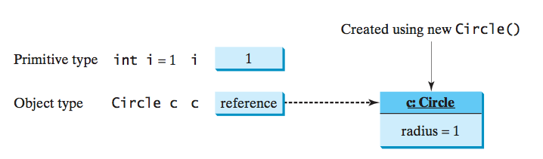
Differences between Variables of
Primitive Data Types and Object Types
Every variable represents a memory location that holds a value. When you declare a variable, you are telling the compiler what type of value the variable can hold.
For a variable of a primitive type, the value is of the primitive type. For a variable of a reference type, the value is a reference to where an object is located.

Slide 35
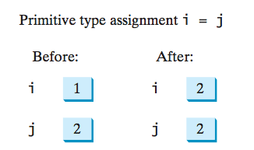
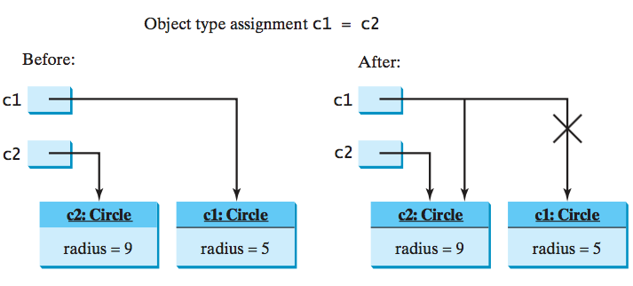
Copying Variables of Primitive Data Types and Object Types

Slide 36
Garbage Collection
As shown in the previous figure, after the assignment statement c1 = c2, c1 points to the same object referenced by c2.
The object previously referenced by c1 is no longer referenced.
This object is known as garbage. Garbage is automatically collected by JVM.

Slide 37
Garbage Collection, cont
TIP: If you know that an object is no longer needed, you can explicitly assign null to a reference variable for the object.
The JVM will automatically collect the space if the object is not referenced by any variable.

Slide 38
Common constructor bugs
1. Re-declaring fields as local variables ("shadowing"):
  public Point(int initialX, int initialY) {
  int x = initialX;
  int y = initialY;
  }
  This declares local variables with the same name as the fields, rather than storing values into the fields. The fields remain 0.
2. Accidentally giving the constructor a return type:
  public void Point(int initialX, int initialY) {
  x = initialX;
  y = initialY;
  }
  This is actually not a constructor, but a method named Point

Slide 39
Client code, version 3
public class PointMain3 {
public static void main(String[] args) {
// create two Point objects
Point p1 = new Point(5, 2);
Point p2 = new Point(4, 3);
// print each point
System.out.println("p1: (" + p1.x + ", " + p1.y + ")");
System.out.println("p2: (" + p2.x + ", " + p2.y + ")");
// move p2 and then print it again
p2.translate(2, 4);
System.out.println("p2: (" + p2.x + ", " + p2.y + ")");
}
}
OUTPUT:
p1: (5, 2)
p2: (4, 3)
p2: (6, 7)

Slide 40
Multiple constructors
A class can have multiple constructors.
  Each one must accept a unique set of parameters.
Exercise: Write a Point constructor with no parameters that initializes the point to (0, 0).
  // Constructs a new point at (0, 0).
  public Point() {
  x = 0;
  y = 0;
  }

Slide 41
Printing objects
By default, Java doesn't know how to print objects:
  Point p = new Point();
  p.x = 10;
  p.y = 7;
  System.out.println("p is " + p); // p is Point@9e8c34
  // better, but cumbersome; p is (10, 7)
  System.out.println("p is (" + p.x + ", " + p.y + ")");
  // desired behavior
  System.out.println("p is " + p); // p is (10, 7)

Slide 42
The toString method
tells Java how to convert an object into a String
  Point p1 = new Point(7, 2);
  System.out.println("p1: " + p1);
  // the above code is really calling the following:
  System.out.println("p1: " + p1.toString());
Every class has a toString, even if it isn't in your code.
  Default: class's name @ object's memory address (base 16)
  Point@9e8c34

Slide 43
toString syntax
  public String toString() {
  code that returns a String representing this object;
  }
  Method name, return, and parameters must match exactly.
  Example:
  // Returns a String representing this Point.
  public String toString() {
  return "(" + x + ", " + y + ")";
  }

