Slide 1
String
Ilayaraja N

Slide 2
What is String?
String is non-primitive data type and it is also class which is under java.lang.package.
String is a collection of characters.
String is immutable
Without new keyword we can create object .
It introduced in JDK1.1.

Slide 3
What is String literals?
“Java” string literal which is stored in String Constant Pool (SCP)
String s=“Java”;
SCP is part of Heap memory.
SCP

Slide 4
Why String is immutable?
Strings are constant, values can’t be changed after they are created.
Because java uses the concept of string literal.
Suppose, if one reference variable changes the value of the object, it will be affected to all the reference variables. That is why string objects are immutable in java.
So, String is immutable.

Slide 5
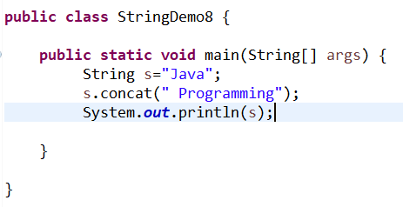

Example 1:
concat() method appends the string at the end so strings are immutable objects.

Slide 6
Heap Memory
String Constant Pool
Java
Java Programming

Slide 7
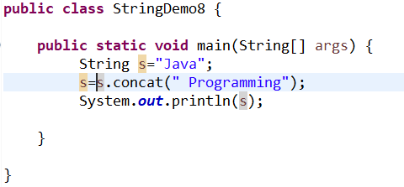

Example 2:
So, it assign it to the reference variable it prints Java Programming

Slide 8
Methods
charAt(), contains(), equals(), equalsIgnoreCase(), toUpperCase, toLowerCase
length(), compareTo, join(), isEmpty(), length(), replaceAll(), replaceFirst()
trim(), index(), lastIndexOf(), toString(),concat(), replace(), equals()
replace(), hashCode(), compareToIgnorCase()
split()
substring()

Slide 9
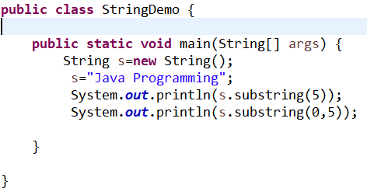

Example 3: subString()
Overloading
substring(int start/begin index)
substring(int startindex, int endindex)
Returns a new string that is a substring of this string.

Slide 10
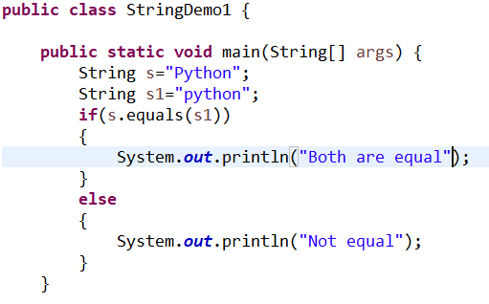

Example 4: equals()
Return type is boolean
The String equals() method overrides the equals() method of Object class.

Slide 11
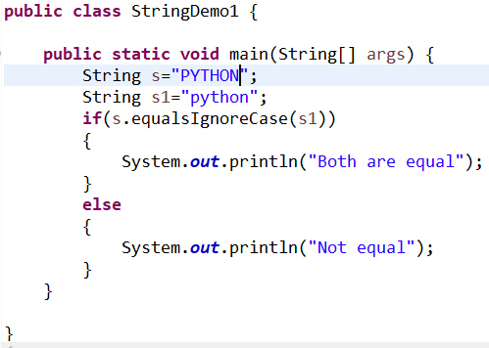

Example 5: equalsIgnoreCase()
Return type is boolean

Slide 12
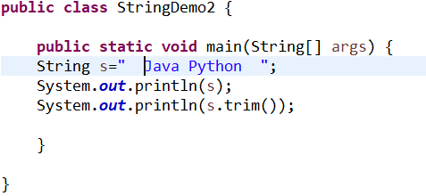

Example 6: trim()

Slide 13
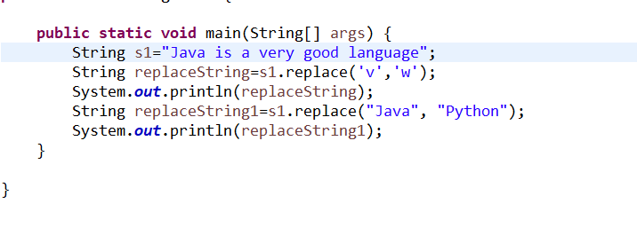

Example 7: replace()
Return type is char, charSequence
Replace methods introduced in JDK1.5

Slide 14
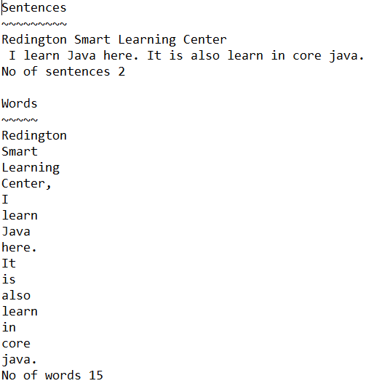
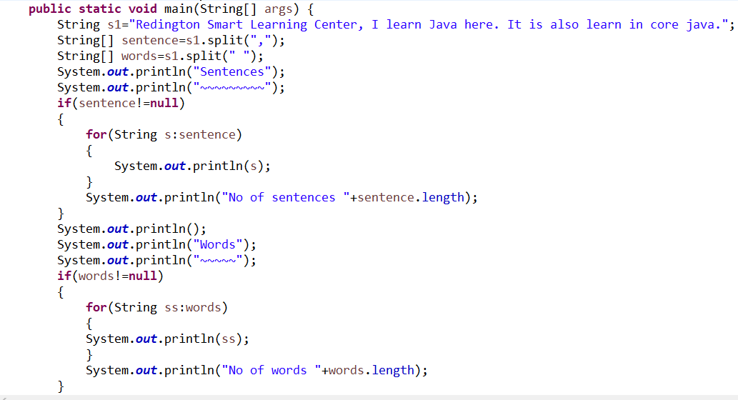
Example 8: split()
It returns array of strings computed by splitting this string around matches of the given regular expression.
It introduced in JDK 1.4.

Slide 15
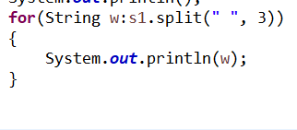

Example 9: split()
Overloading
It returns array of strings computed by splitting this string around matches of the given regular expression.
It introduced in JDK 1.4.

Slide 16
Example 10: concat()
It returns a string that represents the concatenation of this object's characters followed by the string argument's characters.

Slide 17
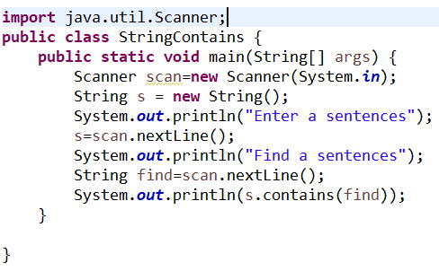
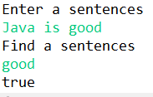
Example 11: contains()
Returns a boolean

Slide 18
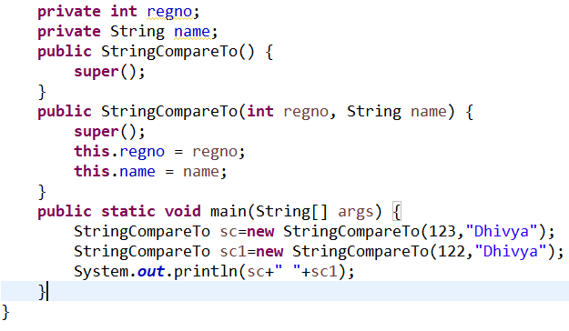
Example 12: toString()
Returns a hash code

Slide 19
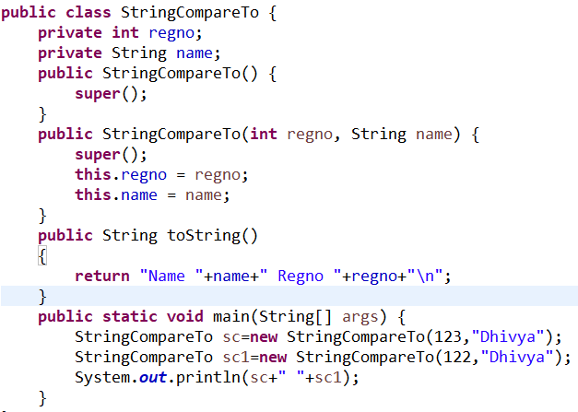

Example 12:
Using toString method to display a value

Slide 20
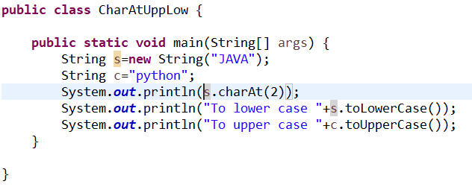

Example 13: toUpperCase(), toLowerCase(), chatAt()

Slide 21
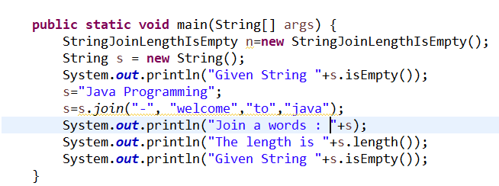
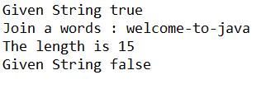
Example 14: length(), join(), isEmpty()

Slide 22
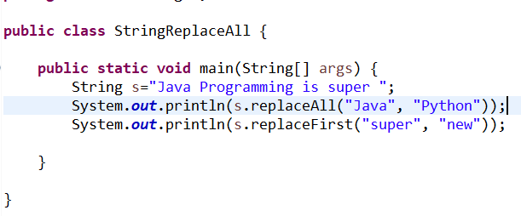

Example 15: replaceAll(), replaceFirst()

Slide 23
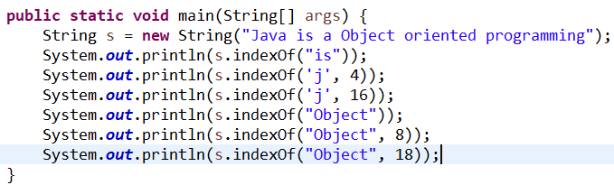

Example 16: index()
Overloading

Slide 24
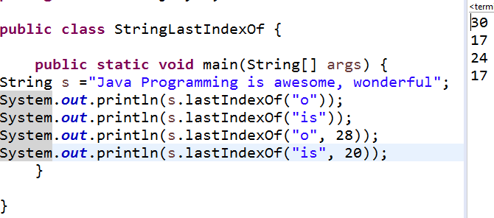
Example 17: lastIndexOf()
Overloading

Slide 25
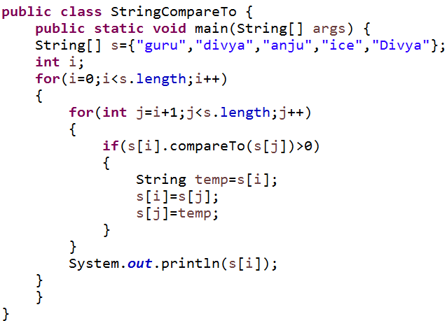

Example 18: compareTo()

Slide 26
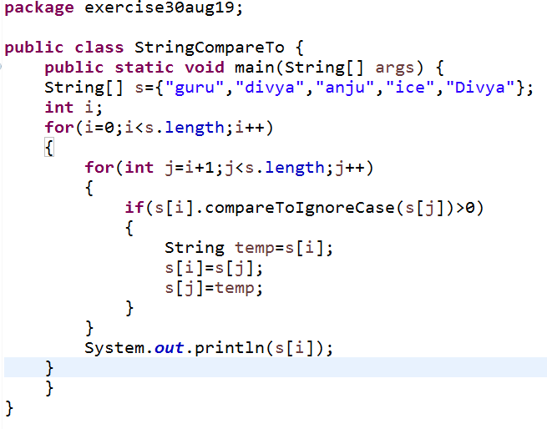

Example 19: compareToIgnoreCase()

Slide 27
Methods Name | Introduced Version | Description | Return Type | Parameter
charAt() | 1.0 | The char value at the specified index. An index ranges from 0 to length() – 1(length in interface CharSequence) | The char value at the specified index of this string. The first char value is at index 0. | index - the index of the char value.
IsEmpty() | 1.6 | If it is true, and only if, length() is 0. | True if length() is 0, otherwise false | No
concat() | 1.0 | Concatenates the specified string to the end of this string.If the length of the argument string is 0, then this String object is returned | A string that represents the concatenation of this object's characters followed by the string argument's characters. | The String that is concatenated to the end of this String.
compareTo() | 1.0 | The comparison is based on the Unicode value of each character in the strings. | The value 0 if the argument string is equal to this string | The String to be compared.

Slide 28
Methods Name | Introduced Version | Description | Return Type | Parameter
contains() | 1.5 | True if and only if this string contains the specified sequence of char values. | True if this string contains s, false otherwise | The sequence to search for.
trim() | 1.0 | a copy of the string, with leading and trailing whitespace omitted. | A copy of this string with leading and trailing white space removed, or this string if it has no leading or trailing white space. | No
equals IgnoreCase() | 1.0 | Compares this String to another String, ignoring case considerations | true if the argument is not null and it represents an equivalent String ignoring case; false otherwise. | The String to compare this String against
length() | 1.0 | The length of this string. The length is equal to the number of Unicode code units in the string. (charAt in interface CharSequence) | the length of the sequence of characters represented by this object. | No

Slide 29
Methods Name | Introduced Version | Description | Return Type | Parameter | Exception
replaceAll() | 1.4 | Replaces each substring of this string that matches the given regular expression with the given replacement. | The resulting String. | the sequence to search for | PatternSyntaxException
replaceFirst() | 1.4 | Replaces the first substring of this string that matches the given regular expression with the given replacement. | The resulting String. | the regular expression to which this string is to be matchedreplacement - the string to be substituted for the first match | IndexOutOfBoundsException -
compareTo IgnoreCase() | 1.2 | Compares two strings lexicographically, ignoring case differences. | The specified String is greater than, equal to, or less than this String, ignoring case considerations. | The String to be compared. | No

Slide 30
Methods Name | Introduced Version | Description | Return Type | Parameter | Exception
toUpperCase() | 1.0 | Converts all of the characters in this String to upper case using the rules of the default locale. | the String, converted to uppercase. | No | No
toLoweCase() | 1.0 | Converts all of the characters in this String to lower case using the rules of the default locale. | the String, converted to lowercase. | No | No
join() | 1.8 | A string joined with given delimiter. In string join method, delimiter is copied for each elements. | Joined string with delimiter. | delimiter : char value to be added with each element elements : char value to be attached with delimiter | NullPointerException

Slide 31
Methods Name | Introduced Version | Description(Overrides a class Object) | Return Type | Parameter
equals() | 1.0 | Compares this string to the specified object. The result is true if and only if the argument is not null and is a String object that represents the same sequence of characters as this object. | True if the given object represents a String equivalent to this string, false otherwise | The object to compare this String against
hashCode() | 1.0 | A hash code for this string. | A hash code value for this object. | No
toString() | 1.0 | The toString method for class Object returns a string consisting of the name of the class of which the object is an instance. This object (which is already a string!) is itself returned. | A string representation of the object. | No

Slide 32
Methods Name | Introduced Version | Description(Overloading) | Return Type | Parameter | Exception
substring() | 1.0 | Returns a new string that is a substring of this string. The substring begins with the character at the specified index and extends to the end of this string. | the specified substring. | beginIndex - the beginning index, inclusive. | IndexOutOfBoundsException -
substring() | 1.0 | Returns a new string that is a substring of this string. The substring begins at the specified beginIndex and extends to the character at index endIndex - 1. Thus the length of the substring is endIndex-beginIndex. | the specified substring. | beginIndex - the beginning index, inclusive. endIndex - the ending index, exclusive. | IndexOutOfBoundsException -

Slide 33
Methods Name | Introduced Version | Description(Overloading) | Return Type | Parameter | Exception
replace() | 1.0 | Returns a new string resulting from replacing all occurrences of oldChar in this string with newChar. | A string derived from this string by replacing every occurrence of oldChar with newChar. | oldChar - the old character.newChar - the new character. | No
replace() | 1.5 | Replaces each substring of this string that matches the literal target sequence with the specified literal replacement sequence. | The resulting String. | target - The sequence of char values to be replacedreplacement - The replacement sequence of char values | NullPointerException

Slide 34
Methods Name | Introduced Version | Description(Overloading) | Return Type | Parameter | Exception
split() | 1.4 | Splits this string around matches of the given regular expression | The array of strings computed by splitting this string around matches of the given regular expression | The delimiting regular expression. | PatternSyntaxException
split() | 1.4 | Splits this string around matches of the given regular expression. | the array of strings computed by splitting this string around matches of the given regular expression. | regex - the delimiting regular expressionlimit - the result threshold, as described above | PatternSyntaxException -

Slide 35
Methods Name | Introduced Version | Description(Overloading) | Return Type | Parameter | Exception
index() | 1.0 | The index within this string of the first occurrence of the specified character. | the index of the first occurrence of the character in the character sequence represented by this object | a character (Unicode code point). | No
index() | 1.0 | “ | “ | fromIndex - the index to start the search from. | No
index() | 1.0 | “ | The index of the first occurrence of the specified substring | the substring to search for. | No
index() | 1.0 | “ | “ | fromIndex - the index from which to start the search. | No

Slide 36
Methods Name | Introduced Version | Description(Overloading) | Return Type | Parameter | Exception
lastIndex() | 1.0 | The index within this string of the last occurrence of the specified character. | the index of the last occurrence of the character in the character sequence represented by this object | a character (Unicode code point). | No
lastIndex() | 1.0 | “ | “ | fromIndex - the index to start the search from. | No
lastIndex() | 1.0 | “ | The index of the first occurrence of the specified substring | the substring to search for. | No
lastIndex() | 1.0 | “ | “ | fromIndex - the index from which to start the search. | No

Slide 37
What is String Buffer?
StringBuffer is mutable String.
Java StringBuffer class is (synchronized )thread-safe i.e. multiple threads cannot access it simultaneously.
So it is safe and will result in an order.

Slide 38
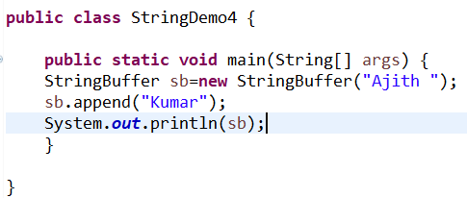

Why String Buffer is mutable?
Overloading
append() it return many data types

Slide 39
Methods
append(), replace(), setCharAt()
insert()
delete()
reverse()
length()
charAt()
deleteChatAt()
setLength()

Slide 40
Methods Name | Introduced Version | Description | Return Type | Parameter | Exception
delete() | 1.2 | Removes the characters in a substring of this sequence. | This object. | start - The beginning index, inclusive.end - The ending index, exclusive. | StringIndexOutOfBoundsException
deleteCharAt() | 1.2 | Removes the char at the specified position in this sequence. This sequence is shortened by one char. | “ | Index of char to remove | “
replace() | 1.2 | Replaces the characters in a substring of this sequence with characters in the specified String. | “ | start - The beginning index, inclusive.end - The ending index, exclusive.str - String that will replace previous contents. | “

Slide 41
Methods Name | Introduced Version | Description | Return Type | Parameter | Exception
reverse() | 1.0.2 | Causes this character sequence to be replaced by the reverse of the sequence | A reference to this object. | No | No
setLength() | 1.0 | Sets the length of the character sequence. The sequence is changed to a new character sequence whose length is specified by the argument | No | The new length | IndexOutOfBoundsException
charAt() | 1.0 | Returns the char value in this sequence at the specified index. | the char value at the specified index | index - the index of the desired char value. | IndexOutOfBoundsException
setCharAt() | 1.0 | The character at the specified index is set. | No | index - the index of the character to modify.ch - the new character. | IndexOutOfBoundsException

Slide 42
Methods Name | Introduced Version | Description(Overloading) | Return Type | Parameter | Exception
append() | 1.0 | Appends the specified string to this character sequence. | A reference to this object. | A string. | No
insert() | 1.0 | Inserts the string into this character sequence | A reference to this object. | offset - the offset.str - a string. | StringIndexOutOfBoundsException
Append() and insert() methods has many types in StringBuffer.

Slide 43
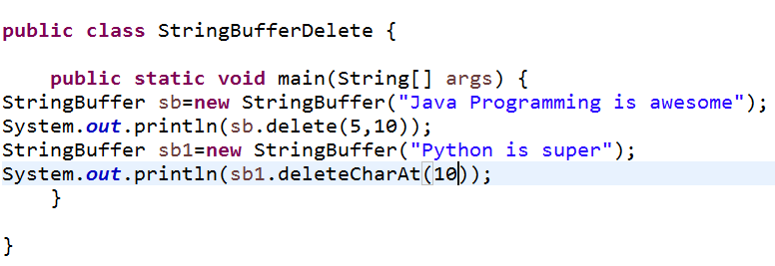

Example 1: delete(), deleteCharAt()

Slide 44
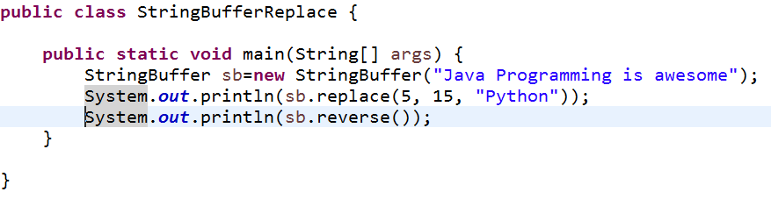

Example 2: reverse(), replace()

Slide 45
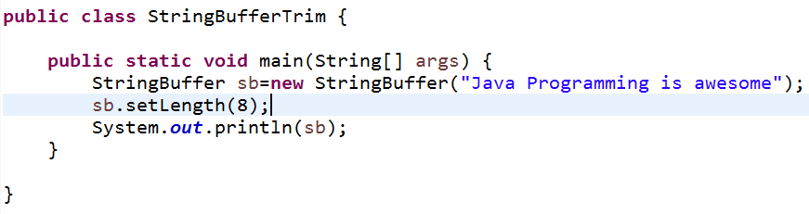

Example 3: setLength()

Slide 46
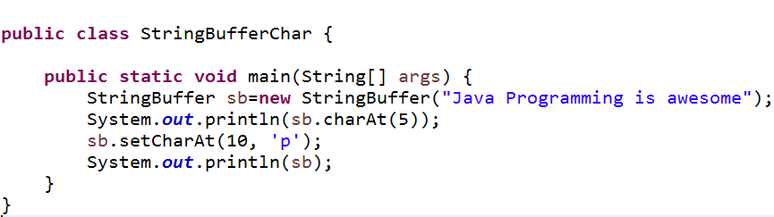

Example 4:charAt(), setCharAt()

Slide 47
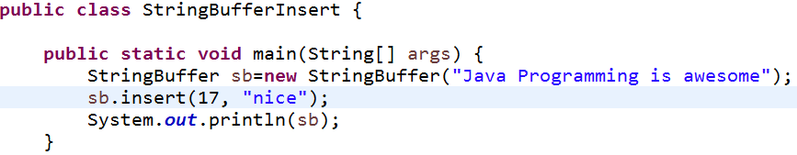

Example 5: insert()
Overloading

Slide 48
What is String Builder?
StringBuilder is mutable String.
The Java StringBuilder class is same as StringBuffer class except that it is non-synchronized (not thread-safe).
It is available since JDK 1.5.

Slide 49
Methods
append(), replace(), subsequence(), substring(), charAt() , trimToSize()
insert() delete(), capacity(), ensureCapacity(), reverse(), length()
StringBuffer methods is similar to StringBuilder

Slide 50
Methods Name | Introduced Version | Description(Overloading) | Return Type | Parameter | Exception
subsequence() | 1.5 | the new character sequence from given start index to exclusive end index value of this sequence. | The subSequence(int start, int end) method returns the specified subsequence. | The start and end index of a subsequence. | IndexOutOfBoundsException
trimToSize() | 1.5 | To reduce the storage used for the character sequence. | No | No | No
reverse() | 1.5 | Causes this character sequence to be replaced by the reverse of the sequence | A reference to this object. | No | No

Slide 51
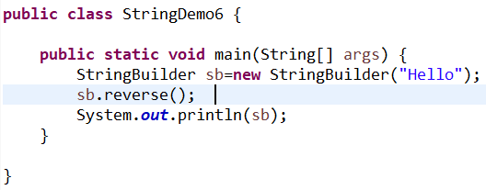
Example 1:reverse()
Overrides in a String Buffer

Slide 52
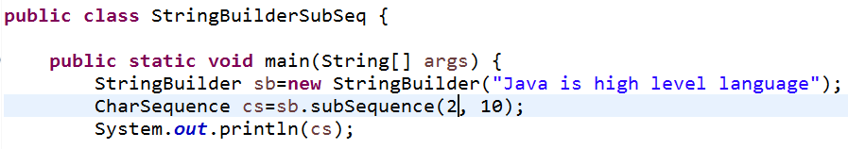

Example 2: subsequence()

Slide 53
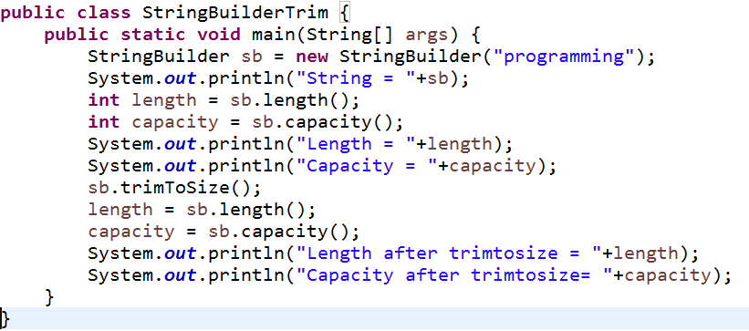
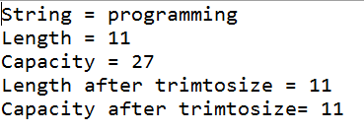
Example 3: trimToSize()

Slide 54
Difference
String | String Buffer
It is immutable | It is mutable.
String is slow and consumes more memory | String is fast and consumes less memory
When you concat too many strings because every time it creates new instance. | When you cancat strings.
1.0 | 1.0
Java.lang.package | Java.lang.pakage

Slide 55
Difference
StringBuffer | String Builder
It is mutable | It is mutable.
It is synchronized i.e. thread safe. | It is non-synchronized i.e. not thread safe.
It means two threads can't call the methods of StringBuffer simultaneously. | It means two threads can call the methods of StringBuilder simultaneously.
1.0 | 1.5
It is less efficient. | It is more efficient.

