Slide 1
Students of 2nd Semester MCA, Welcome to the course ARTIFICIAL INTELLIGENCE (23MXAG)
‹#›

Slide 2
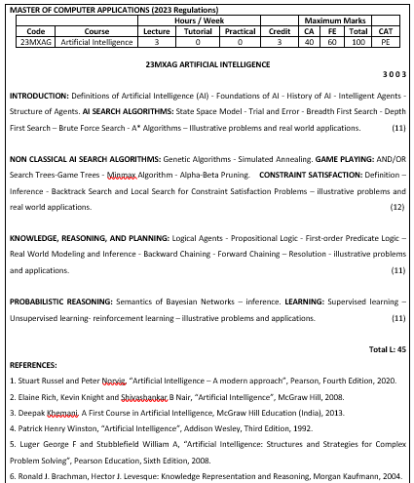
‹#›

Slide 3
Agenda
Introduction
Motivation
Definitions
History of AI
Questions
‹#›

Slide 4
INTRODUCTION
Notes:
‹#›

Slide 5
Introduction
Artificial Intelligence (AI)
is a form of intelligence; a type of technology and a field of study
covers a broad range of domains and applications
is expected to impact every field in the future
is a branch of Computer Science that pursues creating the computers or machines as intelligent as human beings
is the science and engineering of making intelligent machines, especially intelligent computer programs
overall, its core idea is building machines and algorithms - capable of performing computational tasks that would otherwise require human like brain functions
‹#›

Slide 6
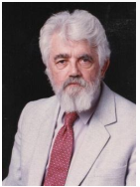
Introduction (contd…)
Al is concerned with the design of intelligence in an artificial device
The term was coined by John McCarthy in 1956
AI is the study of the mental faculties / processes through the use of computational models
AI is unique, sharing borders with Mathematics, Computer Science, Philosophy, Psychology, Biology, Cognitive Science and many others
Although there is no clear definition of AI or even Intelligence, it can be described as an attempt to build machines, that, like humans can think and act, able to learn and use knowledge to solve problems on their own
‹#›

Slide 7
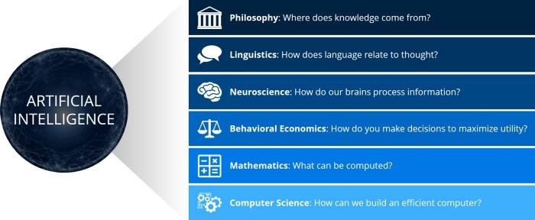
Motivation
“Any fool can know. The point is to understand.” — Albert Einstein
AI - intersection of many classic disciplines - including philosophy, neuroscience, behavioral economics, computer science, and mechanical engineering
This interdisciplinary rooted nature of AI has captured our imagination, especially for people of all interests and backgrounds
‹#›

Slide 8
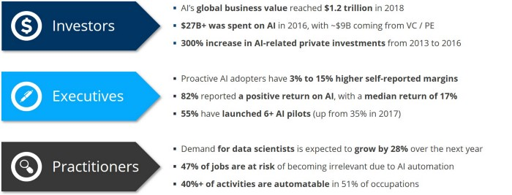
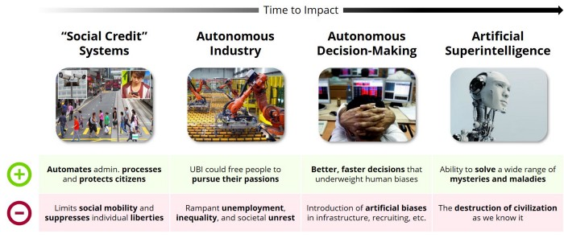
Motivation (contd…)
Business Implications
Societal Implications
‹#›

Slide 9
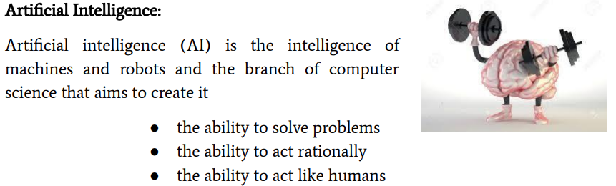
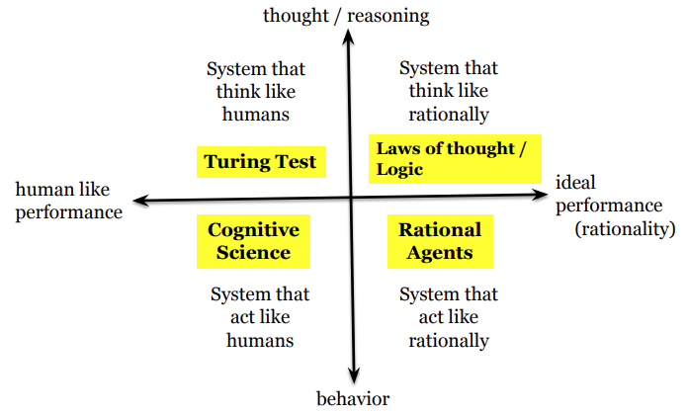
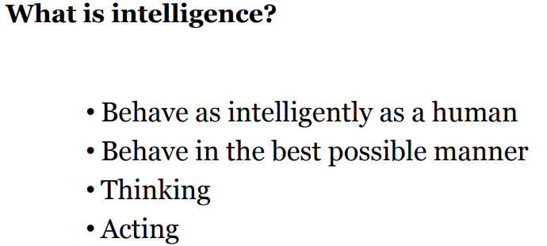
What is Artificial Intelligence (AI) ?
‹#›

Slide 10
Definitions of AI
Definition: Artificial Intelligence is the study of how to make computers do things, which, at the moment, people do better.
“The science and engineering of making intelligent machines, especially intelligent computer programs”. (Father of Artificial Intelligence, John McCarthy)
“AI is the part of computer science concerned with designing intelligent computer systems, that is, systems that exhibit the characteristics one associate with intelligence in human behavior—understanding language, learning, reasoning, solving problems, and so on”. (Avron Barr and Feigenbaum, 1981)
“Artificial intelligence (AI) may be defined as the branch of computer science that is concerned with the automation of intelligent behavior”. (Luger and Stubblefield , 1993)
‹#›

Slide 11
Definitions of AI (contd…)
Stanford Professor and deeplearning.ai CEO’s Andrew Ng is optimistic about the role that AI will play in society:
“AI is the new electricity. Just as 100 years ago electricity transformed industry after industry, AI will now do the same.”
Tesla and OpenAI CEO Elon Musk argues for a much more conservative approach to AI development:
“If I were to guess what our biggest existential threat is, it’s probably [AI]… With artificial intelligence, we are summoning the demon.”
‹#›

Slide 12
Definitions of AI (contd…)
Views of AI – fall into 4 categories:
Systems that think like humans ``The exciting new effort to make computers think ... machines with minds, in the full and literal sense'' (Haugeland, 1985) ``The automation of activities that we associate with human thinking, activities such as decision-making, problem solving, learning ...'' (Bellman, 1978) | Systems that think rationally ``The study of mental faculties through the use of computational models'' (Charniak and McDermott, 1985) ``The study of the computations that make it possible to perceive, reason, and act'' (Winston, 1992)
Systems that act like humans ``The art of creating machines that perform functions that require intelligence when performed by people'' (Kurzweil, 1990) ``The study of how to make computers do things at which, at the moment, people are better'' (Elaine Rich and Kevin Knight, 1991) | Systems that act rationally ``A field of study that seeks to explain and emulate intelligent behavior in terms of computational processes'' (Schalkoff, 1990) ``The branch of computer science that is concerned with the automation of intelligent behavior'' (Luger and Stubblefield, 1993)
‹#›

Slide 13
Definitions of AI (contd…)
Cognitive Science: Think Human-Like
Requires a model for human cognition (mental processes involving learning / comprehension / knowledge)
Precise enough models allow simulation by computers
Laws of thought: Think Rationally
The study of mental faculties through the use of computational models
Focus is on inference mechanisms – using reasoning / logic
Turing Test: Act Humanly
The art of creating machines that perform functions requiring intelligence when performed by people – Turing Test
Laws of thought: Act Rationally
Tries to explain and emulate intelligent behavior in terms of computational process - automation of intelligence
‹#›

Slide 14
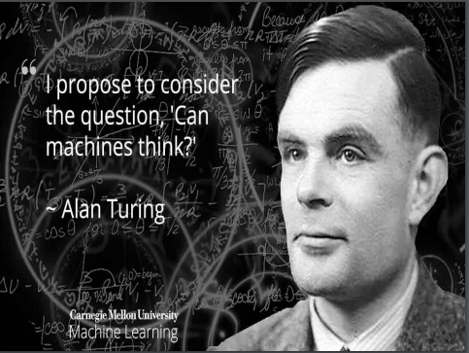
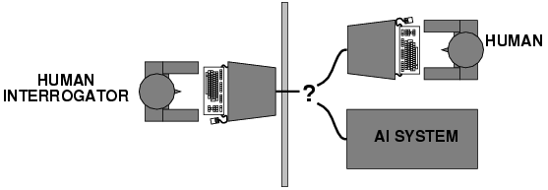
Definitions of AI (contd…)
Turing Test
Turing (1950) "Computing machinery and intelligence":
"Can machines think?" 🡪 "Can machines behave intelligently?"
Operational test for intelligent behavior: the Imitation Game
3 rooms contain: a person, a computer and an interrogator
Interrogator communicates with the other 2 by teletype - to determine which the person is and which the machine is
Machine tries to fool the interrogator to believe that it is the human, and the person also tries to convince the interrogator that it is the human
If the machine succeeds in fooling the interrogator, the machine is intelligent
‹#›
Notes:
‹#›

Slide 15
AI - Perspectives
From the perspective of intelligence, artificial intelligence is making machines "intelligent" - acting as we would expect people to act
Artificial Intelligence - viewed from a variety of perspectives
From a business perspective, AI is a set of very powerful tools, and methodologies for using those tools to solve business problems
From a programming perspective, AI includes the study of symbolic programming, problem solving, and search
‹#›

Slide 16
AI - Views
AI technologies - categorised by their capacity to mimic human characteristics, the technology they use to do this and their real-world applications
Strong AI
“AI is the embodiment of human intellectual capabilities within a computer”
Middle of the road approach
“AI is a set of computer programs that produce output that would be considered to reflect intelligence if it were generated by humans”
Weak AI
“AI is the study of mental faculties through the use of mental models implemented on a computer”
‹#›
Notes:
‹#›

Slide 17
AI - Purpose
AI can have two purposes:
One is to use the power of computers to augment human thinking, just as we use motors to augment human or horse power.
Robotics and expert systems are major branches of that.
The other is to use a computer's artificial intelligence to understand how humans think, in a humanoid way.
“If you test your programs not merely by what they can accomplish, but how they accomplish it, then you're really doing cognitive science; you're using AI to understand the human mind."
- Herb Simon
‹#›

Slide 18
History of AI
1937 Alan Turing published a paper on Turing Machines, which included
mathematical logic
1943 McCulloch & Pitts: Boolean circuit model of brain; they published a
paper, which was a forerunner of Neural Networks
(Artificial Neuron)
1946 “Von Neumann machine” – the digital computer was invented
1948 Turing wrote a paper “Intelligent Machines” (which was a paradox)
1949 Father of Information Theory “Claude Shannon” – discussed on
how a machine can play chess; his invention was called
‘entropy function’ – used by electrical engineers(even decision
tree algorithms use a function called ‘entropy’)
‹#›

Slide 19
History of AI (contd…)
1950 Turing's "Computing Machinery and Intelligence“; a paper entitled
“Can machines think?” –by Alan Turing
1950s Early AI programs, including Samuel's checkers program, Newell &
Simon's Logic Theorist, Gelernter's Geometry Engine
1956 - Dartmouth meeting: John McCarthy believed to have coined the
term “Artificial Intelligence”
- Newell & Simon – the first AI program “The Logic Theory Machine”
- Whitehead &Russell – “Principia Mathematica” – an ancient
problem solving book
- Herbert Simon – a child prodigy – won Noble Prize in Economics
- Rosenblatt – came up with the earliest Neural Network Model
(Perceptron)
‹#›

Slide 20
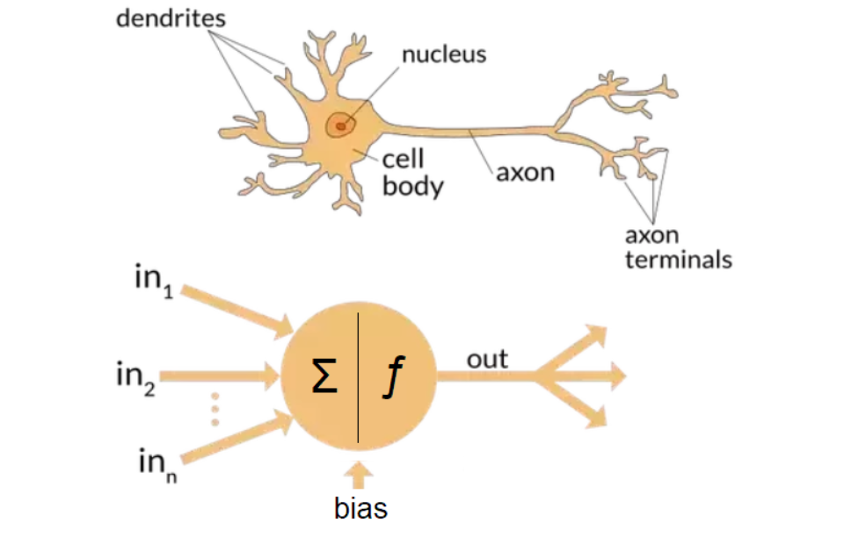
History of AI (contd…)
A biological and an artificial neuron
‹#›

Slide 21
History of AI (contd…)
1965 Robinson's complete algorithm for logical reasoning
1966—73 AI discovers computational complexity Neural network research almost disappears
1969—79 Early development of knowledge-based systems
1980-- AI becomes an industry
1986-- Neural networks return to popularity
1987-- AI becomes a science
1995-- The emergence of intelligent agents
‹#›

Slide 22
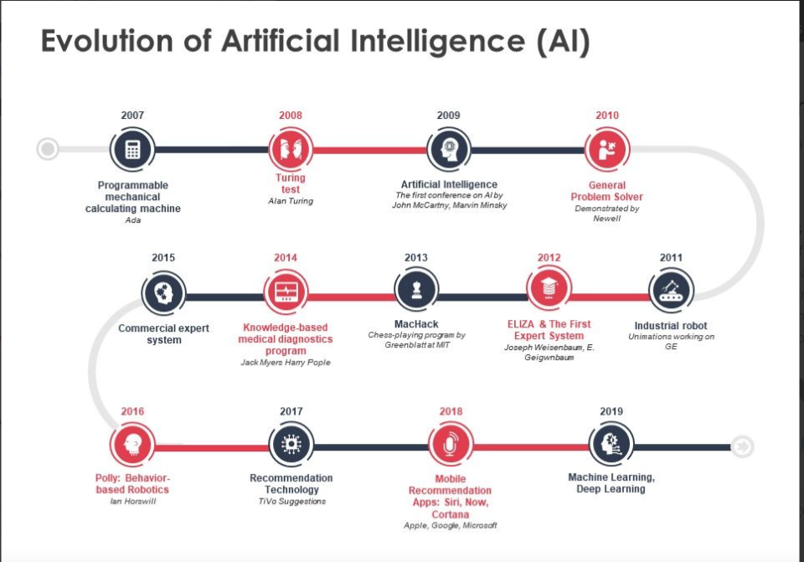
‹#›

Slide 23
Domains related to AI
Philosophy Logic, methods of reasoning, mind as physical system, foundations of learning, language, rationality.
Mathematics Formal representation and proof, algorithms, computation, (un)decidability, (in)tractability, probability.
Economics utility, decision theory
Neuroscience neurons as information processing units.
Psychology how do people behave, perceive, process Cognitive Science
information, represent knowledge.
Computer building fast computers engineering
Control theory design systems that maximize an objective function over time
Linguistics knowledge representation, grammar
‹#›

Slide 24
Questions?
When did the first notion of AI evolve?
Any standard definition of AI?
What is ‘rational’?
What is a turing machine?
How does a neuron work?
“AI Winter”?
https://www.youtube.com/watch?v=mrwc4wpiqsY
‹#›
Notes:
‹#›

