Slide 1
INTELLIGENT AGENTS

Slide 2
Agenda
Introduction
Agents
Terminology
Structure of agents
Questions

Slide 3
INTRODUCTION

Slide 4
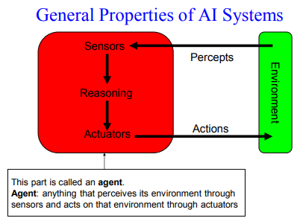
Introduction

Slide 5
Agents
Agent - anything that can be viewed as perceiving its environment through receptors / sensors and acting upon that environment through actuators / effectors (Russell & Norvig)
Examples
Human agent
  – Receptors: Eyes, ears, and other sensors
  – Actuators: Hands, legs, mouth, and other body parts
Robotic agent
  – Receptors: Cameras and infrared range finders
  – Actuators: Various motors
Software agent
  – Receptors: keystrokes, file contents
  – Actuators: Programs to process these inputs and display the outputs

Slide 6
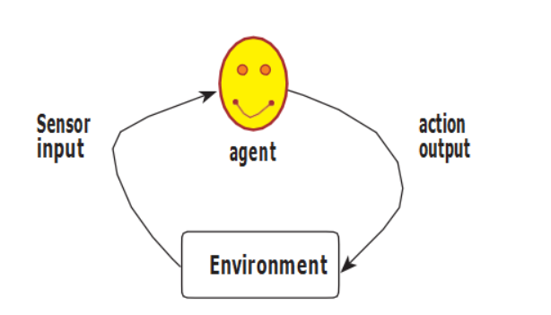
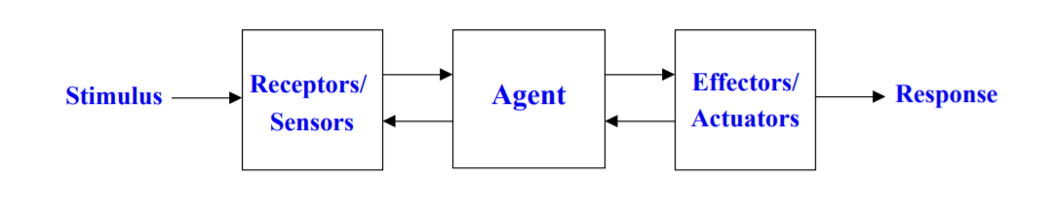
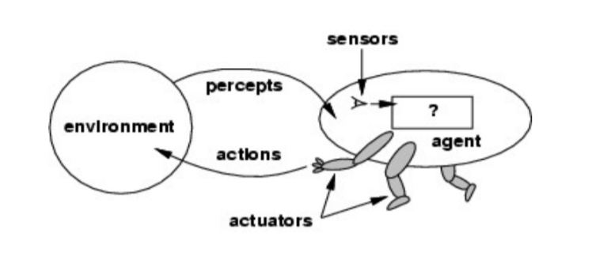
Agents and Environments
A basic agent
Agent interaction - of exactly the same form as that of the interaction of the human nervous system with its environment
Agents interact with environments through receptors / sensors and effectors / actuators

Slide 7
Terminologies
Percept: the agent’s perceptual inputs
Percept sequence: the complete history of everything the agent has perceived
Agent function maps any given percept sequence (percept histories) to an action [f: p* A]
Agent program runs on the physical architecture to produce the agent function, f
  – Agent function: Mathematical abstraction
  – Agent program: Concrete implementation
Agent = Architecture + Program

Slide 8
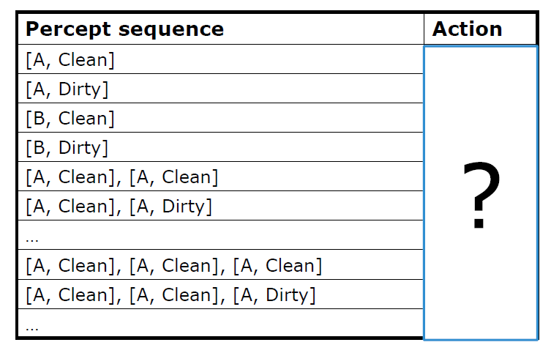
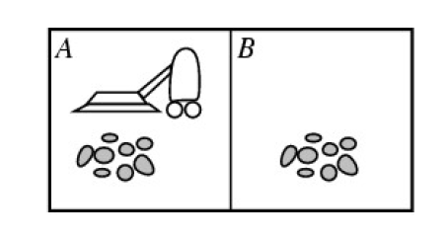
Terminologies (contd…)
Example: Vacuum-Cleaner
Percepts: location and contents, e.g., [A, dirty]
Actions: Left, Right, Suck, NoOp

Slide 9
Rationality
An agent should "do the right thing", based on what it can perceive and the actions it can perform
Performance measure – an objective criterion for an agent’s success
Back to the vacuum-cleaner example
  Amount of dirt cleaned within certain time
  +1 credit for each clean square per unit time
General rule: measure what one wants rather than how one thinks the agent should behave
Rationality is relative to a performance measure. For an agent, judge rationality based on:
– Performance measure
– Environmental knowledge
– Possible actions
– Sensors and accuracy

Slide 10
Rational Agent
Rational Agent - one that acts in a manner that causes it to be as successful as it can
What is rational?
At any given time, being rational depends on four things:
Performance measure that defines degree of success (to be carefully chosen, since many conflicting criteria need to be taken into account)
Everything that the agent has perceived so far - this complete perceptual history is called the percept sequence
What the agent knows about the environment
The actions that the agent can perform

Slide 11
Rational Agent (contd…)
For each possible percept sequence, a rational agent should select an action that is expected to maximize its performance measure, given the evidence provided by the percept sequence and whatever built-in knowledge the agent has.
Example - Vacuum–Cleaner
A simple agent that cleans a square if it is dirty; moves to the other square if not
Is it rational?
Assumptions
  performance measure: 1 point for each clean square at each time step
  environment is known a priori
  actions = {left, right, suck, no-op}
  agent is able to perceive the location and dirt in that location
Given different assumptions, the agent might not be rational anymore

Slide 12
Rationality Vs Omniscience
Difference between the two:
  expected performance vs. actual performance
Agents - can perform actions - to modify future percepts - to obtain useful information (information gathering, exploration)
An agent can also learn from what it perceives
An agent is autonomous if its behavior is determined by its own experience (with ability to learn and adapt)
Rational exploration, learning, autonomy

Slide 13
Agents as Mappings
An agent’s behavior - depends on its percept sequence
Agents – described - by making a table of the action it takes in response to each possible percept sequence
Such a list is called - MAPPING (from percept sequences to actions)
IDEAL MAPPINGS - find out which mapping correctly describes an agent – and hence describe ideal agents
Specifying which action an agent ought to take in response to any given percept sequence provides a design for an ideal agent.

Slide 14
Ideal Rational Agent
Being rational - depends on
    whatever the agent has perceived in the past
    what the agent knows about its environment
    what actions it is able to perform
Ideal rational agent - takes whatever action is expected to maximise its performance measure, on the basis of the evidence provided by its perceptual history and whatever built-in knowledge it has (Artificial Intelligence: A Modern Approach by Stuart Russell and Peter Novig)

Slide 15
Autonomous Agent
Agent lacks autonomy – if its actions are based only on its built-in knowledge, and not on its own experience with its environment
Autonomous agent will supplement its built-in knowledge with its own acquired (or learned) knowledge in order to act appropriately
Building systems/agents that have enough knowledge to get them started, and then leave them to learn the rest - is often a good AI strategy

Slide 16
Structure of Intelligent Agents
Agents - comprised of an architecture (e.g. a computer) plus a program that runs on that architecture
Agent Program - a function - implementing agent mapping from percepts to actions
Architecture:
  computing device on which this program will run
  makes the percepts from the sensors available to the program, runs the program, and feeds the program’s action choices to the effectors as they are generated
Relationship among agents, architectures, and programs - summed up as follows:
Agent = Architecture + Program

Slide 17
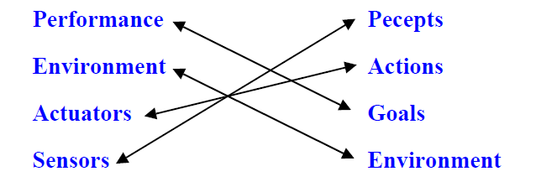
Structure of Intelligent Agents (contd…)
Specifying the task environment - always the first step in designing agents
In designing intelligent systems - 4 main factors to consider:
  P Percepts – the inputs to our system
  A Actions – the outputs of our system
  G Goals – what the agent is expected to achieve
  E Environment – what the agent is interacting with
PAGE Descriptors are not the unique way of describing intelligent systems
One popular alternative involves PEAS Descriptors:

Slide 18
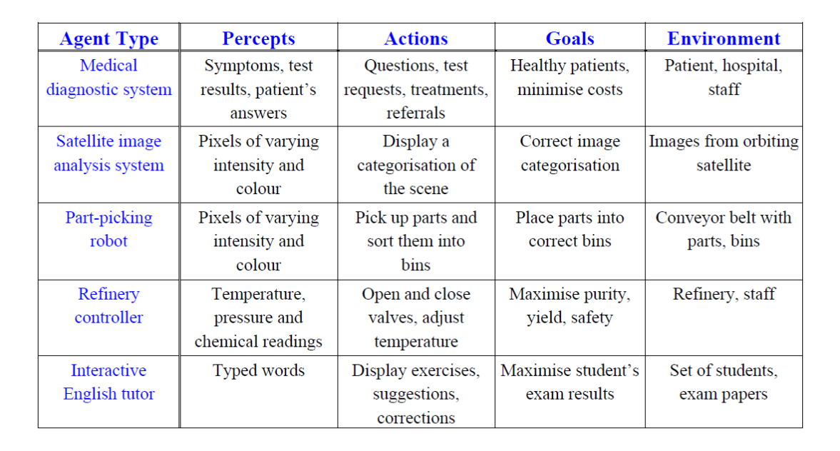
Examples of Intelligent Agents
“
Intelligent agents continuously perform three functions:
perception
of dynamic conditions in the environment;
action
to affect conditionsin the environment; and
reasoning
to interpret perceptions, solve problems, draw inferences, and determine actions.
”
3/15/20232

Slide 19
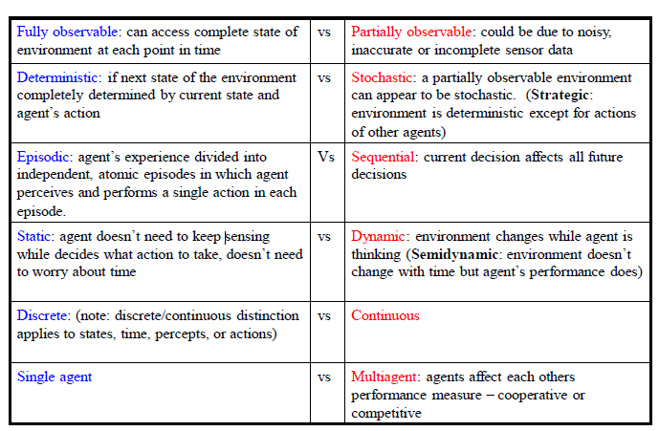
Different types of Task Environments
Following are the dimensions along which the properties of an agent’s environment can be categorized:

Slide 20
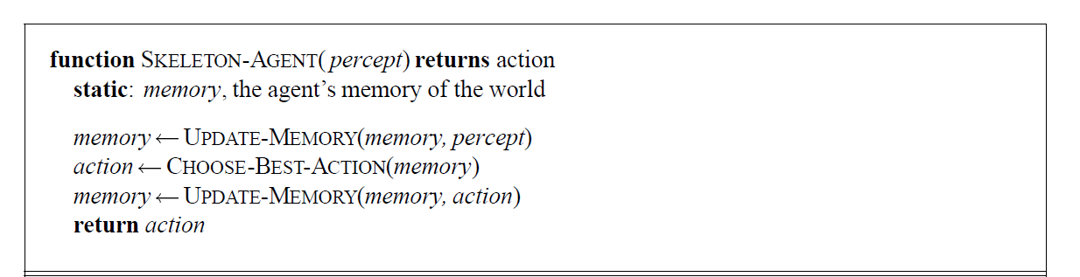
Building Intelligent Agents
Have a skeleton - accepting percepts and generating actions
Two things to note about this skeleton program:
  1) Though the agent mapping is defined as a function from percept sequences to actions, the agent program receives only a single percept as its input.
  2) The goal or performance measure is not part of the skeleton program – and is applied externally to judge the behavior of the agent
A skeleton agent is shown below:

Slide 21
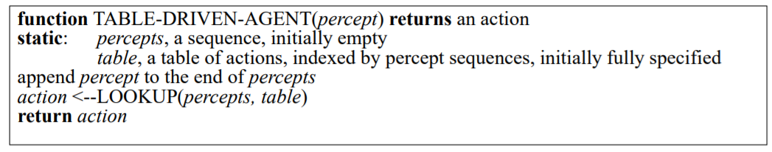
Table Lookup Agent
A trivial agent program - keeps track of the percept sequence and then uses it to index into a table of actions to decide what to do
The designers must construct the table that contains the appropriate action for every possible percept sequence
Drawbacks
Huge table (P^T , P: set of possible percepts, T: lifetime)
Space to store the table
Take a long time to build the table
No autonomy
Even with learning, need a long time to learn the table entries

Slide 22
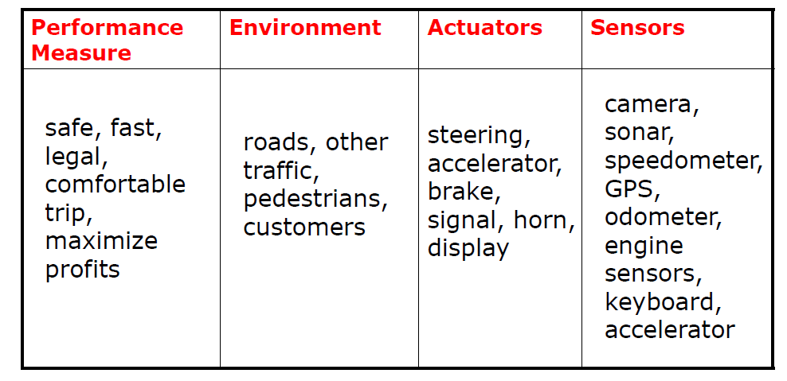
Designing Agent - Examples
Job of designing an automated taxi driver

Slide 23
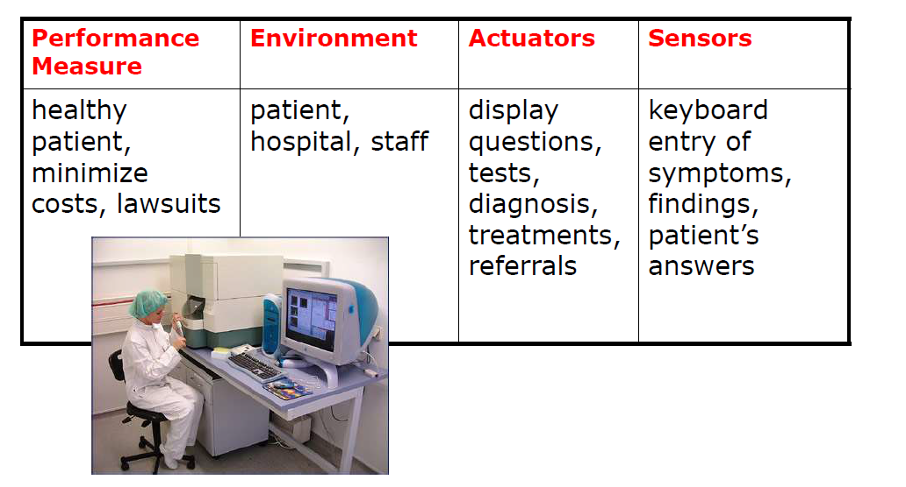
Designing Agent – Examples (contd…)
Medical Diagnosis System

Slide 24
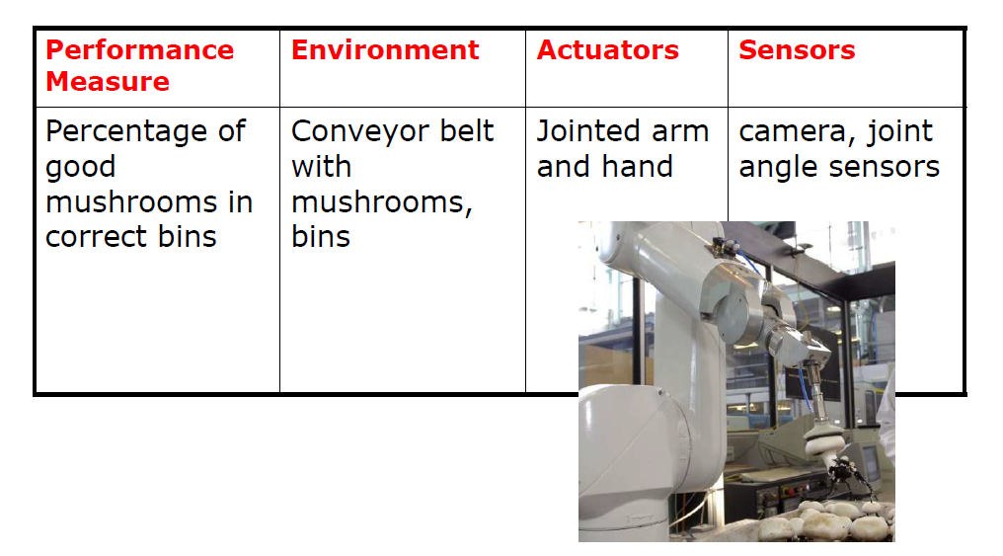
Designing Agent – Examples (contd…)
Mushroom Picking Robot

Slide 25
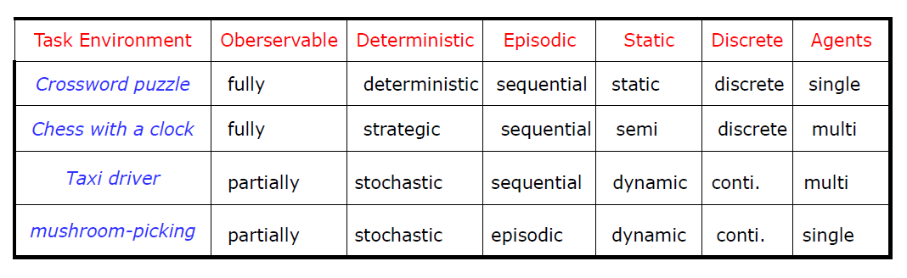
Agent - Environment
Environment type - largely determines the agent design
Real world - is (of course) partially observable, stochastic,
sequential, dynamic, continuous, multi-agent

Slide 26
Agent Program and Function
Agent program
Takes the current percept as input from the sensors
Return an action to the actuators
Agent function
Takes the whole percept history, while agent program takes just the current percept as input which the only available input from the environment

Slide 27
Agent - Types
Real program –implements mapping from percepts to action
Rather than a table, how to produce rational behavior from a small amount of code
Different aspects of driving - suggest different types of agents
Arranged in order of increasing generality:
  Simple reflex agents
  Model-based reflex agents
  Goal-based agents
  Utility-based agents
  Learning agents

Slide 28
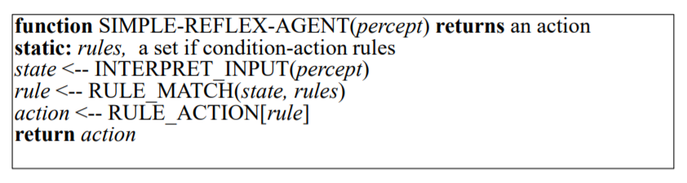
Simple Reflex Agents
Select actions on the basis of the current percept ignoring the rest of the percept history
Works on Condition-action-rule
Example: if car-in-front-is-breaking then initiate-breaking

Slide 29
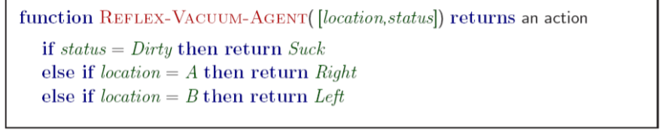
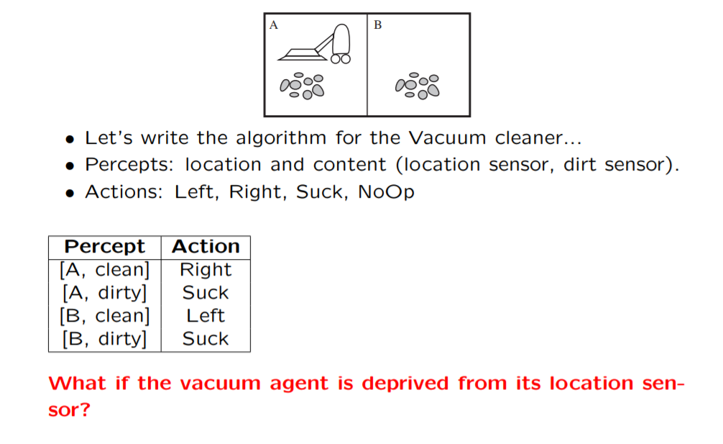
Simple Reflex Agents (contd…)
Example: simple reflex vacuum cleaner agent

Slide 30
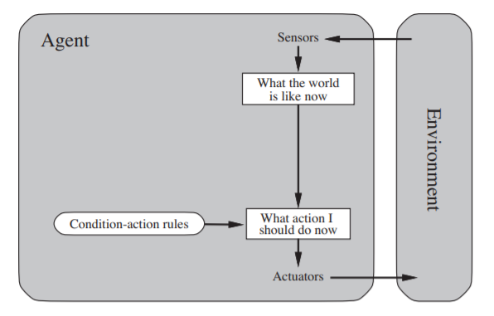
Simple Reflex Agents (contd…)
Drawbacks
They have very limited intelligence
They do not know non-perceptual parts of the present state
Mostly too big to get and to store
Not adaptive to changes within the environment

Slide 31
Model Based Reflex Agents
Handle partial observability by keeping track of the part of the world it can’t see now (partially observable environment)
Maintain internal state, depending on the percept history (best guess)
Reflect at least some of the unobserved aspects of the current state
Updating the internal state information (Model of the world ) - based on
(1) how the world evolves independently of the agent, and
(2) how the agent’s own actions affect the world

Slide 32
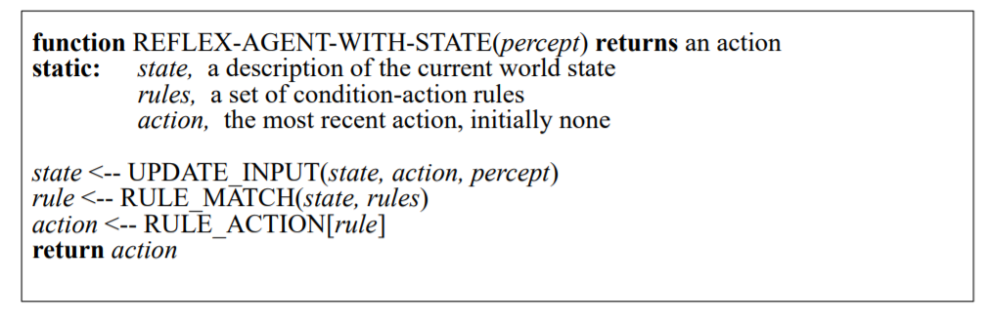
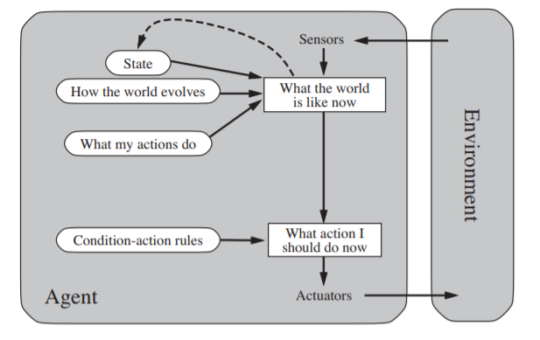
Model Based Reflex Agents (contd…)

Slide 33
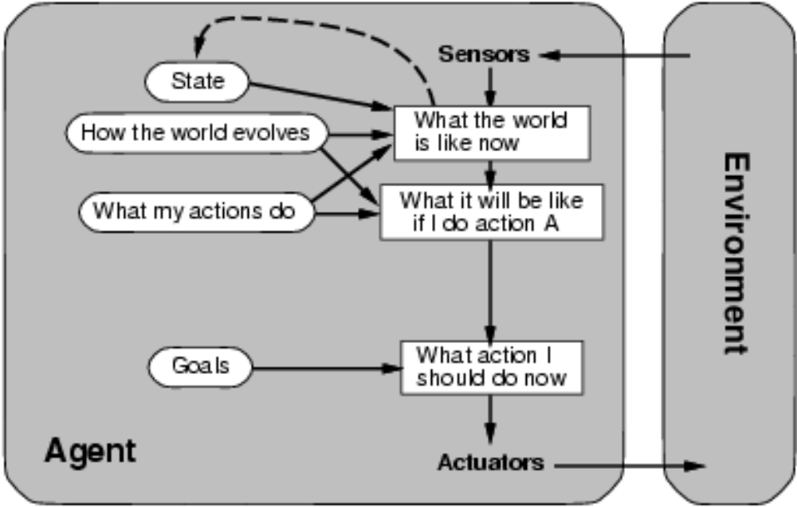
Goal Based Reflex Agents
Knowing about the current state of the environment - not always enough to decide what to do (e.g. decision at a road junction)
Agent - needs some sort of goal information – that describes desirable situations
Agent program - uses knowledge about a goal to guide its actions
Usually requires search and planning

Slide 34
Goal Based Agents Vs Reflex Based Agents
Goal Based Agents | Reflex Based Agents
Appears less efficient, but it is more flexible because the knowledge that supports its decision is represented explicitly and can be modified | Many condition-action rules have to be rewritten
Agent's behavior can easily be changed | Rules must be changed for a new situation

Slide 35
Utility Based Agents
Goals alone
  not really enough to generate high quality behavior in most environments
  they just provide a binary distinction between happy and unhappy states
A more general performance measure of achievement – utility
Utility function
maps a state onto a real number which describes the associated degree of happiness [ Happy –Utility (the quality of being useful) ]
should allow a comparison of different world states - according to exactly how happy they would make the agent if they could be achieved

Slide 36
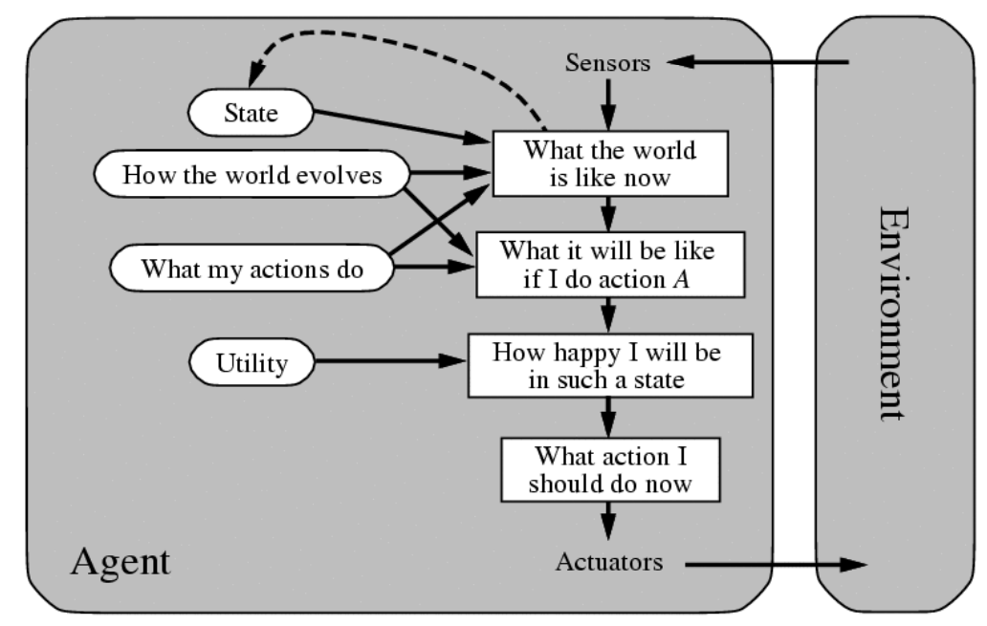
Utility Based Agents (contd…)

Slide 37
Learning Agents
Turing – instead of actually programming intelligent machines by hand, - is too much work, build learning machines and then teach them
Learning
  allows the agent to operate in initially unknown environments
  responsible for making improvements
New Elements
Performance element – responsible for selecting external actions
Learning element - uses feedback from the critic on the agent - determines how the performance element should be modified to do better in the future
Problem generator - responsible for suggesting actions that will lead to new and informative experiences

Slide 38
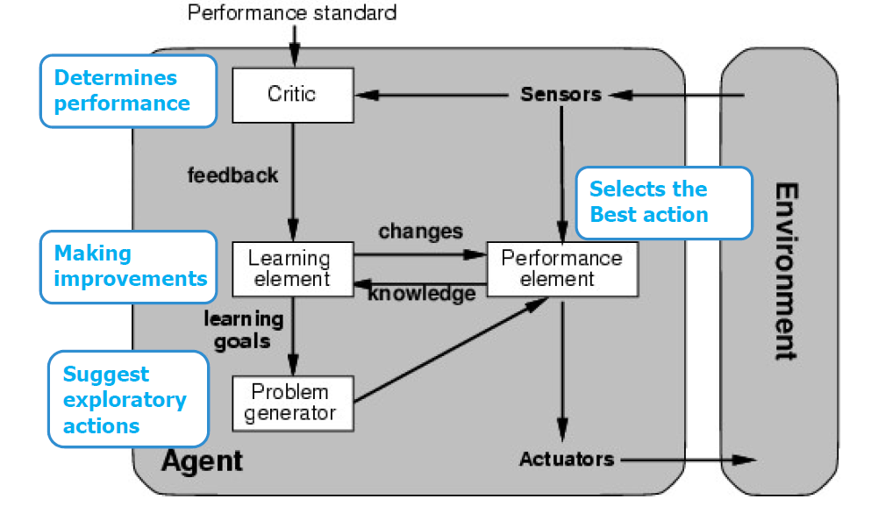
Learning Agents (contd…)

Slide 39
Questions?
Can there be more than one agent program that implements a given agent function?
Identify the drawbacks of table-driven agent program.
Develop PEAS description for the following task environment:
  Movie recommendation agent
  Robot soccer player
  Shopping for used AI books on the Internet
Select a suitable agent design for:
  Robot soccer player
  Shopping for used AI books on the Internet

