Slide 1


SMART FARE
A project by :
Aishwary Samuel (03)
Bhavana (06)
Gowtham (11)
Juwel (13)
Rohith (27)
Tezi Sourya (33)
Vikram Bansal (35)

Slide 2

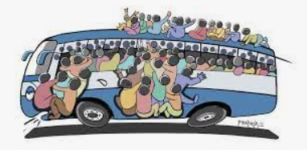

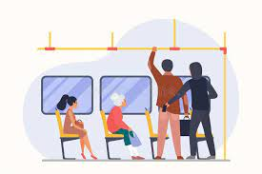
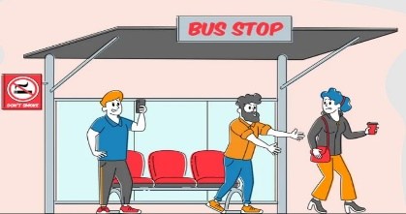
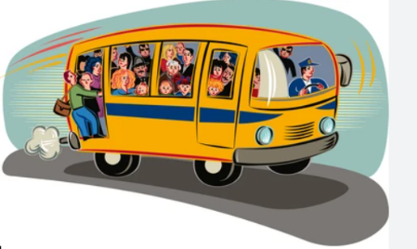
PROBLEMS
Crowd Management
Fare Evasion
Thefts
Harassment / Eve Tease
Deaths

Slide 3

WHY
Addressing a Real-world problem: Everyday people go through the issues of theft, harassment and over-crowding at buses and we are trying to solve this with our learnings at Praxis using face recognition by scanning the faces and reducing the burden of manual procedures of ticketing also ensuring the security of the passengers. Out of 10, 7 female commuters have faced harassment in bus in some or the other way, which usually they can’t report at the real time.
Financial Loss: Businesses and Government loose huge revenue due to fare evasion which can be solved by streamlining the procedure of KYC via face recognition (10% of total revenue).
Integration of Emerging Technologies: Integrating facial recognition technology into the bus fare collection process demonstrates the adoption of emerging technologies in a practical and impactful way. Face recognition is fast, easy to implement and contact-less interactions.
Adaptability to Health Regulations: Facial recognition systems can be integrated with health monitoring features, such as temperature screening or mask detection, to ensure compliance with health regulations and identify individuals displaying symptoms of illness.

Slide 4






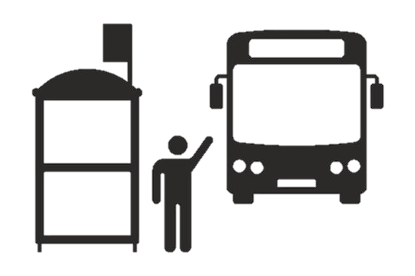





Approach
Implementation of Integrated Facial Recognition and Auto-Debit Payment System in Public Transport.
Process Flow:
Boarding bus
Face Capturing
Source
Bus Arrived
Real-time Cloud uploads
Alerts in case of security breach
Ai-processing Face - Profile match
Time / Distance Calculation
Payment Completed

Slide 5
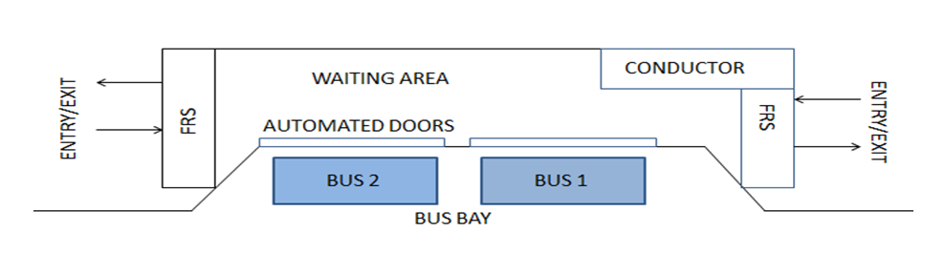
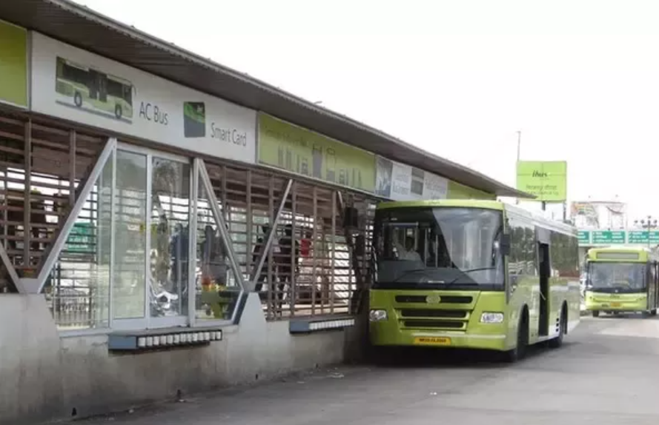
Indore Bus System:

Slide 6



FACE RECOGNITION
Process Flow
Capture: A physical or behavioral sample is captured by the system during enrollment, as well as in the identification and verification process.
Extraction: Unique data is extracted from the sample, and a template is created. Comparison: The template is then compared with the new sample.
Match/Non-match: The system decides whether the extracted feature from the new sample is a match or not.
Matched
Capture Face
Not-Matched
Extracting Features

Slide 7
FACE REGISTRATION:
Registration: Folders are created which contains images of each person ,different angles , different lighting condition. Images are saved with their username.
Step 1:
Launch Application
Step 2:
Face Detection-OpenCV (Haar Cascade Classifier)
The webcam starts capturing live video input.
Step 3:
Image Capture:
When a face is detected, facial image captured and saves it for further processing.
Step 4:
Completion
The process continues until a predetermined number of images (100) are captured or until the user manually stops the process.

Slide 8
FACE RECOGNITION
MTCNN to detect faces in images and extracts the faces for training
The detected faces are then passed through the FaceNet model to obtain a 512-dimensional embedding vector for each face.
The SVM Classifier is used to predict the identity of the input face based on its embedding vector.
Note : Why we used MTCNN and FaceNet?
MTCNN is known for its robustness in detecting faces under various conditions, including occlusions and pose variations.
FaceNet embeddings capture rich facial features, making the method more robust to variations in lighting, pose, and facial expressions.

Slide 9
FACE RECOGNITION
Other methods used :
Voila–Jones algorithm (for Face detection)
PCA (for feature extraction)
SVM Classifier (for Classification)
Limitations
Viola-Jones face detection struggles with detecting faces under challenging conditions such as hinderances, variations in pose, and low lighting.
Incase of PCA, it assumes the underlying structure of data can be captured by linear transformation which limits its ability to represent complex, non-linear relationships. It leads to loss of discriminative information and sensitive to noises.

Slide 10
FACE RECOGNITION
Other methods used :
OpenCV- Haar cascades (for Face detection)
HOG (for feature extraction)
SVM Classifier (for Classification)
Limitations
OpenCV face detection struggles with detecting faces under challenging conditions such as hinderances, variations in pose, and low lighting.
Azure Face API

Slide 11

FARE CALCULATION
The fare is calculated on the basis of time spent in the bus to reach the destination from the boarding point.
While boarding the bus, the user's face image is captured for profile verification. Upon successful verification, the user gains access to the boarding gate and boarding time is updated in database.
While de-boarding at the destination, the image is captured and the fare is calculated on the basis of time spent or distance travelled by capturing the exact time and location of the de-boarding point.
Fare = {(De-boarding_time – On-boarding_time) * (Average fare per min)}
Note : In actual situation, we will be using Location coordinates to calculate the distance, henceforth, the fare.

Slide 12





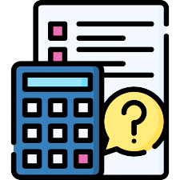

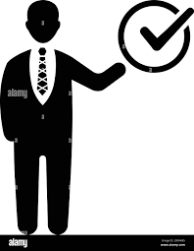

PAYMENT SOLUTION
Payment solution is provided to auto-debit from the user’s bank account and report the transaction as either successful or failed at the real time.
It involves usage of Stripe Api for payment gateways.
Source
Time/Distance Measured
API requesting payment
Profile on Server updated
Destination
Fare Calculated
Fare Auto-debited
Process completed

Slide 13
PAYMENT SOLUTION
The project involved usage of Stripe Api for payment gateways.
Few aspects:
Razorpay/Live Payments(Api) – This involves RBI regulations and approval from the concerned authorities and would take months for approval.
Test/Demo(Api) – This is currently being used in this project where dummy card details and dummy currency gets credited/uploaded in the database(wallet) and also gets debited once the ride gets completed.
Environment variables and Key Vault

Slide 14
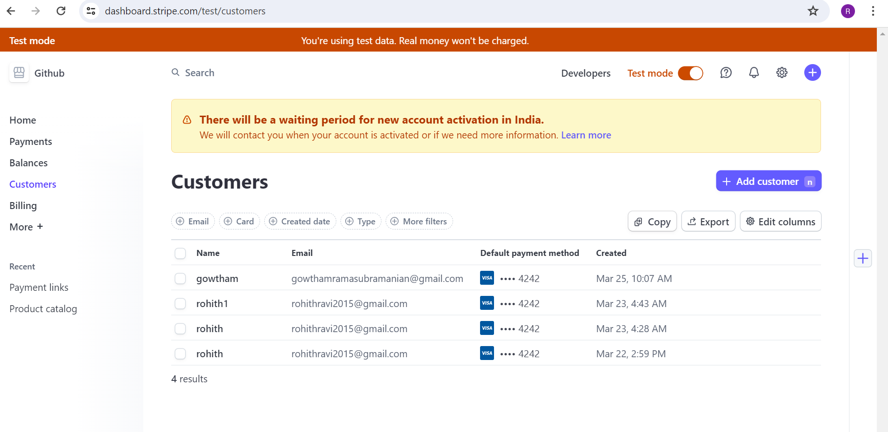

Slide 15
LOCATION
Google maps, MapMyIndia, OpenStreetMap
Process
Coordinates (geopy) → Place/Area (Selenium) → Source and Destination
Capturing location/coordinates while boarding and deboarding
Calculate distance between the 2 coordinates
Calculate fare based on distance
IP based coordinates VS Physical coordinates
Calculating road distance VS geodesic distance
The geodesic distance is calculated taking into account the curvature of the Earth's surface, so it provides a more accurate distance measurement than simple Euclidean distance calculations, especially for long distances.

Slide 16
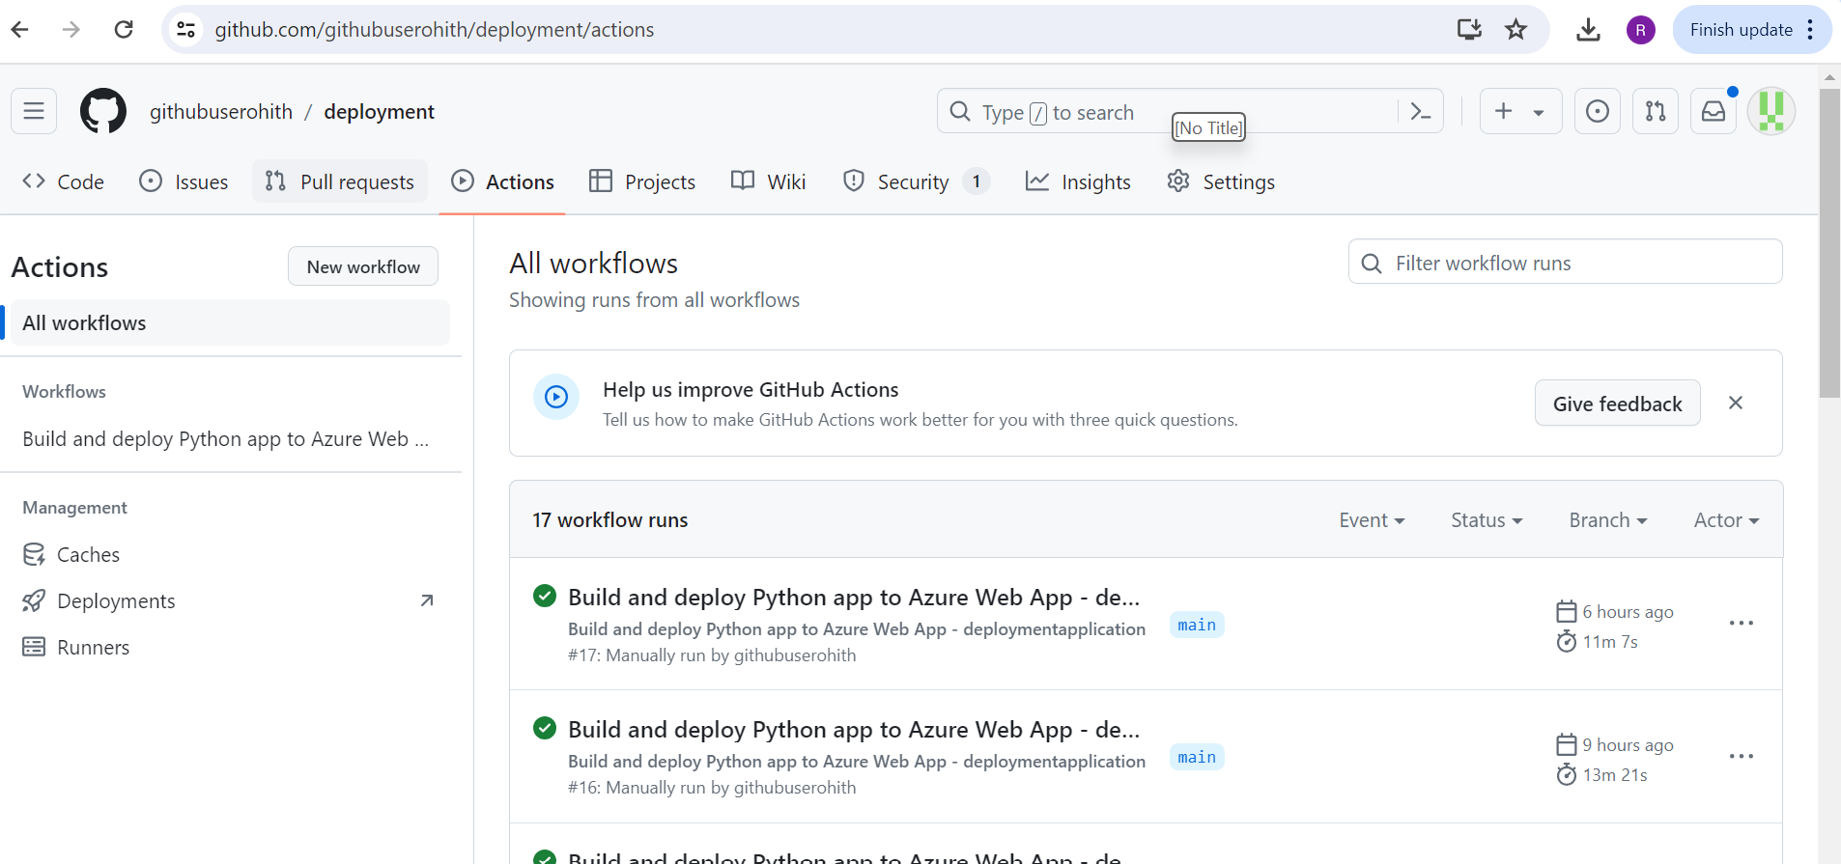
DEPLOYMENT
Cloud – Azure, GCP
Frontend- HTML with Jinja
Backend- Django
Database- SQLite

Slide 17
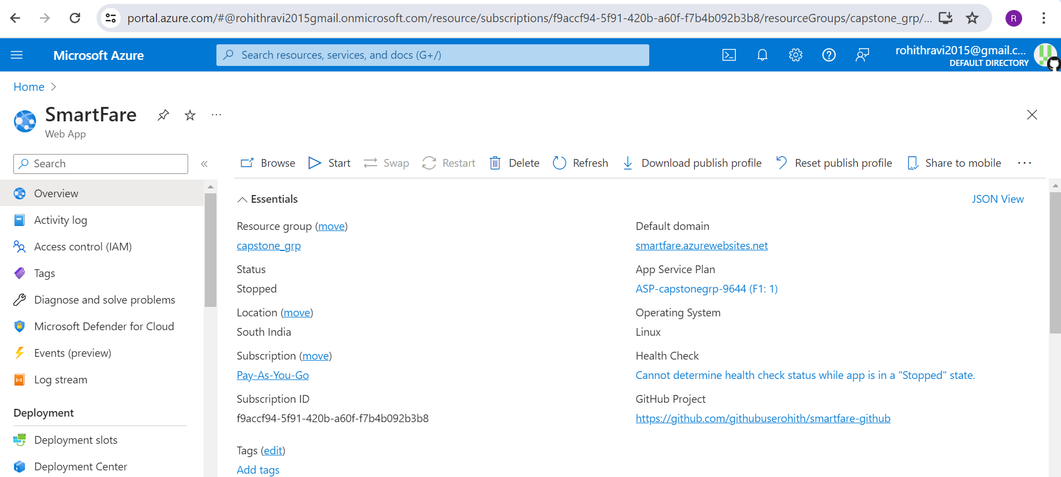
AZURE

Slide 18
Integration
Visual Studio GitHub Actions Create Web app
Build and Deploy Deployment centre Set ENV variables and
Connection string
Issues
Colab- Session expiry, GPU, slowness
Azure machine learning
GCP

Slide 19






LLM MODEL
The project incorporates a Language Model (LLM) to empower administrators with comprehensive insights and facilitate the seamless operation of the entire ecosystem.
The LLM model serves as a gateway to the centralized database containing user profiles and ride details, enabling streamlined access to essential information as needed by the administrators.
Database
Insights

Slide 20
Optimizing Language Model Performance with Fine-Tuning and RAG Methodology
Handling large datasets: Dealing with large datasets are posing performance and scalability challenges, especially when searching for specific information.
Question asked to chatbot
1.Give me user email id who has most money in wallet
2.Number of rows and columns in table
3.Tell me all users name and their destination path?
Question that chatbot would not able to answer correctly
1.Provide statistics on the average wallet balance per user.
2.Display the top 10 users with the highest transaction amounts.
3.List users with a wallet balance greater than a certain threshold.
1.Experiment with different hyperparameters, such as temperature, learning rate, batch size to find the optimal configuration for specific use case.
2.Utilize techniques such as grid search or Bayesian optimization to efficiently explore the hyperparameter space and identify promising configurations.
3.RAG - To retrieve relevant data from the database, the chatbot can utilize advanced search and filtering techniques.
4.Implement keyword-based searches, advanced query parsing, and semantic similarity algorithms to accurately match the admin's query with relevant data in the database.
5.Use indexing and caching mechanisms to optimize data retrieval performance and reduce latency.
Improvements to implement
1.Role-based access control: Implement role-based access control mechanisms to restrict certain users, such as non-administrators, from accessing sensitive information or performing specific actions.
2.Whitelisting allowed queries: Define a whitelist of allowed queries or actions that users can perform, such as querying their own email address or requesting directions to a specific destination.
3.Error handling for unauthorized queries: Implement robust error handling mechanisms to gracefully handle unauthorized queries and provide clear feedback to users.

Slide 21

ASPIRATIONS
LLM – insights for admins and users
Use real time location and coordinates
Fine tuning model/ speedup facial recognition process

Slide 22






FUTURE SCOPE
Solving Burden on Public Transport: Once we have significant count of users, this tech can solve the over-crowding problems by determining which are the regular routes of users and deploying more resources(buses) particularly on those routes.
Application of same tech in Retail Supermarkets: The same technology can be implemented in the supermarkets like (Walmart, Ikea, DMart) where over-crowding at the cashier point is an issue. This technology can be integrated with Self-checkout system, which will not improve the efficiency but also will result in reduction in shop-lifting at the stores.
Customer Queue
Cart with RFID
Face Capturing
Profile Matched
Payment done

Slide 23

THANK-YOU

