Slide 1
Overview: We want to run Dag Tasks from composer project and create the data catalog taxonomy in the same project and in the privileged project.
Privileged project: Main project: kp-devops
Caller project: client project: kp-ccp
IAM permissions
Use case-1: composer running in the kp-ccp with the default compute service account 054 and writing to data catalog in the same project. For this, the IAM permissions given in its own project ie kp-ccp is Data catalog owner in the kp-ccp project
Use Case-2: In this, the composer running in the kp-ccp with the default compute service account 054 and wants to write to data catalog in the other project ie in the privileged project. For this, the IAM permissions given in the kp-devops project to 054 is Data catalog owner

Slide 2
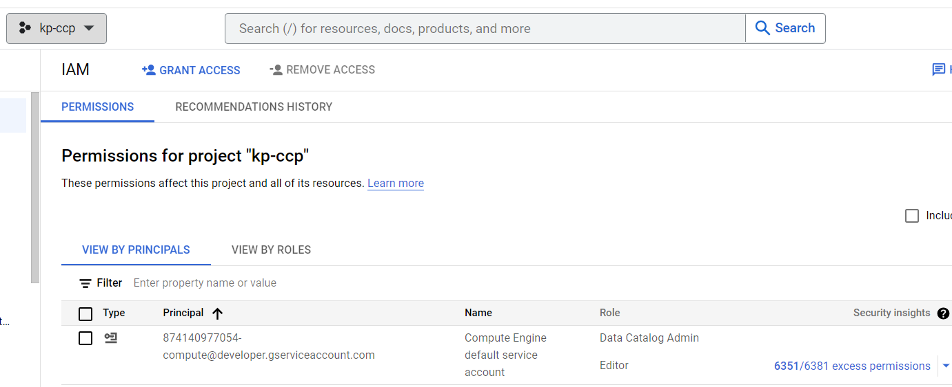
Composer service account IAM permissions in composer (caller) project in its own project – simple case
Created a new project kp-ccp, default Service account is 054
1
Datacatalog admin is assigned for other usecase ie to create taxonomy in same project kp-ccp, please ignore it
CALLER_SA (054) is assigned Service Account Token Creator and Service Account User on PRIV_SA

Slide 3
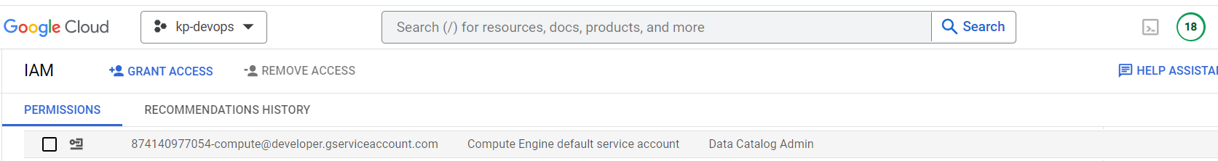
IAM permissions given to composer service account in privileged project – non trivial case

Slide 4
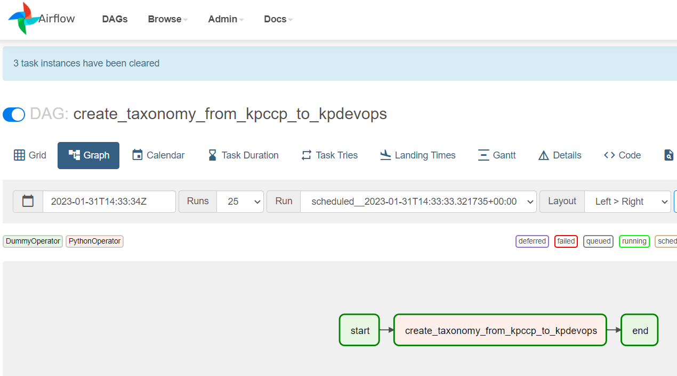
Composer service account writing to data catalog in another project – use case 2

Slide 5
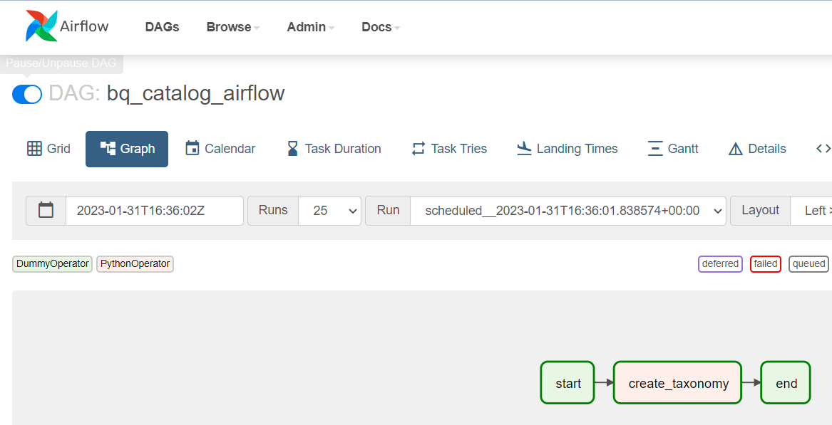
Use case-1 screenshot

Slide 6
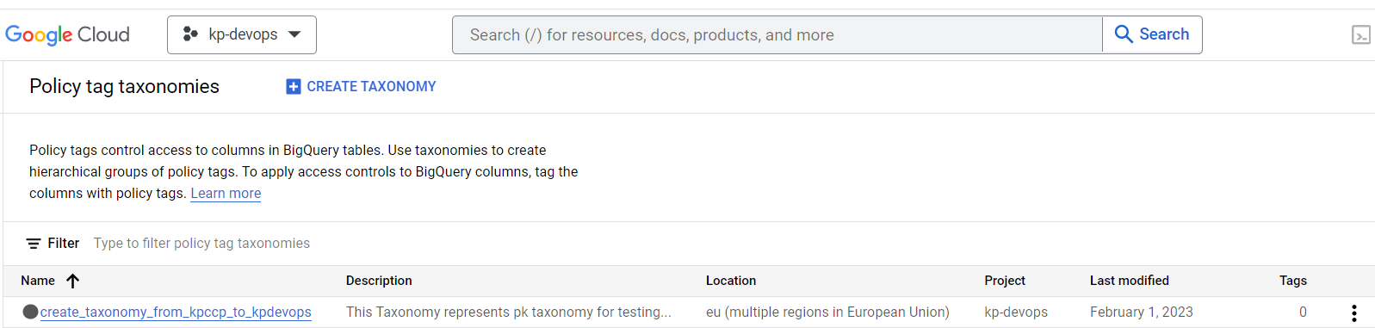
Taxonomy is created in other project

