Slide 1




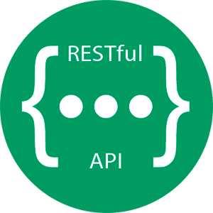
Web Hook Stack
Storage Queue (Queues PayloadInfo)
1
Repository Create WebHook calls
2
Queue PayloadInfo to Storage Queue
4
Call GitHub API (Protect Branch & Create Issue
3
BranchProtect (Processes Queue)

