Slide 1


SMART INDIA HACKATHON 2024
TITLE PAGE
Problem Statement ID – SIH1644
Problem Statement Title - A web application specifically designed for Indian coal mines to quantify their carbon footprint and explore pathways to carbon neutrality.
Theme – Renewable/Sustainable Development
PS Category- Software
Team ID-
Team Name (Registered on portal)

Slide 2
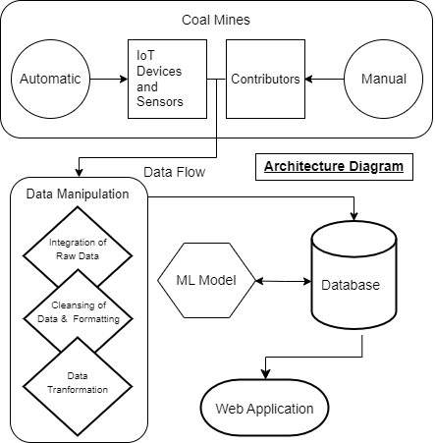
ECO2 VIEW
MATRIX
Proposal of Solution :
We have created a web-based Carbon footprint monitoring System provides real-time Carbon Emissions and Neutrality Pathways, allowing to instantly access carbon footprints by coal mines of pan India. The prototype will function as follows :
Visualize and compare data effortlessly with Data Visualization Tools like heat maps, pictorial displays, bar graphs and line graphs.
Stay informed with our comprehensive Carbon Neutrality Pathways and AI Decision Support System.
Our multi-layered data strategy leverages historical data, providing comprehensive carbon footprints insights using ML prediction model.
IoT Devices and Sensors will be used for real time monitoring and carbon credit management with implementation of Blockchain Technology.
Advanced Geospatial Analysis and Simulation of Clean Technologies to bridge gap between emissions and carbon sinks.

Slide 3
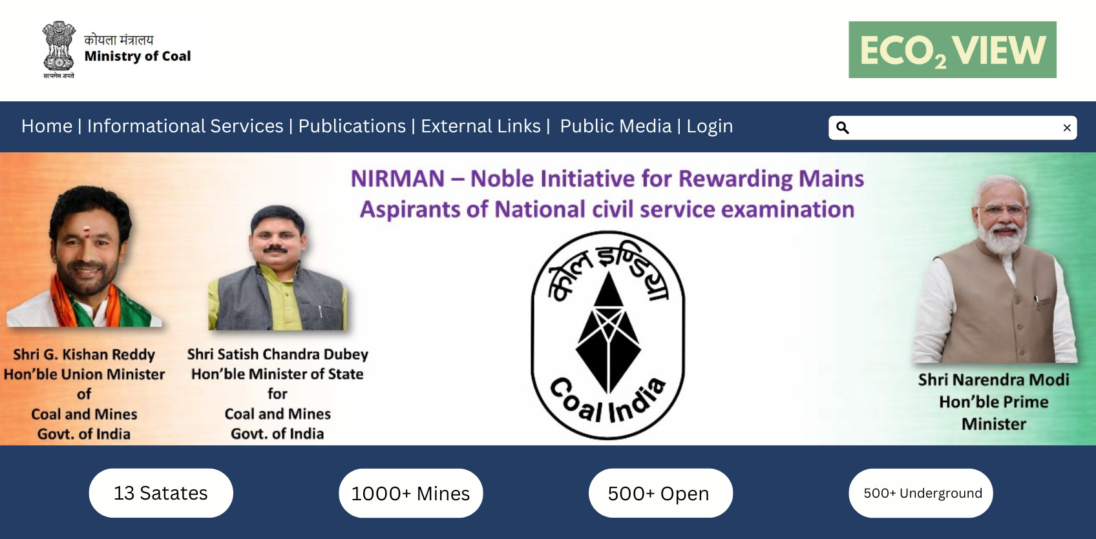
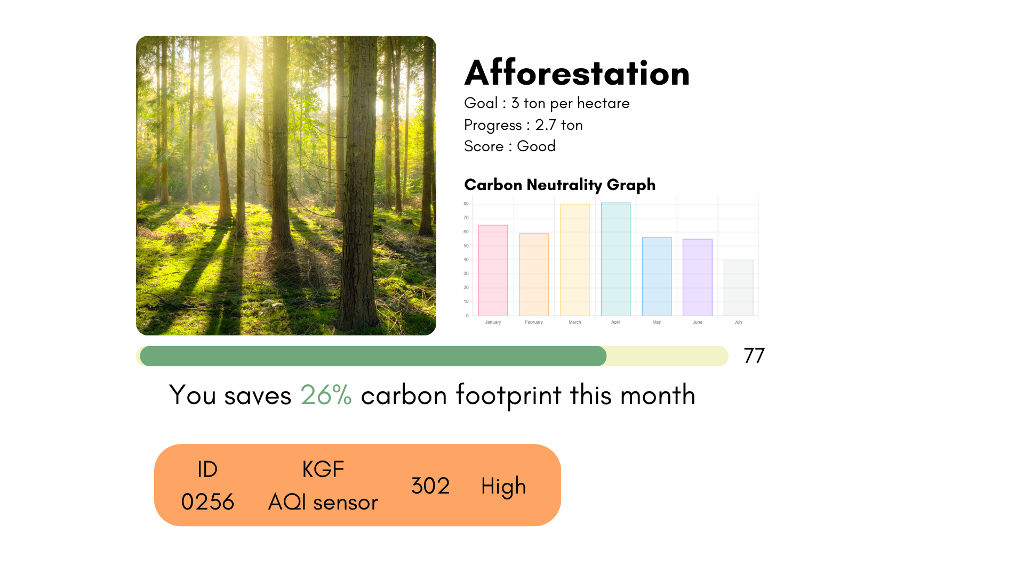
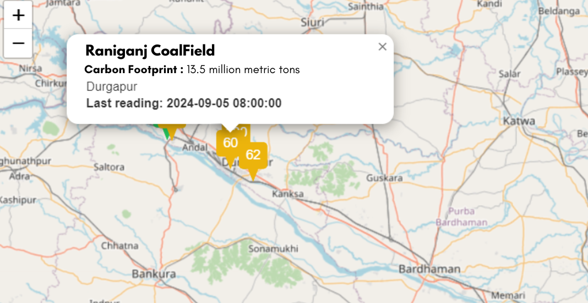
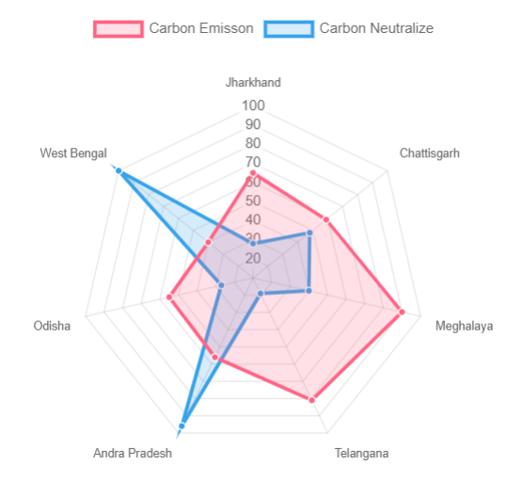
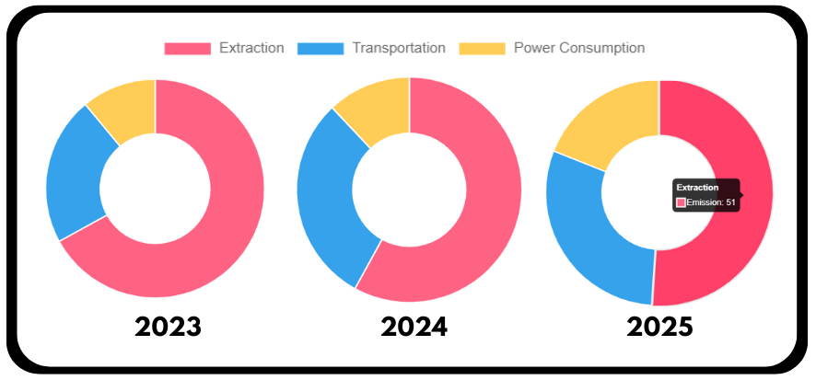
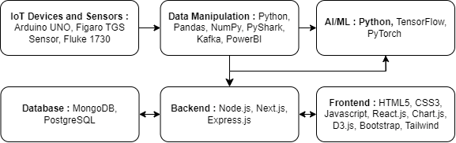
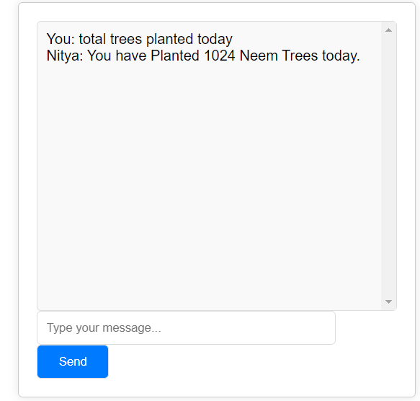
TECHNICAL APPROACH
MATRIX
Search Coal Mine
Frontend : HTML5, CSS3, Javascript, React.js
Backend : Node.js, Express.js, Next.js
Design Framework : Bootstrap, Tailwind
Data Visualization : Chart.js, D3.js
Hardware : Arduino UNO, Fluke 1730
Database : MySQL, PostgreSQL
AI/ML : Python, PyTorch, TensorFlow
Cloud & Reporting : PowerBI, AWS
Personalised Carbon Neutrality Suggestions
Easy to use UI
Real-time IoT Notifications
Comparison of data
Using Graphs
ML Emission Prediction
Geospatial Analysis
 | Geospatial Analysis | AI Decision Support System | Neutrality Suggestion | Graph Comparison
ECO2 View | ✅ | ✅ | ✅ | ✅
TERI | ❌ | ❌ | ❌ | ✅
ICMM | ❌ | ❌ | ❌ | ❌
AI Support System
USP

Slide 4
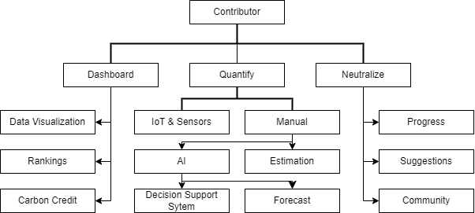
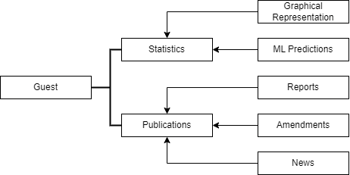
FEASIBILITY AND VIABILITY
MATRIX
Analysis of the feasibility of the idea :
Integrating data from IoT Devices is technically feasible.
Building predictive models using historical data is feasible.
Blockchain technology can be used for transparent carbon credit management.
Potential challenges and risks :
Managing latency to ensure real-time insights.
Ensuring predictive models are accurate and robust.
Accurately simulation of clean technologies and bridging emission-sinks gap.
Strategies for overcoming these challenges :
Implement edge computing solutions to reduce data latency.
Continuously validate and update models.
Partner with experts to accurately simulate models.

Slide 5
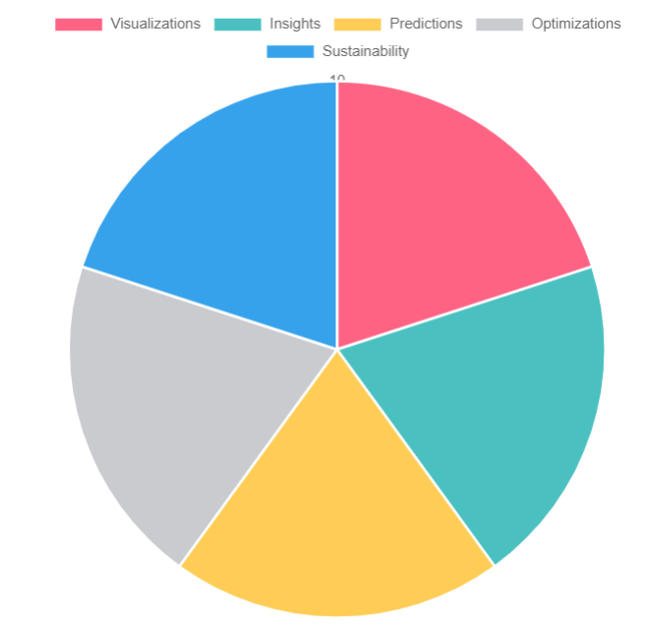
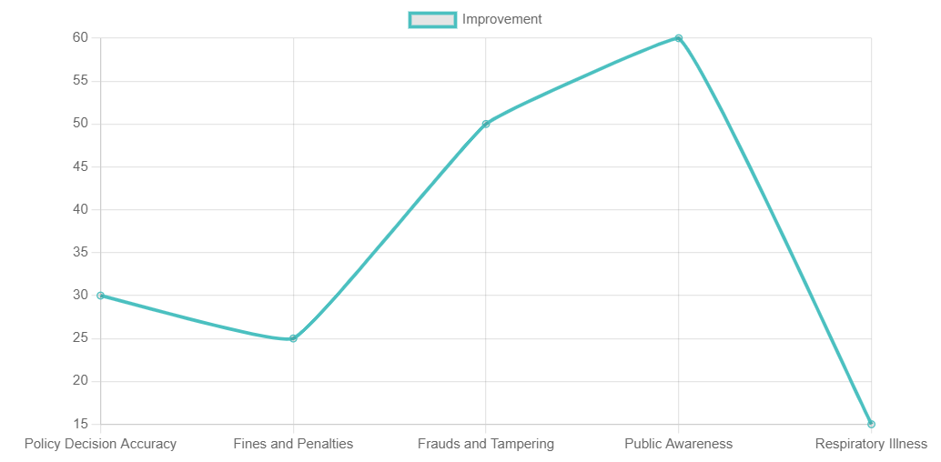
IMPACT AND BENEFITS
Matrix
Impacts :
Enhanced ability to visualize carbon emission data.
Provides actionable insights and strategies for achieving carbon neutrality.
Utilize ML models to provide precise carbon footprint predictions.
Contributes to optimization of Clean Technologies.
Contributes to Environmental Sustainability.
Benefits :
Increases Policy Decision accuracy by 30%.
Reduced fines and penalties costs by 25%.
Blockchain can reduce fraud and data tampering.
Public awareness of Carbon Emissions can increase by upto 60%.
Reduction of respiratory illnesses by upto 15% in affected areas.

Slide 6
RESEARCH AND REFERENCES
MATRIX
Links of the reference
Ministry of Coal : https://coal.nic.in/en
Wikipedia : https://www.wikipedia.org/
YouTube : https://www.youtube.com/
OpeniAI : https://openai.com/
Brave : https://brave.com/

Slide 7
IMPORTANT INSTRUCTIONS
Please ensure below pointers are met while submitting the Idea PPT:
Kindly keep the maximum slides limit up to six (6). ( Including the title slide)
Try to avoid paragraphs and post your idea in points /diagrams / Infographics /pictures
Keep your explanation precise and easy to understand
Idea should be unique and novel.
You can only use provided template for making the PPT without changing the idea details pointers (mentioned in previous slides).
You need to save the file in PDF and upload the same on portal. No PPT, Word Doc or any other format will be supported.
Note - You can delete this slide (Important Pointers) when you upload the details of your idea on SIH portal.

