Slide 1

Basic Details of the Team and Problem Statement
Team Member Details
Ministry/Organization Name/Student Innovation:
Ministry of coal
PS Code: SIH1316
Problem Statement Title: Application of Image Analytics for Tree enumeration for diversion of Forest Land
Team Name: TreeSense Imaging
Team Leader Name: Shreyas Datar
Institute Code (AISHE): C-36022
Institute Name: Lakshmi Narain College of Technology, Bhopal (M.P)
Theme Name: Miscellaneous
Team Leader : Shreyas Datar
Branch : B.Tech Stream : CSE:AIML Year : III
Team Member 1 : Ankit Ranjan
Branch : B.Tech Stream : CSE:AIML Year : III
Team Member 2 : Aryaman Yadav
Branch : B.Tech Stream : IT Year : III
Team Member 3 : Soumya Jain
Branch : B.Tech Stream : CSE:AIDS Year : III
Team Member 4 : Vipul Chaturvedi
Branch : B.Tech Stream : CSE:AIML Year : III
Team Member 5 : Ayush Kumar
Branch : B.Tech Stream : CSE:AIML Year : III
Team Mentor 1 : Dr. Vivek Richhariya
Category : Academic Expertise : IoT Domain Experience: 22y
Team Mentor 2 : Dr. Bhupesh Gour
Category : Academic Expertise : AIML Domain Experience : 21y

Slide 2

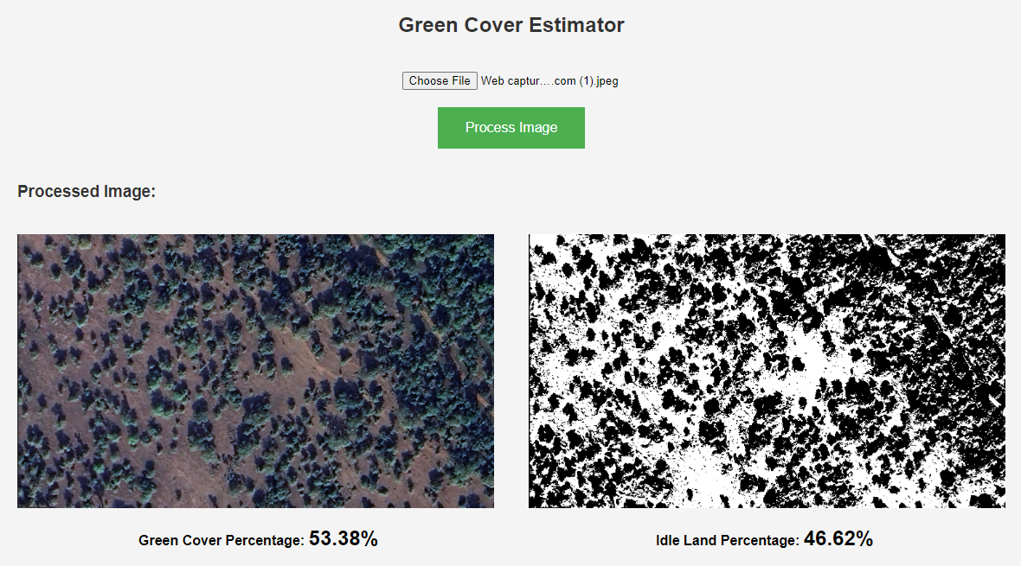
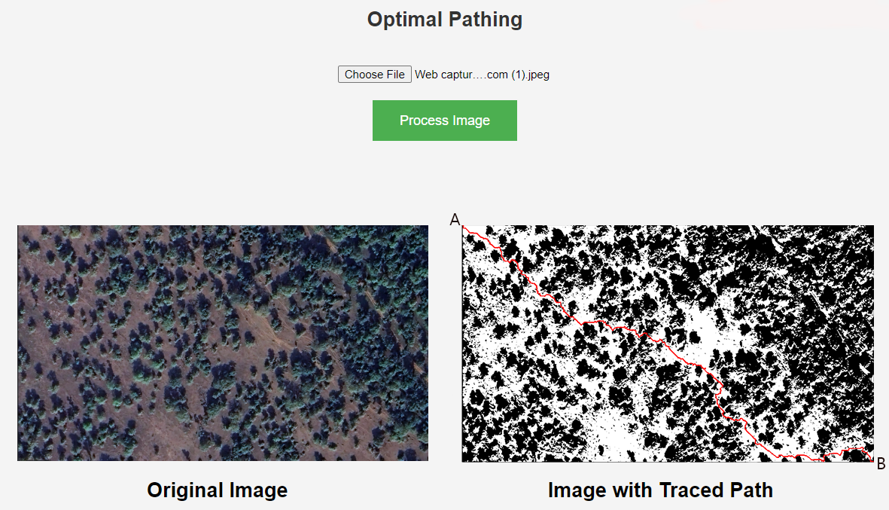
Idea/Approach Details
Prototype of Green Cover Estimator & Optimal Pathing Algorithm
TreeSense Imaging
Idea and Proposed Solution
This project aims to automate the currently used manual surveying processes for tree enumeration & categorization to reduce manpower, costs and increase efficiency
This process keeps in mind the ecological toll development projects take on the environment and provides analytical tools and a recommender & alert system to help combat this issue.
We have also provided a functionality that gives the authorities adequate historical information (Rainfall, Temperature,Humidity,AQI, Soil pH etc.) about the given area to further help with the decision making.
Our system is easy to use with minimal learning curve and user-friendly components and tons of appealing data visualizations with an added option of using user generated satellite imagery directly from the google maps API embedded in our application.
Technology Stack
HTML/CSS/Javascript: Frontend
Python: Machine Learning
Tensorflow/PyTorch: Deep Learning
Flask/Django: Backend
REST APIs: Routing
OpenCV: Image Processing
PostgreSQL/MongoDB: Database

Slide 3
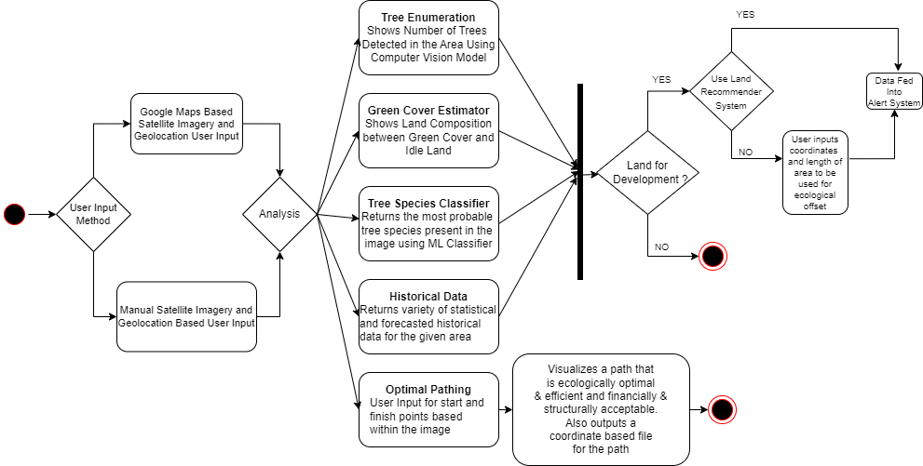
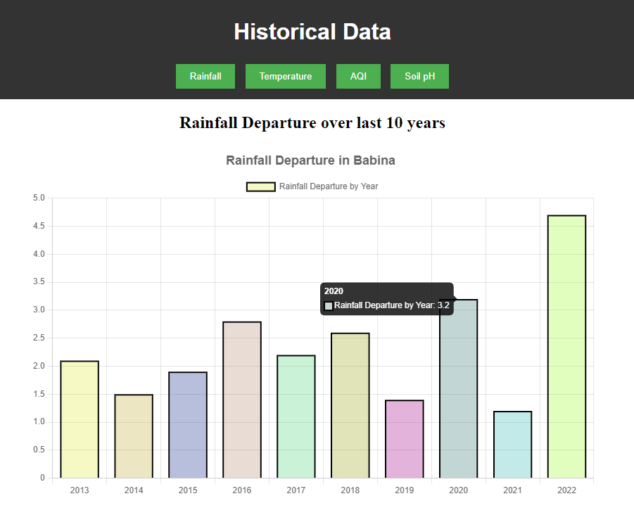
Idea/Approach Details
TreeSense Imaging
Use Cases
UML Activity Diagram
Automated Tree Enumeration
Project Risk Assessment
Monitoring and Reporting tool
Environmental Impact Assessment
For Scientific Research
Gives insights for decision making
Prototype of Historical View

Slide 4
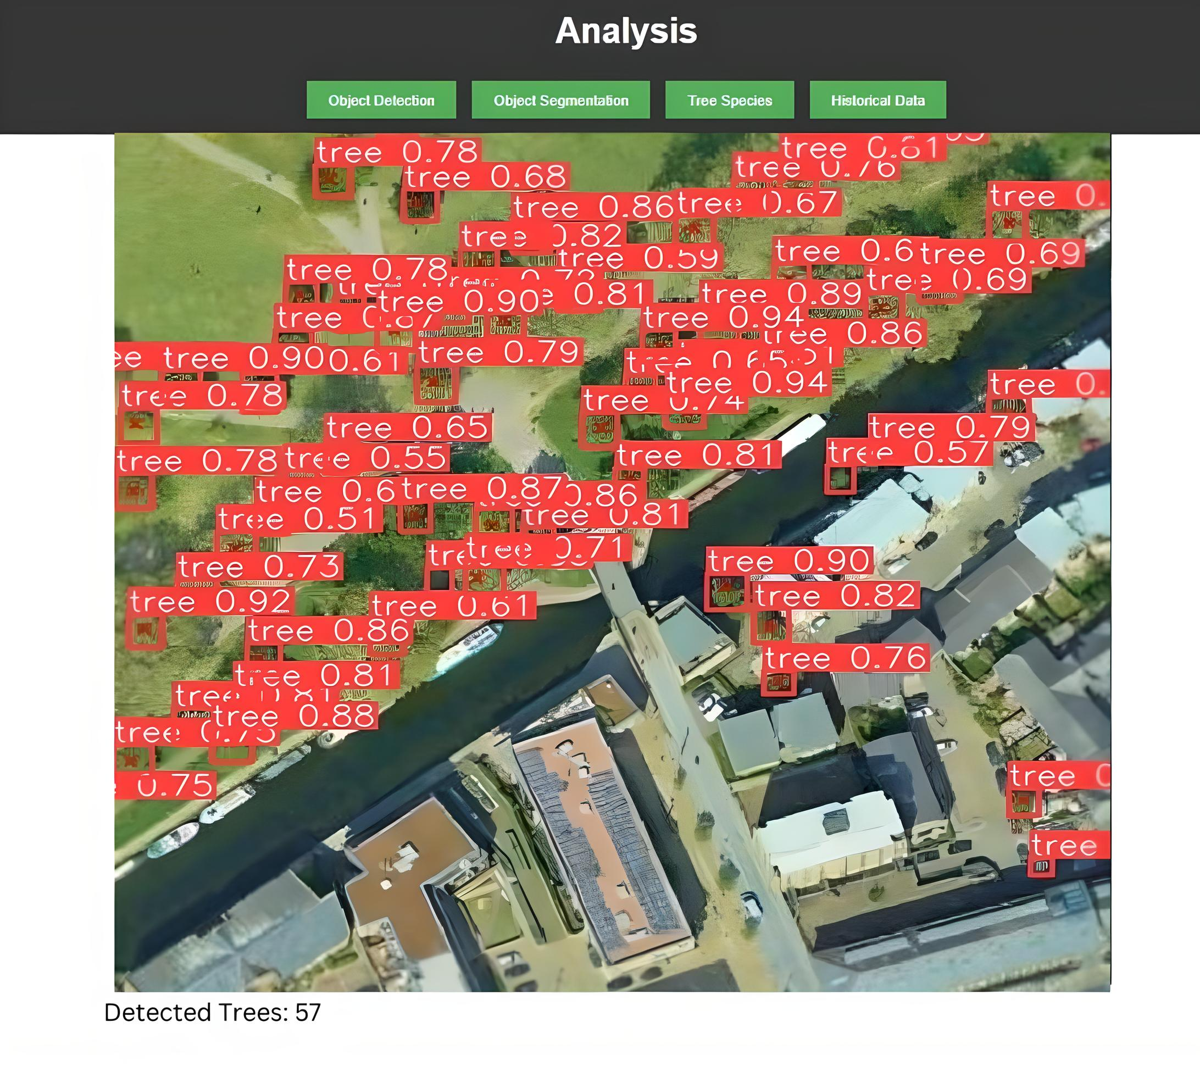
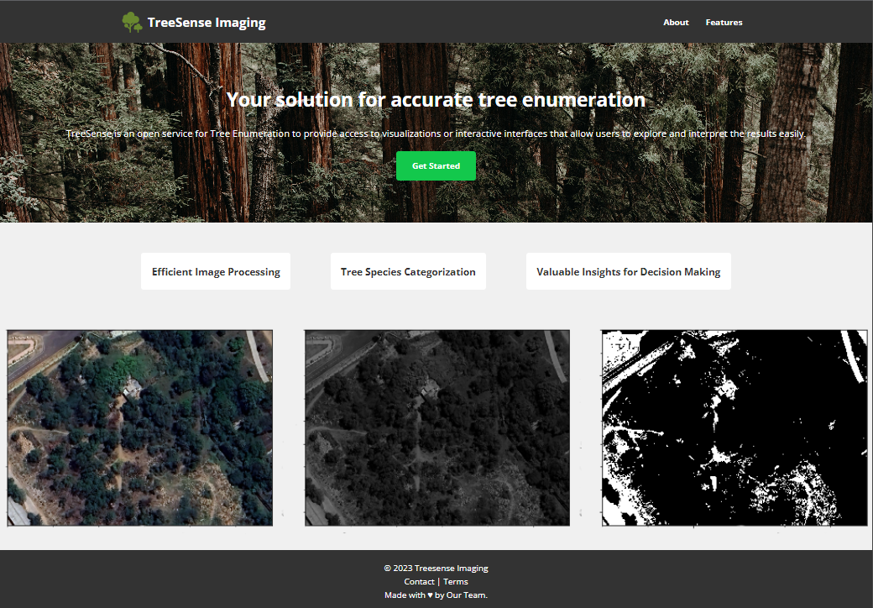
Future Scope
Integration with Government Data portals & services - We hope to Integrate with govt. land and environment portals for seamless data exchange, aiding informed decision-making
Product Customization - We'll offer tailored versions of the system for specific industries with features & analytics relevant to their environmental impact.
Dependencies
Optimal Image input : Users should provide inputs that contains minimal noise and aerial based imagery
Lack of viable datasets present a challenge to model training
Accuracy cannot be guaranteed in every use case
Time Latency is caused by complex CV model
Showstoppers
An algorithm finds an ecologically sound and cost-effective path between user-defined start and end points within an image which aids development authorities in planning suitable roads or paths.
A Computer Vision Model that can accurately detect tree crowns of different species.
A recommender system identifies suitable free land for offsetting the ecological impact of tree logging during development, while an alarm system ensures ongoing monitoring and timely notifications regarding the ecological status of designated offset areas.
Left : Working prototype of our Tree Count System implemented using the YOLOv8 Architecture.
Right : Current Landing page of our Prototyped website

