Slide 1
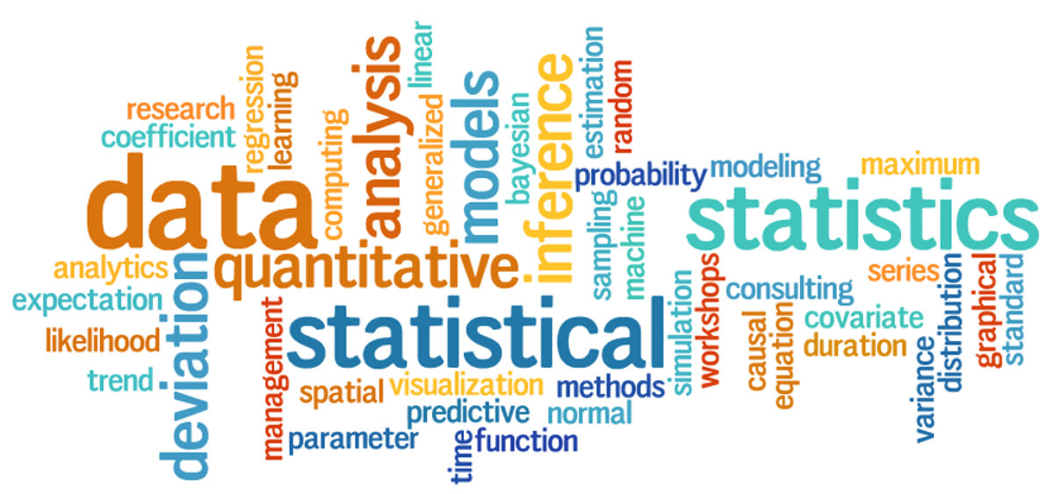
Demo Session: Data Analytics & Data Science
Kickstart Your Journey Into the World of Data!

Slide 2
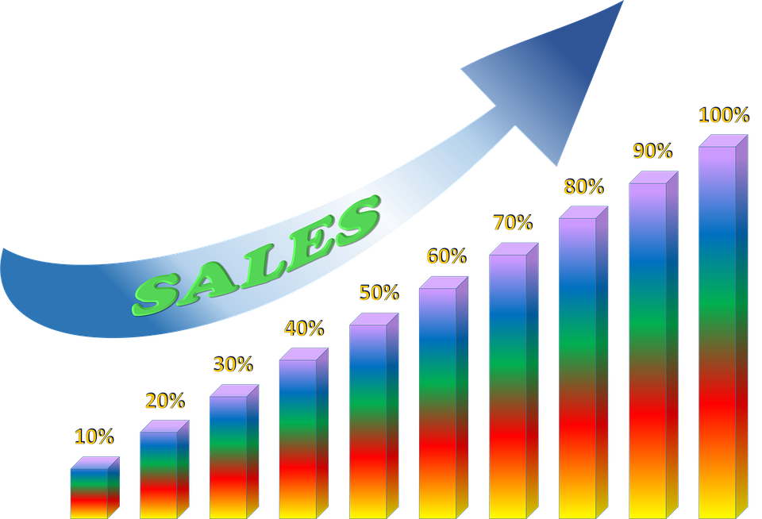
What is Data?
• Real-world examples: sales records, customer feedback, website clicks, medical -> disease , cancer , diabetes etc..
• Structured vs Unstructured Data
Structured means ( text , number and user’s info )
Un-structure means ( video , image , audio and large text or paragraph)

Slide 3
Data Analytics vs Data Science
Data Analytics:
- Focus on historical data
- Tools: Excel, SQL, Power BI and Python or its libraries )
- Example: Sales Trend Analysis
Data Science:
- Focus on predictions/models
- Tools: Advanced Python, ML, AI
- Example: Customer Churn Prediction

Slide 4
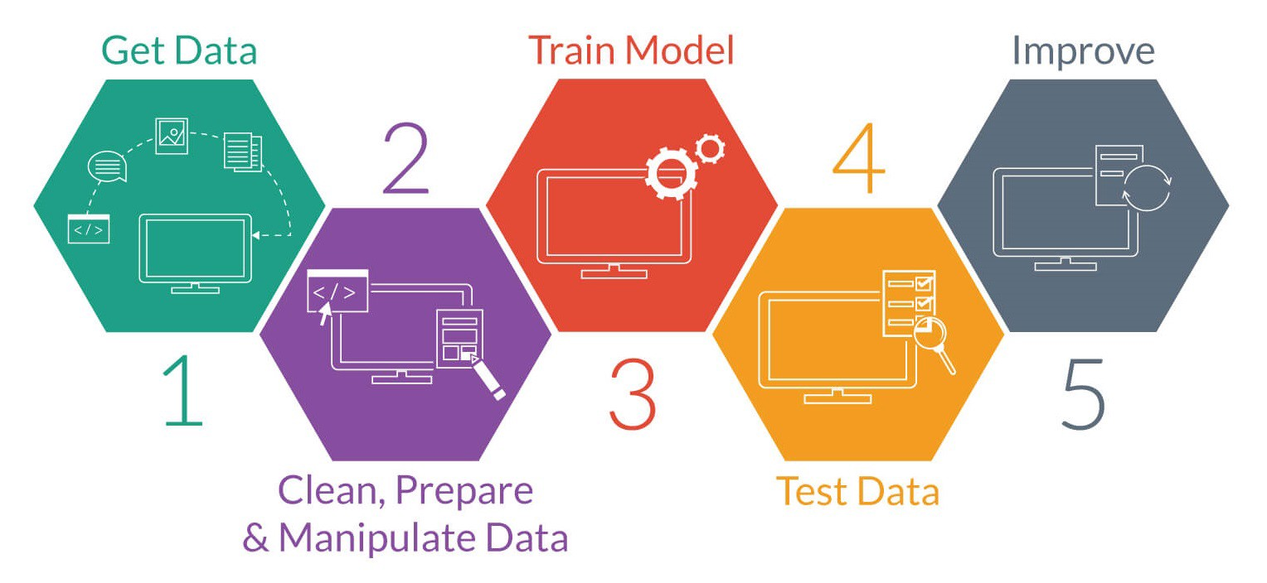
Why Learn Data?
• Growing job demand
• High salaries
• Industries: healthcare, finance, marketing, tech, e-commerce and social media etc..

Slide 5
Career Paths
Data Analyst
Data Scientist
BI Analyst
Machine Learning Engineer
AI/ML Engineer

Slide 6
Learning Roadmap
1. Excel
2. SQL
3. Python
4. Power BI
5. Machine Learning
6. Gen AI (optional)

Slide 7
Mini Demo Preview
Excel: Pivot Table, Charts
Python: Read CSV, Analyze data
Power BI: Dashboard example

Slide 8
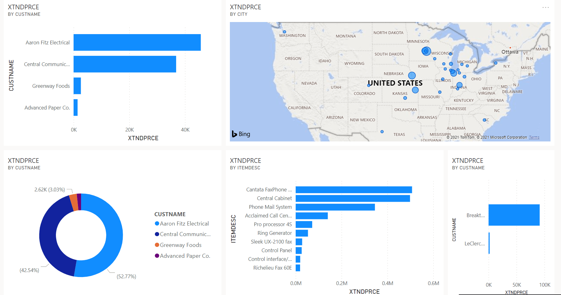

Slide 9
Sample Use Cases
Predict movie success
Analyze student performance
E-commerce sales trends

Slide 10
Tools Overview
Excel
SQL
Python (Pandas, NumPy, matplotlib and seaborn etc.)
Power BI / Tableau
ML Libraries

Slide 11
How to Start
Join our full course
Practice with datasets
Build small projects

Slide 12
Q&A
What kind of projects can I do?
What background do I need?
How long will it take to get a job?

Slide 13
Thank You!
Ready to explore the data world?

