Slide 1

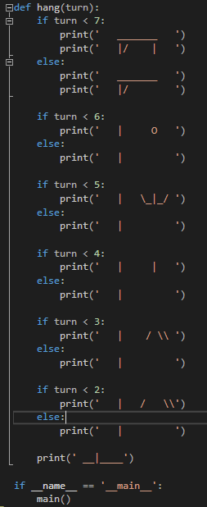
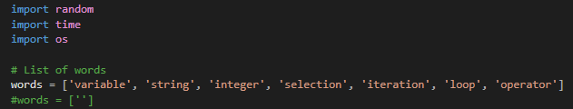
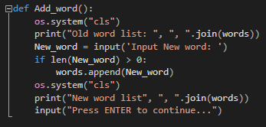
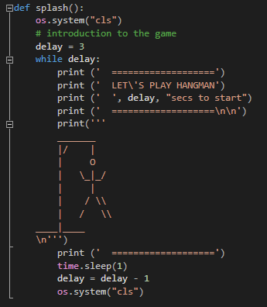
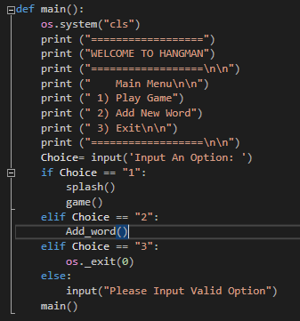
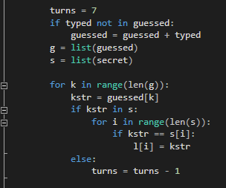
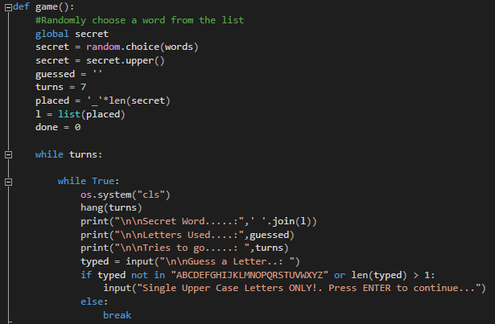
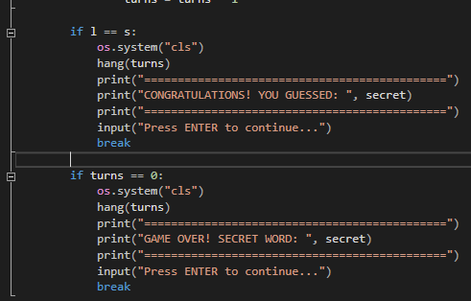
3
6
Play a
game of hangman?
1
4
8
Put the pieces together and enjoy the game!
5
7
2

Slide 2
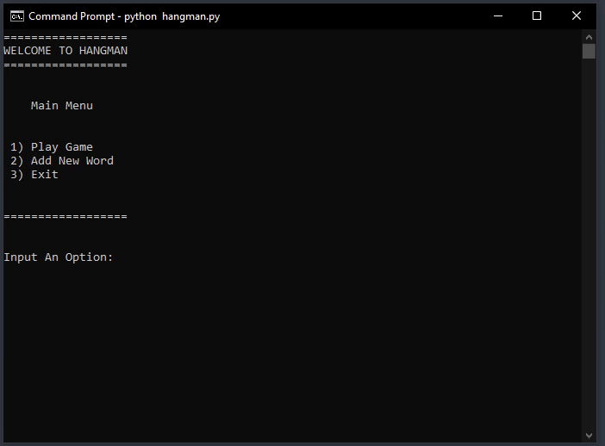
Code overview
In the programme, a variable placed was created which contains a sequence of “_”. The number of underscores is equal to the length of the secret variable.
Then a list was created out of the placed variable called “l”.
Then a list was created out of the guessed variable called “g”
Then a list was created out of the secret variable called “s”
Each element of the g list is compared against the contents of the s list. If everything that the user has typed in the g list is found in the s list then the l list becomes identical to the s list. In other words, the l list is used as a temporary variable to compare against the secret word.
One of two things will happen. The contents of the l list will become the same as the contents of the s list and then WIN. The number of tries will become 0 and then GAME OVER. I believe this is a better, simpler, and more robust architecture with the additional benefit that you have an actual variable which can be stored if needed.
DEMO

Slide 3

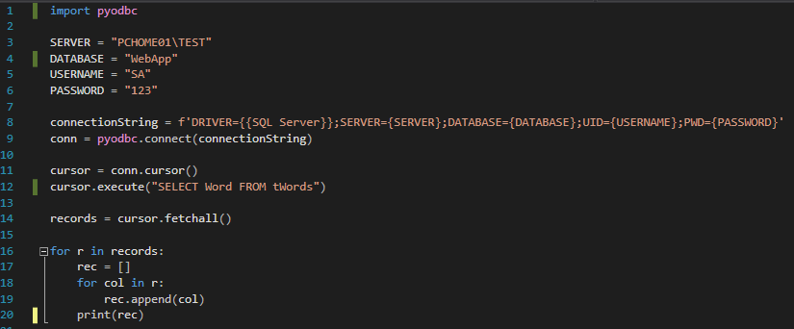
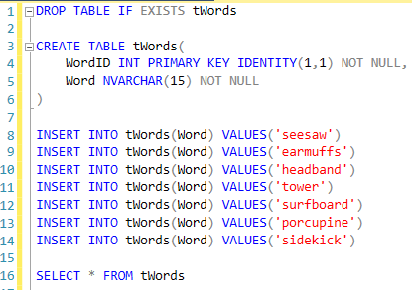
ADDITIONAL CHALLENGE:
Create a SQL table using SSMS as in the example to the right.
Use and modify the code below to read the word library into the Hangman word challenges.
Add this functionality to the Hangman main menu.
This functionality should require the user to login first by supplying a username and a password.
HELP ON ADDITIONAL RESOURCES REQUIRED: https://learn.microsoft.com/en-us/sql/connect/python/pyodbc/step-3-proof-of-concept-connecting-to-sql-using-pyodbc?view=sql-server-ver16

Slide 4

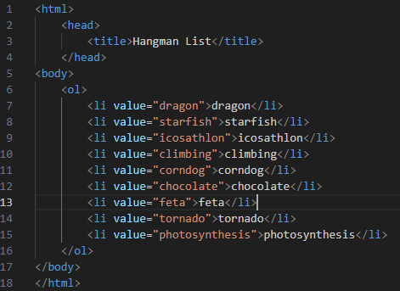
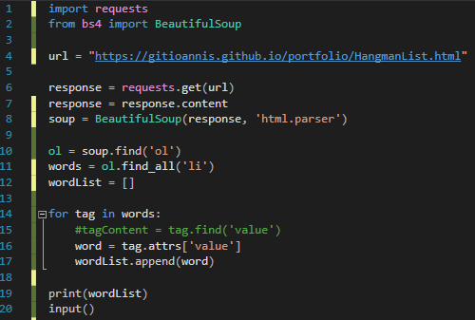
ADDITIONAL CHALLENGE:
Create an HTML document and upload to your GitHub published repository for example: https://gitioannis.github.io/portfolio/HangmanList.html
Use and modify the code below to read the word library into the Hangman word challenges.
Add this functionality to the Hangman main menu.
This functionality should require the website URL as input.
HTML: An ordered list of words
HELP ON ADDITIONAL RESOURCES REQUIRED: https://www.youtube.com/embed/MH3641s3Roc

Slide 5
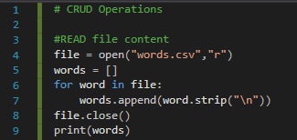

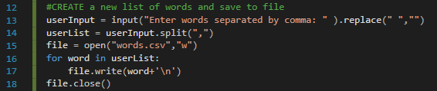
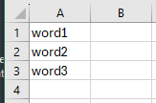
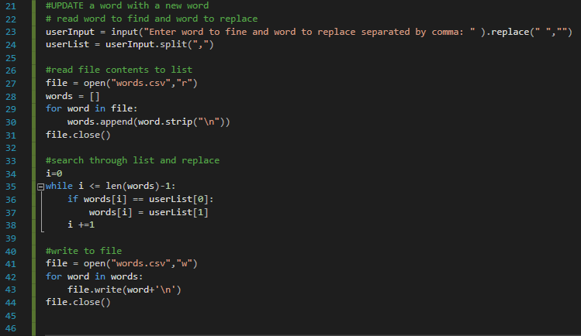
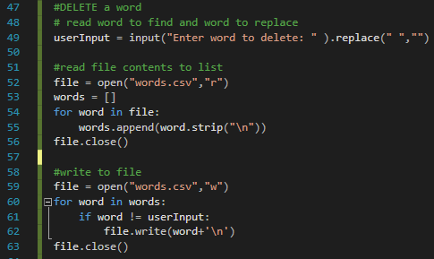
ADDITIONAL CHALLENGE:
Create a CSV document containing a library of words:
Use and modify the code below to read the word library into the Hangman word challenges.
Add this functionality to the Hangman main menu.
Allow CRUD operations to the CSV document. Also allow for adding a new word to the existing list
CSV: List of words (Local File)

Slide 6

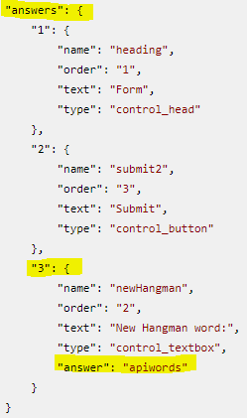
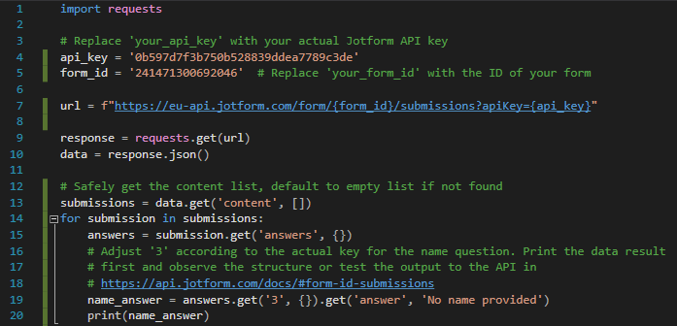
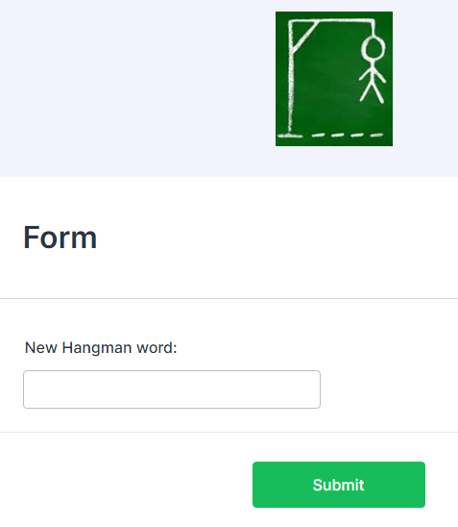
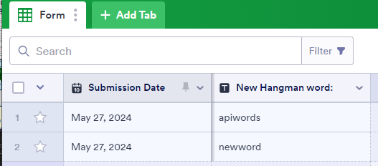
ADDITIONAL CHALLENGE:
Create a JotForm
Use and modify the code below to read the word library into the Hangman word challenges.
Add this functionality to the Hangman main menu.
This functionality should request from the user to supply the API key and form ID
Json abstract example
API: List of words
HELP ON ADDITIONAL RESOURCES REQUIRED:
https://api.jotform.com/docs/#form-id-submissions
https://www.youtube.com/embed/cj3h3Fb10QY
https://www.youtube.com/embed/lsMQRaeKNDk

Slide 7

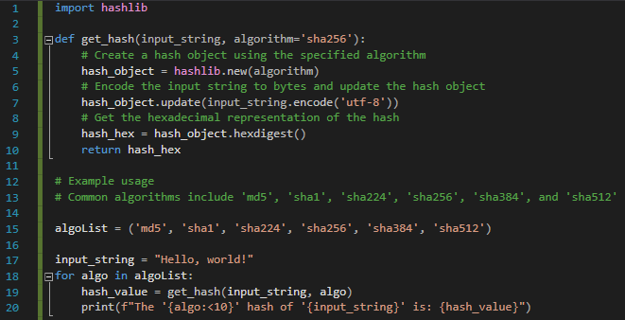
NEW CHALLENGE:
Create an output of the same input string using a list of popular hashing algorithms
Popular HASH algorithms
NEW CHALLENGE:
Create a python program that will take any string as an input.
It will create a dictionary that will store all the unique characters and their hash code.
You can use any has algorithm or you can allow the user to select any of the popular algorithms.
In the end, it will print all the dictionary keys and values.
HELP ON ADDITIONAL RESOURCES REQUIRED:
https://www.youtube.com/embed/lik9aaFIsl4
https://www.youtube.com/embed/b4b8ktEV4Bg
https://www.youtube.com/embed/cczlpiiu42M
https://www.youtube.com/embed/4_s9lOuUpZ4

