Slide 1

Agile Project A
Create a calculator to be used by primary school pupils. The calculator should allow students to perform basic mathematical calculations (addition, subtraction, multiplication and division.) It should also serve as a math quiz app to test pupils on their math calculations and give them as score. The calculator should have a print, import and export functionality.
Agile Project B
Create a recipe calculator. It should provide the novice cook with recipes and a shopping list of necessary ingredients based on requested servings. It should allow the advance cook to create recipes and store ingredients based on number of servings. Pricing could be a bonus. The calculator should have a print, import and export functionality.
Overall project requirements

Slide 2
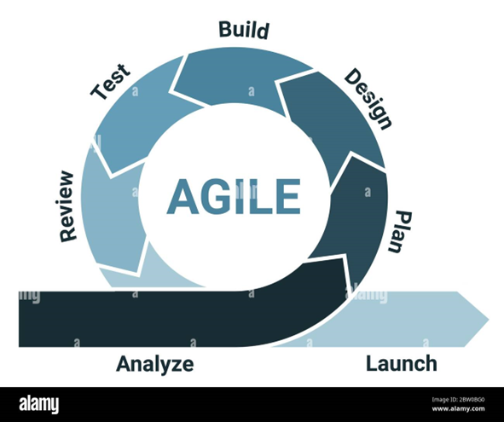
PROJECT SPECIFICATIONS.
Both projects should be produced in python using agile methodology.
There will be three scums per sprint held on Monday, Wednesday and Thursday.
Each product will be delivered in two sprints. Each sprint will last 2 weeks.
Each team will consist of a:
Software developer who is also going to be the architect for the app
Tester who is also going to be UX designer
Scrum master who is also going to be the project manager.
Team A will be team’s B customer and vice versa.

Slide 3
On Day one of the first sprint both teams will create their own app requirements that the other team will need to produce. Then, they will invite a member from the other team to attend a meeting and receive the user story product backlog.
Each product backlog will have maximum 5 user stories. Three stories will be presented at the first meeting and the other two of the requirements will be presented on day 11 at the feedback review and requirements update meeting.
The scrum master/project planer will be responsible for producing the PowerPoint presentation.
One slide will introduce a table with the job roles, the employees responsible in these roles. A job share for a role is allowed. Additional post holders may be allocated as required by the project manager.
Each sprint will include seven slides, one for each of the phases i.e., Analysis, Planning, Designing etc.
For each phase there will be a daily scrum ceremony by each role as necessary
You can exchange in any text and other information using the chat.

Slide 4
USER STORIES BACKLOG
CODE | AS A… | I NEED… | SO THAT…
101 | End User | Login Screen | I can record the user information, protect the application from unauthorised access, build user profile information +++

Slide 5
Teams Roles and Responsibilities
Role | Name | Name | Responsibilities
Software Developer/Architect
Tester/UX Designer
Scrum Master/Project Manager |  |  | Facilitate Agile ceremonies, manage project, ensure timeline adherence.

Slide 6
Sprint1: Foundation and basic Functionality
Phase | Day | Activity | Details
Analysis | 1 | Requirements Gathering | Collect and analyze requirements to define what the calculator must do.
Plan | 1,2 | Sprint Planning | Plan the sprint activities, define scope for development.
Design | 2,3 | UI/UX and System Design | Sketch initial design ideas for UI and outline system architecture.
Build | 4,7 | Development | Develop the basic functionality for recipe calculations.
Test | 8,9 | Testing | Conduct initial testing, including unit and integration tests.
Review | 10 | Sprint Review | Present the calculator to stakeholders for feedback.
Launch | 10 | Initial Release to Test Environment | Deploy the built features into a test environment for further evaluation.

Slide 7
Sprint2: Enhancement and Refinement
Phase | Day | Activity | Details
Analysis | 11 | Requirements Gathering
Plan | 11,12 | Sprint Planning
Design | 12,13 | UI/UX and System Design
Build | 14,17 | Development
Test | 18,19 | Testing
Review | 20 | Sprint Review
Launch | 20 | Initial Release to Test Environment

Slide 8
Daily Scrum Ceremony
DETAILS |  | DESCRIPTION
Sprint | A | User Story: 101 End User, Login Screen, User can record the user information, protect the application from unauthorized access, build user profile information, secure. 102 End User, Search Recipes, User can find recipes based on: Ingredients, portions, allergies, dietary requirements, time 103 End User, Create Shopping List, User can print it. Need quantities, prices, competitors prices (other supermarkets) User can create and print a shopping list In my role, I have reviewed the user story with the team and determined the following: Project timeline: 20 days Project deadline: Day 20 Tools needed: Developer (Ozzy and Amy) * Python * VSCode Architect (Elijah) * Diagrams.net * Sketch Tester (Zee) * VSCode UX/UI Design (Andrew) * Adobe XD, Illustrator, Photoshop and InDesign (subscription) * Dribble for N64 Testing Phases: Testing techniques: Functional Testing – focuses on testing functionality against specified requirements and user stories. Black-box Testing – tests are designed based on applications requirements and expected behavior. Integration Testing – verifies the proper integration and communication between components, modules and interfaces. Boundary Value Analysis – tests boundary conditions or edge cases of input values (min – max or above valid ranges, or null/empty value) Usability Testing - Load and Performance Testing - Security Testing Review Intervals: 2 Days intermittent reviews Cost: Expensive
Phase | Analysis and Planning
Role | Project Manager
Day | 1
User Stories | 0

Slide 9
Daily Scrum Ceremony
DETAILS |  | DESCRIPTION
Sprint | A | Designer: Making the login screen, make the recipe screens. Architect: Login screen for the user inputs, search recipes page and page layout, Opening screen and content. Developer: Setting up the logic in flow charts and pseudocode, researching security strategy. Tester: Researching testing approach and setting up testing environment in preparation. I will take the points from the team an work out the project scope, the cost of the subscriptions for the environments needed and the levels we will be at in different stages.
Phase | Design
Role | Project Manager
Day | 2-3
User Stories | 101

Slide 10
Daily Scrum Ceremony
DETAILS |  | DESCRIPTION
Sprint | A | Designer: Design logo and follow design language, advanced functionalities on the form elements, error screens and message content, advanced design approaches Architect: Collaborating with the devs to build implementation spec Developer: Building the apps functionality and implementing UX/UI designs Tester: Lock step testing as the dev writes the code logic, starting the unit tests and testing for different platforms Milestone review and check back with the client to make sure designs and current project direction is ideal
Phase | Build
Role | Project Manager
Day | 4-7
User Stories | 101-102

Slide 11
Daily Scrum Ceremony
DETAILS |  | DESCRIPTION
Sprint | A | Designer: Making sure the current product follows the initial design language Architect: Making sure the current product follows the required functionality requirements Developer: Taking feedback from the wider team and implementing fixes Tester: Collaborating with the developer to make notice of bug fixes and side effects At this point I will make sure that the project has followed the intended flow and has been done to budget, preparing for review.
Phase | Testing
Role | Project Manager
Day | 8-9
User Stories | 101-103

Slide 12
Daily Scrum Ceremony
DETAILS |  | DESCRIPTION
Sprint | A | Designer: Reflect on the process and prepare UI improvements for the second sprint Architect: Review application flow and propose adjustments in collaboration with the dev Developer: Collaborate with the team at large to incorporate ideas in preparation for final sprint Tester: Summarise the project with the team and managers to go through the costs and milestones reached, in the time given.
Phase | Review
Role | Project Manager
Day | 10
User Stories | 101-103

Slide 13
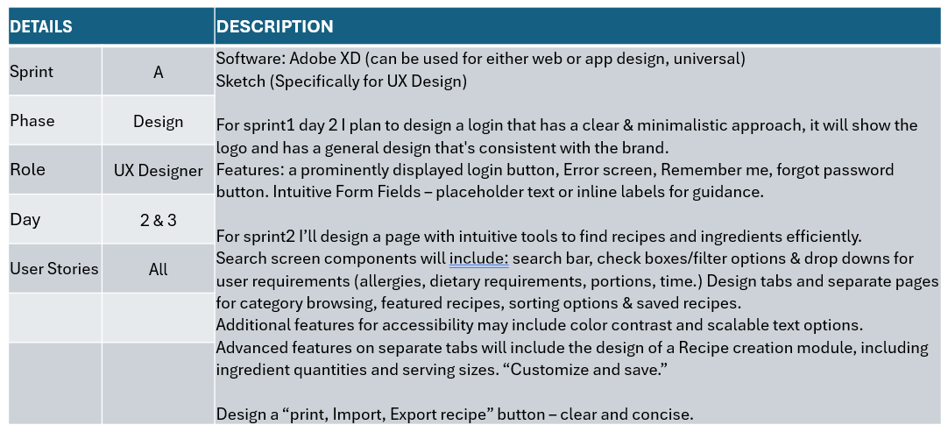

Slide 14
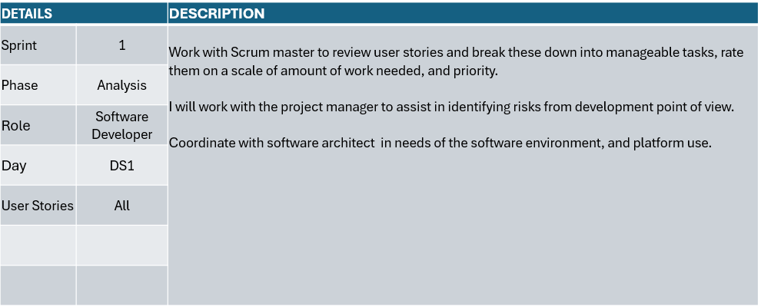

Slide 15
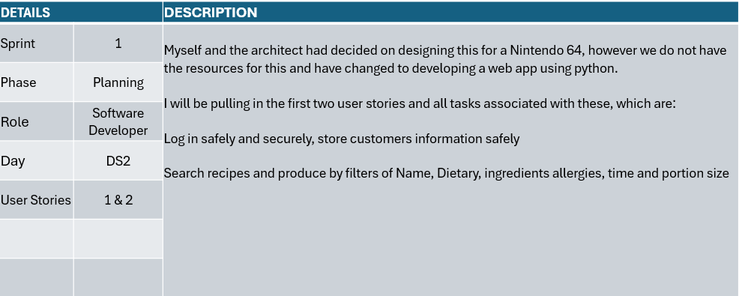

Slide 16
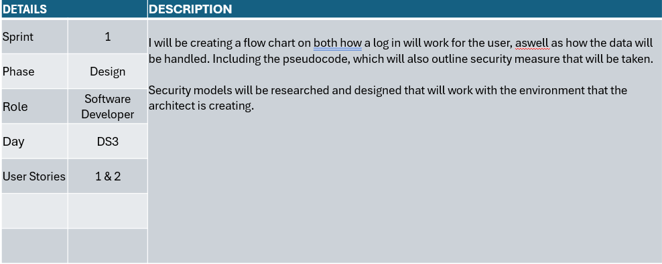

Slide 17
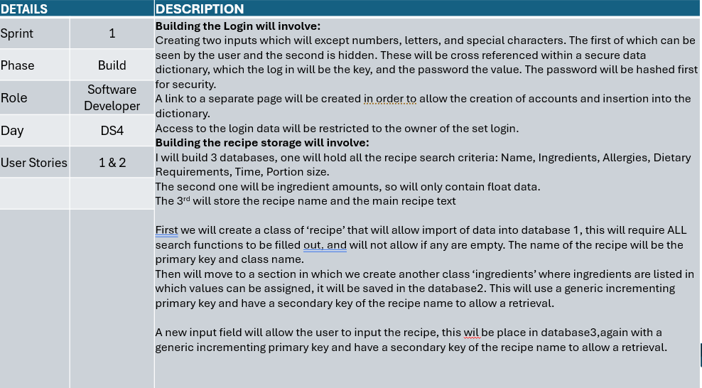

Slide 18
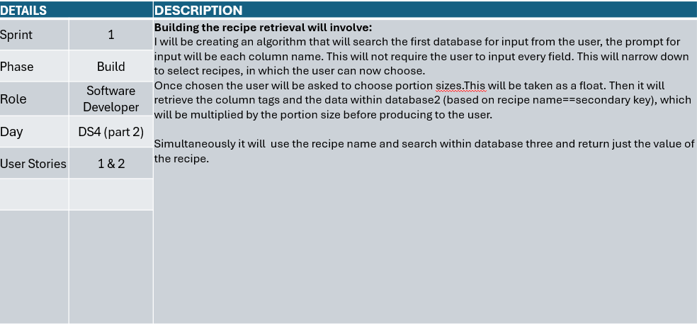

Slide 19
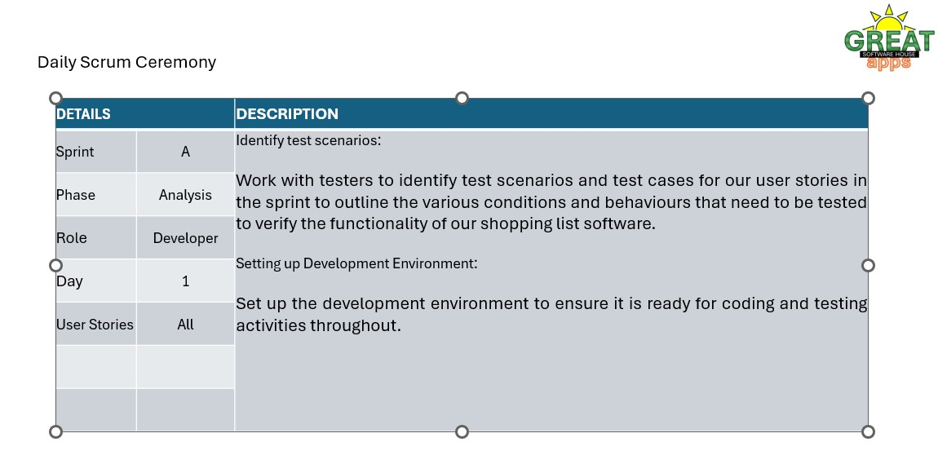

Slide 20
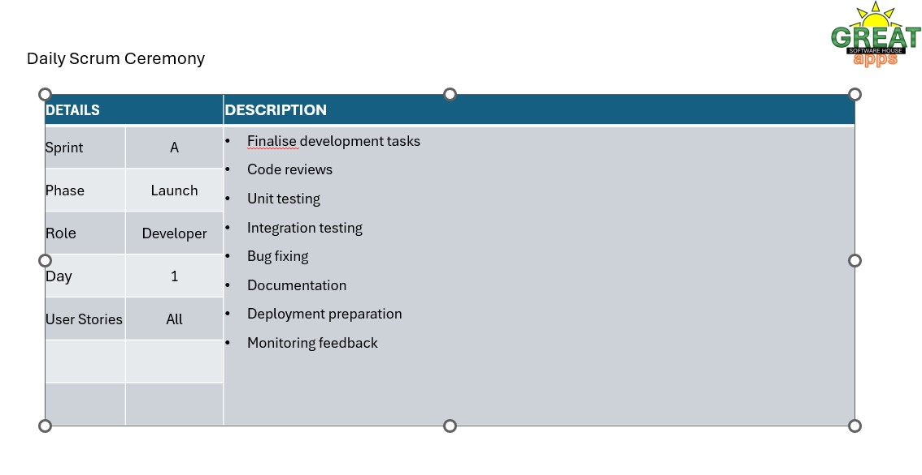

Slide 21
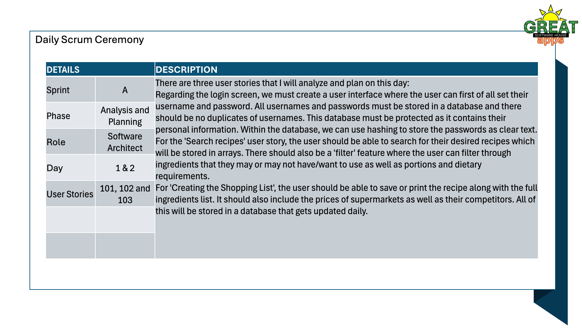

Slide 22
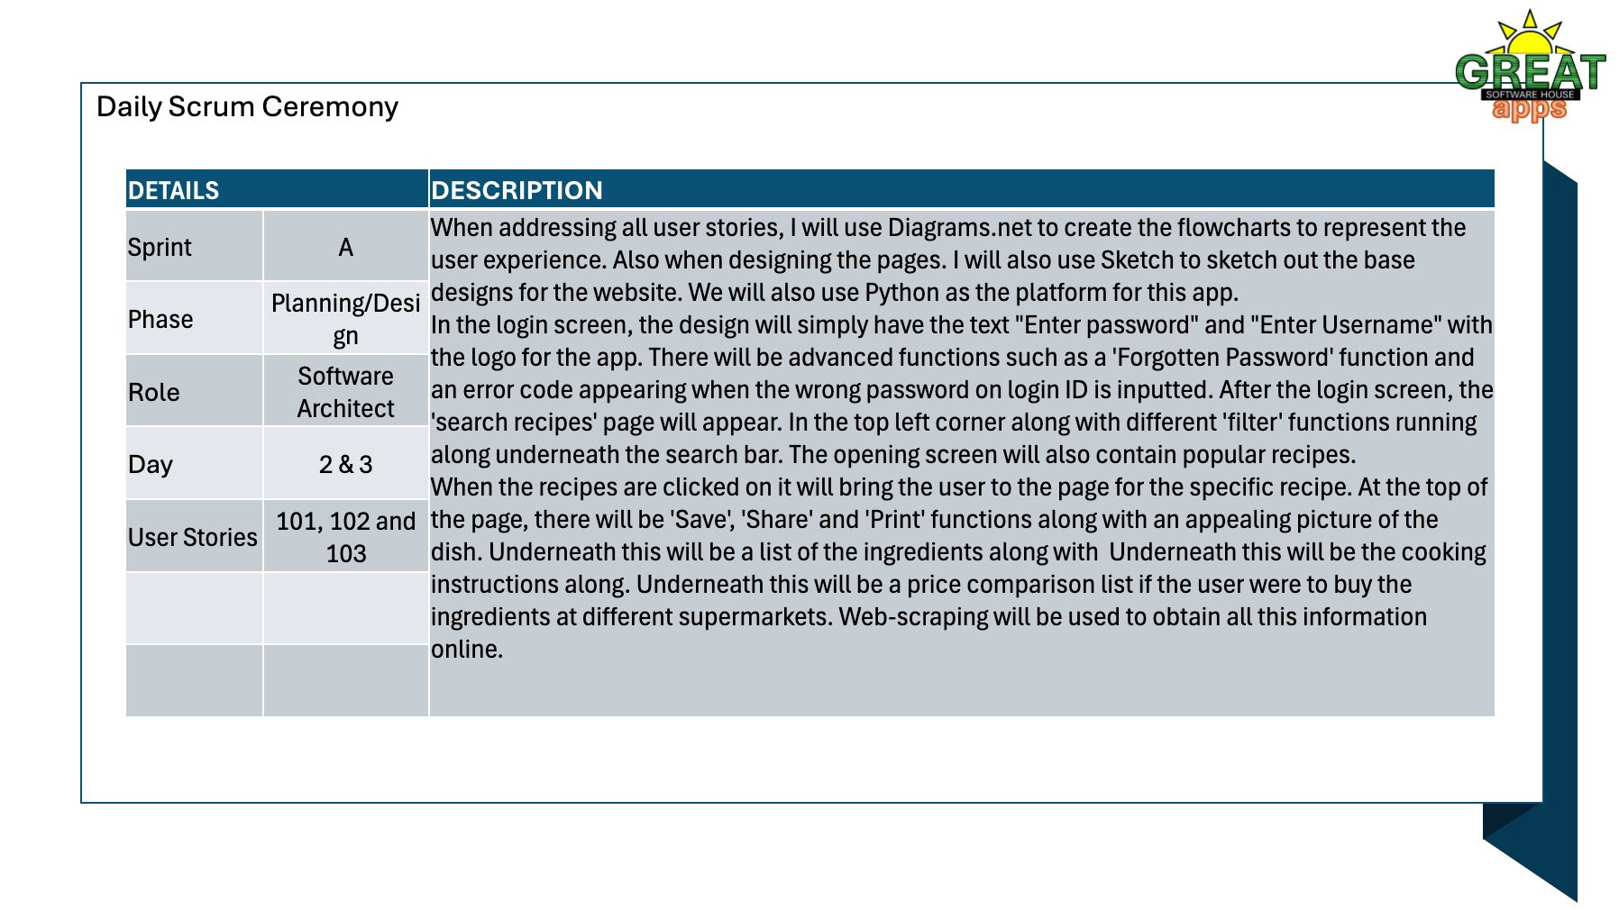

Slide 23
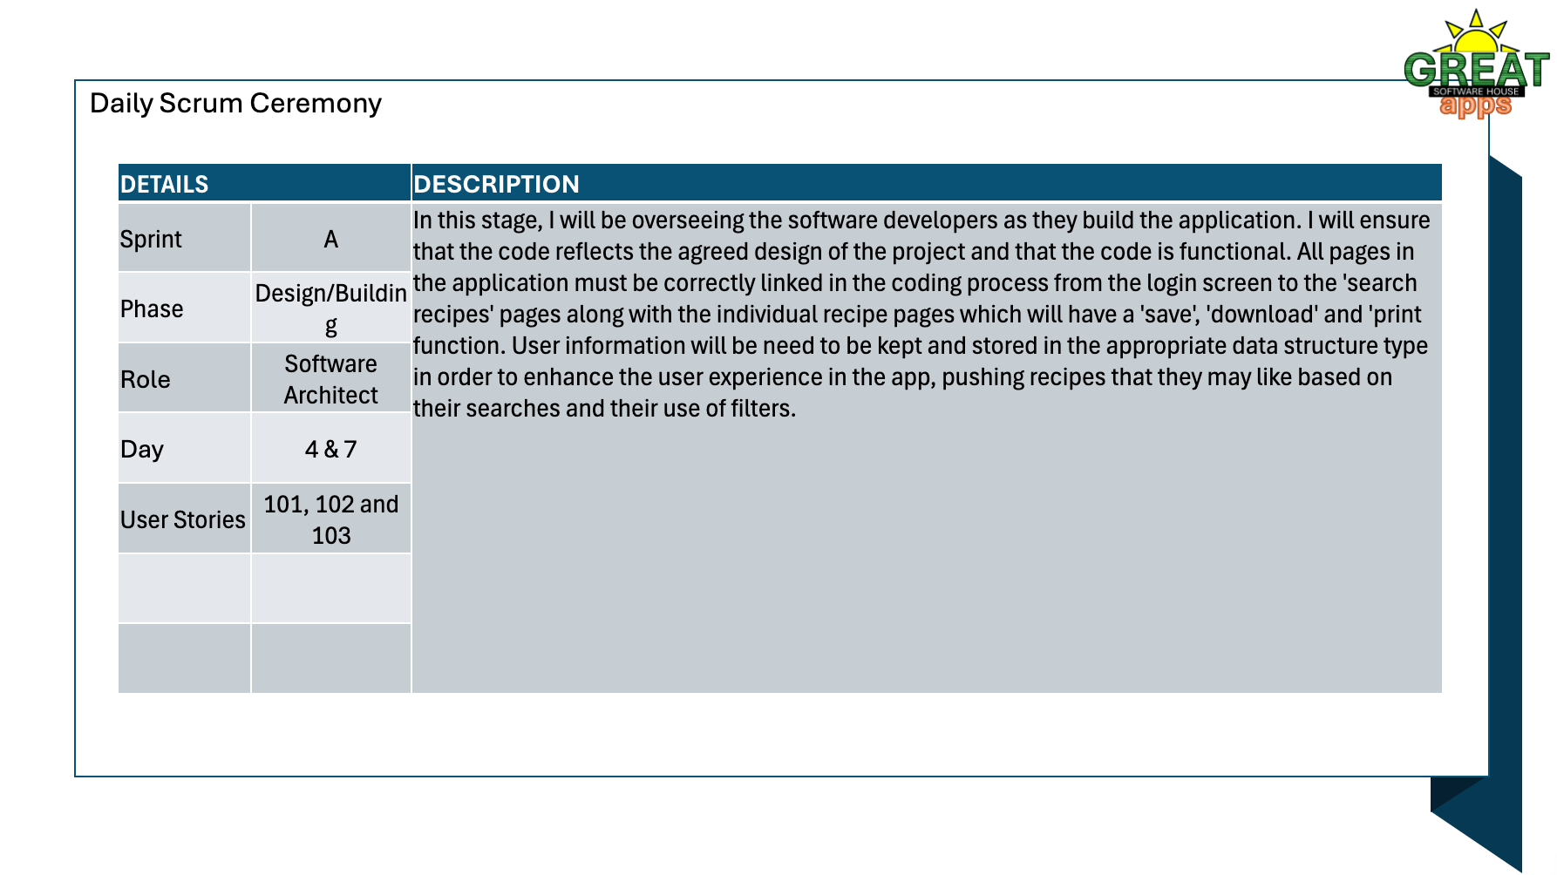

Slide 24
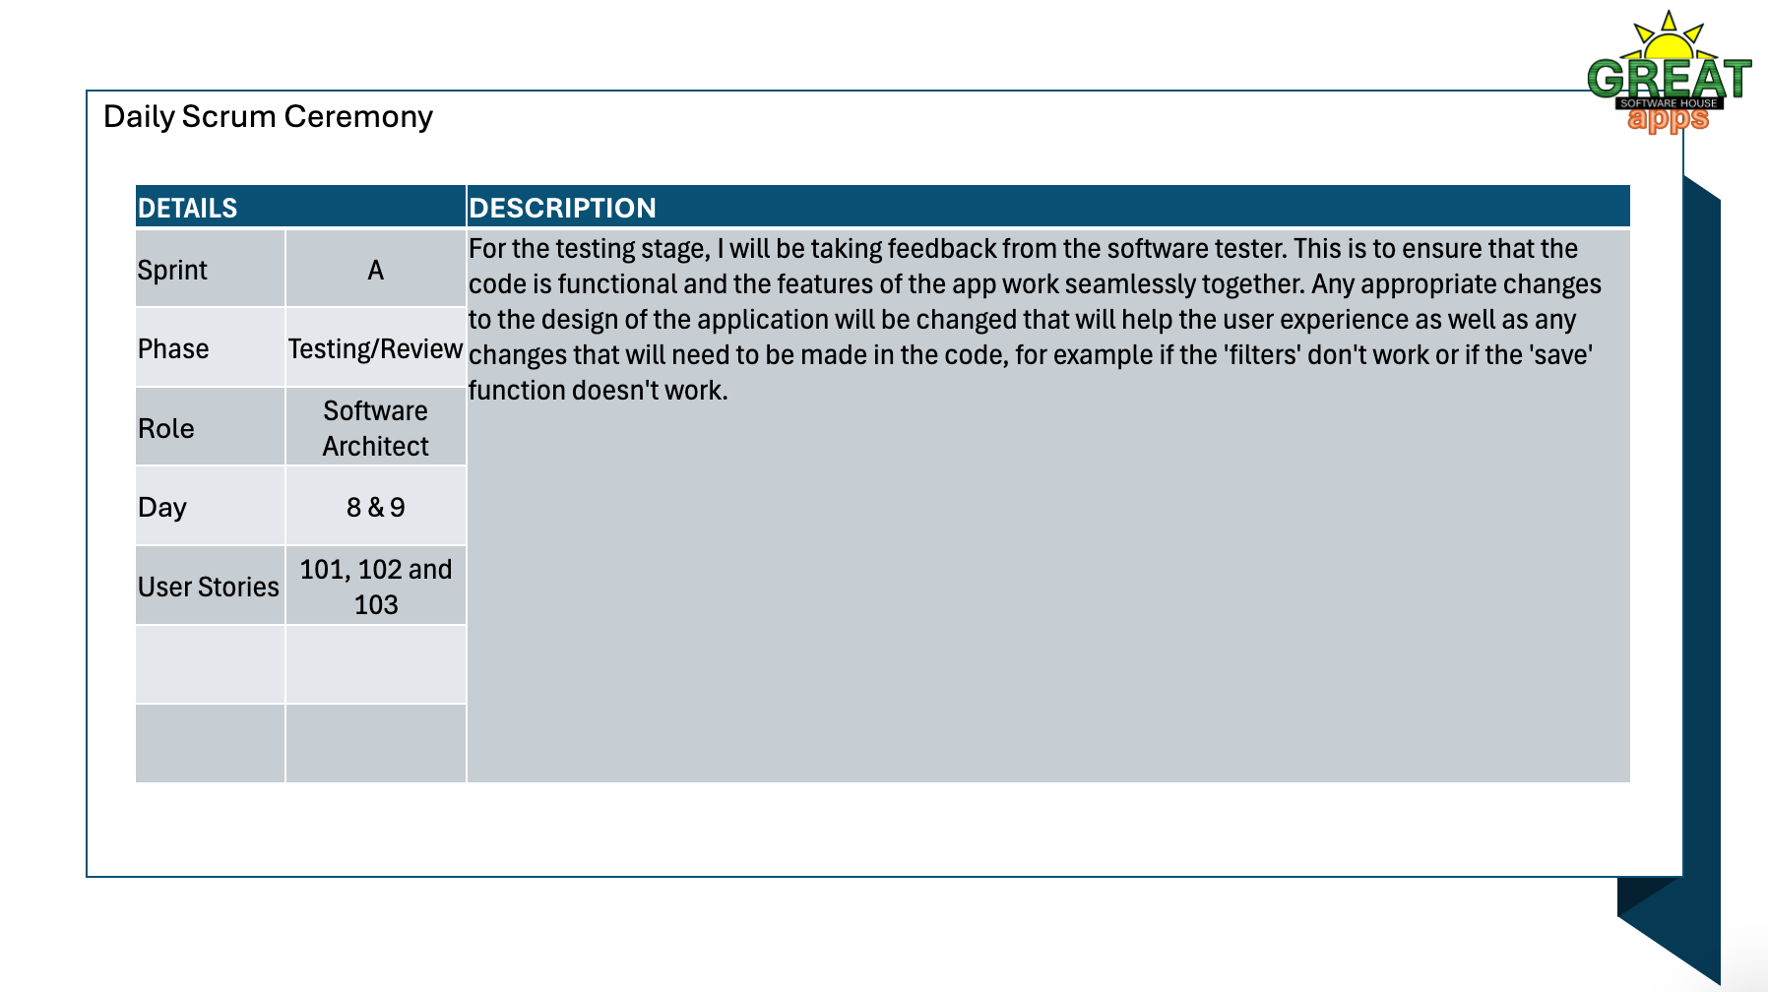

Slide 25
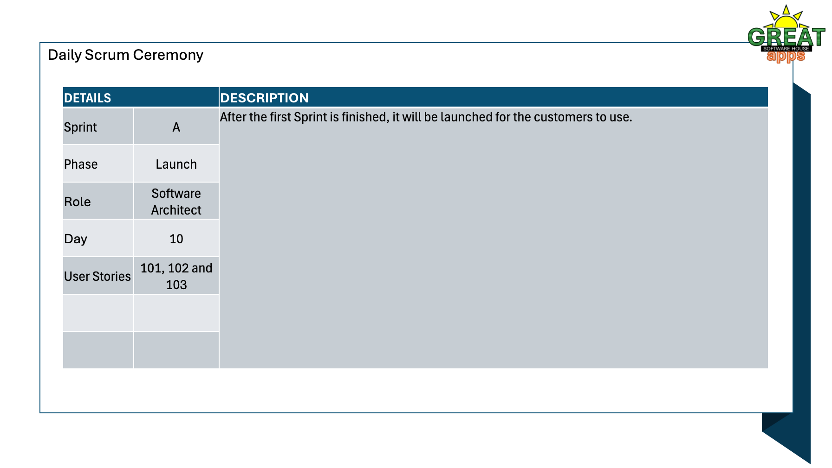

Slide 26
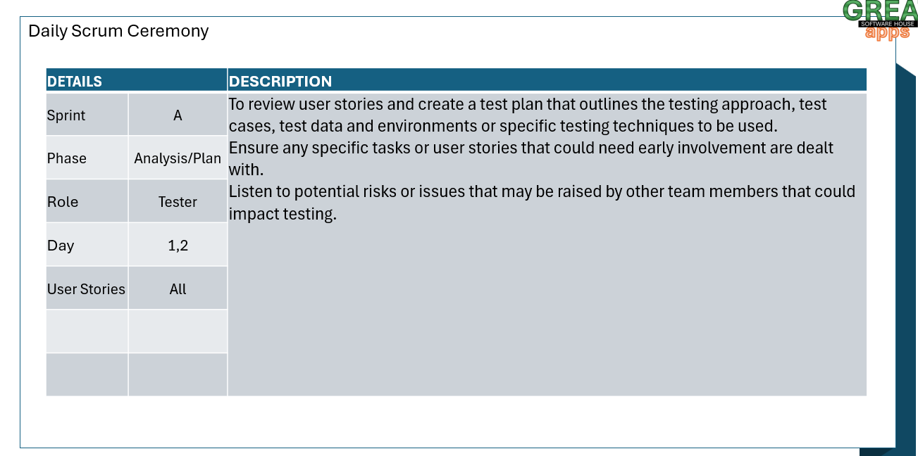

Slide 27
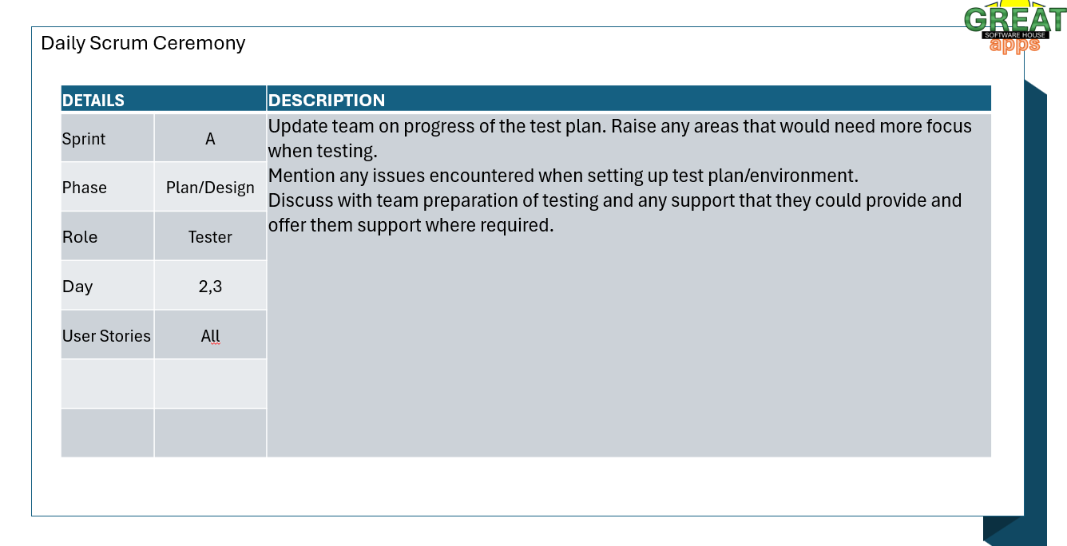

Slide 28
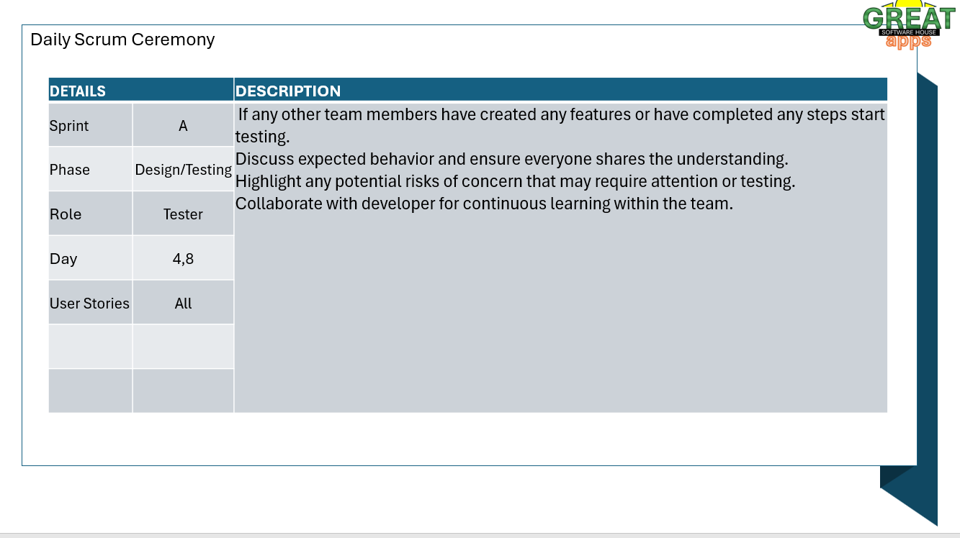

Slide 29
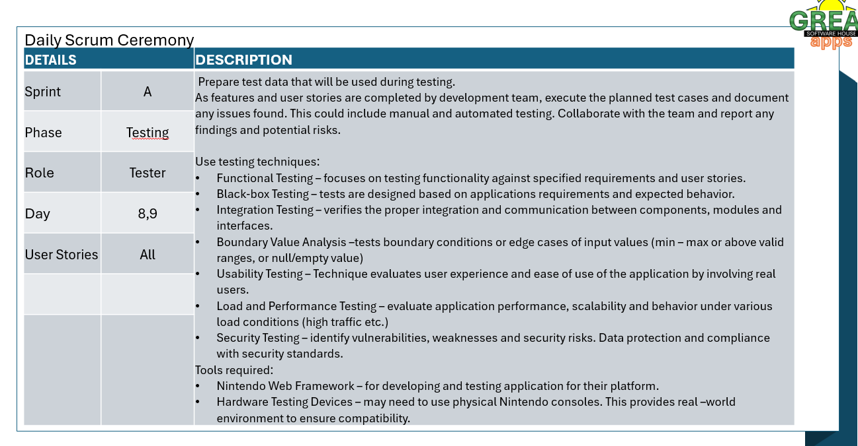

Slide 30
