Slide 1

Agile Project A
Create a calculator to be used by primary school pupils. The calculator should allow students to perform basic mathematical calculations (addition, subtraction, multiplication and division.) It should also serve as a math quiz app to test pupils on their math calculations and give them as score. The calculator should have a print, import and export functionality.
Agile Project B
Create a recipe calculator. It should provide the novice cook with recipes and a shopping list of necessary ingredients based on requested servings. It should allow the advance cook to create recipes and store ingredients based on number of servings. Pricing could be a bonus. The calculator should have a print, import and export functionality.
Overall project requirements

Slide 2
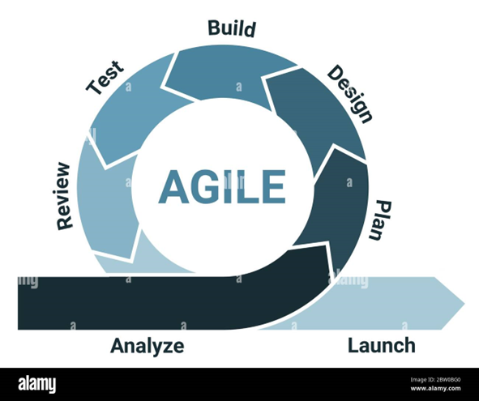
PROJECT SPECIFICATIONS.
Both projects should be produced in python using agile methodology.
There will be three scums per sprint held on Monday, Wednesday and Thursday.
Each product will be delivered in two sprints. Each sprint will last 2 weeks.
Each team will consist of a:
Software developer who is also going to be the architect for the app
Tester who is also going to be UX designer
Scrum master who is also going to be the project manager.
Team A will be team’s B customer and vice versa.

Slide 3
On Day one of the first sprint both teams will create their own app requirements that the other team will need to produce. Then, they will invite a member from the other team to attend a meeting and receive the user story product backlog.
Each product backlog will have maximum 5 user stories. Three stories will be presented at the first meeting and the other two of the requirements will be presented on day 11 at the feedback review and requirements update meeting.
The scrum master/project planer will be responsible for producing the PowerPoint presentation.
One slide will introduce a table with the job roles, the employees responsible in these roles. A job share for a role is allowed. Additional post holders may be allocated as required by the project manager.
Each sprint will include seven slides, one for each of the phases i.e., Analysis, Planning, Designing etc.
For each phase there will be a daily scrum ceremony by each role as necessary
You can exchange in any text and other information using the chat.

Slide 4
USER STORIES BACKLOG
CODE | AS A… | I NEED… | SO THAT…
101 | End User | Login Screen | I can record the user information, protect the application from unauthorised access, build user profile information +++

Slide 5
Teams Roles and Responsibilities
Role | Name | Name | Responsibilities
Software Developer/Architect
Tester/UX Designer
Scrum Master/Project Manager |  |  | Facilitate Agile ceremonies, manage project, ensure timeline adherence.

Slide 6
Sprint1: Foundation and basic Functionality
Phase | Day | Activity | Details
Analysis | 1 | Requirements Gathering | Collect and analyze requirements to define what the calculator must do.
Plan | 1,2 | Sprint Planning | Plan the sprint activities, define scope for development.
Design | 2,3 | UI/UX and System Design | Sketch initial design ideas for UI and outline system architecture.
Build | 4,7 | Development | Develop the basic functionality for recipe calculations.
Test | 8,9 | Testing | Conduct initial testing, including unit and integration tests.
Review | 10 | Sprint Review | Present the calculator to stakeholders for feedback.
Launch | 10 | Initial Release to Test Environment | Deploy the built features into a test environment for further evaluation.

Slide 7
Sprint2: Enhancement and Refinement
Phase | Day | Activity | Details
Analysis | 11 | Requirements Gathering
Plan | 11,12 | Sprint Planning
Design | 12,13 | UI/UX and System Design
Build | 14,17 | Development
Test | 18,19 | Testing
Review | 20 | Sprint Review
Launch | 20 | Initial Release to Test Environment

Slide 8
Daily Scrum Ceremony
DETAILS |  | DESCRIPTION
Sprint | A | To review user stories and …
Phase | Analysis
Role | Project Manager
Day | 1
User Stories | All

