Slide 1



SUMMER PROJECT ON EXAM SEAT MANAGEMENT SYSTEM AT HIMALAYA DARSHAN COLLEGE BY Kailash Yadav BIM-6th Semester 9327/18

Slide 2
INTRODUCTION
The Exam Seat Management System can automate the process of exam
seating arrangement.
Avoid conflict of same roll number in more than one seat.
It will be easier to manage the location by arranging each hall in a computer-generated way.
This is very useful for colleges.

Slide 3
INTRODUCTION OF ORGANIZATION
Himalaya Darshan College(HDC) is a service oriented organization.
It is established in 2070 B.S.
Provides innovative opportunities in highly academic environment.
HDC is TU affiliated and currently running Five programs.
Programs: Bsc. CSIT, BIM, BCA, BHM and BBS.

Slide 4
PROBLEMS STATEMENT
Allocation of seating arrangement is done manually, making lots of paper work.
Most of the students feels difficult to search their allotted seat during exam.
Difficult to arrange invigilators.

Slide 5
OBJECTIVES OF SYSTEM
To automate the exam seat plan.
To generate the master seat-plan.
To manage the details of Student, Room, Invigilator, Exam and Faculty.

Slide 6
DATA COLLECTION
Primary sources
Interview
Observation
Questionnaires
Questionnaire
Does the organization use any kind of computer-based system or not?
How do you manage the seating arrangement for the exam?
Secondary sources: Websites

Slide 7
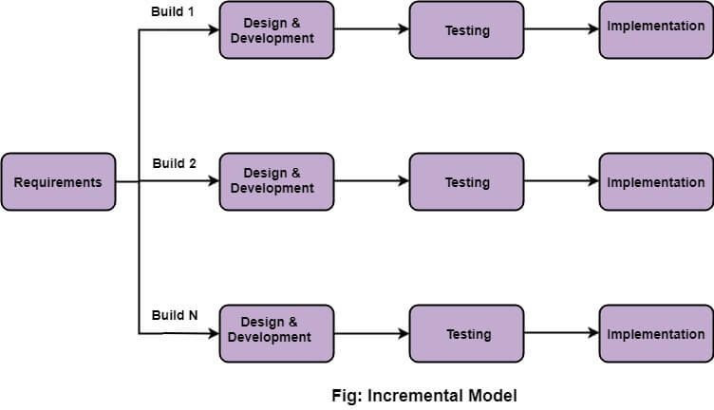
METHODOLOGY
Incremental Model

Slide 8
IMPLEMENTED TOOLS
Frontend: HTML, CSS, Bootstrap and JavaScript
Backend: PHP
Database: MySQL
Server: Apache

Slide 9
EXPECTED OUTCOMES
Automatic generate the exam seat plans and master plan.
Student can search their exam seat.
Make tasks much faster and more reliable.
Avoids the errors and conflict.

Slide 10
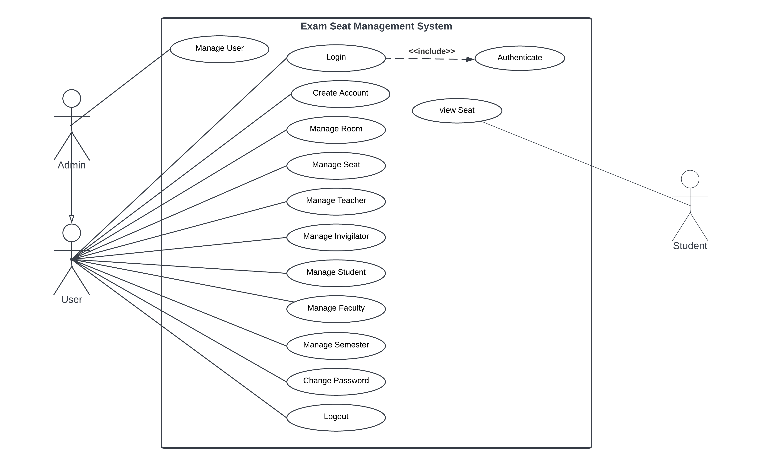
Use case Diagram

Slide 11
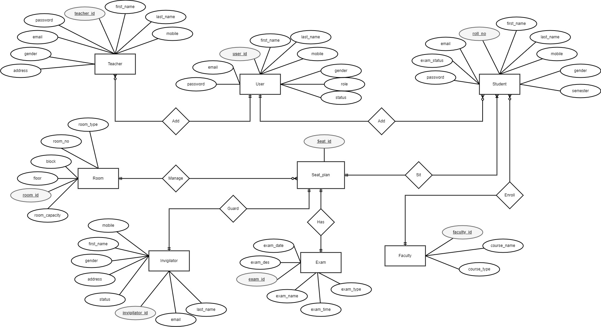
ER-Diagram

Slide 12
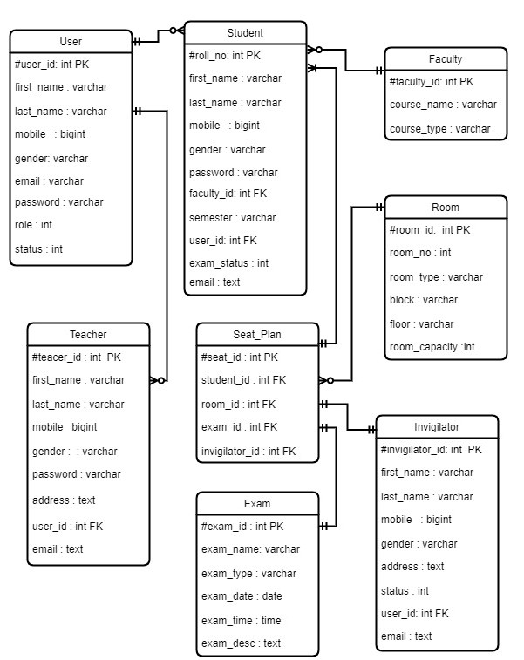
Schema Diagram

Slide 13
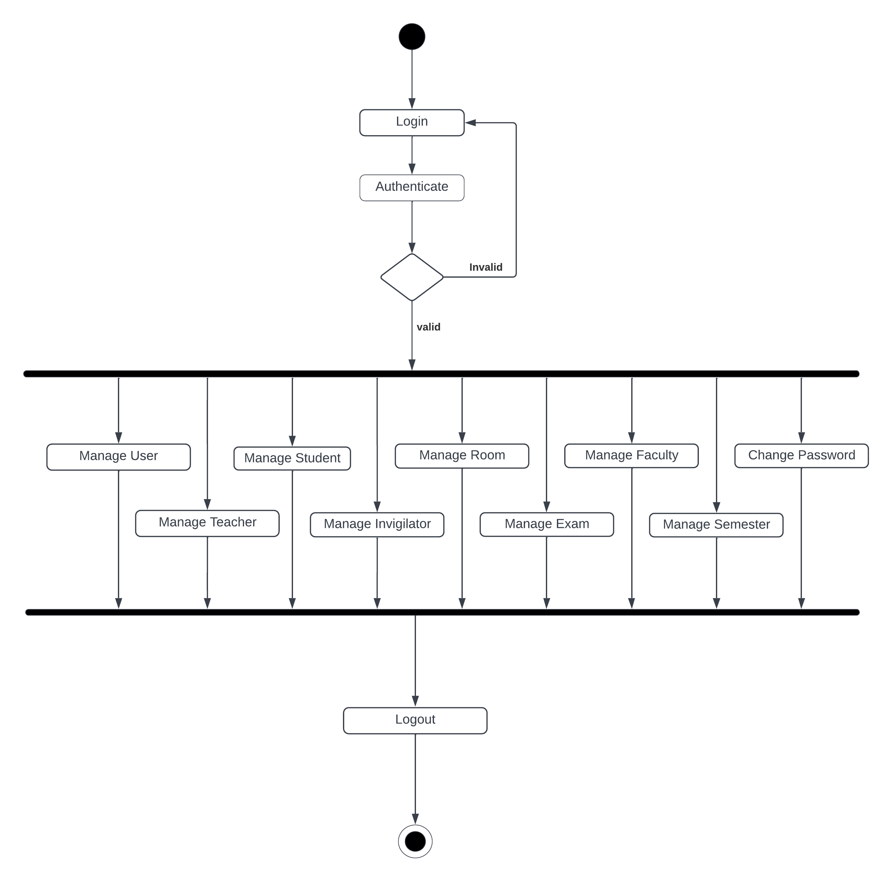
Activity Diagram

Slide 14
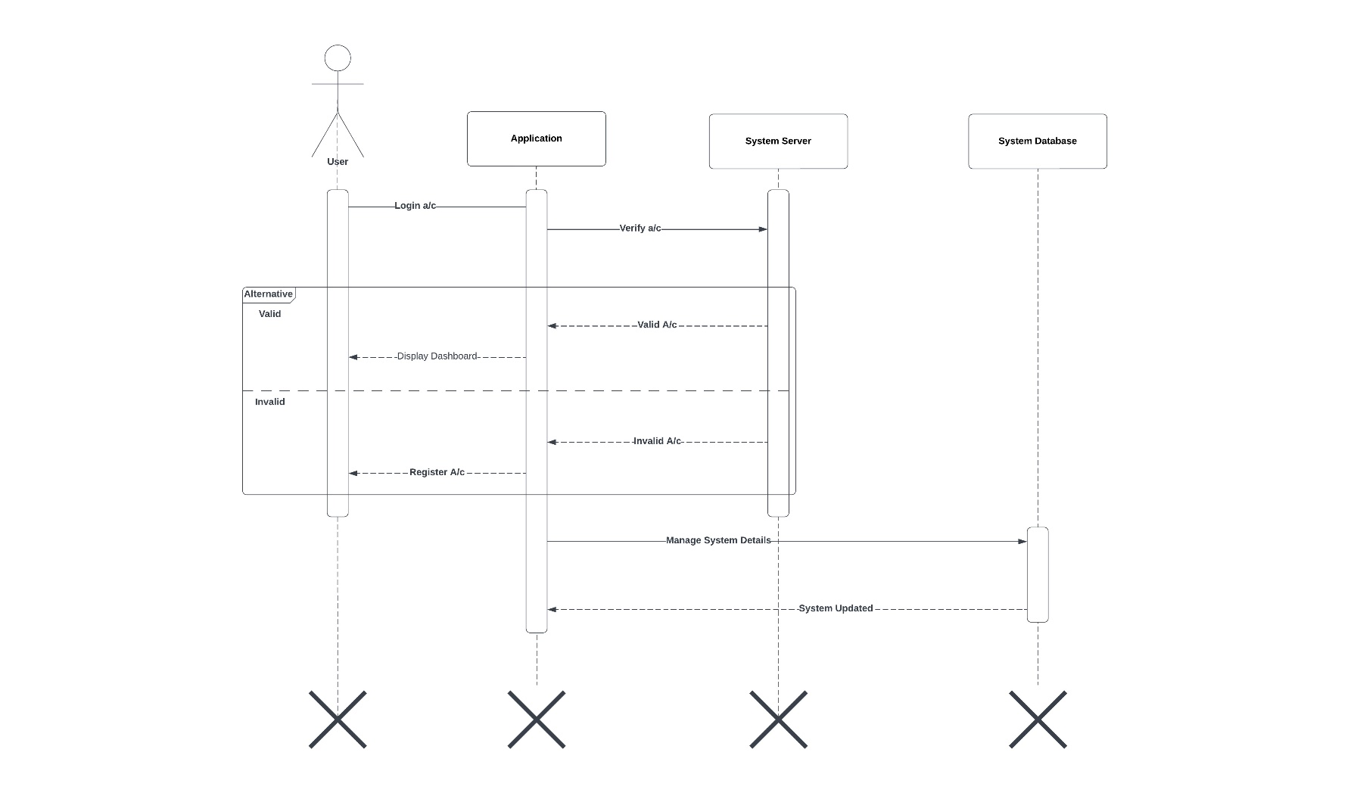
Sequence Diagram

Slide 15
Future Enhancements & Limitation
Future Enhancements
Make system accessible to faculty members with authentication.
Generate attendance sheet as per the seating arrangement.
Limitation
Seating arrangement is proper in case students from all the classes have almost equal number of students.

Slide 16
REFERENCES
Gokila, R. and Dass, A.R. (2018) Examination Hall and Seating Arrangement Application using PHP. International Journal of Engineering Science and Computing. Available at: https://ijesc.org/upload/81007e44d9a4b5cf6db7d5748e1019fa.Examination%20Hall%20and%20Seating%20Arrangement%20Application%20using%20PHP.pdf (Accessed: July 20, 2022).
Freeprojectz (2016) Exam Seating Arrangement System, Freeprojectz. Freeproject. Available at: https://www.freeprojectz.com/paid-projects/exam-seating-arrangement-system (Accessed: July 20, 2022).
Anjum, S., Chodey, M.D. and C, M.A. (2021) Automation of Exam Hall Allotment and Seating Arrangement, ijert. IJERT. Available at: https://www.ijert.org/automation-of-exam-hall-allotment-and-seating-arrangement (Accessed: August 3, 2022).

Slide 17
Screenshots

Slide 18
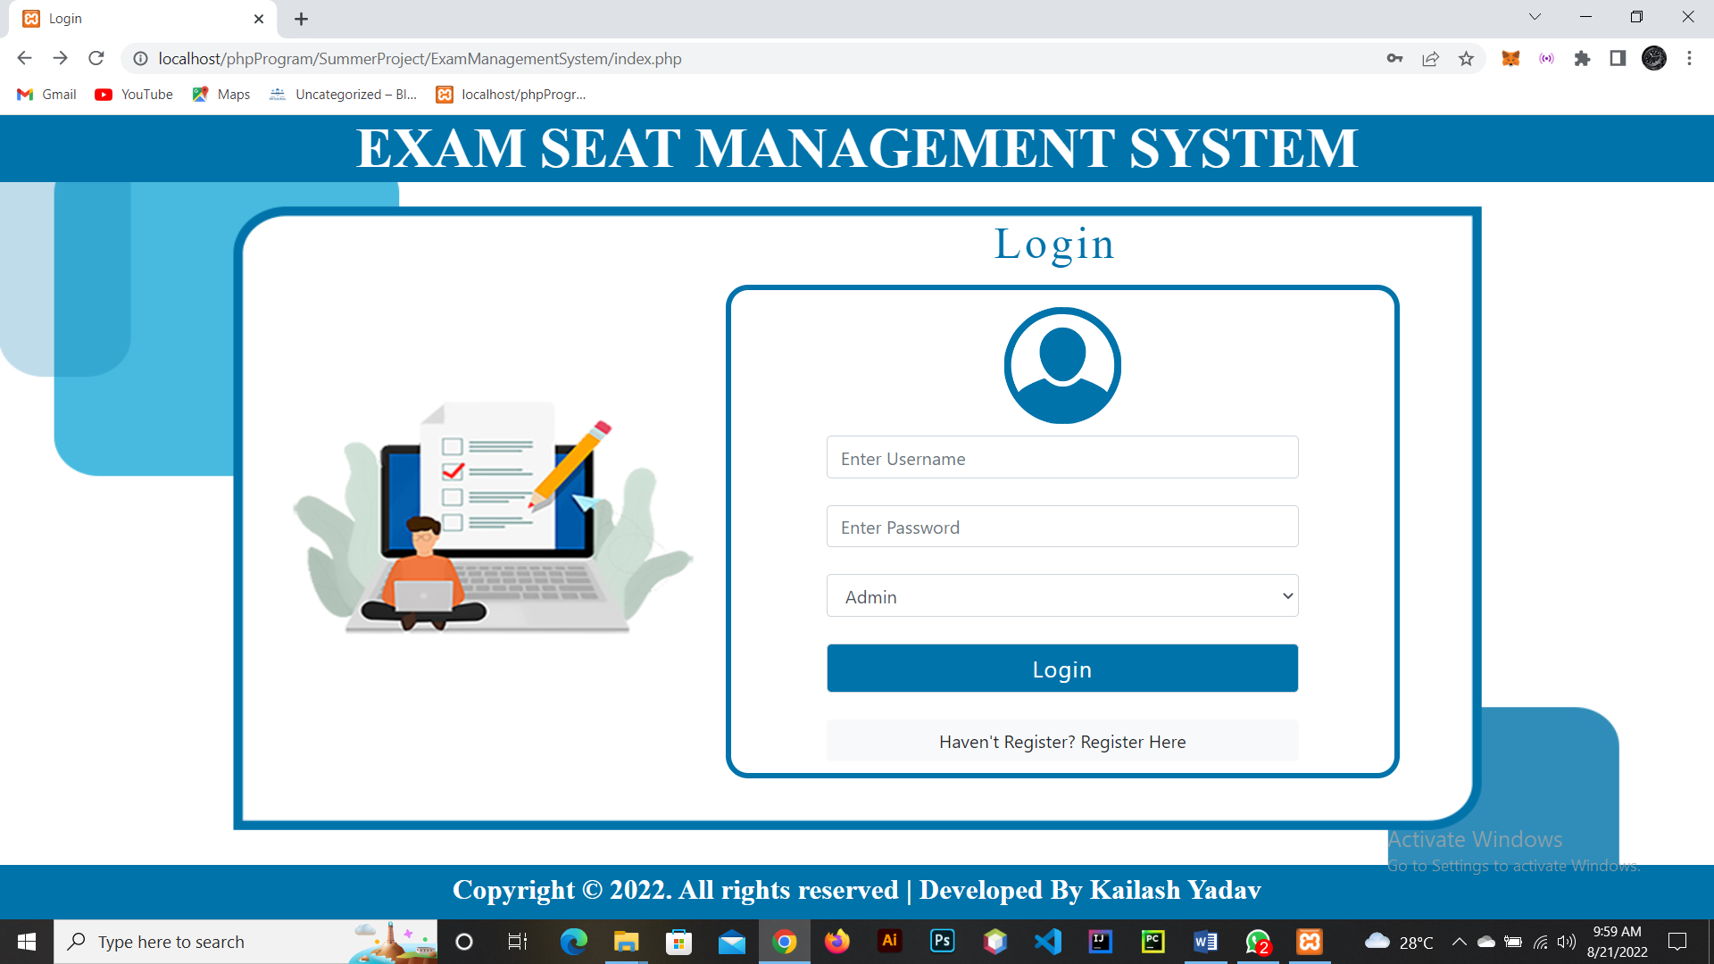
Login

Slide 19
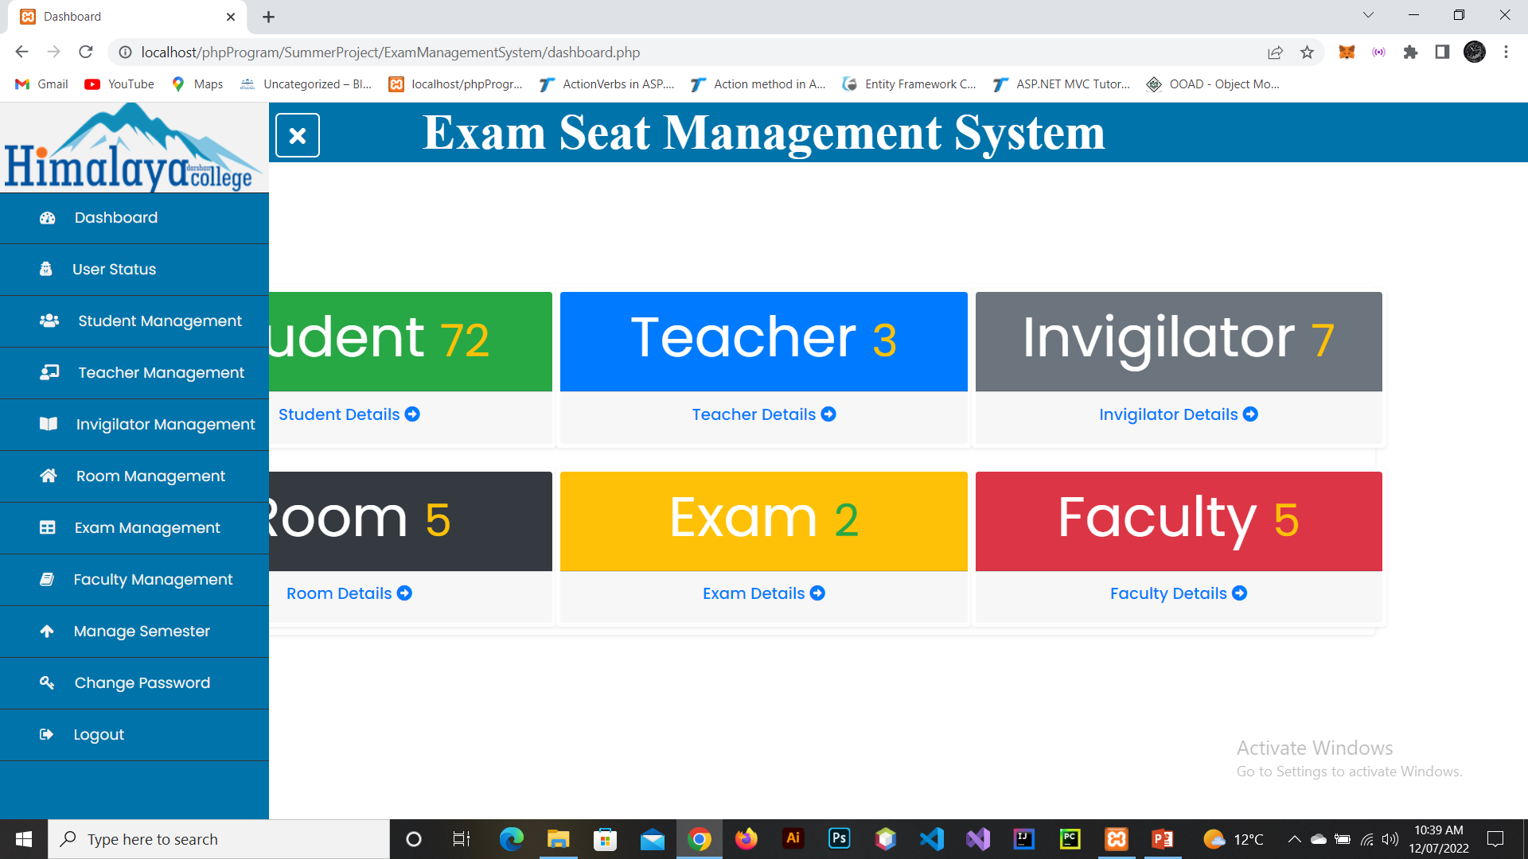
Dashboard

Slide 20
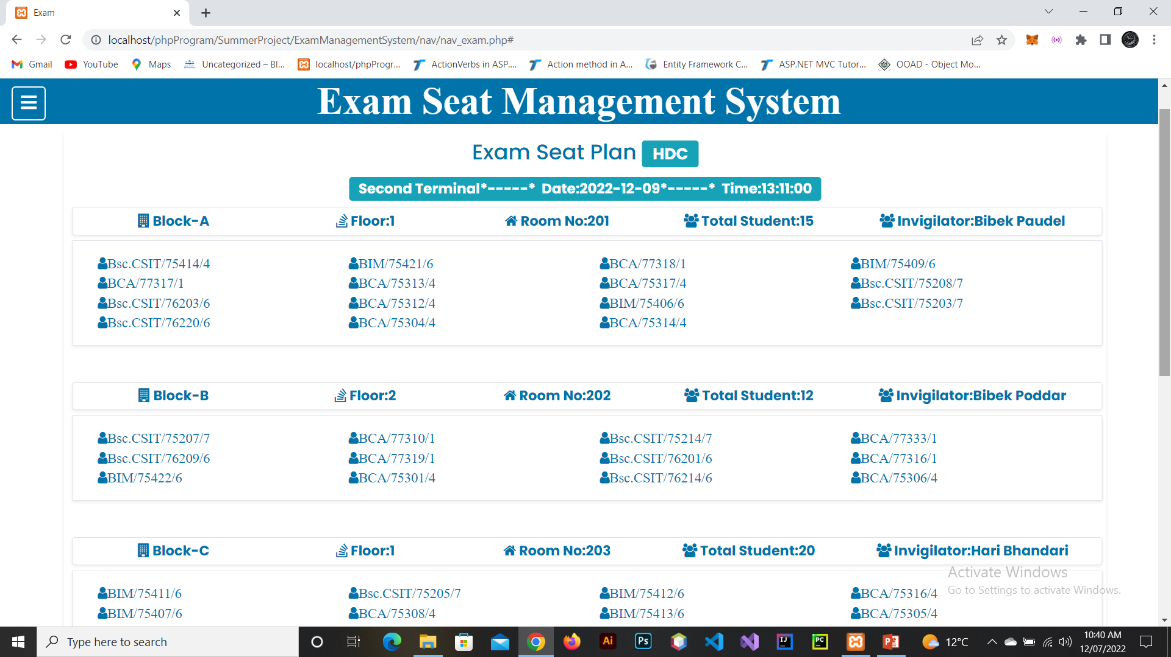
Exam Seat

Slide 21
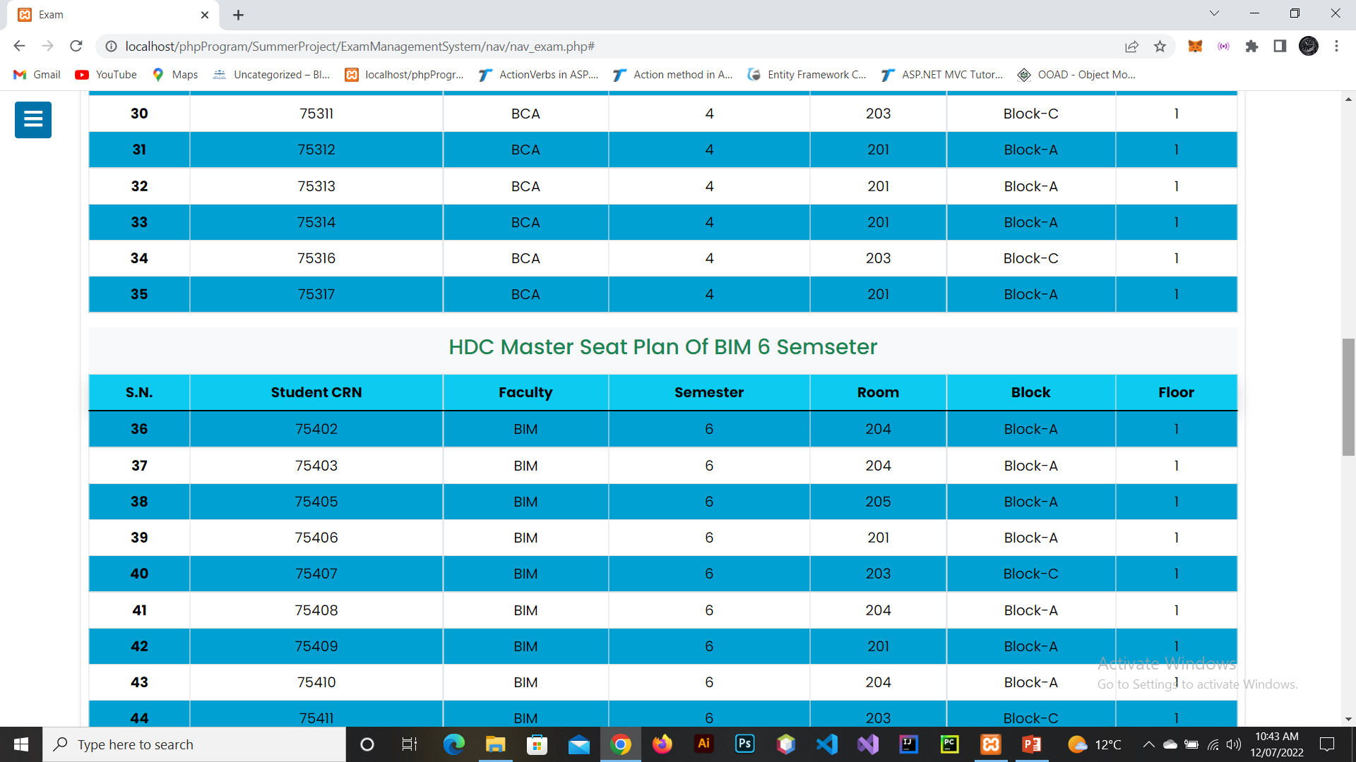
Master Seat

Slide 22
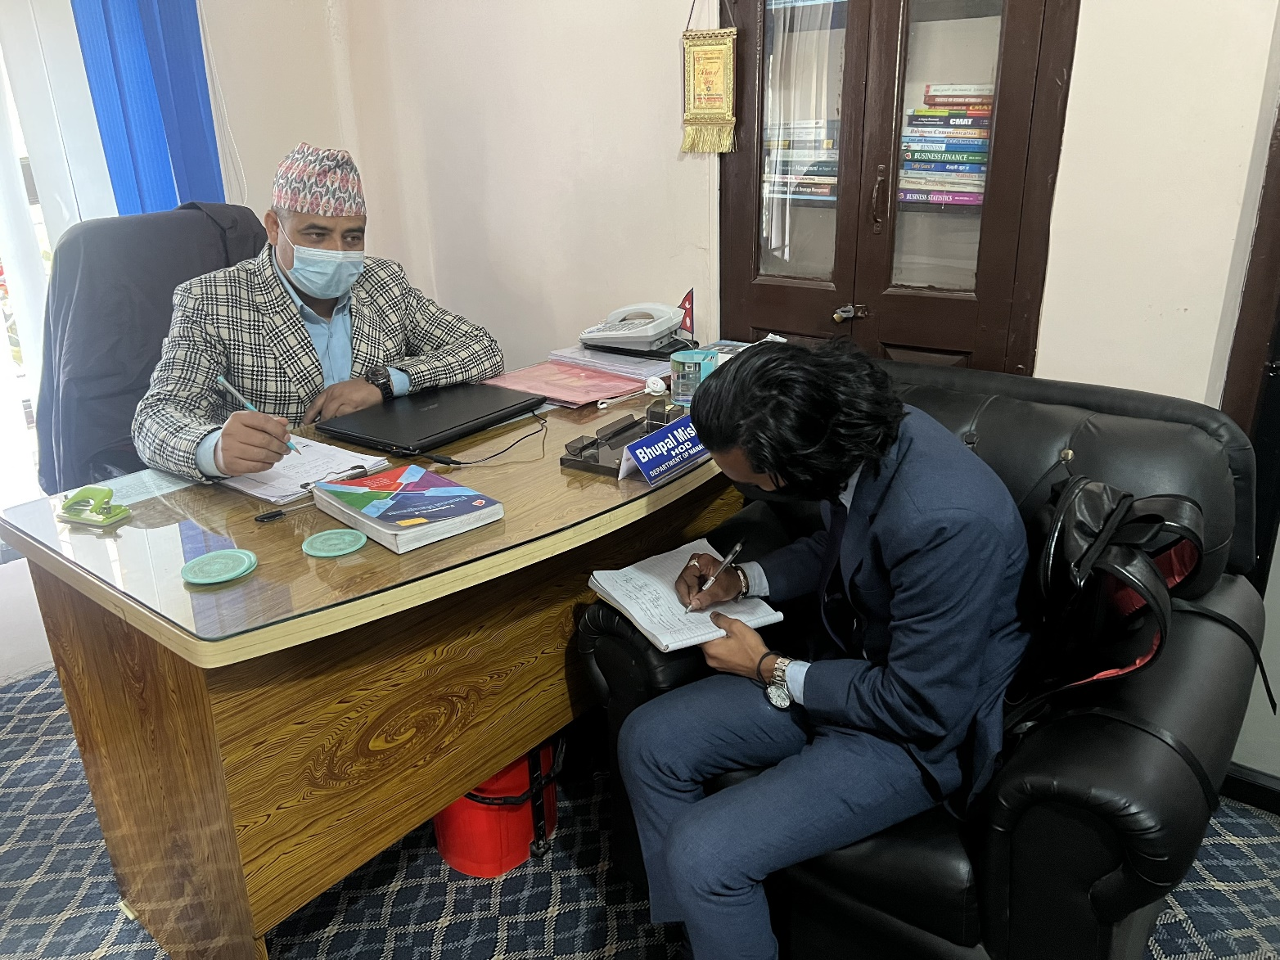
Interview with exam coordinator

Slide 23
Thank You

