Slide 1
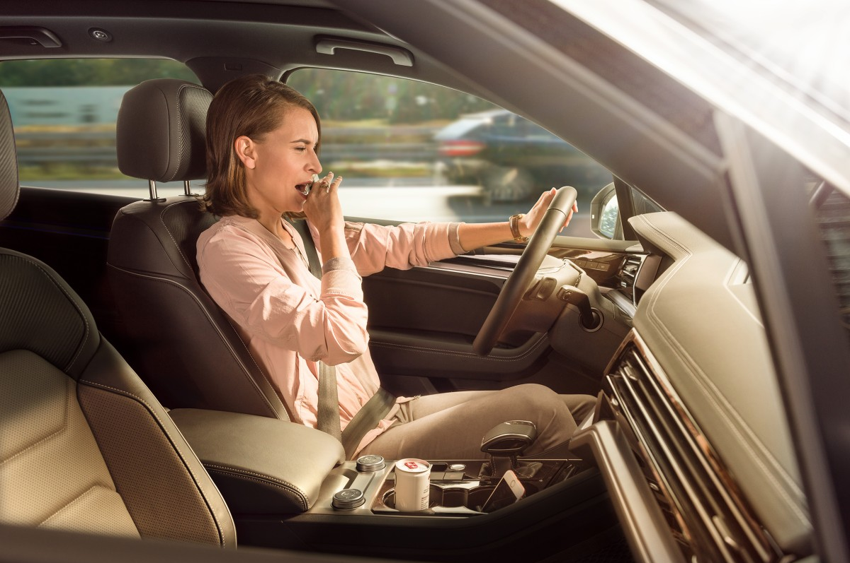
Driver Drowsiness Detection

Slide 2
Tired while driving?
And you have already drunk a coffee, turned up the music and or opened the window?
You have to drive even longer. What are you doing now?
Notes:
- Verhandeln ist Bestandteil unseres Lebens

Slide 3
Tired while driving?
Try the Driver Drowsiness Detection
even if you don't realize that you're tired
Notes:
- Verhandeln ist Bestandteil unseres Lebens

Slide 4
Main Idea
DROWSINESS
BLINKTIME
The system detects the drowsiness of the car driver.
z
z
z
The system analyze how long the car driver blinks.
EYE BLINK
WARNING
The system detects the eye blink of the car driver.
The system warns the car driver by playing a sound, if the blink time is too long.

Slide 5
Driver Drowsiness Detection
prevents accidents caused by inattention due to driver fatigue!

Slide 6


Technical data
PYTHON
IMPUT
The programming language is Python.
The imput is a video or maybe the camera.
OPENCV
OUTPUT
The system uses the OpenCV library.
The output is the blink time and the warning sound (if the blink time is too long).

