Slide 1
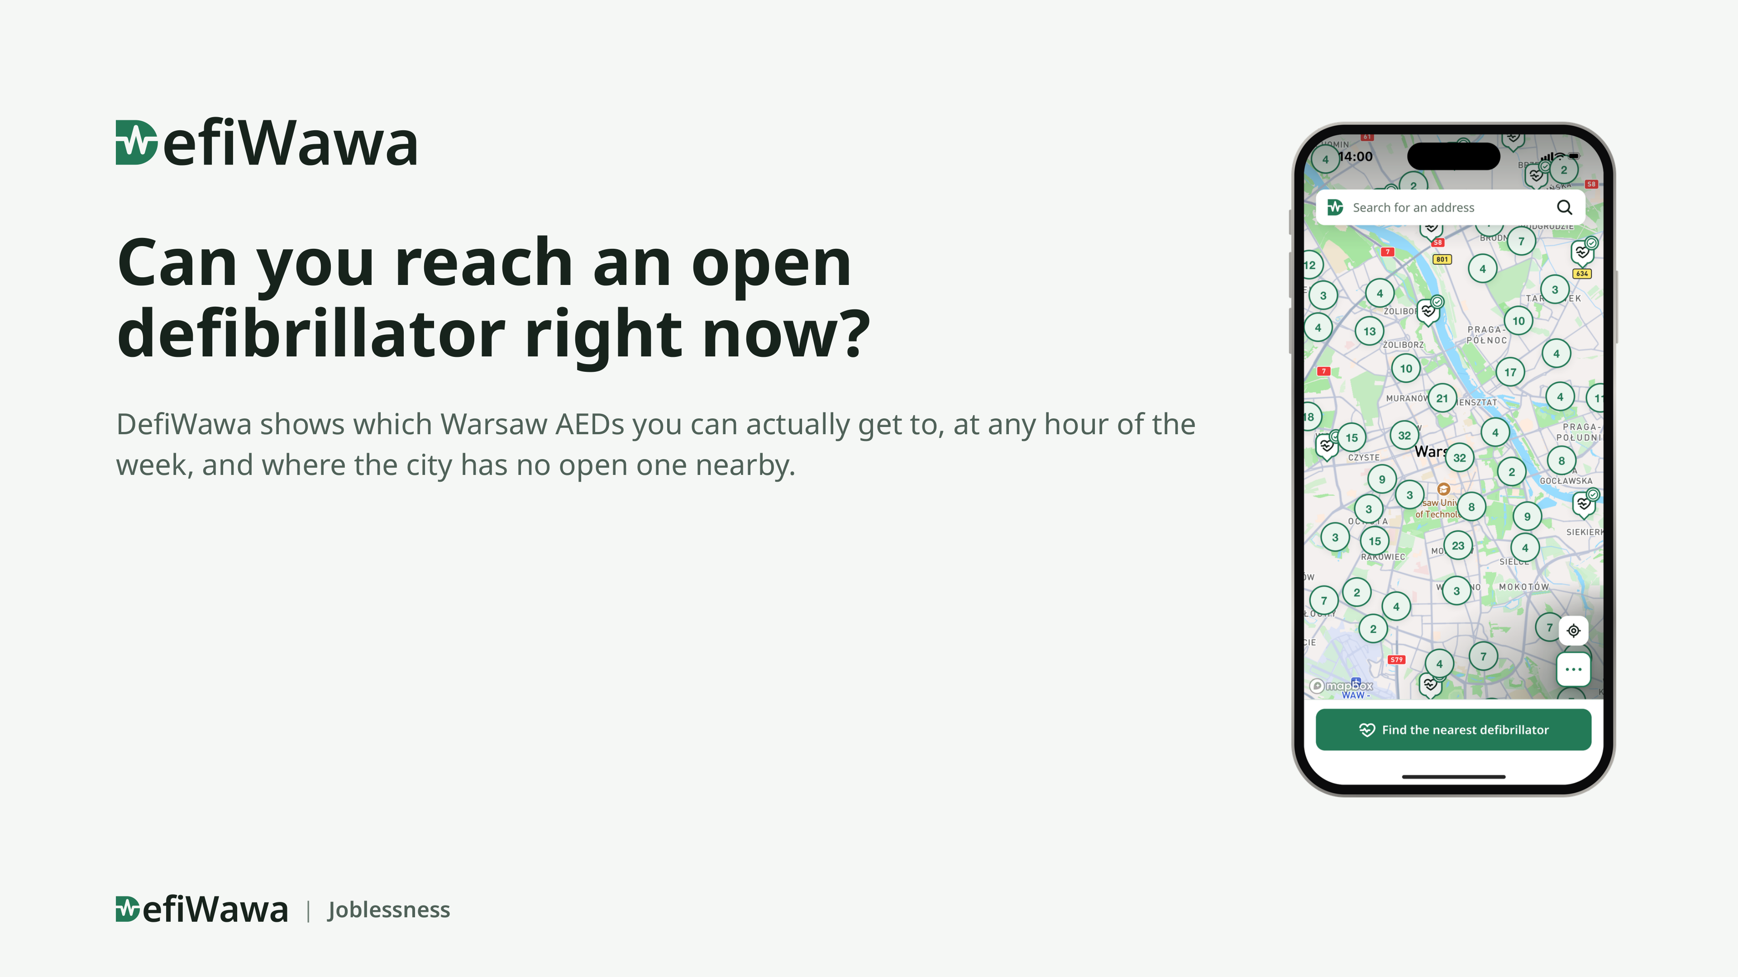
Notes:
0:00–0:10. One line: “We built a map that answers one question: can you get to a defibrillator right now?” Then go straight to the next slide.

Slide 2
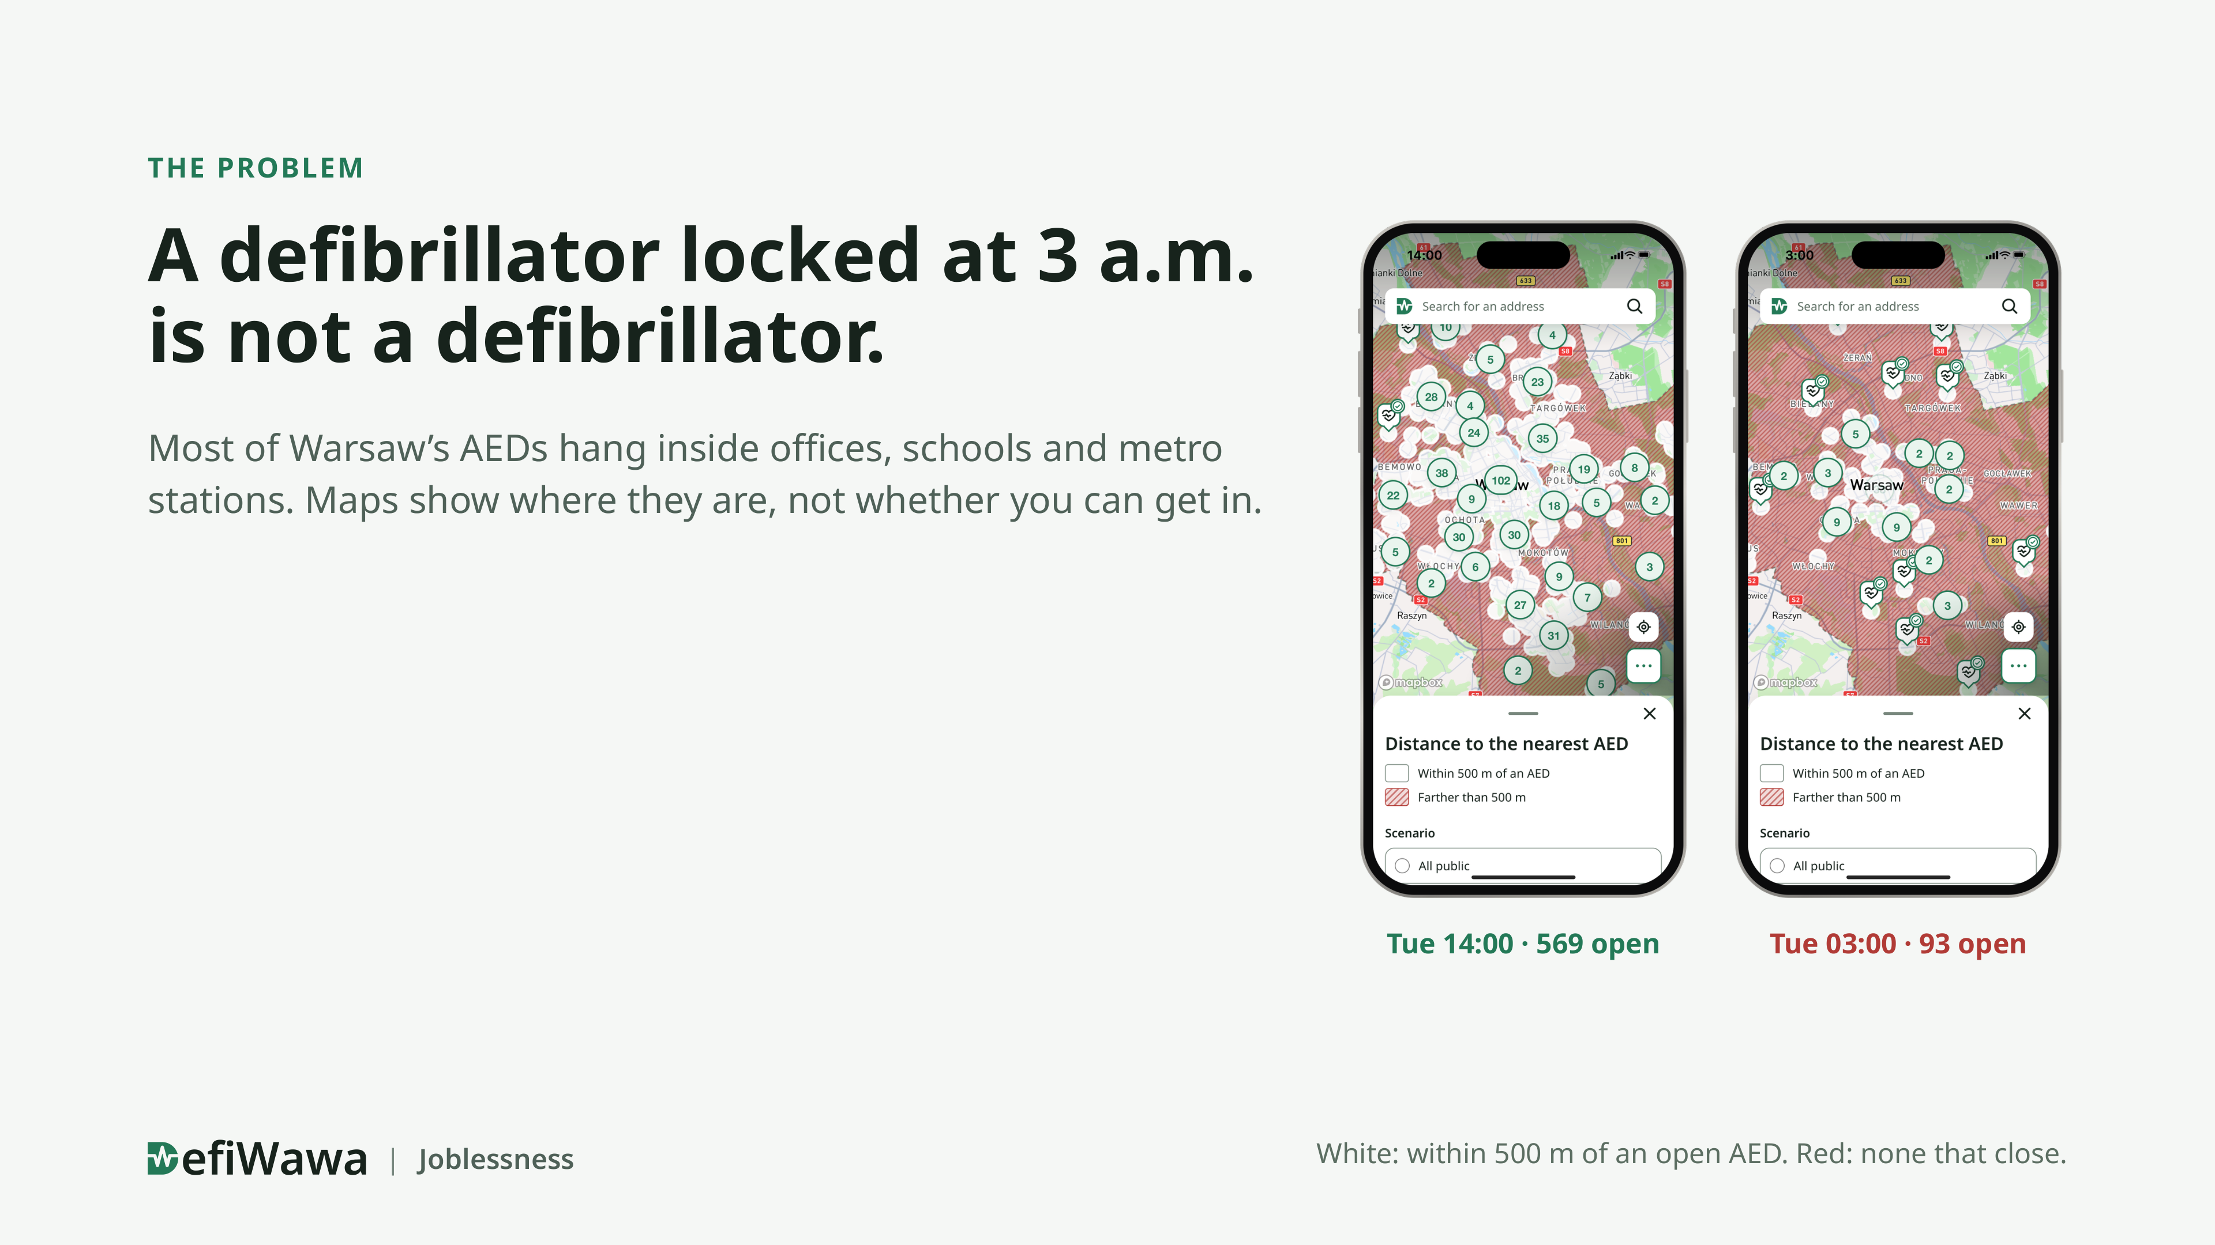
Notes:
0:10–0:30. “Imagine someone collapses on the street at three in the morning. The nearest defibrillator is in a locked office. Here is Warsaw at two in the afternoon, and the same city at three at night. Red means: no open defibrillator within 500 metres.” Point at the red phone.

Slide 3
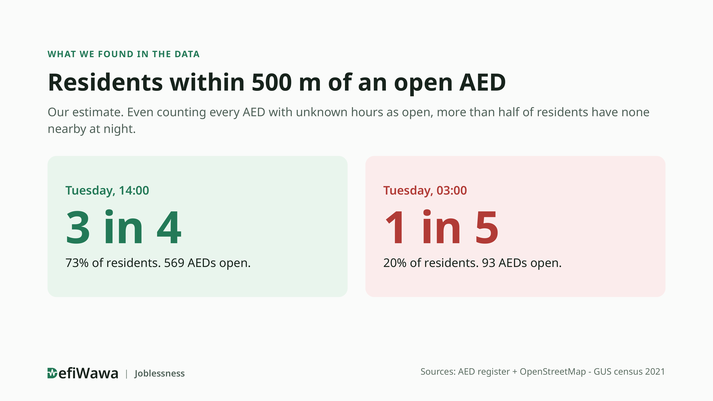
Notes:
0:30–1:00. Say the number three times in plain words. “During the day, three in four residents have an open defibrillator within 500 metres. At night, one in five. This is our estimate from confirmed hours. Even if we assume every unknown one is open, more than half of Warsaw still has none at night.” Say “as far as we found”, never “nobody”.

Slide 4
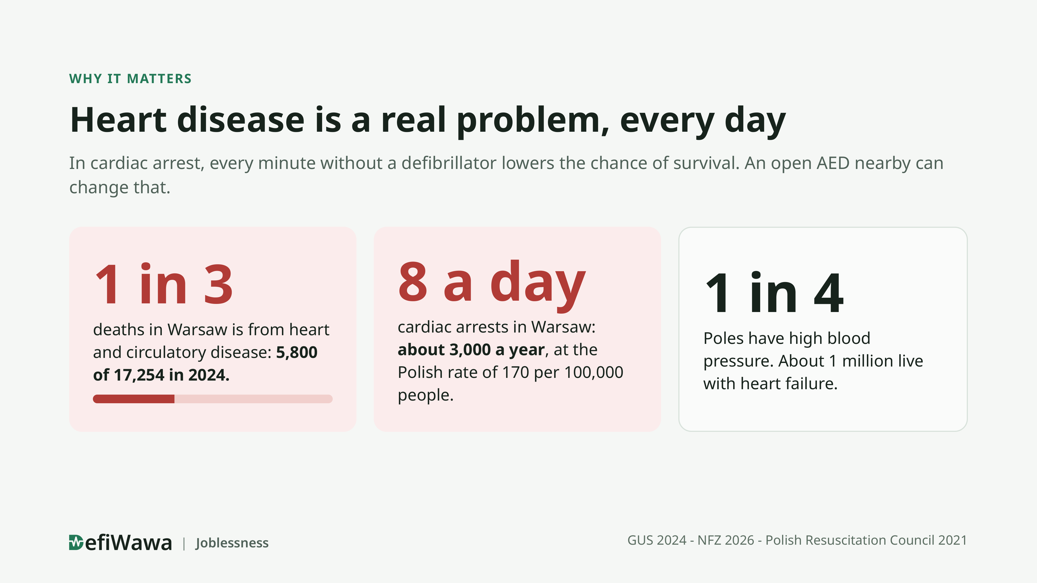
Notes:
“This is not a rare problem. Of 17 thousand deaths in Warsaw in 2024, 5,800 were from heart and circulatory disease: one in three. At the Polish rate, Warsaw has around eight cardiac arrests every day, about three thousand a year. Up to one in four Poles has high blood pressure, about a million live with heart failure. In cardiac arrest every minute without a defibrillator counts, so an open AED nearby can change the outcome, even if only for some of them.” Sources if asked: GUS 2024 cause-of-death data for Warsaw (33.9% of 17,254 deaths); NFZ data reported in May 2026 (up to 10 million with hypertension, about 1 million with heart failure); cardiac arrest incidence 170 per 100,000 per year (Polish data from 2016, cited in the 2021 resuscitation guidelines). The 5,800, 3,000 and 8 a day are our own arithmetic from those rates.

Slide 5

Notes:
Demo, about 3 minutes. Invite the jury to scan the code and follow along. 1) Coverage at Tuesday 14:00, then drag to 03:00: the city turns red. 2) Open one AED: hours, entrance, unknown hours shown as unknown. 3) Type an address: the nearest open AED and the walking time. 4) If time allows: where to add AEDs at night. If the network fails, play the recorded video of the same build.

Slide 6
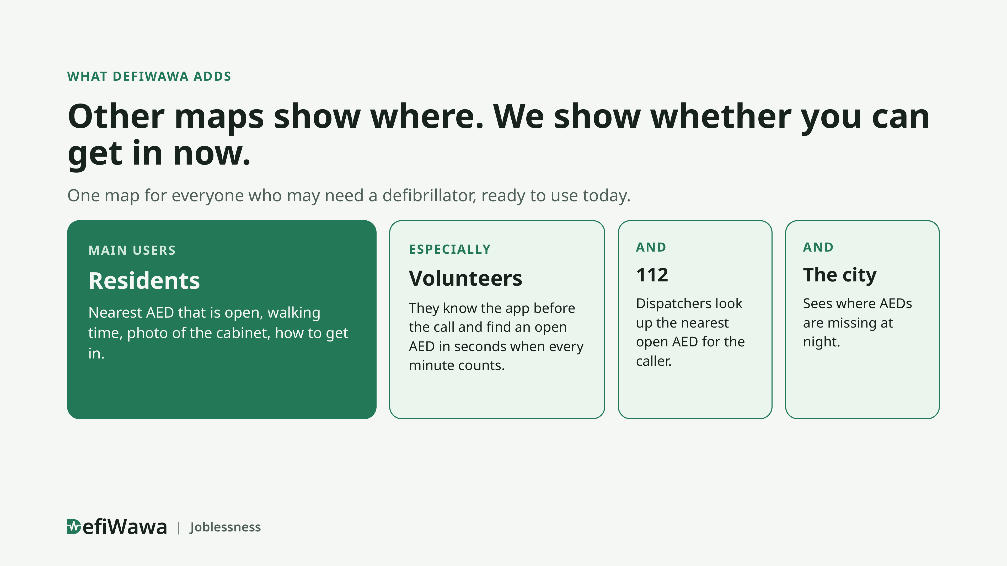
Notes:
1:00–1:30. “Other maps show where defibrillators are. We show whether you can get in right now.” Then: “It is one map for a very wide audience, and it works today. First of all residents and visitors: anyone who sees someone collapse. Especially volunteers: if they know the app before an emergency, they find an open AED in seconds. A 112 dispatcher can look one up for the caller, and the city sees where AEDs are missing at night.”

Slide 7
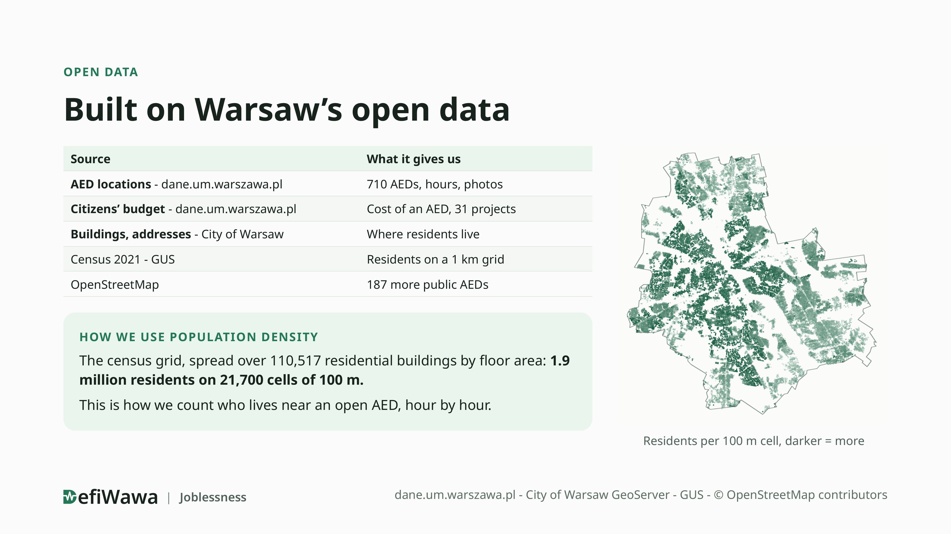
Notes:
Close: “We used the city’s own data from dane.um.warszawa.pl: the AED register and the citizens’ budget. With the city’s buildings we spread the 2021 census over 110 thousand residential buildings, so we know how many people live in every 100 metre cell. That is how we measure who has an open defibrillator nearby, hour by hour. Thank you.” Keep this slide on screen during the questions.

