Slide 1


Project management system
Work flow update

Slide 2
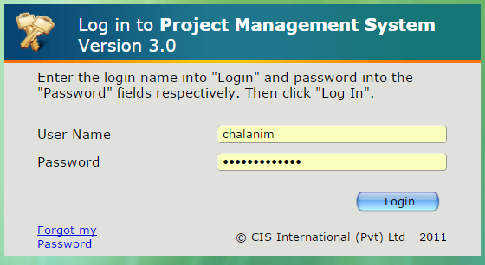
PMS
Login to the PMS account
PMS Link - http://69.63.218.233:86/pms/index.php

Slide 3
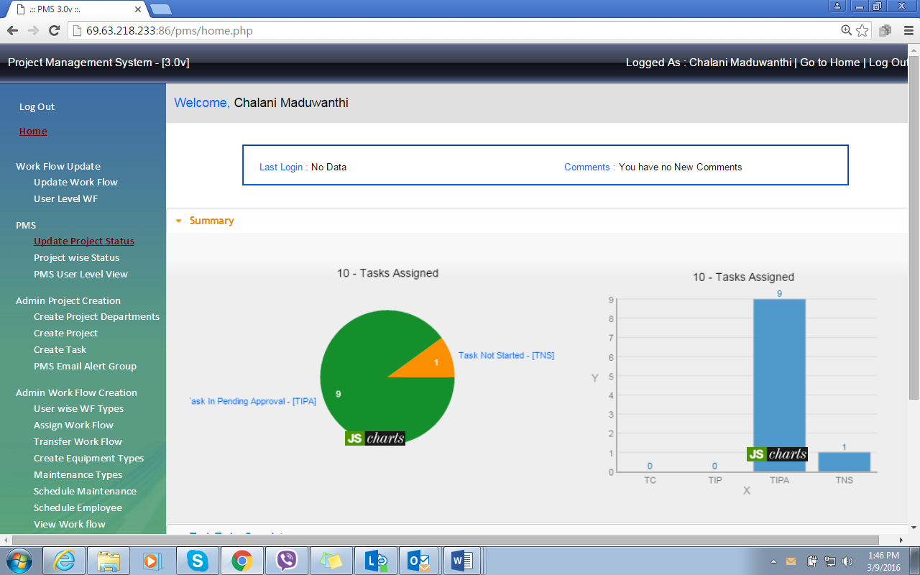
PMS home screen

Slide 4
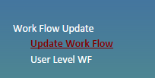
Workflow Update
Initial training is arranged by HR, for all newcomers on how to update workflows.
Workflows should be updated before 11:00pm on each day. There are NO EXCUSES for not updating the workflows.
System Admin department follows up with workflow updates and if not updated, System Admin will send an email requesting explanations for not executing this task. This should be addressed at the requested time and CANNOT be ignored.
If you miss your workflow updates consecutively for more than three days, HODs are responsible for taking necessary actions as per company policy.
When an employee has resigned/ terminated, the supervisor/HOD of that department should send an email to Admin Dept. asking to remove / transfer workflows of that employee to another employee.
System admin will do the needful and confirm by a retuned email for the same.
Update workflow
Select Update workflow
Update workflow – go to each task where mentioned and tick “Yes” if the work done, tick “No” if the work is not done and tick “N/A” if the data is not available or any other reason.
Please note to mention time, actual time duration and user review note.

Slide 5
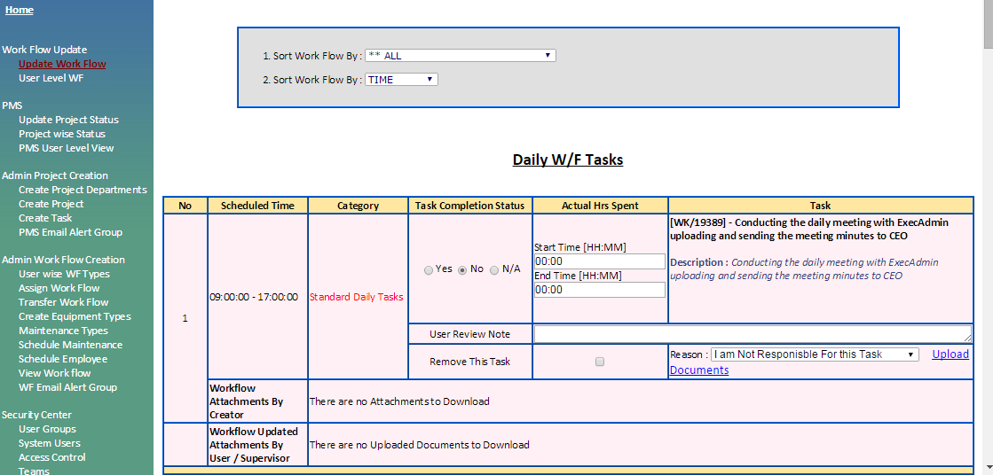

Once you have completed the tasks, you can keep on saving and at the end of the day once you complete all the task click save and Send mail.

Slide 6
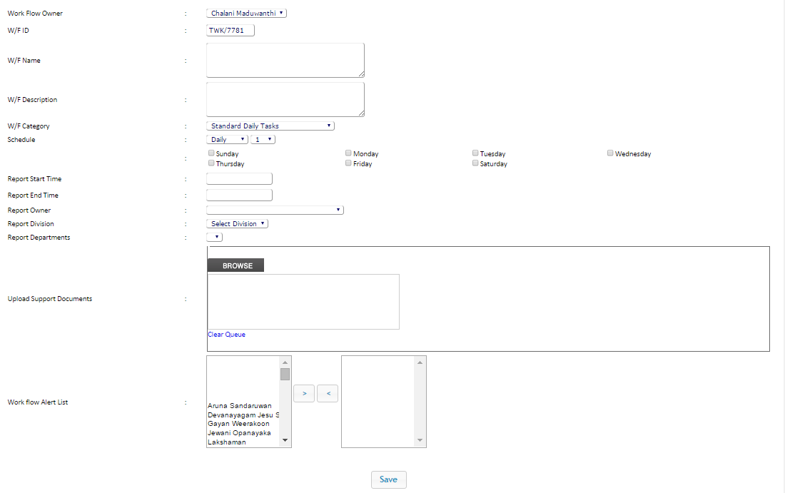
Non schedule workflow
If the employee is doing tasks which are not related to workflow or not under PMS/ if the employee is doing somebody else's workflow- This task needs to be recorded in “add nonscheduled tasks.”
Click Add nonscheduled tasks and fill the form as mentioned below.
Click “Save and send email”
Once you save and “send email “you will get an individual summary and. “Department summary” report will go to system admin and HOD of the department.

Slide 7
Thank you !

