Slide 1


E Tropical Fish - ETF
ETF – admin level

Slide 2
Content
Report Calendar
Report and Document Calendar
Manage Users
Manage Reports
Add Division
Meeting Calendar
Manage Meetings
Add Meeting Minutes
Add Participants
Add Non – Scheduled Meetings
Add Divisions
Training Calendar
Add Training
Training Log
Add Participants
Training Calendar
OPR/User Guides/Process Diagrams
Upload user guides
Download user guides

Slide 3
ETF
ETF is a system developed for the use of managing meeting and reports for all the staff members of TFI and TEKSS.
It is a place to refer scheduled/ non-scheduled meetings/meeting minutes. It is a place to review /upload reports on monthly/daily basis. All the relevant documents could be uploaded along with where it works as a store also for these two categories
Report Calendar
Report calendar is a tool available in ETF system. It is used to review/ upload Reports available for each employee (if reports assigned). Following is the process of uploading a report to the report calendar of ETF
1.1 Report and document Calendar
Every ETF user has access to this section and this include all reports uploaded to the system by each report owner and anyone can review these reports after downloading.

Slide 4
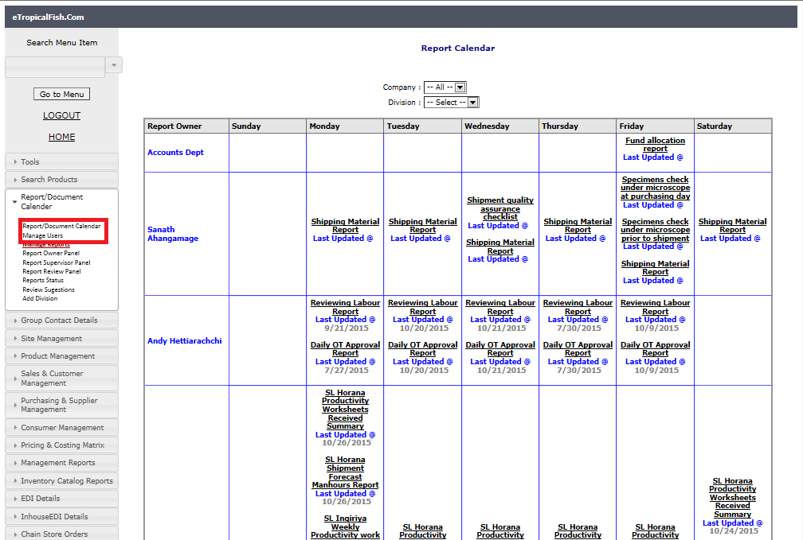

Slide 5
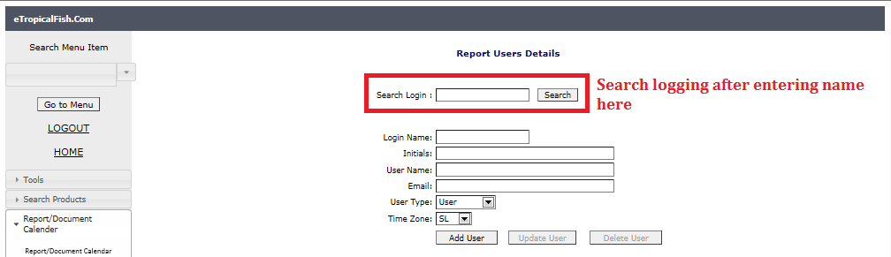
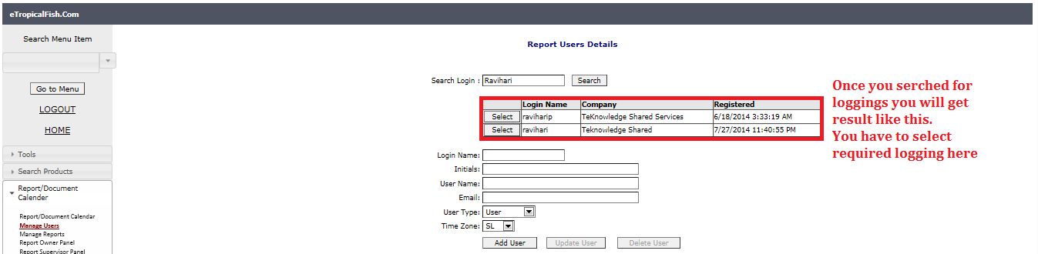
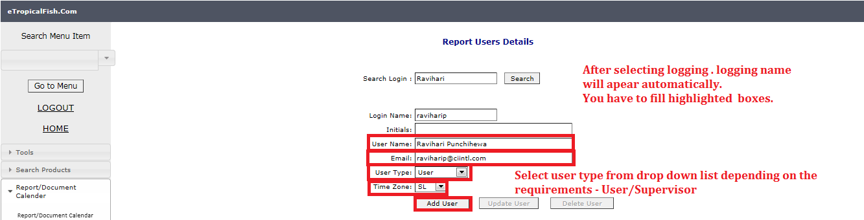
1.2 Manage Users
System admin has access to this section to add/update users .When there is a new employee, system admin has to add him/her to report calendar by adding his log in details. You can follow the steps given using screen shots.
To edit details of existing user, follow steps as in below screen shot.

Slide 6
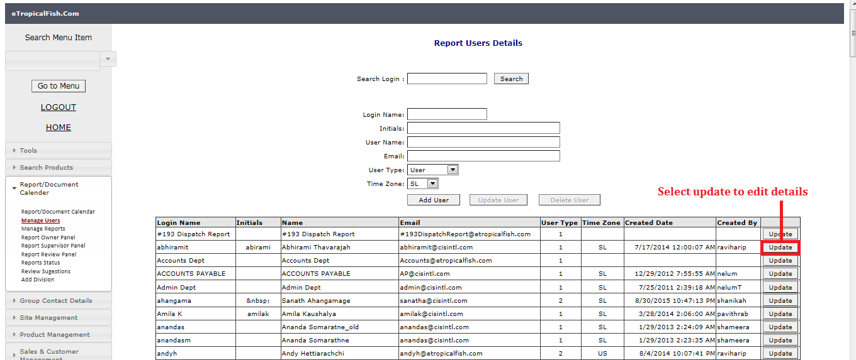
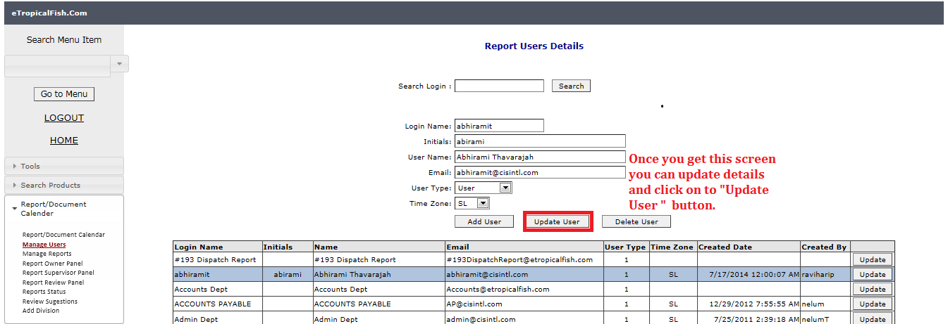

Slide 7
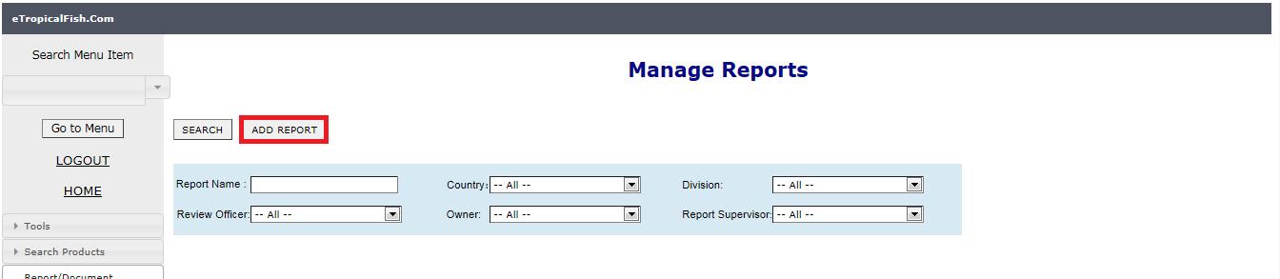
1.3 Manage Reports
System admin has access to this section to add new reports and edit existing report details.
To add new reports, follow instructions in below screen shots.

Slide 8
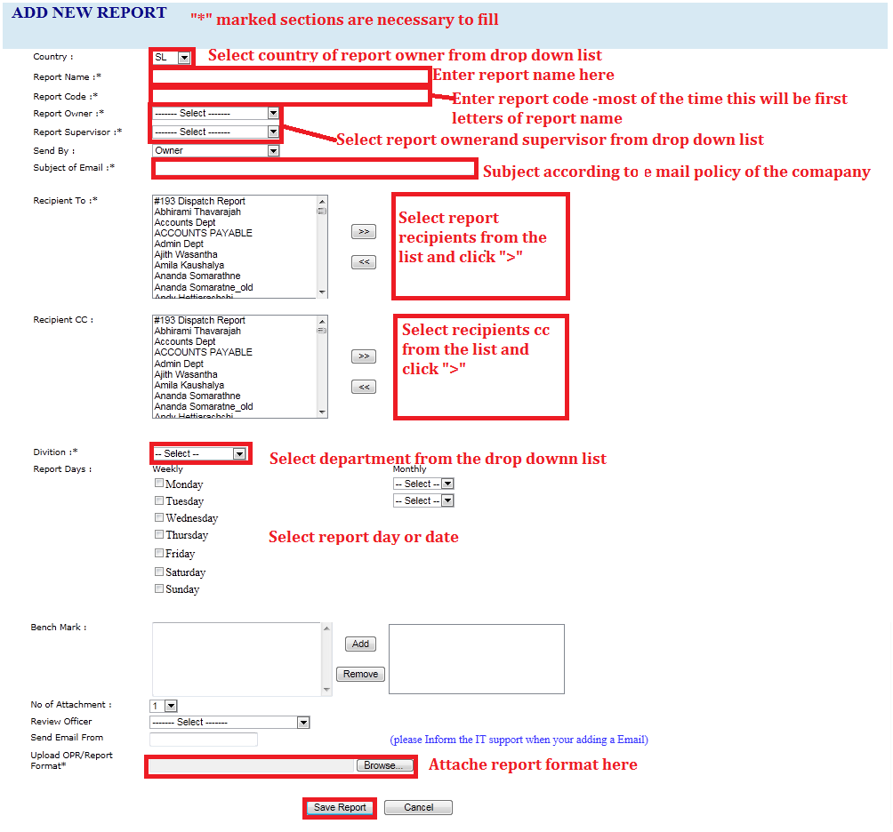

Slide 9
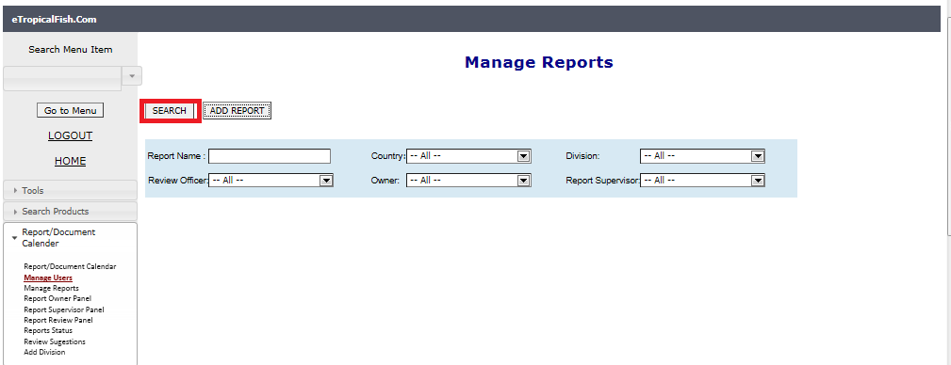
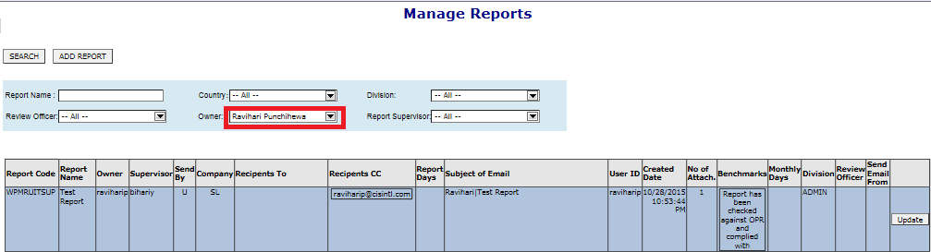
To edit details of existing report, search for the report using given options.

Slide 10
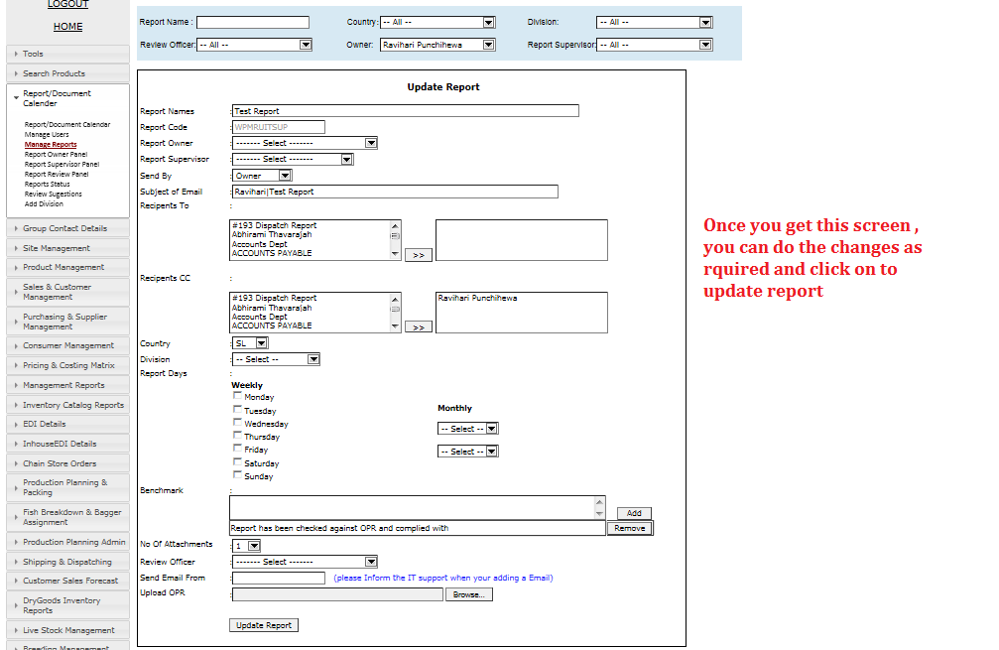

Slide 11
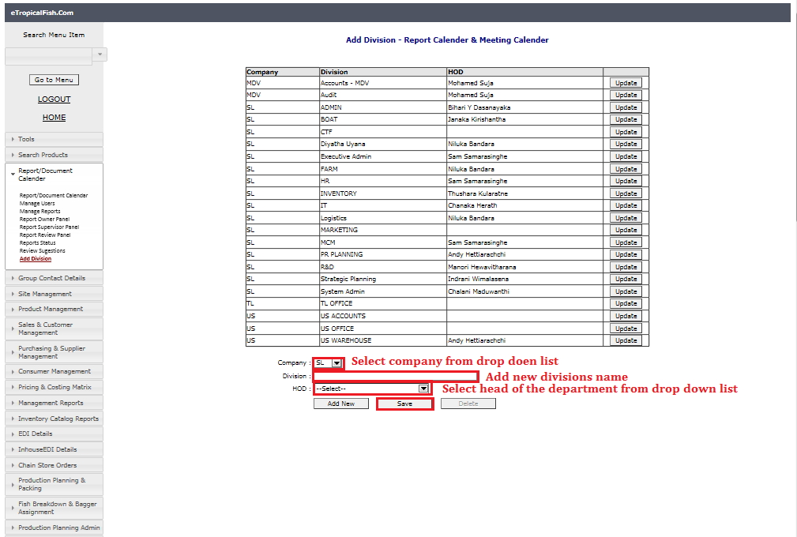
1.4 Add Division
System admin can create department using this section
And you can follow same steps after click “update “button to do any changes for existing divisions.

Slide 12
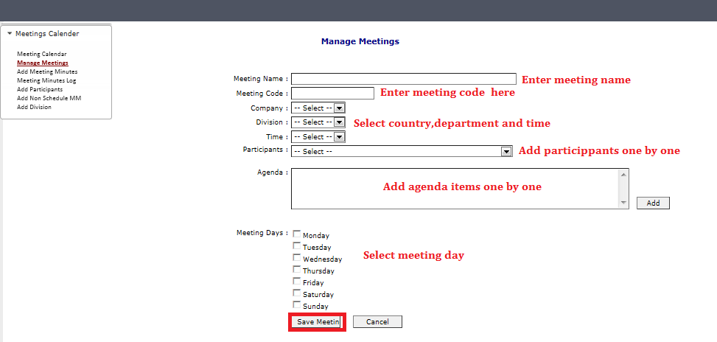
Meeting Calendar
All schedule weekly and monthly meeting of the company should be listed in this section.
2.1 Manage Meetings
System admin can add meetings and edit existing meetings using this section.
To add meetings you can follow below steps as in the screen shot.
To update existing meetings, select meeting from the list and click “update” button. Meeting details will be appeared in bottom of the page.

Slide 13
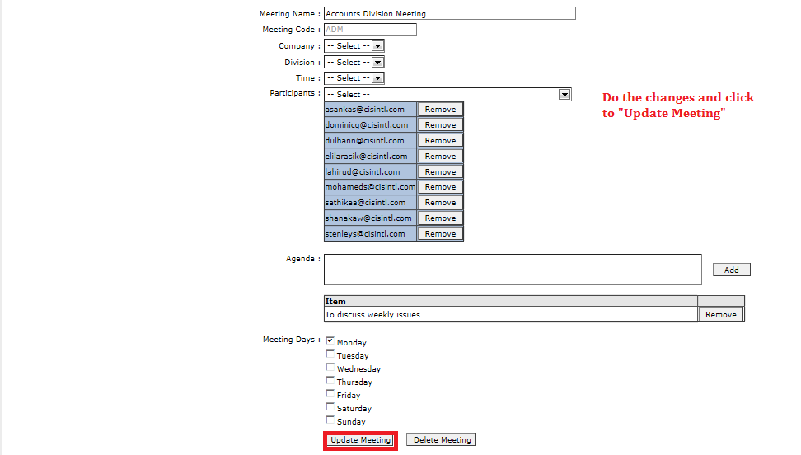
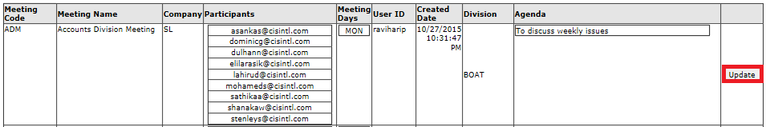

Slide 14
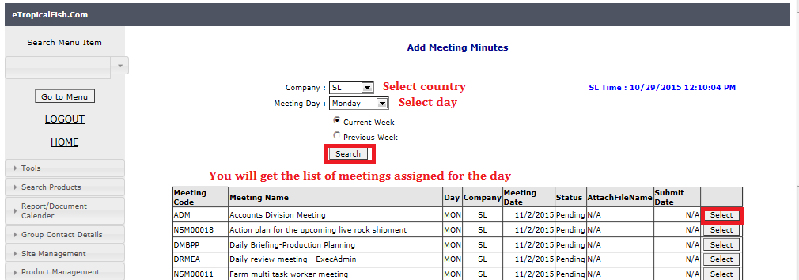
2.2 Add Meeting Minutes
After completing the meeting, one of the participants have to upload meeting minutes in to the system. This is not necessary to add by system admin.
To add meeting minutes, you have to “search” for the meeting and “select” the meeting and follow steps as in the screen shots.

Slide 15
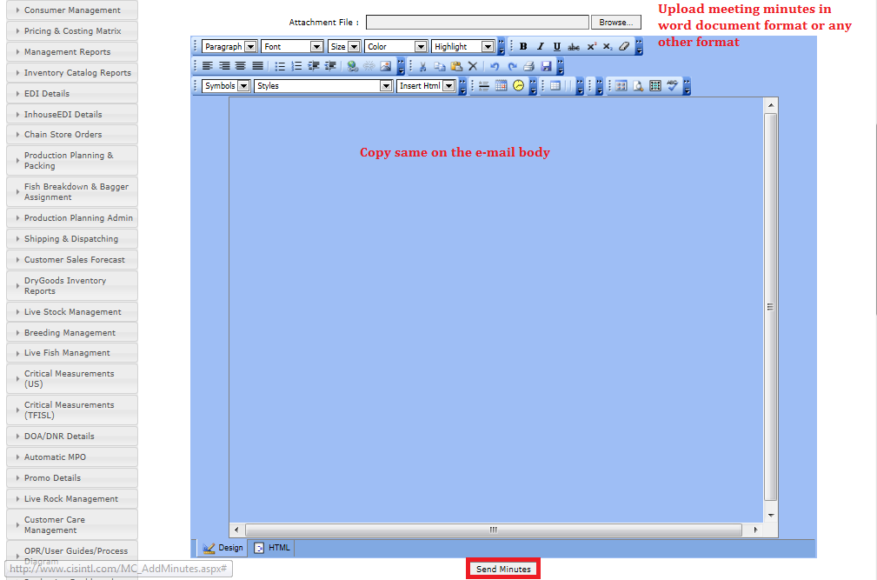

2.3 Add Participants
When there is a new employee, system admin has to add him/her to meeting calendar .This section is common to both Meeting calendar and Training calendar.
You have to add “Name” , “E mail” and select country from the drop down list.

Slide 16
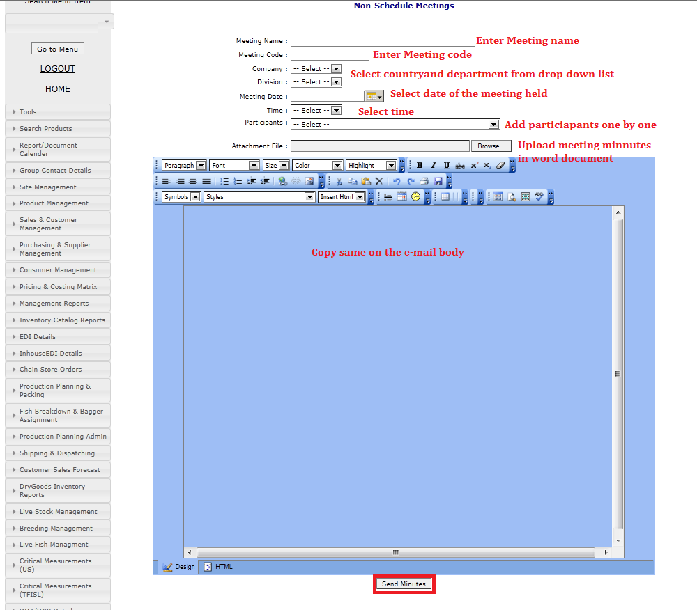
2.4 Add Non- Scheduled Meetings
Non-schedule meetings are sudden meetings/ unplanned meetings. You can follow below instructions to add non schedule meeting minutes.

Slide 17
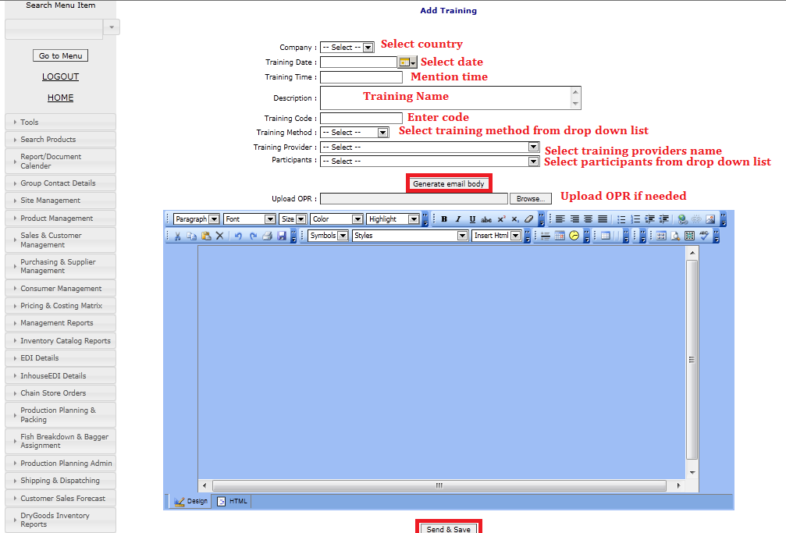
2. 5 Add divisions
This section is linked to report calendar Add divisions section
Training Calendar
All the trainings conducted internally need to be recorded in training calendar.
3.1 Add Training
System admin have access to add trainings to training calendar. You can follow steps mentioned in below screen shots.

Slide 18
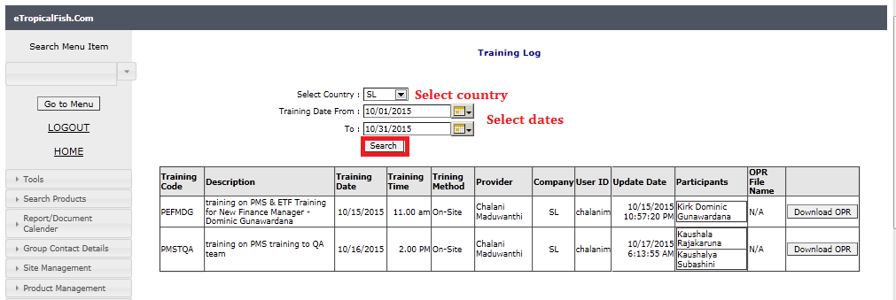
3.2 Training log
Once you add trainings to the system, it will appear in “Training Log” .
You can select country and dates to have summary of trainings which are planned to conduct during the selected time period.
3.3 Add participants
This section linked to Meeting Calendar-Add Participants
Training Calendar
Once you have completed the training, select training from training calendar and click “Complete” button .Training can be completed by training provider or system admin.

Slide 19
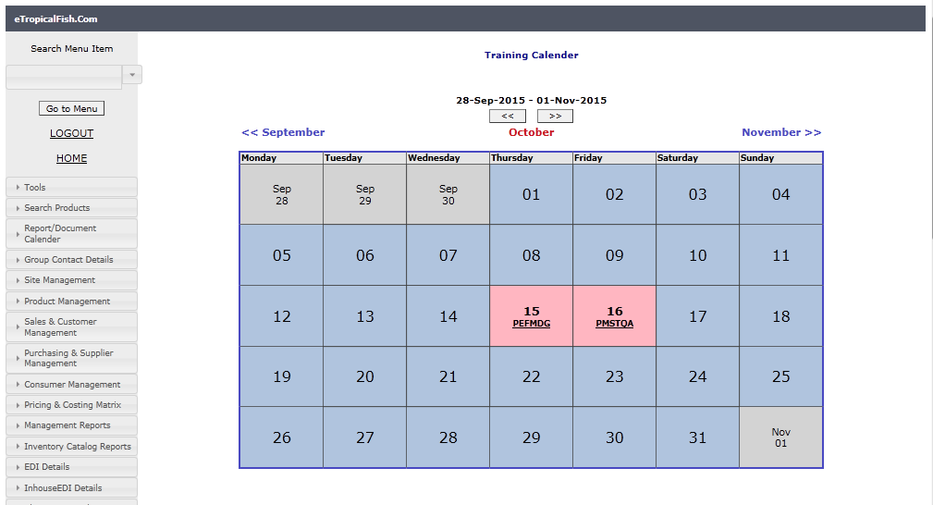
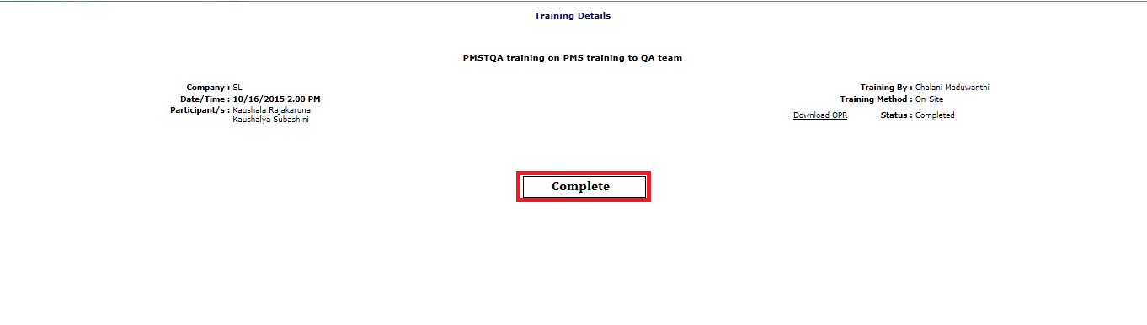

Slide 20
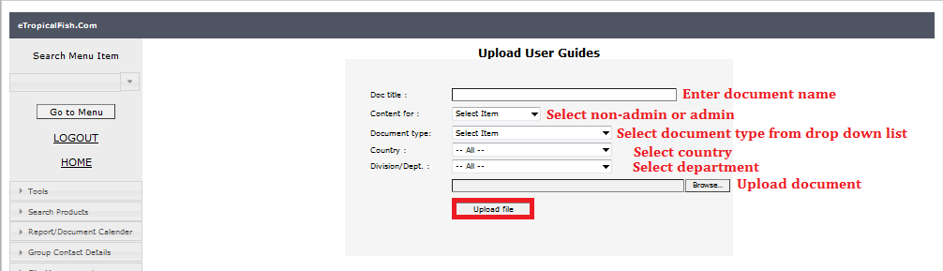
OPR /User Guides/Process Diagrams
This section includes documented processes of the company which support any staff member to have an idea about company processes. Anyone can download uploaded OPRs, User guides and process diagrams. But system admin will be responsible for uploading these documents in to the system with specific format.
4.1 Upload user guides
To upload OPR, user guides, process diagrams you have to fill below details mentioned in the screen shot and select “Upload File”

Slide 21
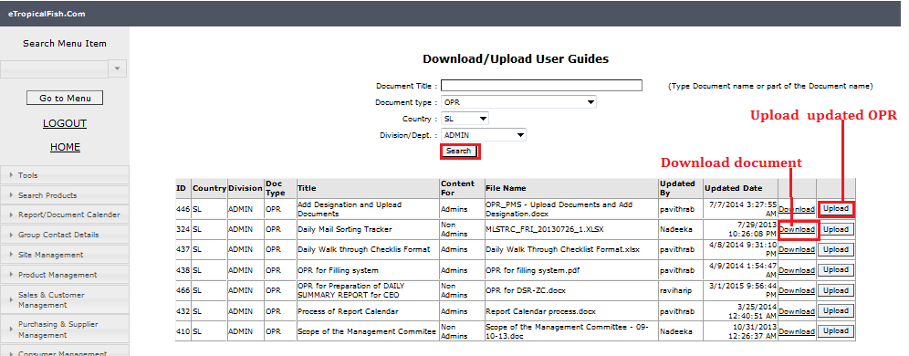
4.2 Download user guides
To download or to upload updated OPRs, user guides or process diagrams , you can search for the document, once documents are listed click “download” or “ upload” buttons depending on the requirement.

Slide 22
Thank you !

