Slide 1


E Tropical Fish - ETF
ETF – User level

Slide 2
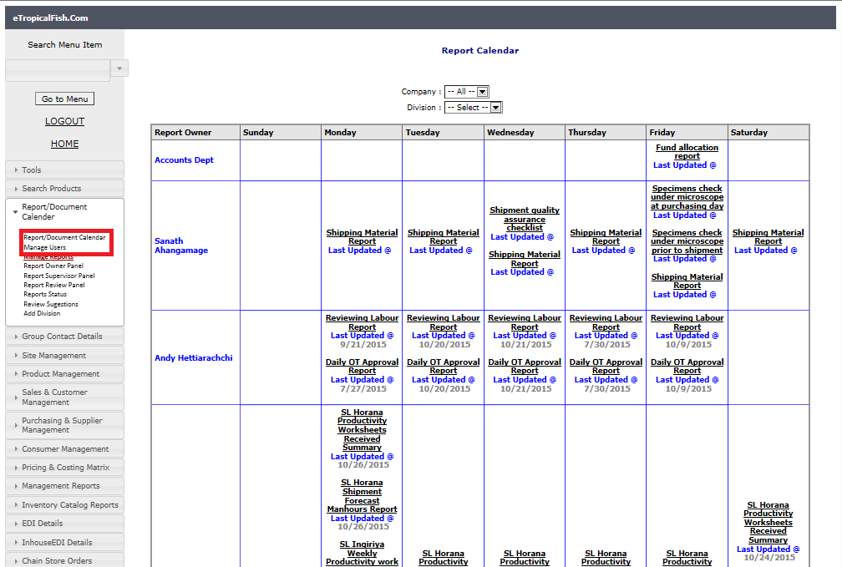
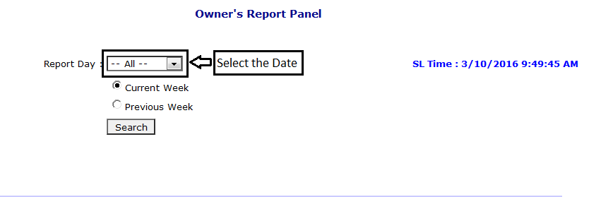
ETF
Report document calendar
Report calendar -Update report – report owner panel
Go to report/ document calendar – report owner panel – then select the report date – then current week and if you want to add the previous week select the previous week.

Slide 3
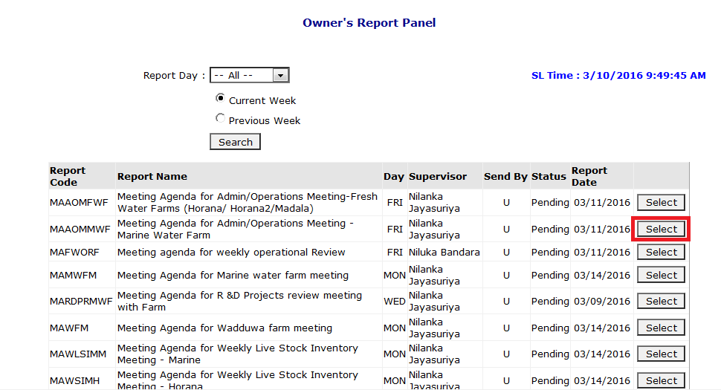
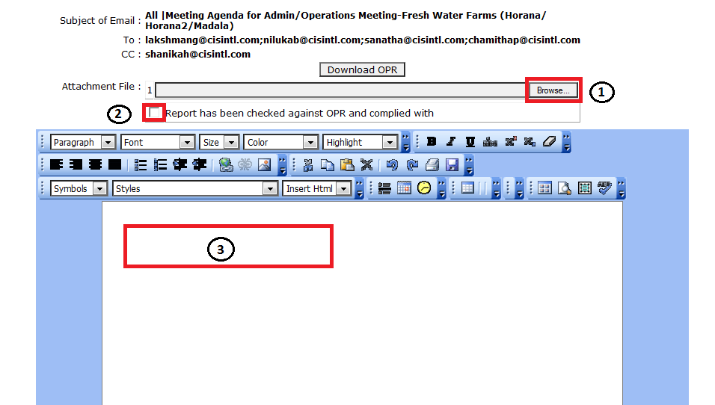
If you want select all and check search then you will see you’re all the reports. Then select as mentioned red and also check the report date.
Browse your document (1) - tick the box (2) – write on email body (3) as our company policy you need copy and paste email body whatever in the attachment

Slide 4
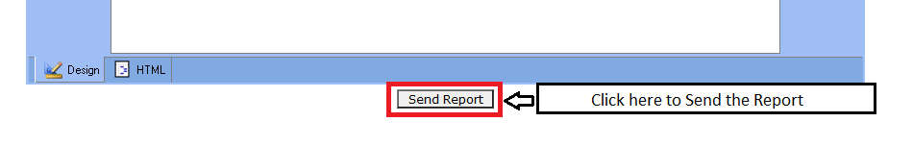
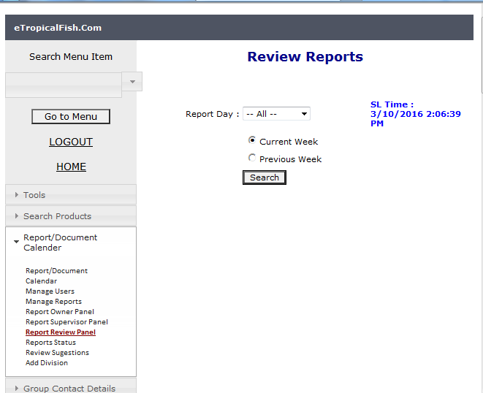
Click send report mail to proceed
Then system will generate email to all the recipients on behalf of you.
Report review panel

Slide 5
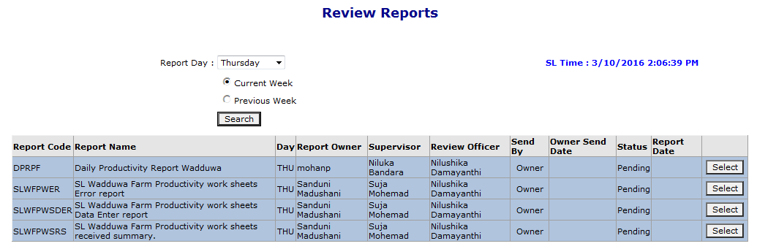
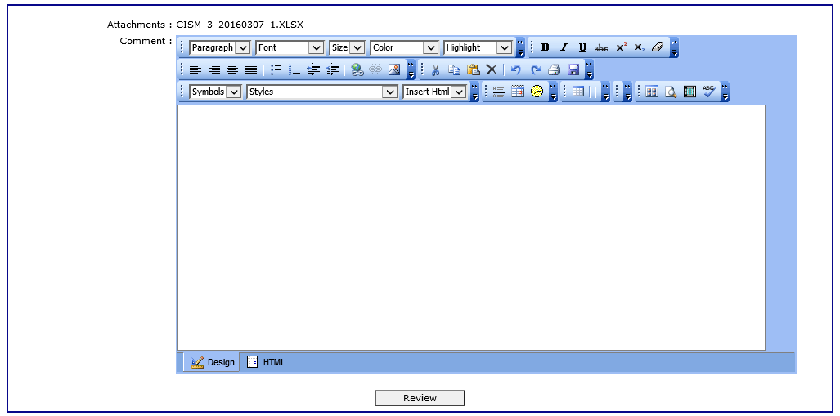

Slide 6
Meeting calendar
After completing the meeting, one of the participants have to upload meeting minutes in to the system. This is not necessary to add by system admins.
To add meeting minutes, you have to “search” for the meeting and “select” the meeting and follow steps as in the screen shots.
Add meeting minutes
Select the company – select the day – tick the current week if you going to update current week and tick the previous week to update the previous week meeting minutes.
Please note that before select the meeting need to check the meeting

Slide 7
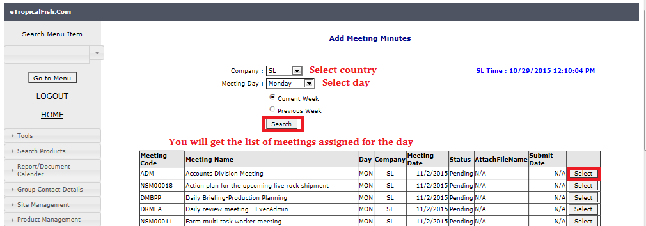
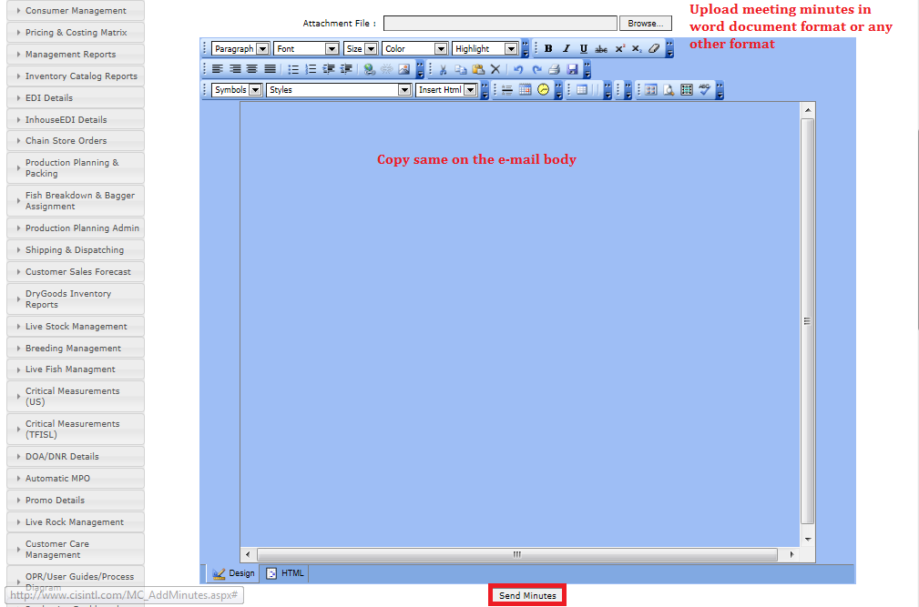

Slide 8
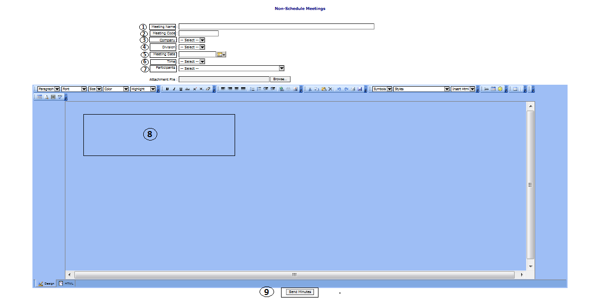
Add non schedule meeting minutes
Meeting name – Name o the meeting
Meeting code – First letter of the meeting name
Company – SL/US/TL/UK …etc.
Division – select the department from the drop down list.
Meeting date – date of the meeting
Time – meeting time
Participant – add participant one by one to the list
Email body – paste the meeting minutes to the body also attached the minutes using browser
Save & send minutes - System will generate the email to all the participant on behalf of the sender

Slide 9
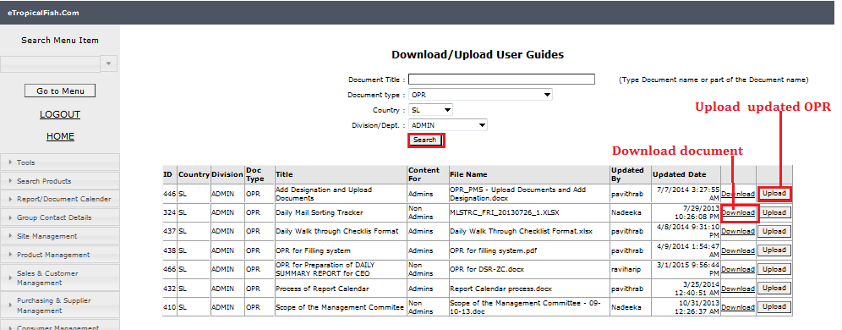
OPR
Download user guides
To download or to upload updated OPRs, user guides or process diagrams , you can search for the document, once documents are listed click “ download “ or “ upload” buttons depending on the requirement.

Slide 10
Thanks You !

