Slide 1


Project management system
Project update

Slide 2
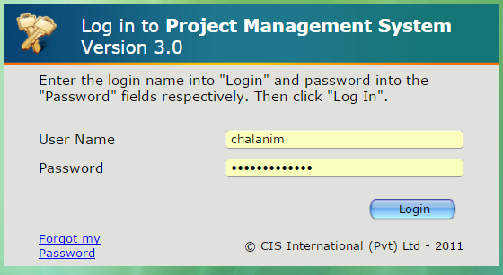
PMS
Login to the PMS account
PMS Link - http://69.63.218.233:86/pms/index.php

Slide 3
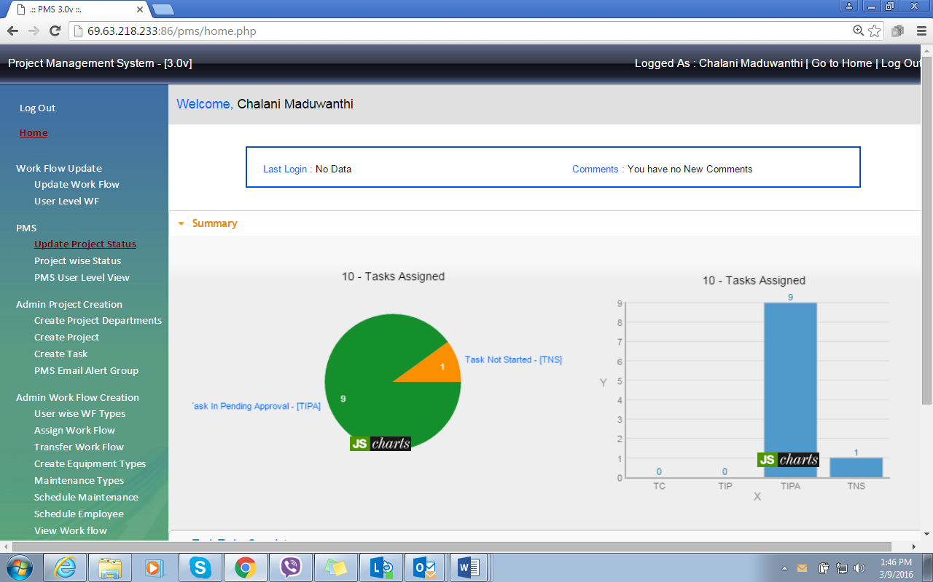
PMS home screen

Slide 4
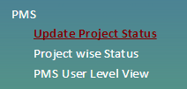
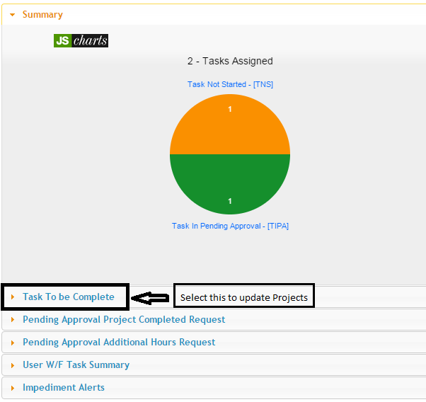
2. PMS Update
2.1 Select project status
2.2 Task to be completed– To check all the projects and task that come under employee account

Slide 5
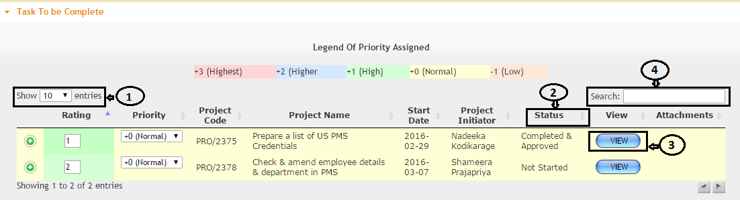
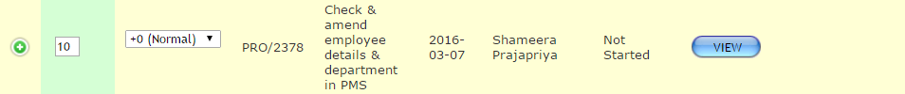
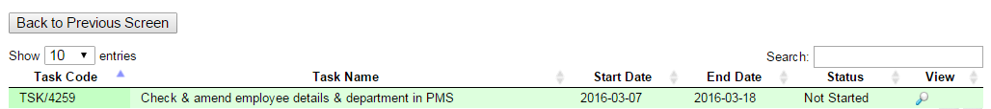
Go to Task to be completed – then select show “100” (1) to show all the projects in one page/click status (2) to sort all the completed and pending project separately/ go to search (4) if you want to search by name or project no / select and view project by selecting view (3)
Select the project by view
Select the task and click to update project task

Slide 6
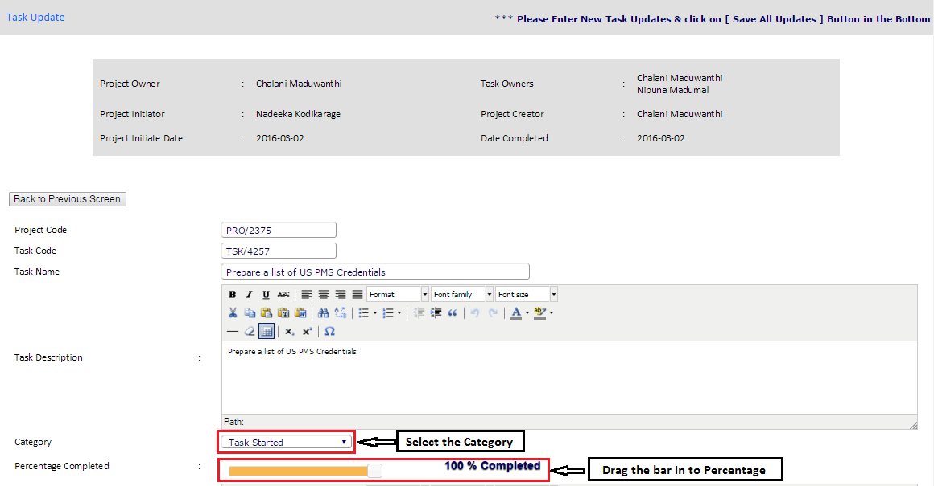
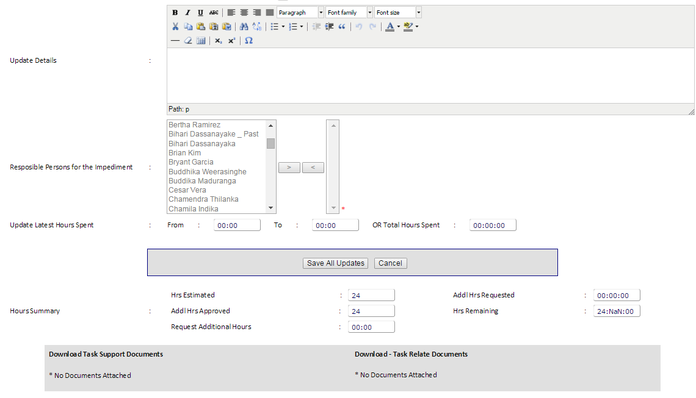
Update project status

Slide 7
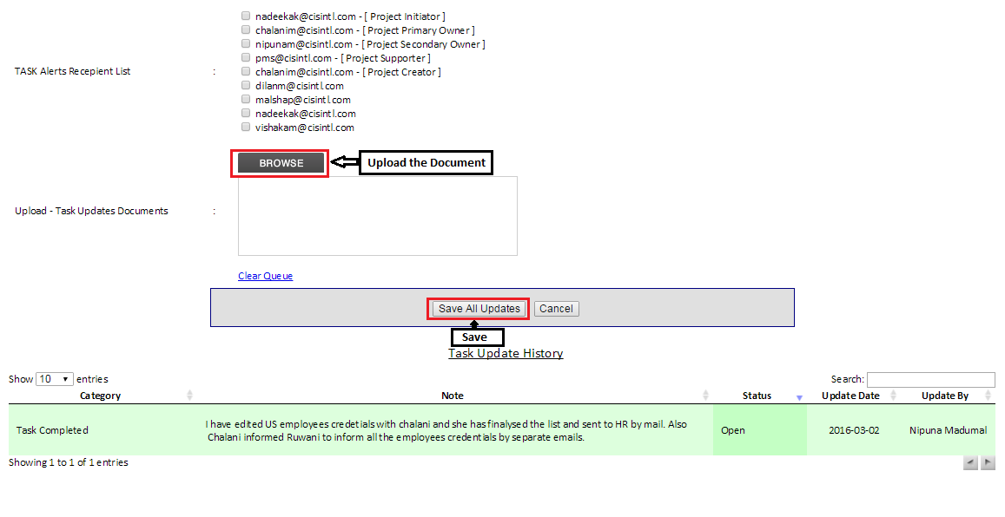

Slide 8
Thank you !

