Slide 1
D365 CAPABILITIES

Slide 2



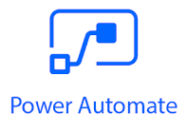









Microsoft Dynamics 365 Practice Overview
We deliver benchmarked outcome-based innovations to enable our customers solve their complex digital-industrial problems through Intelligent Microsoft Business Solutions
DYNAMICS 365
Massive Head-start
Noiseless Transitions
Strong Governance
Multi-tier structure
Digitally Transform
Optimize & Evolve
Consulting
Transformation
Automation
Operations
Faster Executions
Sure Step Methodology
NextGen
Framework
Technology
Stack

Slide 3
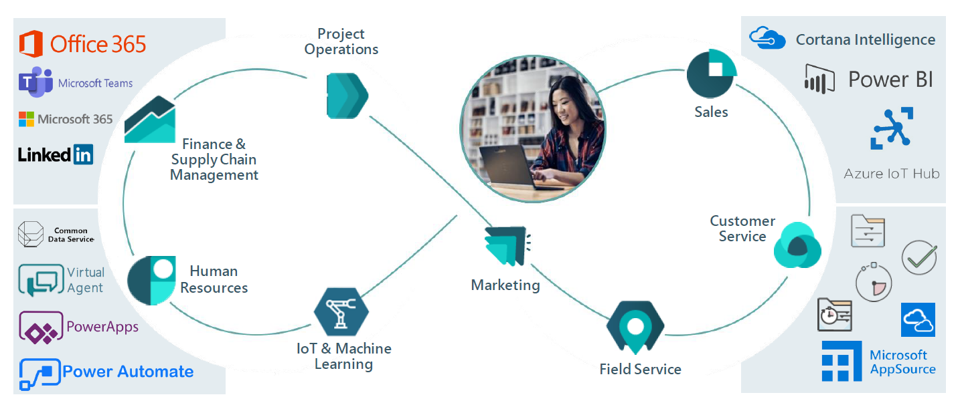
Dynamics 365 as part of the Microsoft Platform

Slide 4
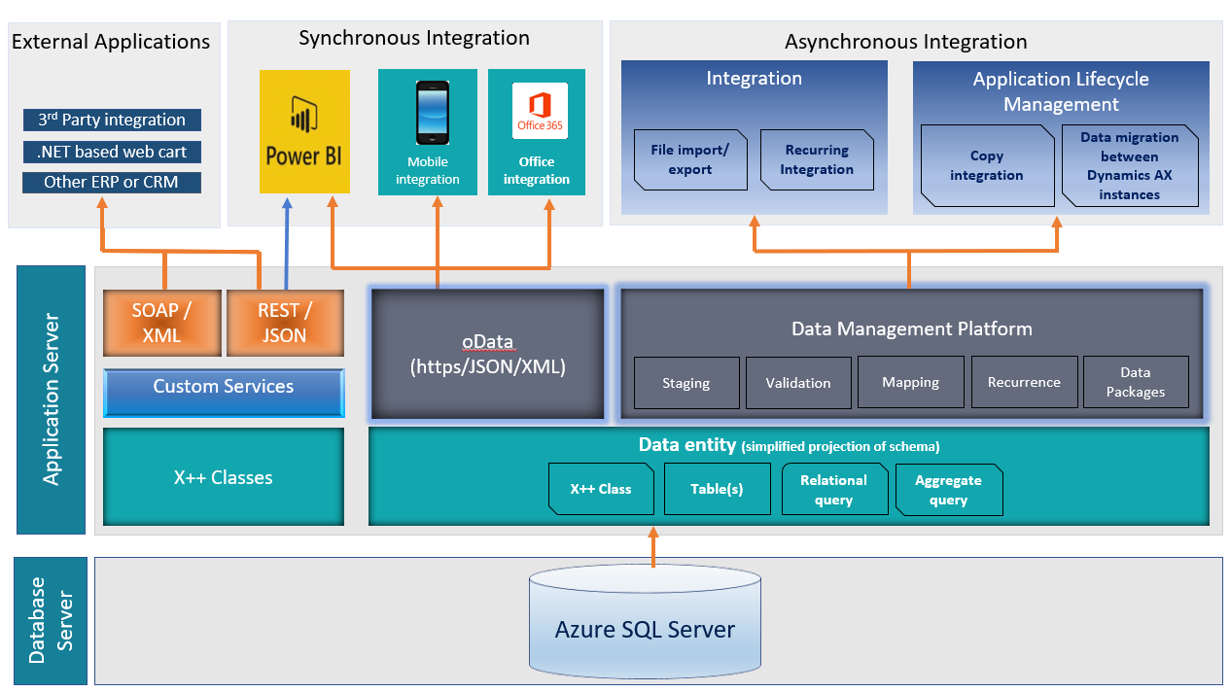
Dynamics 365 Integrations

Slide 5
Case Studies on D365

Slide 6
Salesforce & D365 365 Integration

Slide 7
Salesforce & Dynamics 365 Integration for a Global Retail Company
Company Background
A global retail company operates both B2B and B2C sales. They use Salesforce Sales Cloud for lead and opportunity management and Microsoft Dynamics 365 Finance & Operations (D365 F&O) for financial and order processing.
Business Challenge
Sales teams in Salesforce needed real-time access to customer credit limits, invoices, and order statuses stored in D365.
Finance teams in D365 required instant updates on new customer sign-ups and sales opportunities from Salesforce.
Lack of integration caused delays in order approvals and manual data entry errors.
7

Slide 8
Salesforce & Dynamics 365 Integration for a Global Retail Company
Solution
Real-Time API-Based Integration
We have implemented an API-based real-time integration using Azure Logic Apps and Power Automate with the following key components
Synchronizing Customer Data (Salesforce → D365)
When a new account is created or updated in Salesforce, a Power Automate flow triggers.
The flow calls the D365 Web API to create or update the customer record in Dynamics 365.
A confirmation is logged in Salesforce with the D365 Customer ID.
Order & Invoice Sync (D365 → Salesforce)
When an order is placed in Salesforce, a Logic App is triggered to:
Validate the customer's credit limit in D365 F&O.
If approved, it automatically creates the order in D365.
Sends an instant update back to Salesforce with the order status and estimated delivery date.
Real-Time Case Management (D365 Customer Service ↔ Salesforce Service Cloud)
If a customer raises a complaint in Salesforce Service Cloud, it triggers an API request to create a case in D365 Customer Service. Any updates in D365 (like case resolution or SLA breaches) are immediately reflected in Salesforce.
8

Slide 9
Salesforce & Dynamics 365 Integration for a Global Retail Company
Business Impact & Results
Real-Time Order Processing – No delays in finance approvals, reducing order fulfillment time by 40%.
Eliminated Data Entry – API automation prevented human errors and saved 100+ hours per month.
Better Customer Service – Instant case updates helped customer service teams respond 30% faster.
Improved Decision-Making – Sales and finance teams had real-time visibility into orders and customer status.
Technology Stack Used
Salesforce (Sales Cloud, Service Cloud, REST API)
Microsoft Dynamics 365 F&O, Customer Service
Azure Logic Apps (for API orchestration)
Power Automate (for Salesforce-D365 triggers)
Dataverse (for unified data storage)
Key Takeaways
API-based real-time sync ensured seamless data flow.
Power Automate & Logic Apps simplified integration without extensive custom coding.
Customer satisfaction improved with faster issue resolution.
9

Slide 10
Analysis for Intelligence customer management

Slide 11
Analysis for Intelligence Customer Management with D365
Company Background
One of the Company focuses on various domains such as vehicle engineering, digital transformation, artificial intelligence, and customer experience innovation. As a key digital transformation hub, It plays a critical role in product development, connected vehicle technology, and customer service enhancements.
Rapid growth of the automotive industry and increasing customer expectations for personalized, digital-first experiences, leverage advanced Customer Relationship Management (CRM) solutions to improve its engagement strategies.
Business Challenge
A company faced several challenges in managing customer interactions, support services, and after-sales operations effectively
Disparate Customer Data – Customer insights were fragmented across different systems, leading to inconsistent experiences.
Lack of Predictive Insights – There was no AI-driven intelligence to anticipate customer needs, impacting proactive engagement.
Manual Service Request Handling – Customer service teams relied on manual processes, leading to delays in query resolution.
Limited Integration with Connected Car Services – Customer support teams lacked real-time access to vehicle performance and telematics data.
Inefficient Omni-Channel Communication – Managing inquiries from multiple channels (email, phone, website, social media) was time-consuming and lacked automation.
11

Slide 12
Analysis for Intelligence Customer Management with D365
Solution
Microsoft Dynamics 365 Customer Insights & Customer Service to create a centralized, AI-driven customer engagement platform.
Unified Customer Data Platform
Integrated customer profiles across dealership interactions, service requests, and connected vehicle data.
Enabled a 360-degree view of customers by merging insights from sales, marketing, and after-sales service.
AI-Powered Predictive Customer Insights
Implemented Microsoft AI & Machine Learning to predict vehicle service needs based on historical data and driving patterns.
Used AI-driven lead scoring to personalize marketing campaigns and improve conversion rates.
Automated Case & Service Request Management
Integrated D365 Customer Service with self-service portals & chatbots for instant query resolution.
Enabled intelligent case routing to match customer queries with the best available service agents.
Integration with Connected Car Services
Connected vehicle data from IoT platforms with D365, allowing real-time vehicle diagnostics.
Enabled proactive service alerts and personalized service recommendations.
Omni-Channel Customer Engagement
Automated email, social media, and chatbot interactions using Power Automate and Azure Logic Apps.
Provided seamless communication across platforms to improve customer satisfaction.
12

Slide 13
Analysis for Intelligence Customer Management with D365
Business Impact & Results
30% Improvement in Customer Service Efficiency
Automated case routing reduced response time for service requests.
40% Reduction in Manual Effort
AI-driven automation reduced repetitive tasks in customer support.
Real-Time Vehicle Diagnostics for Proactive Maintenance
Integrated vehicle data helped identify potential issues before they became critical.
Enhanced Omni-Channel Engagement
Improved customer satisfaction scores due to faster query resolution across multiple platforms.
Data-Driven Decision Making
Power BI dashboards provided real-time insights into customer interactions, service performance, and predictive analytics.
Technology Stack Used
Microsoft Dynamics 365 Customer Insights & Customer Service – CRM & AI-driven analytics
Azure AI & Machine Learning – Predictive customer insights
Power Automate & Azure Logic Apps – Intelligent workflow automation
Microsoft Power BI – Data visualization and reporting
IoT & Connected Car Services – Real-time vehicle diagnostics & telematics integration
AI Chatbots & Virtual Agents – Self-service customer engagement
13

Slide 14
Integration of Microsoft Dynamics 365 with ServiceNow

Slide 15
Integration of Microsoft Dynamics 365 with ServiceNow
Company Background
One of the Company focuses on various domains such as vehicle engineering, digital transformation, artificial intelligence, and customer experience innovation. As a key digital transformation hub, It plays a critical role in product development, connected vehicle technology, and customer service enhancements.
Rapid growth of the automotive industry and increasing customer expectations for personalized, digital-first experiences, leverage advanced Customer Relationship Management (CRM) solutions to improve its engagement strategies.
Business Challenge
The Company was managing IT service requests and customer support processes across ServiceNow (ITSM platform) and Microsoft Dynamics 365 Customer Service (CRM & ERP). However, the lack of integration led to multiple inefficiencies:
Data Silos Between IT & Customer Support Teams – IT service tickets in ServiceNow were not linked with customer records in D365.
Manual Case Management & Duplication of Efforts – Agents had to manually update incidents and cases across both platforms.
Delayed Issue Resolution – No real-time sync of incident updates from ServiceNow to D365.
Lack of Visibility in IT & Business Operations – No consolidated reporting for ITSM & customer service teams.
15

Slide 16
Analysis for Intelligence Customer Management with D365
Solution
Real-Time Incident & Case Synchronization (ServiceNow ↔ D365)
Automated ticket creation in ServiceNow when a case is logged in D365 Customer Service.
Incident status updates in real-time sync with D365 for visibility across teams.
Automated Workflows for Faster Resolution
AI-based case routing assigned incidents to the right IT teams based on priority.
Automated SLA tracking ensured faster response times.
Unified Customer & ITSM Data for Better Decision Making
ServiceNow incidents linked to D365 customer records for full visibility.
Single source of truth for ITSM & customer service teams through Power BI dashboards.
Proactive Issue Resolution & Service Automation (IoT & AI-driven Service Management)
IoT alerts trigger automatic incident creation in ServiceNow when a system detects failures.
AI-driven sentiment analysis in D365 provides insights on customer feedback.
Business Impact & Results
35% Faster IT Incident Resolution
Automated case routing & SLA tracking reduced response times.
50% Reduction in Manual Workload
Eliminated duplicate data entry between IT & customer service teams.
Improved Visibility Across IT & Business Operations
Integrated Power BI dashboards provided real-time insights into incident trends & resolution times.
Increased Customer Satisfaction Scores
Faster case resolutions led to enhanced customer experience & reduced downtime.
16

Slide 17
Analysis for Intelligence Customer Management with D365
Technology Stack Used
Microsoft Dynamics 365 Customer Service – Case & Customer Management
ServiceNow ITSM – Incident & IT Service Request Management
Azure Logic Apps – API Integration & Real-time Sync
Power Automate – Workflow Automation
Power BI – Data Analytics & Reporting
17

Slide 18

Let’s accomplish
our mission together!

