Slide 1
Adapter
Pavana Manikanta

Slide 2
Adapter
This type of design pattern comes under structural pattern.
Adaptor design pattern is used when you want two different classes with incompatible interface to work together.

Slide 3
Adapter
Problem
  By default in audio player will accept the mp3 format.
  If we want to use some other formats?.
  We need and adapter to play the different formats.

Slide 4
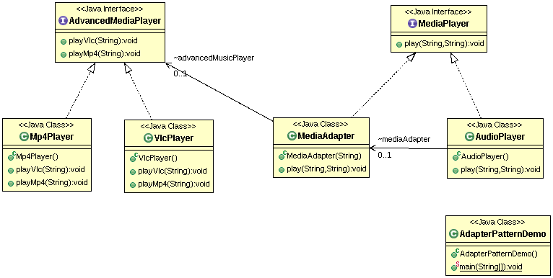
Class Diagram

