Slide 1
Agenda:
Design Patterns
Decorator Pattern
By
Gopakumar
Notes:
ATS Application Programming: Java Programming
7.2 Design Patterns
© Accenture 2005 All Rights Reserved
Course Code #Z16325

Slide 2
Contents
Decorator Pattern
  Definition
  Problem & Context
  Solution
  Class Diagram
  Examples in Java API
Notes:
ATS Application Programming: Java Programming
7.2 Design Patterns
© Accenture 2005 All Rights Reserved
Course Code #Z16325

Slide 3
Decorator
Definition
Decorator pattern is one of the widely used structural patterns. This pattern dynamically changes the functionality of an object at runtime without impacting the existing functionality of the objects.
Notes:
ATS Application Programming: Java Programming
7.2 Design Patterns
© Accenture 2005 All Rights Reserved
Course Code #Z16325

Slide 4
Problem & Context
Imagine a scenario where we have a pizza which is already baked with tomato and cheese. After that you just recall that you need to put some additional topping at customer’s choice. So you will need to give some additional toppings like chicken and pepper on the go.
Solution
So in this case we are not using inheritance to add additional functionalities to the object i.e. pizza, instead we are using composition. This pattern is useful when we don’t want to use inheritance and rather use composition.

Slide 5
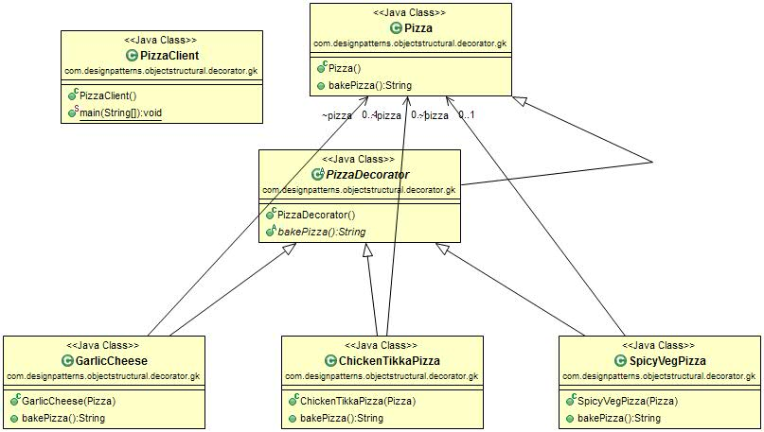
Decorator (Diagram)
Notes:
ATS Application Programming: Java Programming
7.2 Design Patterns
© Accenture 2005 All Rights Reserved
Course Code #Z16325

Slide 6
Examples in JAVA API:
There are various live examples of decorator pattern in Java API.
java.io.BufferedReader;
java.io.FileReader;
java.io.Reader;
  Example:
  new BufferedReader(new FileReader(new File(“File1.txt”)));

Slide 7
Reflection Tutorial
Reflection is commonly used by programs which require the ability to examine or modify the runtime behavior of applications running in the Java virtual machine.
Reflection API is commonly used in Debugging tools and third party tools/plugin
Drawbacks:
1. Performance Overhead
2. Security Restrictions
3. Exposure of Internals
Notes:
ATS Application Programming: Java Programming
7.2 Design Patterns
© Accenture 2005 All Rights Reserved
Course Code #Z16325

Slide 8
Java.lang.Class:
This is the Entry point to all the Reflection APIs.
For Every type of Object, JVM instantiates an immutable instance of Java.lang.Class.
This Provides methods to examine the runtime properties of Object including its members and type information.

Slide 9
Retrieving Class Object:
There are several ways to get a Class depending on whether code has access to an Object, name of class,type or an existing Class.
1. Object.getClass() : ex: Class c = “foo”.getClass();
Used for Reference Types
2. .class Syntax: ex: boolean b = false; Class c = boolean.class;
Used for mainly Primitive Types
3. Class.forName() : ex: Class c = Class.forName(“java.util.Date”); //fully Qualified Name
4. TYPE Field : ex: Class c = Double.TYPE;

