Slide 1
Agenda:
Design Patterns
Observer & Factory Patterns
By
Gopakumar
Notes:
ATS Application Programming: Java Programming
7.2 Design Patterns
© Accenture 2005 All Rights Reserved
Course Code #Z16325

Slide 2
Contents
Observer Pattern
  Definition
  Problem & Context
  Solution
  Class Diagram
  Examples in Java API
  Java.util.Observer
Factory Pattern
  Problem
  Description
  Solution
  Class diagram
  Examples in Java API
Notes:
ATS Application Programming: Java Programming
7.2 Design Patterns
© Accenture 2005 All Rights Reserved
Course Code #Z16325

Slide 3
Observer
Definition
Defines a one-to-many dependency between objects so that when one object changes state, all its dependents are notified and updated automatically
Problem & Context
Useful for designing a consistent communication model between a set of dependent objects (observers) and an object that they are dependent on (subject). Each of these observers needs to know when the subject undergoes a change in its state
Solution
The subject should provide an interface for registering and unregistering change notifications. Observers should provide an interface for receiving notifications from the subject
Notes:
ATS Application Programming: Java Programming
7.2 Design Patterns
© Accenture 2005 All Rights Reserved
Course Code #Z16325

Slide 4
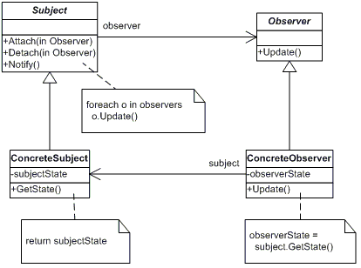
Observer (Diagram)
Notes:
ATS Application Programming: Java Programming
7.2 Design Patterns
© Accenture 2005 All Rights Reserved
Course Code #Z16325

Slide 5
Examples in JAVA API:
  Button (Subject)
  ActionListener (Observer)

Slide 6
Factory Method
Definition
Defines an interface for creating an object, but let subclasses decide which class to instantiate. Factory Method lets a class defer instantiation to subclasses
Problem & Context
If an object needs to know the selection criteria to instantiate an appropriate class, this results in a high degree of coupling. Whenever the selection criteria change, every object that uses the class must be changed correspondingly
Solution
Encapsulate the functionality required to select and instantiate the appropriate class. One way to do this is to create an abstract class or an interface that declares the factory method. Different subclasses can then implement the method in its entirety
Notes:
ATS Application Programming: Java Programming
7.2 Design Patterns
© Accenture 2005 All Rights Reserved
Course Code #Z16325

Slide 7
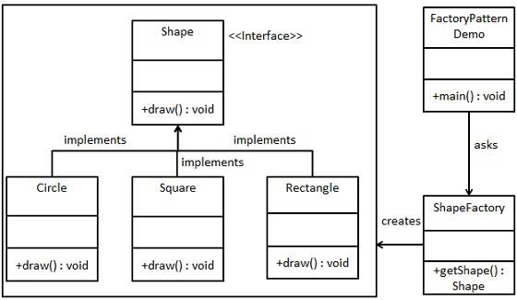
Factory (Class Diagram)

Slide 8
Examples in JAVA API:
  Calender.getInstance()
  NumberFormat.getInstance()

