Slide 1

Zomato Survey Dataset For Business Enhancement
By Mamta Khatri(Data Scientist, IITM-CODE, Intellipaat

Slide 2
Data description
The Zomato has created data to explore every corner of the globe and taste the best cuisines within their budgetary range.
This dataset consists of 21 variables in it which are – Restaurant Name, Location, Rating, etc.,

Slide 3
Variable description
Total size : 9551 x 21
Data file : zomato.csv
Variable | Description | Data Type
Restaurant ID | Unique id of every restaurant across various cities of the world – (6317637, 6304287, etc.,) | Numeric
Restaurant Name | Name of the Restaurant – (Balay Dako, Guevarra’s,etc.,) | Categorical
Country Code | Country in which the restaurant is located – (1,13,14, etc.,) | Numeric
City | City in which the restaurant is located – (Makati City, Pasay City, etc.,) | Categorical
Address | Address of the restaurant | Categorical
Locality | Location in the city – (Asa Norte, Asa Sul, etc.,) | Categorical
Locality Verbose | Detailed description of the locality | Categorical
Longitude | Longitude coordinate of the restaurant's location | Numeric
Latitude | Latitude coordinate of the restaurant's location | Numeric
Cuisines | Cuisines offered by the restaurant | Categorical

Slide 4
Variable description
Total size : 9551 x 21
Data file : zomato.csv
Variable | Description | Data Type
Average Cost for two | Cost for two people in different currencies | Numeric
Currency | Currency of the country | Categorical
Has Table booking | If the Table is booked – Yes/No | Categorical
Has Online delivery | If the restaurant has online delivery – Yes/No | Categorical
Is delivering now | If delivering now – Yes/No | Categorical
Switch to order menu | Yes/No | Categorical
Price range | Range of price of the food | Numeric
Aggregate Rating | Average rating out of 5 | Numeric
Rating color | Depending upon the average rating color | Categorical
Rating text | Text on the basis of rating of rating | Categorical
Votes | Number of ratings casted by people | Numeric

Slide 5
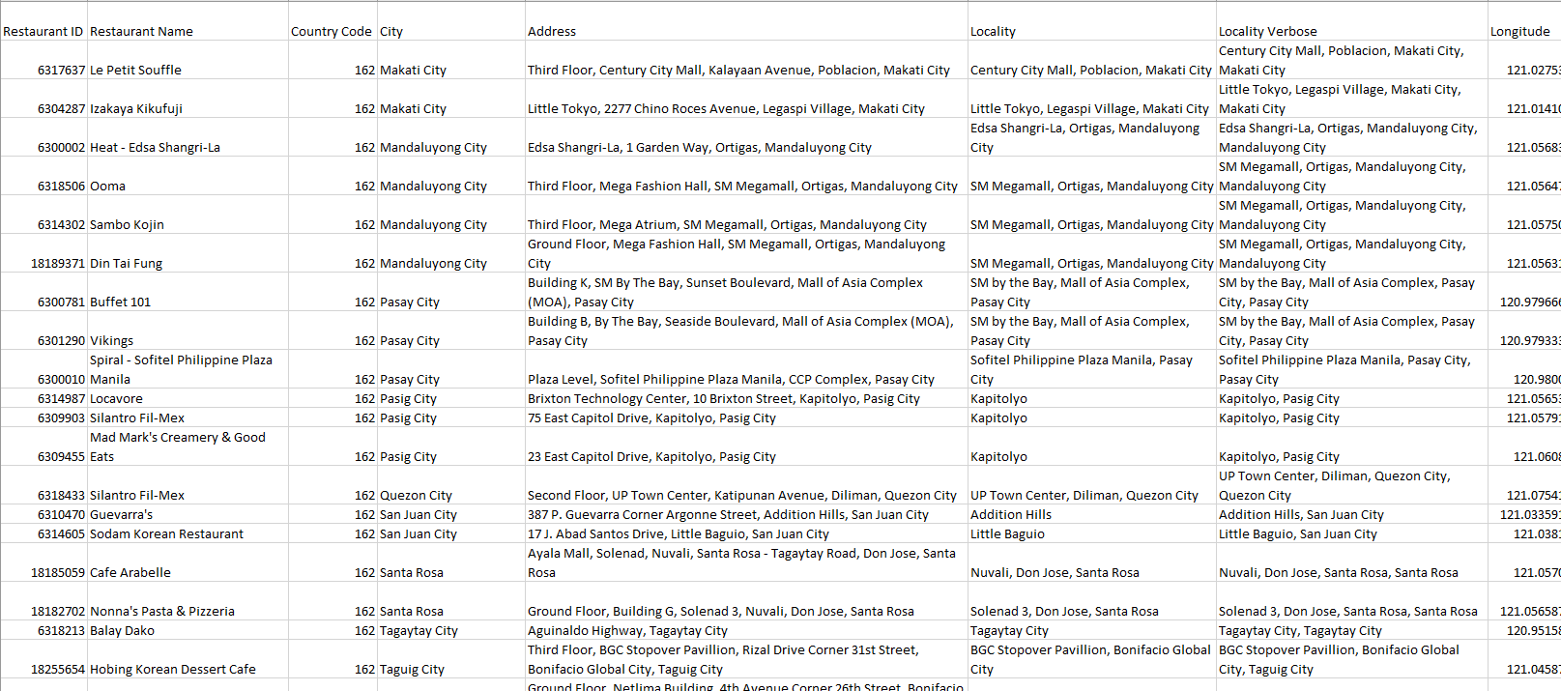
Snippet of Zomato.csv

Slide 6
Scope of work with Data
As Data Scientist/Analyst we can draw insight from data with perspective of :
Customers – As which restaurant to place order or dine in.
Zomato Business – To approach excellent and very Good restaurants who don’t deliver online or book table online for dine in.
But this presentation is purely EDA
Further Scope – After having analysis of EDA i.e. descriptive statistics of Data we can build model to suggest restaurant in a particular locality of required rating. Also can build business model for increasing Zomato Business by approaching Restaurants not using online services yet.

Slide 7
Action Plan
Using Python and Microsoft Power Point
Import libraries in python code file
Import data files
Merge Country Code file with Zomato Data file
EDA – Check for data fields and types, data size, null values
Imputation if required or selecting data of interest for analysis
Making Inferences/insight about data

Slide 8
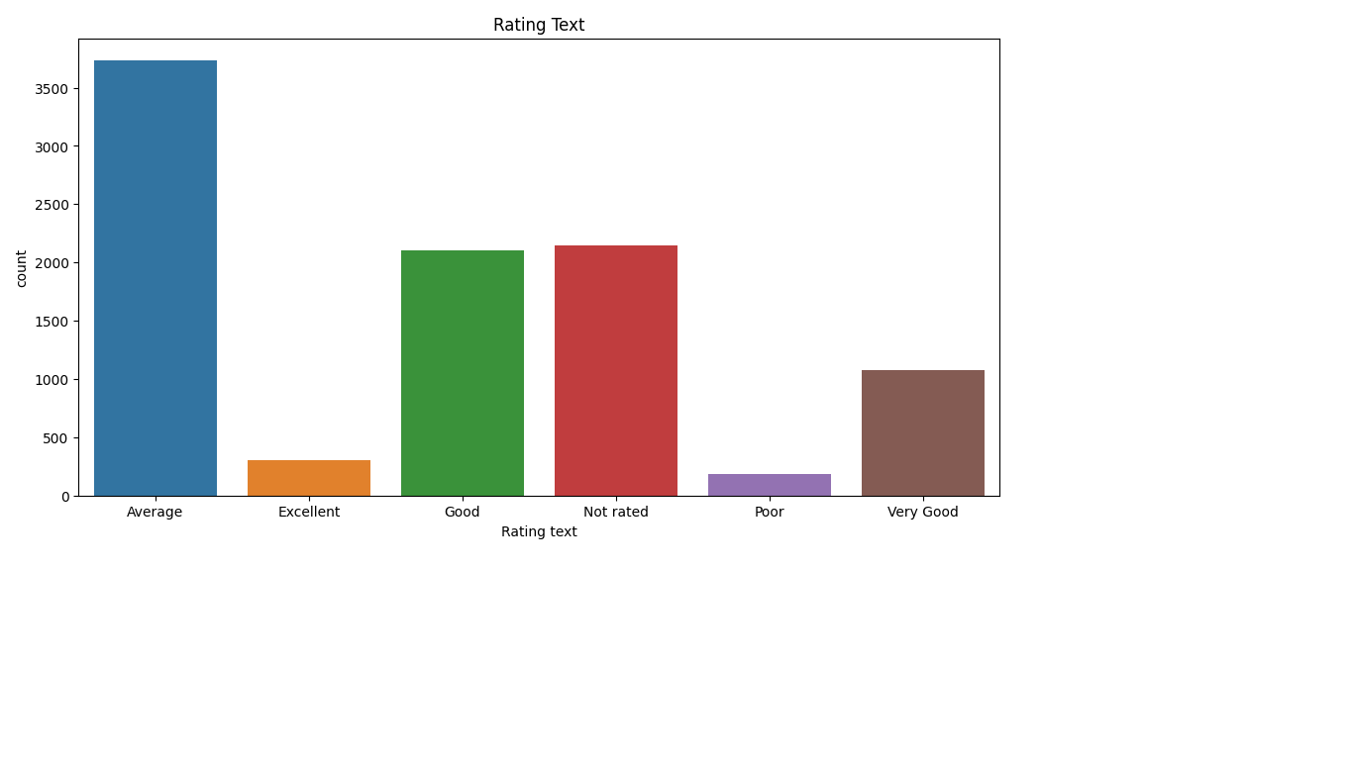

Slide 9
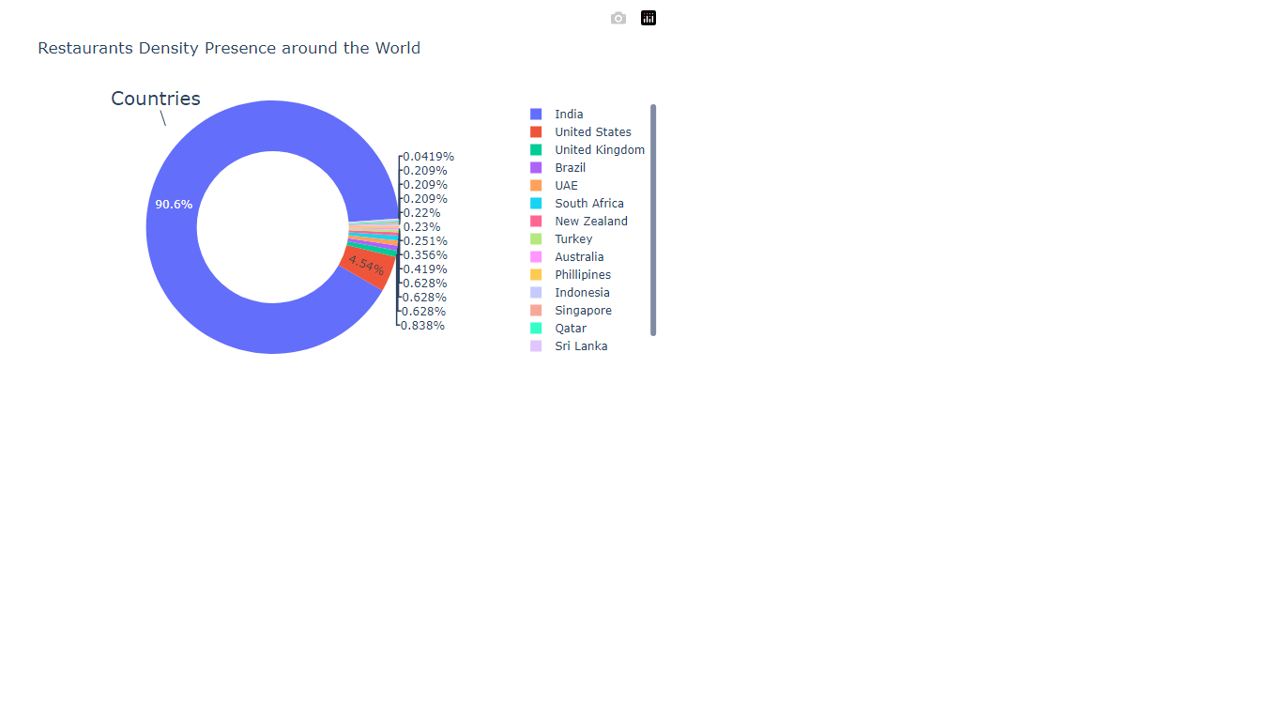

Slide 10
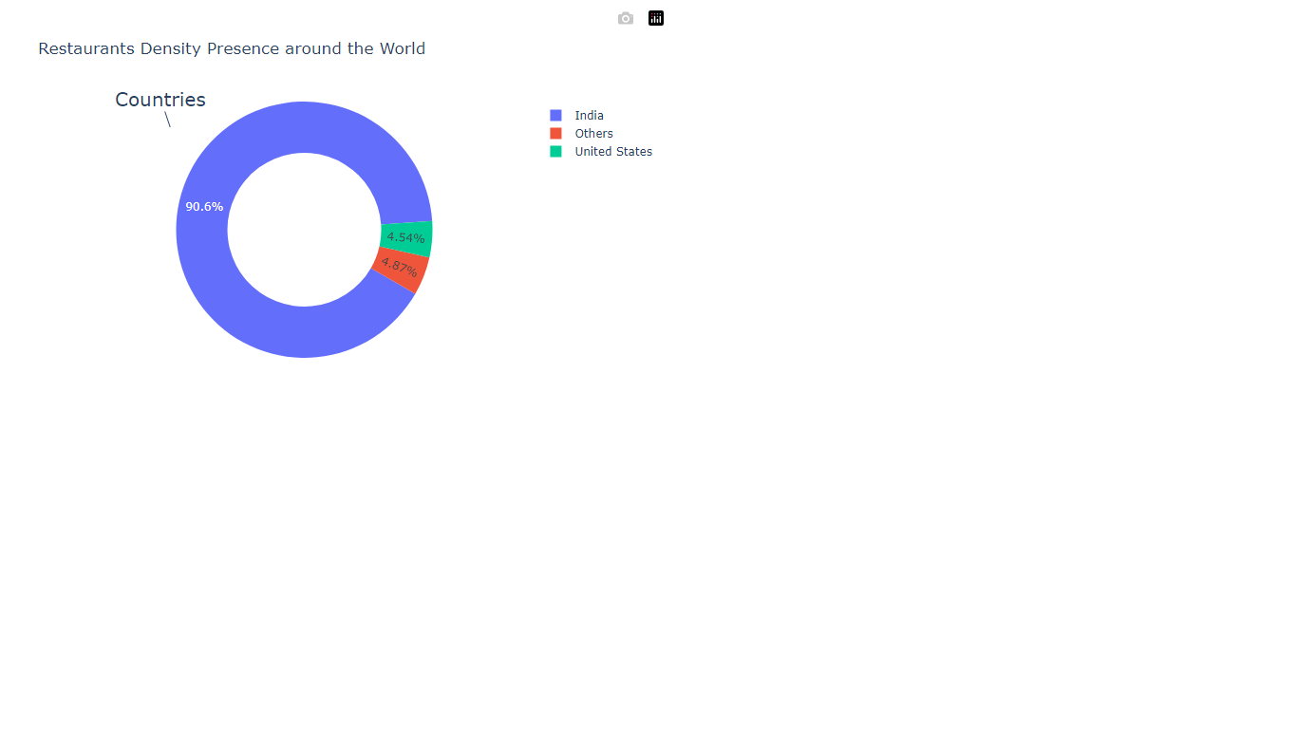

Slide 11
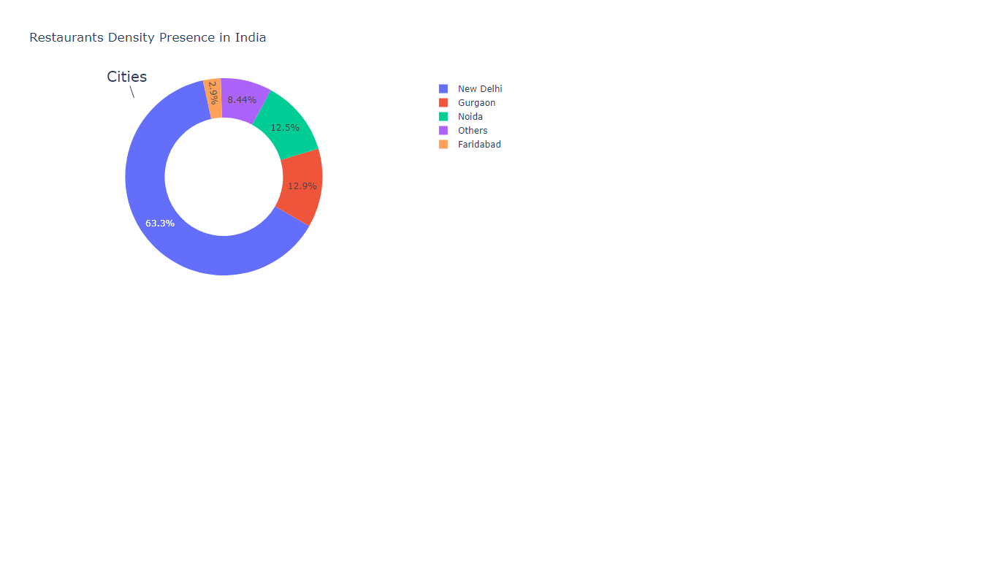

Slide 12
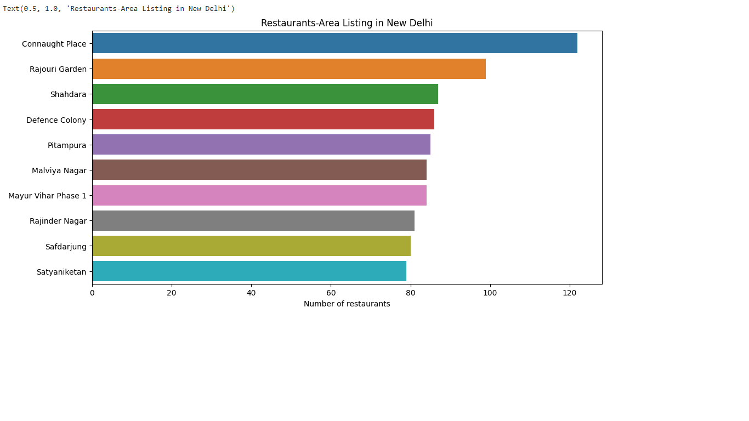

Slide 13
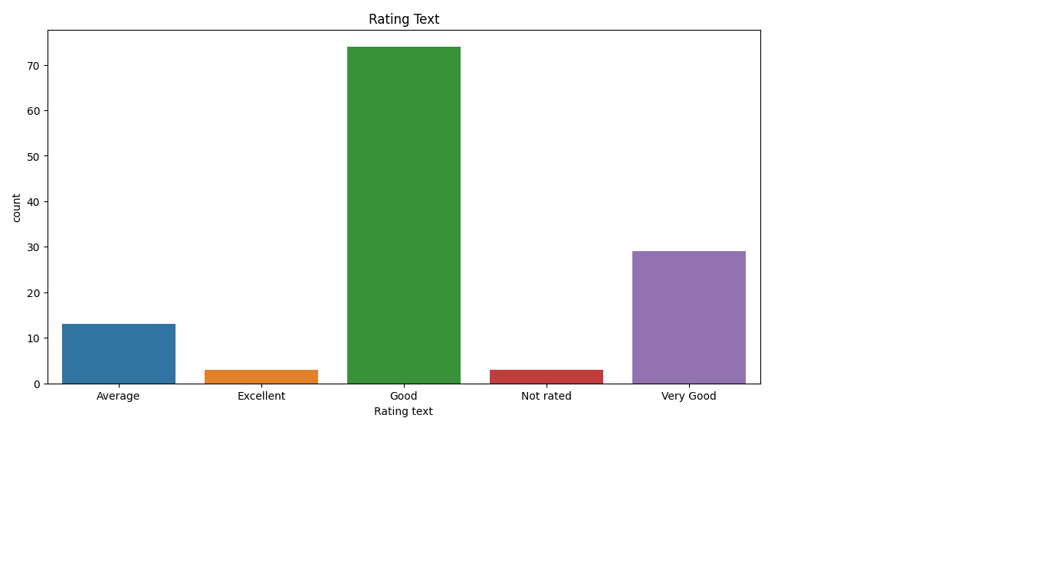
Restaurant Ratings of Connaught Place

Slide 14
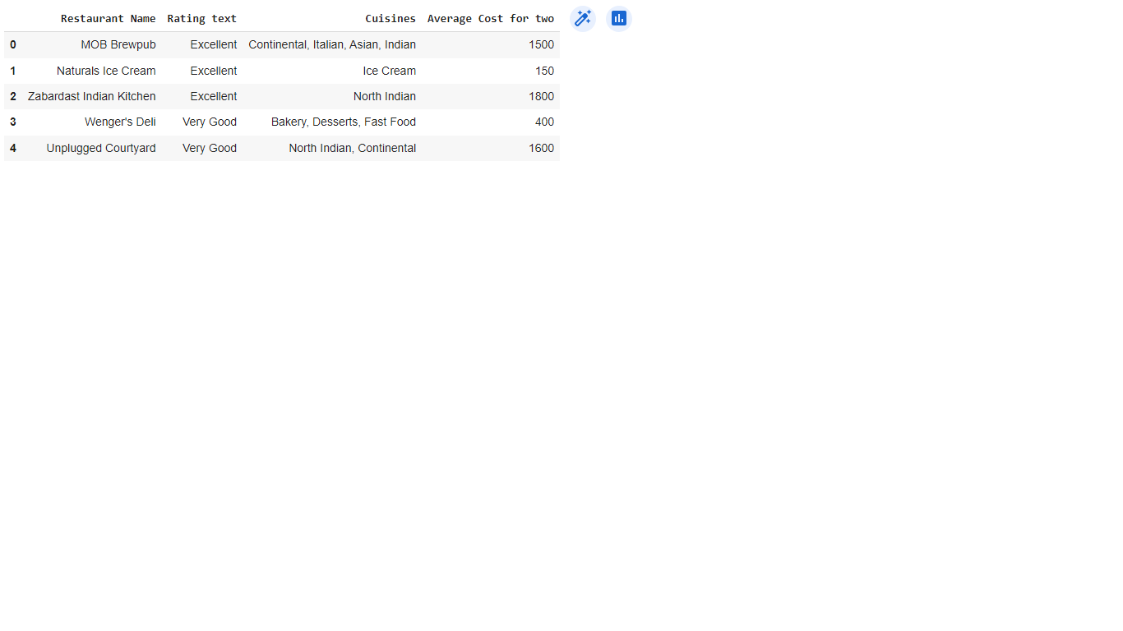
Top 5 Restaurants of Connaught Place Customer Perspective

Slide 15
Zomato Business Perspective
Key Parameters
Locality
Ratings
Cuisines
Has table booking
Has Online delivery
Is delivering Now---mostly No(only 34 restaurants in India)
Average for two---varies with cuisines like desserts to buffets---so very difficult to compare A cake shop with Proper 5-star Dine-in Restaurants

Slide 16
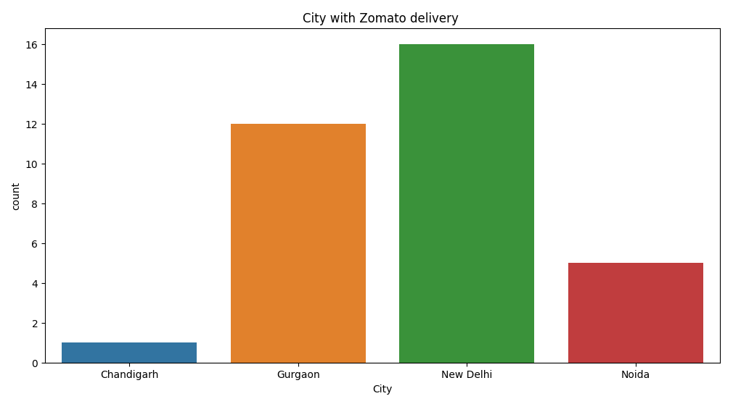
Current Zomato business with city restaurants
City | Count
Chandigarh | 1
Gurgaon | 12
New Delhi | 16
Noida | 5

Slide 17
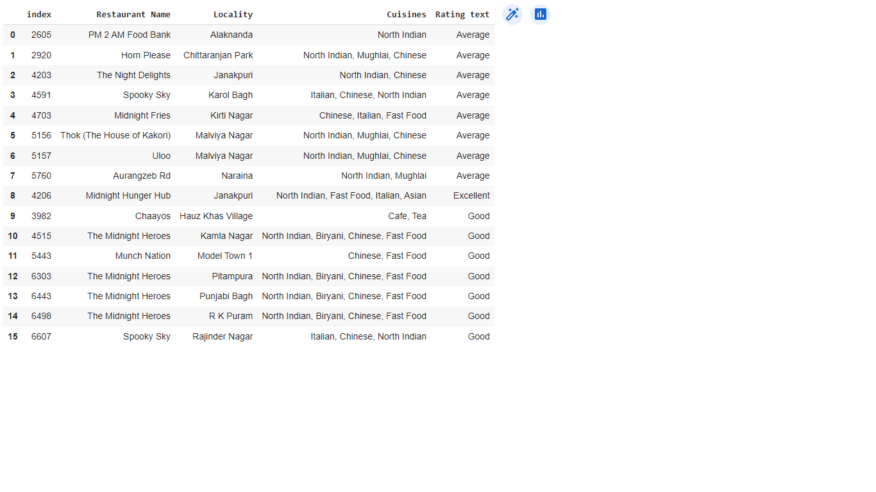
Zomato Business in New Delhi

Slide 18
Business Scope
Presently in India total 34 restaurants within 4 cities – chandigarh, New delhi, Gurgaon and Noida
Among these, 16 restaurants in New Delhi
None restaurant of Connaught Place is delivering now with Zomato – 122 restauarants
So to start Locality-wise for Connaught Place, in first phase , Zomato can approach (Excellent, Very Good, Good ----106 restaurants) restaurants who ‘Has Online Delivery’ and ‘Has Table Booking’
In second phase All the remaining restaurants with Excellent, Good, Very Good rating
In third phase, Not Rated, Poor, Average restaurants with ‘Has Online delivery’
In fourth phase, rest of the restaurants of the Locality

Slide 19
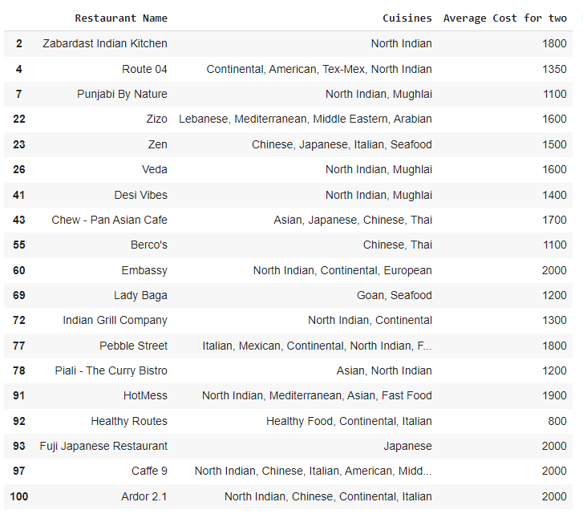
First phase for CP -19 restaurants

Slide 20
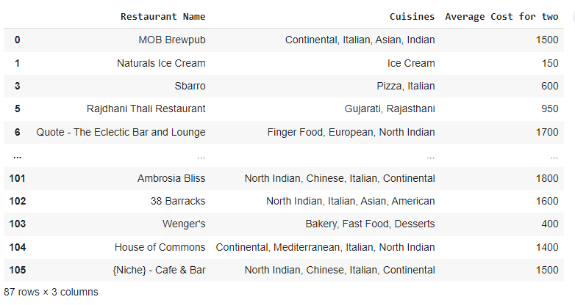
Second phase for CP -87 Restaurants

Slide 21
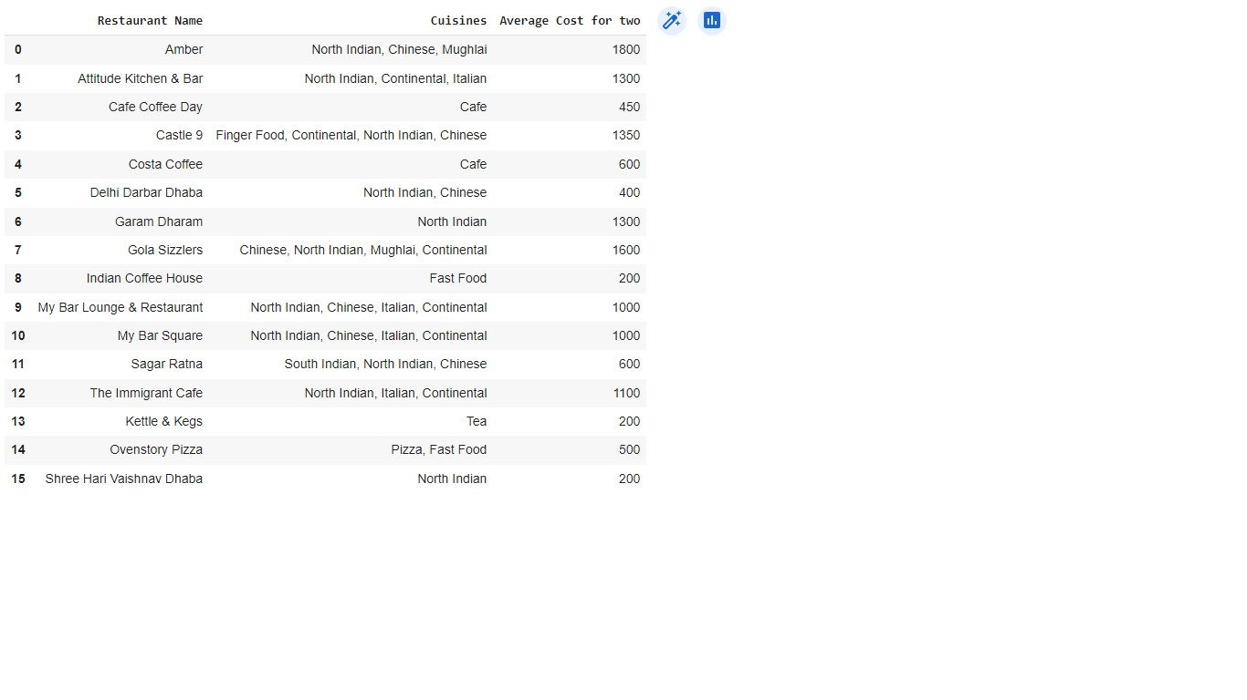
Third/Fourth phase for CP – 1+15=16 restaurants since among these only one restaurant is having online delivery /table booking

Slide 22
First phase for CP

Slide 23

THANK YOU

