Slide 1
Recruiting and managing highly skilled talents
Michael Vercruyssen, Odoo Consulting Team

Slide 2
Topics
1
Introduction: A real use case at Odoo
2
Recruitment process
3
Demonstration
4
Conclusion

Slide 3
Introduction
A real case at Odoo

Slide 4
A real case at Odoo
I am the HR manager of a new IT start up called Odoo, and to speed up my recruitment process I decide to use the Odoo Recruitment Apps to manage new job positions, applicants (interview meetings & questionnaires) until the final decision.
Michael Vercruyssen, HR manager at Odoo

Slide 5
Recruitment process

Slide 6
Recruitment Process
Create job positions
Application via Emails
Application via your website
Follow-up of recruitment
Manage documents, interviews meeting and recruitment tests
Hire or reject the applicants?

Slide 7
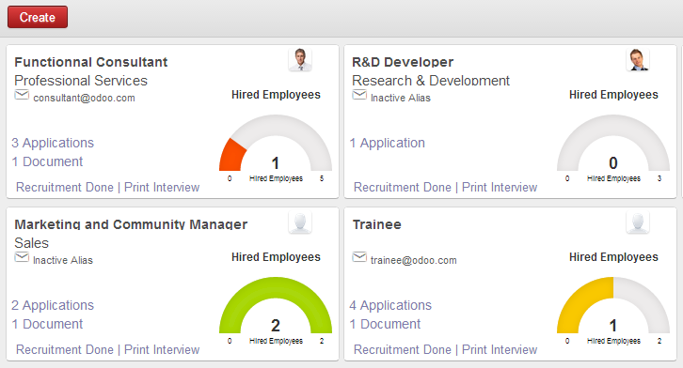
Job positions dashboard
Job positions
Applications
Follow-up
Recruitment tests
Hire or not?

Slide 8
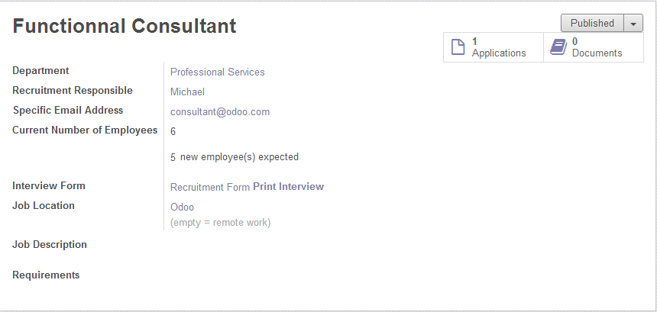
Job positions formview
Job positions
Applications
Follow-up
Recruitment tests
Hire or not?

Slide 9
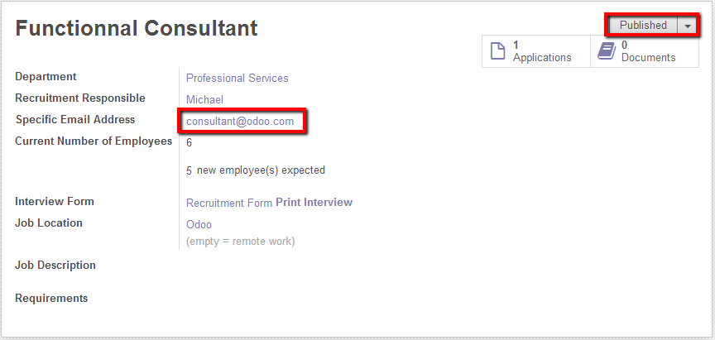
Email and website Applications
Job positions
Applications
Follow-up
Recruitment tests
Hire or not?

Slide 10
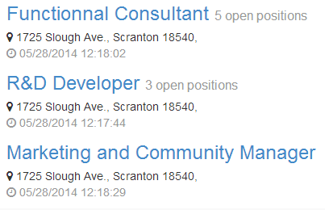
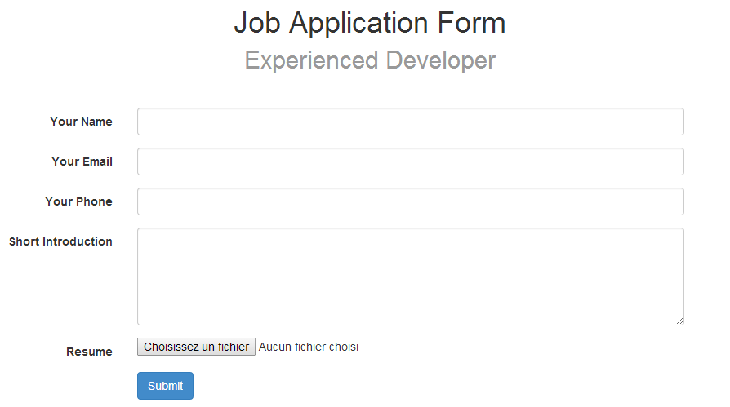
Email and website Applications
Job positions
Applications
Follow-up
Recruitment tests
Hire or not?

Slide 11
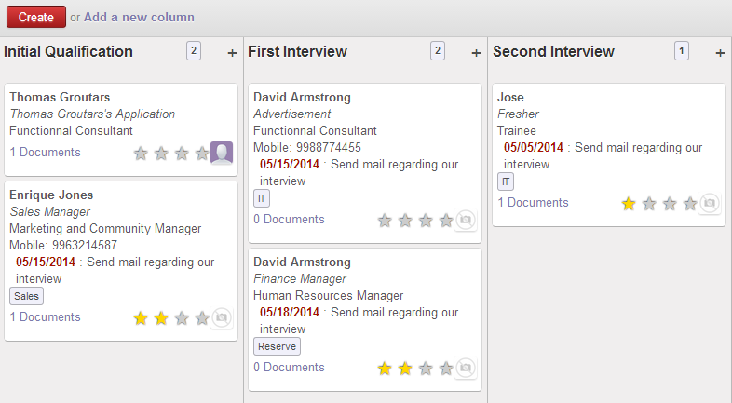
Follow-up
Job positions
Applications
Follow-up
Recruitment tests
Hire or not?

Slide 12
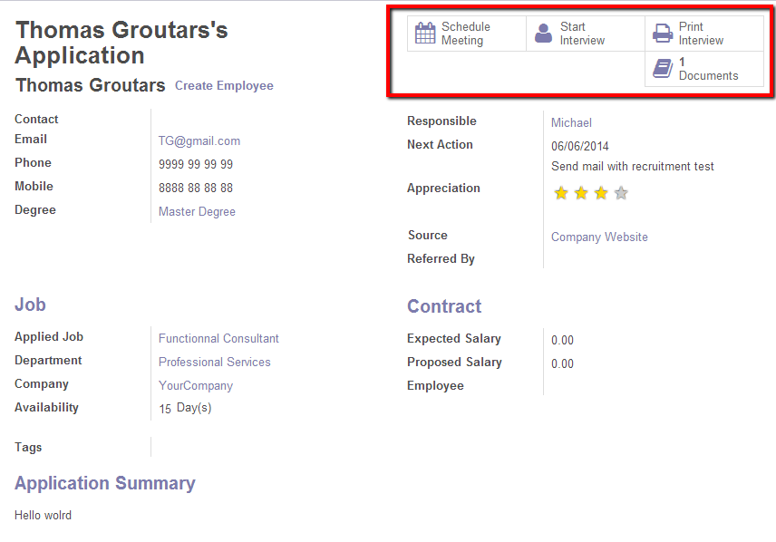
Follow-up
Job positions
Applications
Follow-up
Recruitment tests
Hire or not?

Slide 13
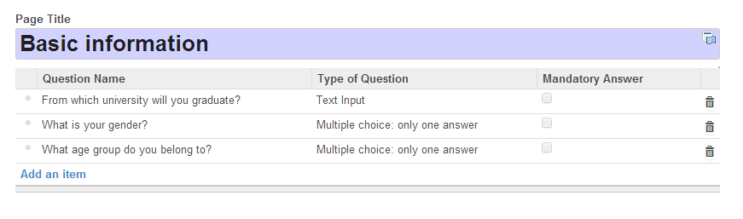
Recruitment tests
Job positions
Applications
Follow-up
Recruitment tests
Hire or not?
Create survey template
In order to test your applicants in function of the job position
applied and which stage of the recruitment process the
Applicant is.

Slide 14
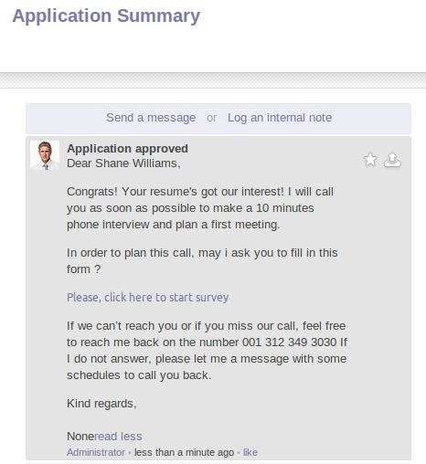
Recruitment tests
Job positions
Applications
Follow-up
Recruitment tests
Hire or not?
Create e-mail template
When candidate apply for
the job, HR send e-mail
with the application test form
or mass-mail all the
applicants in a specific stage.

Slide 15
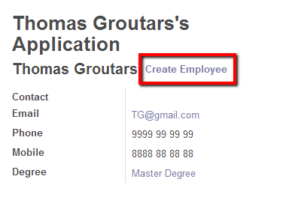
Hire or not?
Job positions
Applications
Follow-up
Recruitment tests
Hire or not?

Slide 16
Demonstration

Slide 17
Conclusion

Slide 18
Questions ?

Slide 19
Thank You

