Slide 1
Combinational Circuits
Pavel Kryukov 06/10/2017

Slide 2
Acknowledgements
These slides contain material developed and copyright by:
Alexandr Titov (MIPT), Digital Circuit Design

Slide 3
Layers of Abstraction in Computes Science
Application
Algorithms
Programming Language
Operating System
Instruction Set Architecture
Microarchitecture
Gates/Register-Transfer Level (RTL)
More about logical circuits
Topics of
this lecture
Circuits
Less about physics, wires and transistors…
Physics

Slide 4

Abstracting From Physics
X
$$∇∙D=ρ$$
$$∇∙B=0$$
$$∇×E=−\frac{∂B}{∂t}$$
$$∇×H=j+\frac{∂D}{∂t}$$
Real physical circuits deal with physical properties, such as voltages and currents
Digital circuits use the abstractions of 0 and 1 to represent the presence or absence of these physical properties (signals) rather than a continuous range
voltage
It could not be a stable state: should not occur in the circuit except during transitions from one state to he other
5 V
Logic 1
3.5 V
Weak 1
undefined
1.5 V
Weak 0
Logic 0
0 V
Boolean algebra describes two-stated systems

Slide 5
Refresher: Boolean Algebra

Slide 6
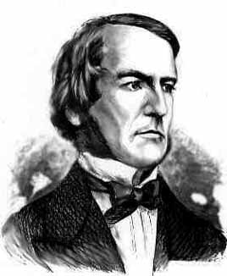
Boolean Algebra
Boolean Algebra works with objects that can take only two values (true and false, or 1 and 0)
Such object is called a Boolean object (term bit of information is used in CS)
Boolean algebra defines operations on Boolean objects → Boolean operations and functions
It is convenient to represent these operations and functions via truth tables:
George Boole
(1815 – 1864)
English mathematician, philosopher and logician
a | b | c
0 | 0
a | b | c
a | b | c
0 | 0 | c₀₀
a | b | c
0 | 0 | c₀₀
0 | 1 | c₀₁
1 | 0 | c₁₀
1 | 1 | c₁₁
a
c = F(a,b)
c
b
Boolean function
(logical gate)
Truth table

Slide 7
Main Boolean operations
identity
The simplest Boolean operation is …
The second simplest Boolean operation is inversion
x | id x
0 | 0
1 | 1
x
x
x | !x
0 | 1
1 | 0
x
!x

Slide 8
Main Boolean operations
AND (or Boolean multiplication)
AND is often used as a logical key:
NAND
x | y | x*y
0 | 0
0 | 1
1 | 0
1 | 1
x
0
x*y
0
y
0
1
x | y | x*y
0 (closed) | y | 0
1 (open) | y | y
x | y | !(x*y)
0 | 0
0 | 1
1 | 0
1 | 1
1
x
1
!(x*y)
1
y
0

Slide 9
Main Boolean operations
OR (or Boolean addition)
x | y | x+y
0 | 0
0 | 1
1 | 0
1 | 1
0
x
x+y
1
y
1
1
NOR !(x+y)
XOR (or exclusive OR, or addition by module 2)
x | y | x ⊕ y
0 | 0
0 | 1
1 | 0
1 | 1
0
x
x ⊕ y
= x*!y + !x*y
1
y
1
0

Slide 10
Main axioms
There about ten axioms and theorems that can be used to create new or to simplify existed functions
Axiom | AND form | OR form
Identity law | 1*x = x | 0 + x = x
Idempotent law | x*x = x | x + x = x
Inverse law | !x*x = 0 | !x + x = 1
Commutative law | xy = yx | x + y = y + x
Associative law | (xy)z = x(yz) | (x + y) + z = x + (y + z)
Distributive law | xy + z = (x + z)(y + z) | (x + y)z = xz + yz
De Morgan's laws | !(xy) = !x + !y | !(x + y) = !x!y
… and a lot of other useful equations:
!x ⊕ y = x ⊕ !y = !(x ⊕ y)

Slide 11
Boolean functions
Boolean operations can be combined into functions
F(x, y, z) = x + !y*z
x
x + !y*z
x | y | z | F
0 | 0 | 0
0 | 0 | 1
0 | 1 | 0
0 | 1 | 1
1 | … | … | 1
y
0
z
1
0
0

Slide 12
Examples of reduction
F = (!x!y!z) + (!x y z) + (x !y !z) + (x y !z) =
= (!x !y !z) + (!x y z) + (x !z)(!y + y) =
= (!x !y !z) + (!x y z) + (x !z) =
= !x (!y !z + y z) + (x !z) =
= !x (!y ⊕ z) + (x !z).
= (!x + x)(!y !z) + (!x y z) + (x y !z) =
= (!y!z) + y(!x z + x !z) =
= (!y!z) + y(x ⊕ z) =
= !(y + z) + y(x ⊕ z).

Slide 13
Canonical disjunctive normal form (CDNF)
CDNF is an algorithm of reconstructing a Boolean function from its truth table
Take lines with ‘1’ only
Conjunct all variables in line with correct sign
Make disjunction on expressions
→ Hint: use CDNF if there are less 1’s than 0’s
x | y | z | F
0 | 0 | 0 | 1
0 | 0 | 1 | 0
0 | 1 | 0 | 0
0 | 1 | 1 | 1
1 | 0 | 0 | 1
1 | 0 | 1 | 0
1 | 1 | 0 | 1
1 | 1 | 1 | 0
!x * !y * !z
F = (!x!y!z) + (!x y z) + (x !y !z) + (x y !z)
!x * y * z
x * !y * !z
x * y * !z

Slide 14
Canonical conjunctive normal form (CCNF)
CCNF is an algorithm of reconstructing a Boolean function from its truth table
Take lines with ‘0’ only
Make disjunction on all variables in line with correct sign
Conjunct expressions
→ Hint: use CCNF if there are less 0’s than 1’s
x | y | z | F
0 | 0 | 0 | 1
0 | 0 | 1 | 0
0 | 1 | 0 | 0
0 | 1 | 1 | 1
1 | 0 | 0 | 1
1 | 0 | 1 | 0
1 | 1 | 0 | 1
1 | 1 | 1 | 0
x + y + !z
x + !y + z
F = (x + y + !z)(x + !y + z)(!x + y + !z)(!x + !y + !z)
!x + y + !z
!x + !y + !z

Slide 15
Combinational Circuits

Slide 16
Combinational Circuits
If the output of a function is completely defined by the current input then the function is called combinational :
Qt = F(xt, yt, zt, …)
Combinational circuit (scheme) is an implementation of a combinational function
A lot of things can be implemented using combinational circuits
Just a few examples that will be presented soon: adder, decoder, multiplexer

Slide 17
Many-input devices
Primitives like OR, AND may be composed to support several inputs
x
x+y
x
y
y
x+y+z+w
x+y+z+w
z
z
z+w
w
w

Slide 18
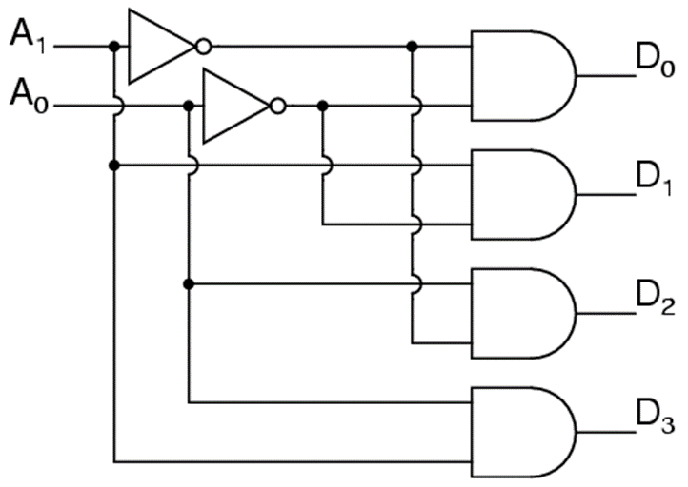
Binary Decoder
A binary decoder is a logic circuit that converts a binary integer value to an associated pattern of output bits.
A₀ | A₁ | D₀ | D₁ | D₂ | D₃
0 | 0 | 1 | 0 | 0 | 0
0 | 1 | 0 | 1 | 0 | 0
1 | 0 | 0 | 0 | 1 | 0
1 | 1 | 0 | 0 | 0 | 1

Slide 19
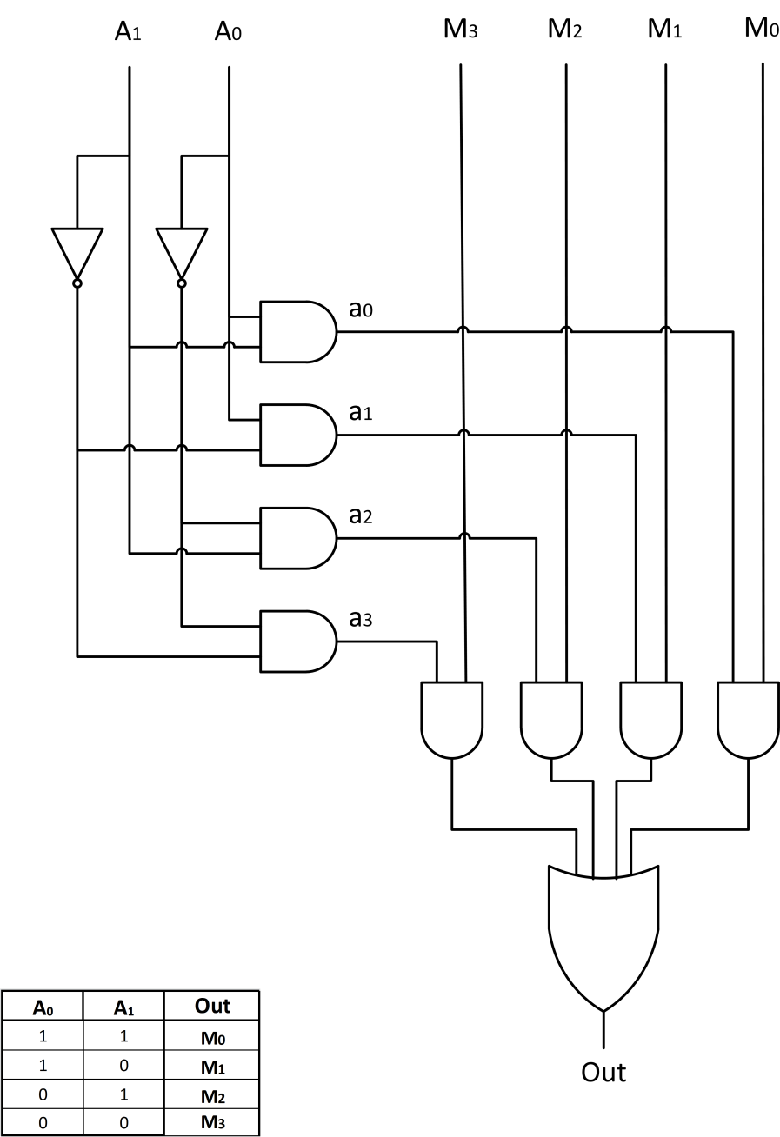
Multiplexer
A multiplexer (or mux) is a device that selects one signals and forwards the selected input into a single line.
The entry wires are address bus and data buses
Address bus is connected via decoder
M₀
M₁
A₀ | A₁ | Out
0 | 0 | M₀
0 | 1 | M₁
1 | 0 | M₂
1 | 1 | M₃
Out
M₂
M₃
A₀
A₁

Slide 20
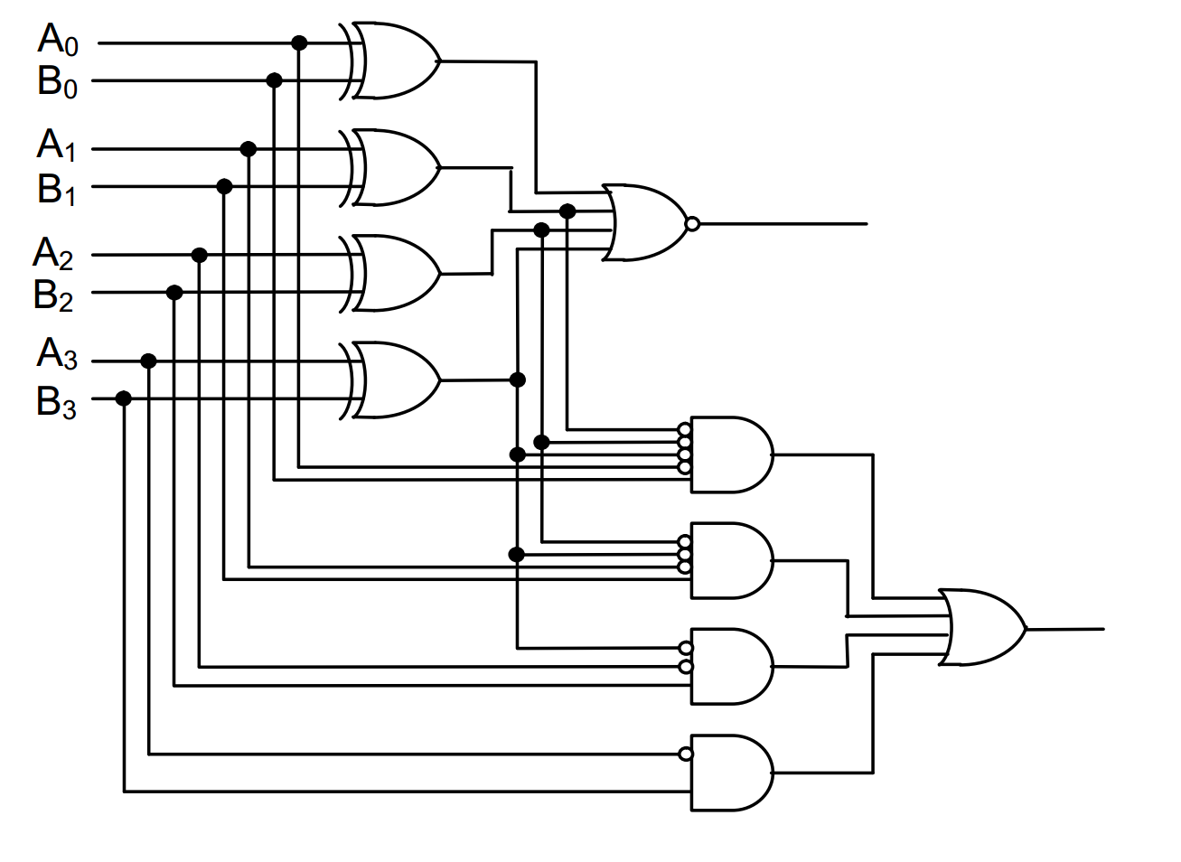
Comparator
A comparator is a device that takes two numbers as input in binary form and determines whether one number is greater than, less than or equal to the other number
 | EQ | LEQ
B<A | 0 | 1
B=A | 1 | 1
B>A | 0 | 0
EQ
LEQ

Slide 21
Adder and ALU

Slide 22
Half adder scheme
It is an adder, but it is not a full adder, because it does not have input carry
It is an adder, but it is not a full adder, because it does not have input carry
x
x | y | s | c
0 | 0
0 | 1
1 | 0
1 | 1
s
y
x
half +
sum
0
0
1
0
y
carry
1
0
0
1
c
Calculations:
Sum =
= !x * y + x * !y =
= x ⊕ y
Carry = x * y

Slide 23
Full adder scheme
xn | yn | cn-1 | sn | cn
0 | 0 | 0
0 | 1 | 0
1 | 0 | 0
1 | 1 | 0
We add input carry here
cn-1
0
0
1
0
half +
1
0
xn
half +
sn
0
1
0 | 0 | 1
0 | 1 | 1
1 | 0 | 1
1 | 1 | 1
1
0
yn
0
1
0
1
1
1
c
Cn
x
+
sum
It is called a full adder
y
carry

Slide 24
Wide adder
We may add more adders to sum numbers wider than 1 bit
yn+1
xn+1
yn
xn
+
+
+
+
+
cn+1
cn
cn-1
sn+1
sn
In real HW, wide adders have more com`plicated schemes to avoid long “carry chains”

Slide 25
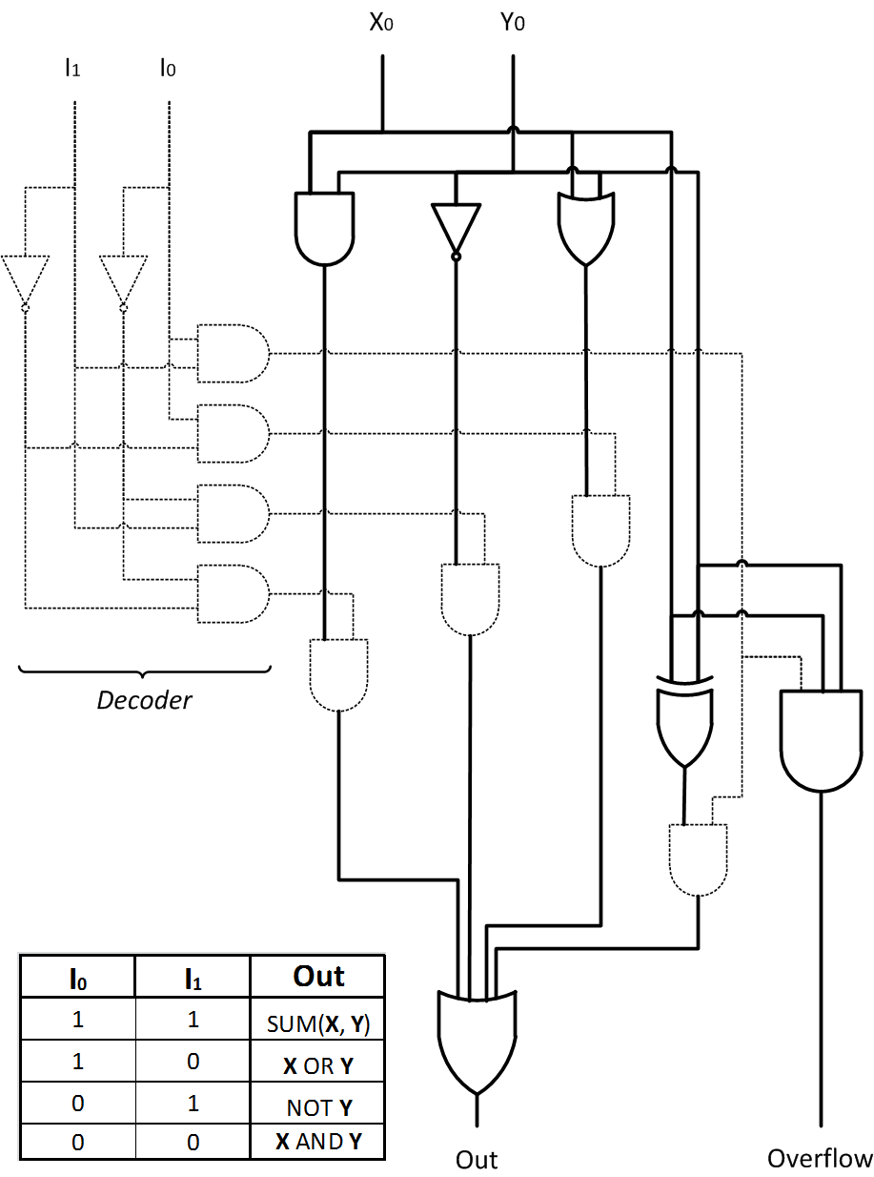
Arithmetic Logic Unit
ALU is a circuit that is able to perform different arithmetic and bitwise logical operations on integer binary numbers
ALU
Operand 1 (X)
Result (out)
Operand 2 (Y)
Opcode (I)

Slide 26
Subtraction

Slide 27
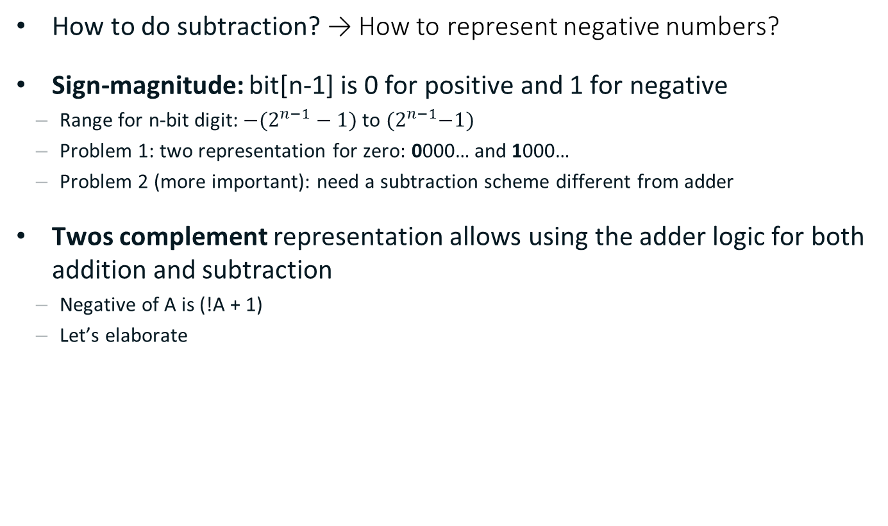
Negative Numbers
How to do subtraction? → How to represent negative numbers?
Sign-magnitude: bit[n-1] is 0 for positive and 1 for negative
Range for n-bit digit: ${−(2}^{n−1}−1)$ to ${(2}^{n−1}−1)$
Problem 1: two representation for zero: 0000… and 1000…
Problem 2 (more important): need a subtraction scheme different from adder
Twos complement representation allows using the adder logic for both addition and subtraction
Negative of A is (!A + 1)
Let’s elaborate

Slide 28

Twos Compliment Representation
Asymmetric range: ${−2}^{n−1}$ to ${(2}^{n−1}−1)$
One representation for zero
Representation on n-digit number:
A = ${−2}^{n−1}a_{n−1 }+ …+2a_{1}+a_{0}$
Example: 101 = ${−2}^{2}+$1 = -3
How to convert to negative?
How to do subtraction via addition?
subtraction
0
addition
-1
000
+1
111
001
-2
110
010
+2
101
011
+3
-3
100
-4
overflow

Slide 29
Example of subtraction (1)
0
Example: 2 – 3 = ?
2 – 3 = 2 + (−3)
2 + (−3) = 010 + 101 = 111
111 = −1
-1
000
+1
111
001
-2
110
010
+2
0
-1
000
+1
101
011
+3
111
001
-3
100
-4
-2
110
010
+2
0
101
011
+3
-1
000
+1
-3
100
111
001
-4
-2
110
010
+2
101
011
+3
-3
100
-4

Slide 30
Example of subtraction (2)
0
Example: −1 – 3 = ?
−1 – 3 = −1 + (−3)
−1 + (−3) = 111 + 101 = 1100
100 = −4
-1
000
+1
111
001
-2
110
010
+2
0
-1
000
+1
101
011
+3
111
001
-3
100
-4
-2
110
010
+2
0
101
011
+3
-1
000
+1
-3
100
111
001
-4
-2
110
010
+2
101
011
+3
-3
100
-4

Slide 31
Overflow
Example: −2 – 3 = ?
−2 – 3 = −2 + (−3)
−2 + (−3) = 110 + 101 = 1011
011 = 3 → Overflow ☹
Overflow conditions
negative + negative = positive
positive + positive = negative
How to check in HW?
If C_{n-1} != C_{n-2} then overflow
0
-1
000
+1
111
001
-2
110
010
+2
0
-1
000
+1
101
011
+3
111
001
-3
100
-4
-2
110
010
+2
0
101
011
+3
-1
000
+1
-3
100
111
001
-4
-2
110
010
+2
101
011
+3
-3
100
-4

Slide 32
Negation
How to convert to negative?
School math: −B = (−1 − B) + 1
What is (−1 − B)?
Thus, −B = !B + 1
Finally:
A − B = A + (−B) = A + !B + 1
000
111
0
001
−1
+1
→ Inversion
110
−2
+2
010
-1
1 | … | 1 | 1 | 1
Bn-1 |  | B2 | B1 | B0
–
1 | … | 1 | 1 | 1
Bn-1 |  | B2 | B1 | B0
!Bn-1 |  | !B2 | !B1 | !B0
B
−3
+3
!B
101
011
−4
100

Slide 33
Add/Subtract Schematic
A − B = A + (−B) = A + !B + 1
of = C_{n-1} ⊕ C_{n-2}
…
y_{n-1}
y₂
y₁
y₀
…
x_{n-1}
x₂
x₁
x₀
c_{n-1}
+
c_{n-2}
…
c₂
c₁
c₀
subtract?
+
+
+
s_{n-1}
s₂
s₁
s₀
of

Slide 34
Thank You

