Slide 1
Caches, pt. I
Pavel Kryukov
10 February 2017

Slide 2
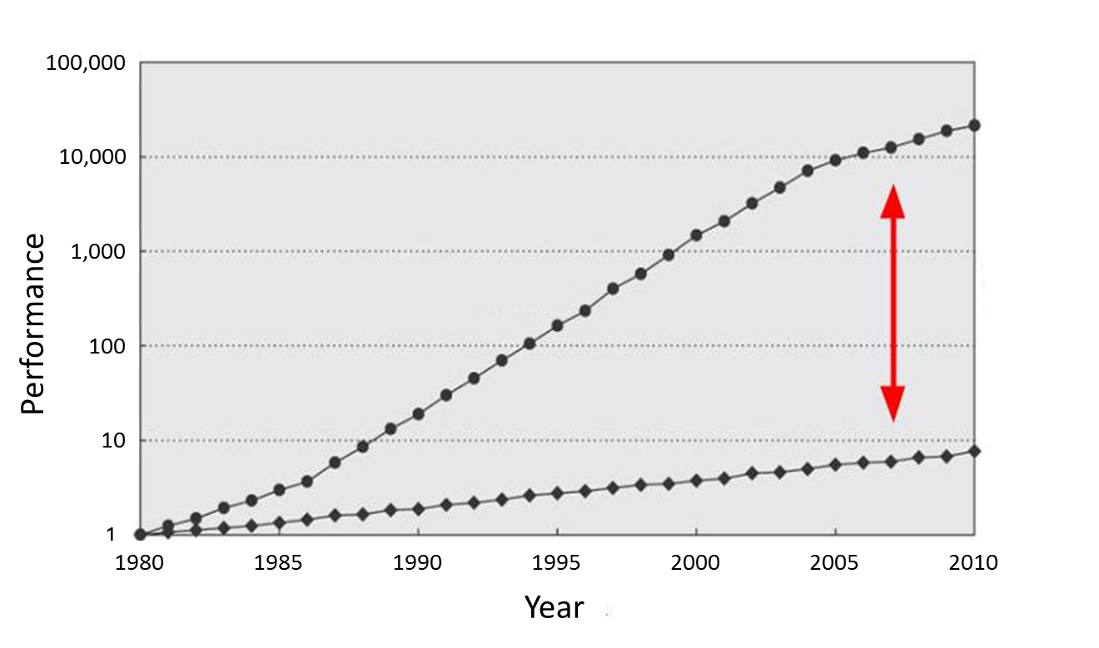
Memory Is Slow
CPU
60% per year
(Doubles every 1.5 year)
Performance gap
9% per year
(Doubles every 10 year)
DRAM

Slide 3
Why is memory slow?
A1: Memory uses DRAM technology, while registers are SRAM
DRAM is slower, but cheaper
This is not the answer: may we use SRAM for memory?
A2: Memory transistors are smaller, therefore they are slower
Again: may we use big transistors for memory?
DRAM cell
SRAM cell

Slide 4
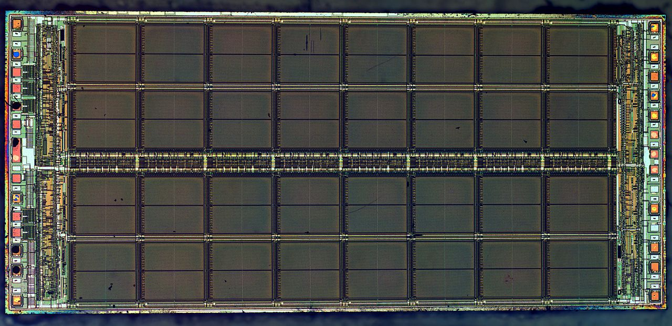
Correct answer is: area
Large memory arrays have large area, so wires have to be long
Large memory cannot be fast. Fast memory cannot be large.

Slide 5
Refresher: Pipeline limitations
Max speed of the pipeline is one instruction per clock
It is rare achievable in in-order processors due to dependencies among instructions and long latency operations
Load from the memory
F | D | E | M | W
 | F | D | E | M | W
 |  | F | D | E | M | W
M | W
 |  |  | F | D | E | M | W
 |  |  |  | F | D | E | M | W
 |  |  |  |  | F | D | E | M | W
F | Stall
D | E | M | W
F | D | E | M | W
 | F | D | E | M | W

Slide 6
Memory Hierarchy
Main memory is large, but too slow
Small memory is fast, but cannot hold all required data
Solution: take the best of both and combine
Memory hierarchy provides visibility that memory is usually fast
L3
Cache
Main Memory
L1
L2
CPU
smallest, but fastest
slowest, but largest

Slide 7
Real life example: Logistics
Factory
Your shop
Shop store
Large storehouse
Storehouse
The delay is decreased, but the cost is increased

Slide 8
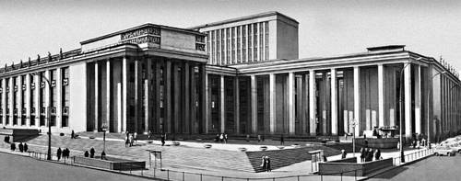
Real life example: bookshelf
Your bookshelf
A-B | C-D | E-F | G-H | I-J | … | … | … | … | … | Y-Z
Places for books
The first letter in the name of the author
fast
slow
Your table
City library

Slide 9
Why Does It Work?
Temporal Locality (Locality in Time):
If an item is accessed, it will tend to be accessed again soon
Example: code and variables in loops
→ Keep recently accessed data closer to the processor
Spatial Locality (Locality in Space):
If an item is accessed, nearby items tend to be accessed soon
Example: scanning an array
→ Move contiguous blocks closer to the processor
Locality + smaller HW is faster memory → hierarchy

Slide 10
Cache: Main Idea
The cache holds a small part of the entire memory
Need to map parts of the memory into the cache
Main memory is virtually partitioned into lines
Typical block size is 32 to 64 bytes
Blocks are aligned
Memory
#line
0
1
2
3
4
5
6
…
…
91
92
93
…
…
The cache holds data by lines
Only a subset of the blocks is mapped to the cache at a given time
Address of lines is used as a key
Cache
#line
2
91
4
5

Slide 11
Cache Lookup
Case 1: Cache Hit
The requested line is in the cache
The cache returns the requested line (fast)
Case 2: Cache Miss
Memory
line#
0
1
2
3
4
5
6
…
…
91
92
93
…
…
Cache
line#
2
91
5
hit
4
4?
CPU

Slide 12
Cache Lookup
Case 1: Cache Hit
The requested line is in the cache
The cache returns the requested line (fast)
Case 2: Cache Miss
The requested line is not in the cache
Need to fetch it from the main memory (slow) and fill the cache
May need to evict another line from the cache to free space for the new one
Memory
line#
0
1
2
3
4
5
6
…
…
91
92
93
…
…
Cache
line#
91
5
2
93
miss
93?
4
93?
CPU

Slide 13
Fully Associative Cache
Line may be mapped to any cache entry
Lookup line in all entries
Address is partitioned to
Offset within a line (byte#)
Line # (so-called tag)
Each cache entry has a tag
All tags are compared to the line# in parallel
If one of the tags matches the line#, we have a hit
Address
64 | 5 | 0
Tag = line# | Offset
Tag
Array
Data
Array
63
0
0
1
…
511
=
=
…
…
=
…
hit/miss
data

Slide 14
Direct Mapped Cache
Line is mapped to the fixed entry only
Lookup line in one entry
Address is partitioned to
Offset within a line (byte #)
Set (fixed cache entry #)
Tag (works as a key)
Conflicts are possible
If several lines are mapped to the same entry, only one can reside in the cache
Address
64 | 14 |  | 5 | 0
Tag | Set |  | Offset
Data
Array
Tag Array
set#
63
0
0
1
…
511
…
=
hit/miss
data

Slide 15
Memory Layout: Direct Mapped Cache
Memory is virtually partitioned
into lines
line size = 2 ^ offset_size
lines grouped into slices
# of lines in slices = 2 ^ set_size
slice size = # of lines in slice * line_size = cache size
slice # = tag value
line # inside a slice = set value
64
0
 | Offset
 | Set | Offset
Tag | Set | Offset
Memory Space
set#
cache size
set#
cache size
tag#
Mapped to the same set
set#
cache size
…
Disadvantage is line evictions due to set conflicts
set#
cache size

Slide 16
2-Way Set Associative Cache
Conflicts are harmful → multi-ways cache is a solution
Each set holds two entries (way 0 and way 1)
Each line can be mapped into one of two entries in the appropriate set
Address
64 | 13 |  | 5 | 0
Tag | Set |  | Offset
way #0
way #1
Tag Array
Data Array
Tag Array
Data Array
set#
63
0
set#
63
0
0
1
…
255
0
1
…
255

Slide 17
2-Way Set Associative Cache
Address
64 | 13 |  | 5 | 0
Tag | Set |  | Offset
Tag Array
Data Array
way #0
way #1
way #0
way #1
set#
set#
63
0
63
0
0
1
…
255
0
1
…
255
=
=
MUX
hit/miss
data

Slide 18
Memory Layout: Multi-Way Cache
Memory is virtually partitioned almost the same as in direct map cache
The only difference is slice size
slice size = cache size / # of ways
Compared to direct map cache
Decrease slice size → increase # of slices → increase # of lines mapped to the same set
But in each set we can have multiple lines (= # of ways) at a given time
Example: 32KB, 8 ways, 64B line
Memory Space
set#
way size
Mapped to the same set
…
address
way size = 32KB / 8 = 4KB
# of sets = 4KB / 64B = 64
64 | 11 |  | 5 | 0
Tag | Set |  | Offset

Slide 19
Memory Layout: Multi-Way Cache
Slice is Nx smaller
For fully-associative cache N is equal to cache size in lines
For direct mapped cache N == 1
Address partitioning formulas:
set #
slice
Mapped to N cache lines
63 | Y |  | X | 0
Tag | Set |  | Offset
…
X = log(block_size)
Y = log(cache_size / N)

Slide 20
Cache Performance
Terms:
Miss Rate = Misses / total CPU request
Hit Rate = Hits / total CPU request = 1 – Miss Rate
Cache goal is decreasing average memory access time (AMAT)
AMAT = Hit Rate * Hit Time + Miss Rate * Miss Penalty
AMAT ≈ Hit Time + Miss Rate * Miss Penalty
Example:
HitRate ≈ 0.9, HitTime ≈ 4 clk, MissRate ≈ 0.1, MissPenalty ≈ 200 clk, then…
AMAT = 0.9 * 4 + 0.1 * 200 = 23.6 clk
AMAT w/o cache = 200 clk
About 10x improve!

Slide 21
Multi-Level Caches
L1 cache: AMAT ≈ HitTimeL1 + MissRateL1 * MissPenaltyL1
L2 reduces L1 miss penalty – saves access to memory
Now, on L1 miss we access L2, but not memory
MissPenaltyL1 ≈ HitTimeL2 + MissRateL2 * MissPenaltyL2
L2 Cache is larger (better HitRate), but has higher latency
Example:

Slide 22
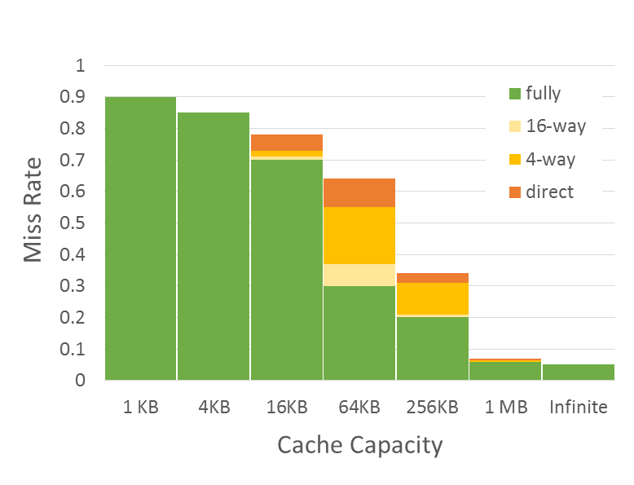
Three Types of Cache Misses (3-C)
Compulsory misses
Those that occurs even in a infinite cache
First access to data
So-called cold misses
Capacity misses
Those that occurs in an fully associative cache
Workset is larger than the cache size
Miss Rate = F(Cache Capacity, Associativity)
Conflict
Compulsory
Capacity
Conflict misses
Difference between fully associate and direct mapped cache
The size of the cache is enough, but the problem is in line mapping to sets

Slide 23
Code optimizations

Slide 24
Merging Arrays
Merge arrays into an array of compound elements
Before: two sequential arrays
int val[SIZE];
int key[SIZE];
After: One array of structures
struct merge {
int val;
int key;
} merged_array[SIZE];
Reduce conflicts between val and key
Improves spatial locality

Slide 25
Loop Fusion
Combine loops that have same looping and work with the same memory
Assume each element is 8 bytes, 32KB cache, 64 B/line
for (i = 0; i < 10240; i++)
a[i] = 1 / a[i];
…
for (i = 0; i < 10240; i++)
sum = sum + a[i];
Fuse the loops
for (i = 0; i < 10240; i++) {
a[i] = 1 / a[i];
sum = sum + a[i];
}
Improves temporal locality

Slide 26
Loop Interchange
Change loops nesting to access data in order stored in memory
Two dimensional array in memory:
x[0][0] x[0][1] … x[0][99] x[1][0] x[1][1] …
Before:
for (j = 0; j < 100; j++)
for (i = 0; i < 5000; i++)
x[i][j] = 2 * x[i][j];
Improves spatial locality
Sequential accesses instead of striding through memory every 100 words
After:
for (j = 0; j < 100; j++)
for (i = 0; i < 5000; i++)
for (j = 0; j < 100; j++)
x[i][j] = 2 * x[i][j];
for (i = 0; i < 5000; i++)
x[i][j] = 2 * x[i][j];

Slide 27
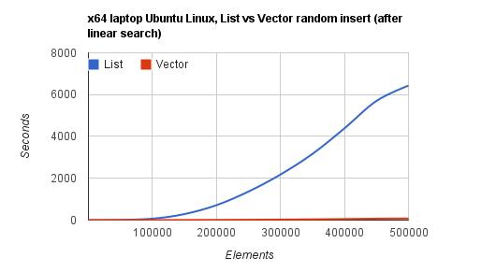
“Stop using linked lists”
Linked lists have no spatial locality
→ cache handles them worse than arrays
→ O(N) operation with array is much faster than O(N) operation with list
Example: random insert after linear search
https://kjellkod.wordpress.com/2012/02/25/why-you-should-never-ever-ever-use-linked-list-in-your-code-again

Slide 28
End of Pt. I

