Slide 1
Caches, part II
Igor Smirnov
17 February 2018

Slide 2
Improving Cache Performance

Slide 3
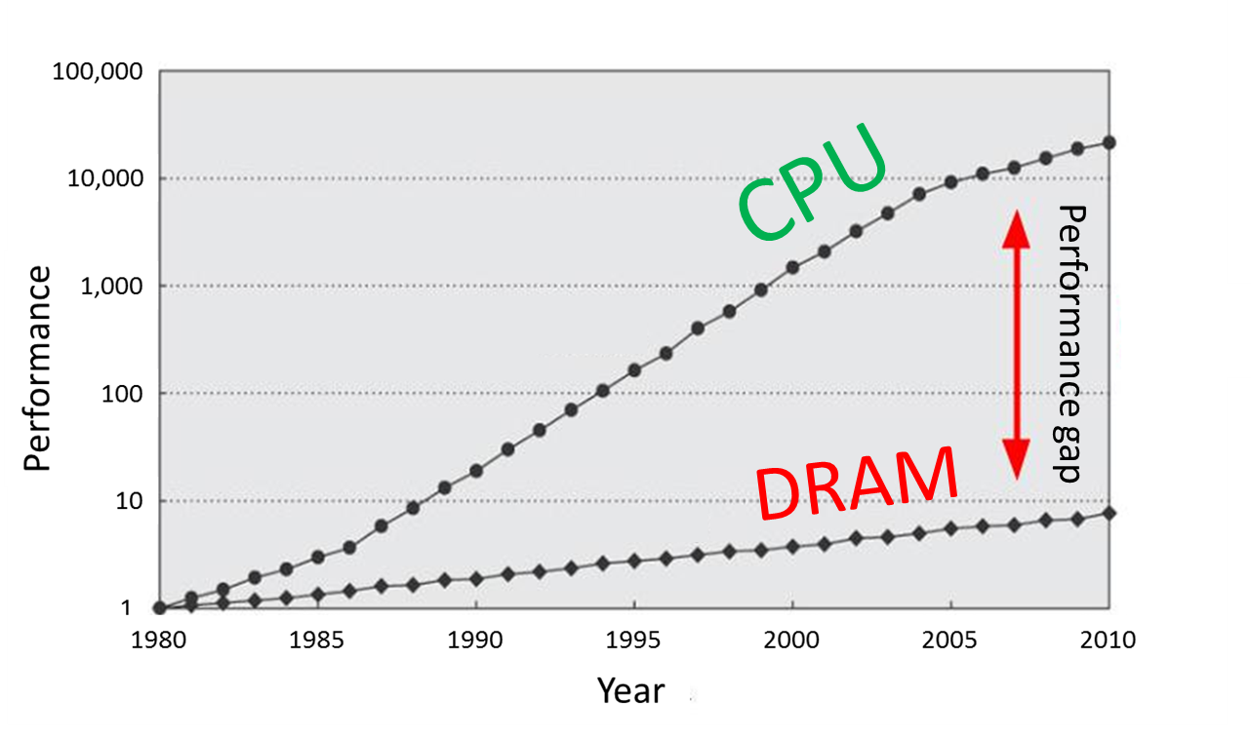
Refresher: Memory Hierarchy
Main memory is large, but too slow
Luckily, there are temporal and spatial locality in our workloads
Memory hierarchy provides visibility that memory is usually fast
L3
Cache
Main Memory
L1
L2
CPU
smallest, but fastest
slowest, but largest

Slide 4
Refresher: Caches
Three types of caches
Fully Associative: no conflict, but slow and complex HW
Direct MAP: fast and simple HW, but many conflicts
Multi-Way: something in between (more ways → closer to fully associative)
Example: 32KB, 8 ways, 64B line
To estimate performance use average access time
AMAT = Hit Rate * Hit Time + Miss Rate * Miss Penalty
address
64 | 11 |  | 5 | 0
Tag | Set |  | Offset
→
way size = 32KB / 8 = 4KB
# of sets = 4KB / 64B = 64

Slide 5
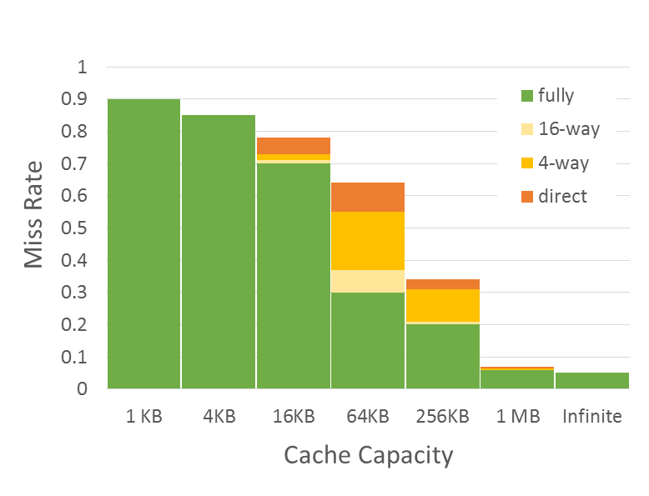
Refresher: Three Types of Cache Misses (3-C)
Compulsory misses
Those that occurs even in a infinite cache
First access to data
So-called cold misses
Capacity misses
Those that occurs in an fully associative cache
Workset is larger than the cache size
Miss Rate = F(Cache Capacity, Associativity)
Conflict
Compulsory
Capacity
Conflict misses
Difference between fully associate and direct mapped cache
The size of the cache is enough, but the problem is in line mapping to sets

Slide 6
Multi-Level Caches
L1 cache: AMAT ≈ HitTimeL1 + MissRateL1 * MissPenaltyL1
L2 reduces L1 miss penalty – saves access to memory
Now, on L1 miss we access L2, but not memory
MissPenaltyL1 ≈ HitTimeL2 + MissRateL2 * MissPenaltyL2
L2 Cache is larger (better HitRate), but has higher latency
Example:

Slide 7
Prefetching
Prefetching – predict future memory accesses
Instruction Prefetching
On a cache miss, prefetch sequential cache line
Data Prefetching
Next sequential: on a cache miss, prefetch sequential cache line
Stride: remember the repetitive step of a load and prefetch data in advance
General direction: even if there is no fixed stride can understand general direction and prefetch along it
Software Prefetching: special prefetching instructions
Prefetch Limitations
Prefetching relies on extra memory bandwidth
Too aggressive / inaccurate prefetching slows down demand fetches

Slide 8
Metrics
Accuracy
Portion of prefetched lines which eventually become demand-hits
Coverage
Reduction of number of demand misses
Timeliness
Reduction of demand miss time
For L1 cache prefetch schemes with high accuracy are used
Bigger caches usually leverage schemes with higher coverage

Slide 9
Next sequantial
On a cache miss, prefetch sequential cache line (± 64 bytes)
Prefetch metrics:
Moderate accuracy
Low coverage
Lack of timeliness (prefetch performed too late)
Simple HW
Works well for instructions prefetch
“Fallback" if more complex methods not available
lw $t0, 0x0($t1)
prefetch 0x40($t1)

Slide 10
Stride detection
HW detects the repetitive step of a load and prefetch data in advance
Prefetch metrics:
High accuracy (for long loops)
Low coverage
Highly timeliness
Issues with unrolled loops
Initially single load operation occupies multiple entries in detector
Detector
0x00402f0: lw $t0, 0x20($t1)
0x00402f4: add $t2, $t2, $t0
0x00402f8: addi $t1, $t1, 0x100
0x00402fc: beq $t1, $t3, -4
IP | Stride | Last address
0x00402f0 | 0x100 | 0x00f4180
prefetch 0x00f4280
prefetch 0x00f4380

Slide 11
Stream detection (1)
HW detects stream with the repetitive step
Similar to the previous technique, but without reference to IP
Example:
0xba20200
0x3cf1140 0xba203с0
0x3cf1100
0x3cf10c0
0x3cf1080
0xba20740
0xba20900
...
Base address | Stride | Last address
0xba20200 | +0x1c0 | 0xba20900
0x3cf1140 | −0x40 | 0x3cf1080
prefetch 0xba20ac0
prefetch 0x3cf10c0

Slide 12
Stream detection (2)
Stream detection without repetitive step
In case load pattern not found, but the direction was predicted – load everything following this direction
Prefetch metrics:
Low accuracy
High coverage
Highly timeliness
0xba20200 0xba20340
0xba203a0
0xba204с0
0xba20520
...
Base address | Stride | Last address
0xba20200 | ????
prefetch 0xba20ac0
prefetch 0x3cf10c0

Slide 13
Writing and Replacement Policies

Slide 14
Cache Line Replacement
When miss occurs need to free space in a cache for a new line
Direct mapped cache
A new line is mapped to a single entry → evict old line from the entry
N-way set associative cache
Choose a victim from all ways in the appropriate set, but how?
FIFO (First In First Out) replacement
Easy to implement in HW, but can violate temporal locality
LRU (Least Recently Used) replacement
Evict the most unused line (was not accessed longer than other)
Good temporal locality, but complex HW → use simplified pseudo-LRU

Slide 15
Pseudo-LRU
Pseudo-LRU is a good approximation of LRU with a binary tree
Each node stores information about which of the descendants was recently used
Request «B»
Request «A»
Request «E»
L
R
R
L
R
L
L
L
R
L
R
R
A
B
C
D
A
B
C
D
A
B
C
D
A
B
E
D

Slide 16
Counterexample
Sometimes there is no temporal locality
Example: read of large data array (data size >> cache size)
In case of LRU the second loop will always ‘miss’
If data eviction follows MRU policy (most-recently used) the second loop will start with ‘hit’
for (size_t i = 0; i < N; ++i)
sum += a[i];
double average = sum / N; for (size_t i = 0; i < N; ++i)
a[i] -= average;

Slide 17
Write Handling
Memory writes (store instructions) also need to update a cache
If update only memory, the old data can be read from the cache later
There two main approached of write handling
WriteThrough: always update both memory and cache
WriteBack: update only cache, update memory at line eviction
Event | WriteThrough | WriteBack
Write hits cache | Update memory and cache | Update only cache (make line “dirty”)
Write misses cache | Option 1: Upload missing line into cache, update memory and cache Option 2: Update only memory | Upload missing line into cache, update only cache (make the line “dirty”)
A line is evicted | Do nothing | If the line is “dirty” write it back into memory

Slide 18
Write Back example
from execution
cache set (16 ways)
data write
data read
miss
fetched data
to memory

Slide 19
Small Summary
How is a block found?
Indexing → direct mapped
Limited search → set associative
Full search → full associative
Where can a block placed?
One place → direct mapped
A few places → set associative
Any place → full associative
What line is replaced on a miss?
FIFO
LRU
Pseudo-LRU
How are writes handled?
WriteThrough
WriteBack

Slide 20
The End

