Slide 1
Out-Of-Order Execution (part II)
Igor Smirnov 17 March 2018

Slide 2
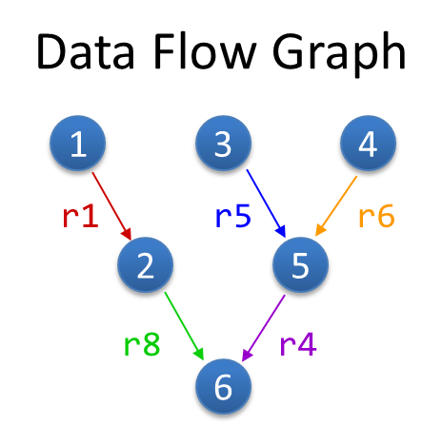
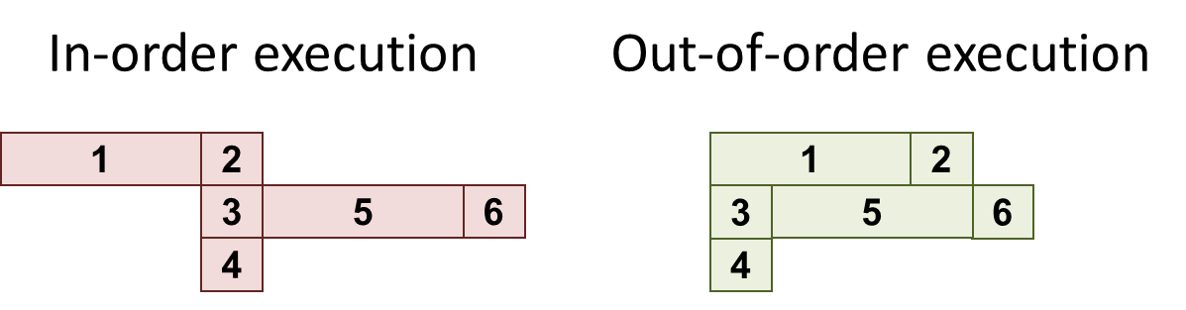
Refresher: OOO Exe
Superscalar – wide pipeline (4-5 in modern CPU)
Out-of-order – execute according real dependencies (“data flow”) rather than program order
Advantages:
Exploit parallelism beyond adjacent instructions
Hide long latencies (e.g., cache misses)
Compatibility: need to maintain visibility of in-order execution
Precise exceptions, memory model, etc.

Slide 3
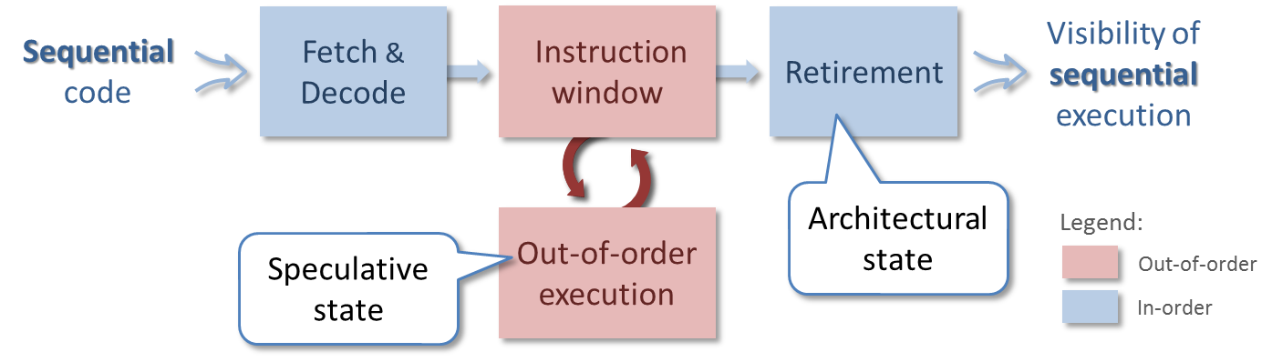
Refresher: HW Instruction Window
Two states are supported: speculative and architectural
Instruction window (ROB) keeps all in-flight instructions and allows reconstruction of the original order at retirement
The large window the better performance
Limitations:
False dependencies -> rename registers
Branches -> accurate dynamic prediction
Complex HW (so far we did not talk about that)

Slide 4
RAT Restore
Each ROB entry saves previous register alias (history)
On flush, ROB is restores history
Example:
Renaming
History
(1) r1 ← r4 / r7
(2) r8 ← r1 + r2
r1 ← r5 + 1
jump
(5) r6 ← r6 – r3
(6) r4 ← load [ r1 + r6 ]
(7) r7 ← r8 * r4
pr10 ≡ r1
pr11 ≡ r8
pr12 ≡ r1
pr13 ≡ r6
pr14 ≡ r4
pr15 ≡ r7
r1 was pr7
r8 was pr8
r1 was pr10
r6 was pr20
r4 was pr21
r7 was pr3
pr10
pr11
pr10
pr12
pr13
pr14
pr12
pr13
pr15
pr11
pr14
Register Aliases Table (RAT)
 | r0 | r1 | r2 | r3 | r4 | r5 | r6 | r7 | r8
 |  | pr7 |  |  | pr21 |  | pr20 | pr3 | pr8
pr10
pr14
pr15
pr12
pr13
pr11

Slide 5
Exception Handling

Slide 6
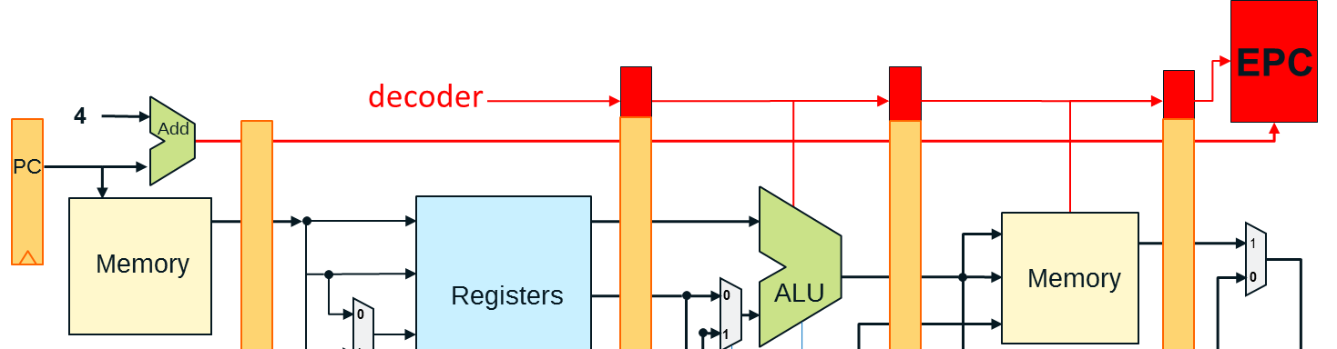
Refresher: Exception Handling
In pipelined machine exceptions handling is complicated:
Speculative code
Simultaneous exceptions on different pipe stages
Cancellation of consequent code
The solution was to postpone handling until writeback
In OOO, we have retirement instead of writeback

Slide 7
Exceptions
Instruction that caused exception
…
Retire
Fetch
deleted
At execution instruction that takes a fault/exception is marked
Instructions older than the marked instruction are retired
When the marked instruction retires – handle the fault
Flush the ROB
Initiate the handling code according to the type
Re-fetch the faulting instruction and the subsequent instructions

Slide 8
Interrupts
If an interrupt occurs, let the oldest instruction retire, flush everything younger and proceed to handling:
F
D
A
E
R
F
D
A
E
R
F
D
A
E
F
D
A
F
D
A
E
F
D
A
F
D
A
F
D
A

Slide 9
Scheduling

Slide 10
Why Is ROB Complex?
Allocation
Retirement
from decoder
Rename Registers
Check
Dependencies
ROB
ARF
Write data
Out-of-order execution
Memory
Scheduler
PRF
EXE
The two complex searches though all ROB entries
At allocation (once per each instruction): to identify producers of the instruction sources
At scheduling (every cycle): to identify ready instructions and send them to execution
The larger ROB the longer search and large HW structures
Prevents from doing ROB really large -> loose potential performance

Slide 11
Scheduler Queue
Allocation
Retirement
from decoder
Rename Registers
Check
Dependencies
ROB
ARF
Write data
Out-of-order execution
Memory
Scheduler
PRF
EXE
It is enough to check only not completed instructions
Their number is usually significantly less than ROB size (20-30%)
Decision:
Create a smaller queue for not completed instructions only (scheduling queue or reservation stations)

Slide 12
Scheduler Queue
Allocation
ROB
Retirement
from decoder
Rename Registers
Check
Dependencies
ARF
Write data
Out-of-order execution
SQ
Scheduler
Memory
PRF
EXE
It is enough to check only not completed instructions
Their number is usually significantly less than ROB size (20-30%)
Decision:
Create a smaller queue for not completed instructions only (scheduling queue or reservation stations)
All checks (allocation and scheduling) are performed on it
Use ROB only for order reconstruction at retirement

Slide 13
SQ Operation Example
Example:
(1) r1 ← …
(2) r2 ← …
(3) … ← r1 + r2
Free entries
1
5
3
At allocation of (3):
Search for Src1 producer
Found in entry 1
Mark dependency
Search for Src2 producer
Found in entry 5
Mark dependency
At least one is found -> not ready
Dependency Matrix
Producers
0 | 1 | 2 | 3 | 4 | 5 | … | N
 | Dst | Src 1 | Src 2
0
1
2
3
4
5
…
N
Ready?
r1
…
…
…
r1
r2
1
1
false
r2
…
…

Slide 14
SQ Operation Example
Example:
(1) r1 ← …
(2) r2 ← …
(3) … ← r1 + r2
Free entries
At completion of (1,2):
Reset dependency to all consumers
For each entry check its readiness
Dependency Matrix
Producers
0 | 1 | 2 | 3 | 4 | 5 | … | N
 | Dst | Src 1 | Src 2
0
1
2
3
4
5
…
N
Ready?
r1
…
…
…
r1
r2
1
1
false
true
r2
…
…

Slide 15
The End

