Slide 1
Multiprocessor Systems
Igor Smirnov
07 April 2018

Slide 2
Refresher: Intel CPUs timeline
Prescott P4
Power wall
P4
Pentium Pro
PII
PIII
80386
80486
8086
80286
Pentium

Slide 3
Motivation
Increasing performance becomes harder and less power efficient
Area budget can be divided in several ways:
Single core — 6x area, 2.9 performance boost
3 smaller cores — 2x area, 2.0 performance boost each — 6x area, 6.0 performance boost total!

Slide 4
Thread-level parallelism
To achieve the best performance, workload should be parallelized to several threads
This is possible due to the thread-level parallelism (TLP)
Unlike ILP, TLP is extracted manually by programmer
Threads can be extracted either from:
The same application
Different applications running simultaneously
Operating system services
Each thread is executed on single CPU

Slide 5
Multiprocessor and Multicore
Originally, each CPU had its own chip
Works well for independent workloads
Otherwise for cooperative workloads (big latency for data exchange)
Later, multicore CPUs were introduced
Caches and memory bus are shared between CPUs (cores)
Thus, data exchange is made through the cache
CPU 1
CPU 2
Memory
CPU
Core 1
Core 2
Cache
Memory

Slide 6
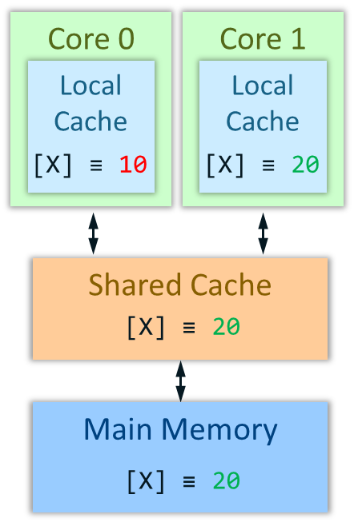
Memory Coherence in Multicore/multiprocessor System
Problem: one core modifies data that another core has in its local cache
Example:
Memory system must be coherent
Cores should see memory identically
Cores should see the latest state of memory
Core 0
Core 1
Local
Cache
Local
Cache
Memory: Mem[X] ≡ 10
Core 0: a = Mem[X] # a = 10
Core 1: Mem[X] = 20
Core 0: b = Mem[X] # b = 10
hit
[X] ≡ 10
[X] ≡ 20
miss
Shared Cache
20
Error: read the old value from the local cache
[X] ≡ 10
miss
Main Memory
20
[X] ≡ 10

Slide 7
Coherence protocol: MESI
Coherency protocols describe how to handle writes and reads in a multi-core system in order to maintain memory coherence
The most famous one is MESI
Define the four possible state of a cache line
Describe transactions from one state to another (next foils)
 | Is the line valid? | Do we own this line? (others do not contain it) | Has it been modified?
Invalid | NO | NA | NA
Shared | YES | NO | NO
Exclusive | YES | YES | NO
Modified | YES | YES | YES
There is no state when a line is modified and contained by other cores
To write a line, ownership should be obtained first

Slide 8
MESI Operating Example
Memory: Mem[X] ≡ 25
Core 0: a = Mem[X] # a = 25
Core 0: Mem[X] ≡ 35
Core 1: b = Mem[X] # b = 35
Snoop [X]
Core 0 writeback [X]
Core 1: Mem[X] ≡ 45
Request ownership for [X]
Core 0 invalidate [X]
Core 0
Core 1
Local
Cache
Local
Cache
[X] ≡ 25
[X] ≡ 35
[X]
[X]
35
[X]
45
S
35
I
E
M
S
M
Shared Cache
[X] ≡ 25
35
(1, 0)
(1, 1)
(0, 1)
Main Memory
[X] ≡ 25
[X] ≡ 25

Slide 9
MESI State Diagram
SN or RO
R and Sh
R or SN
I
RO
S
RO
SN
RO
R and !Sh
SN
W
W
E
M
R – read
W – write
Sh – line shared
!Sh – line not shared
W
R
R or W
SN – snoop
RO – request ownership

Slide 10
HPC Alternative Topologies
SMP — Symmetric Multi Processing
Identical processing units
Single shared memory, single bus, mesh interconnections
Low scalability (systems with > 8 units will have performance problems)
NUMA — Non Uniform Memory Access. A CPU can access its own local memory faster than non-local memory.
Highly scalable
Requires special coherency protocols and OS support

Slide 11
The End

