Slide 1
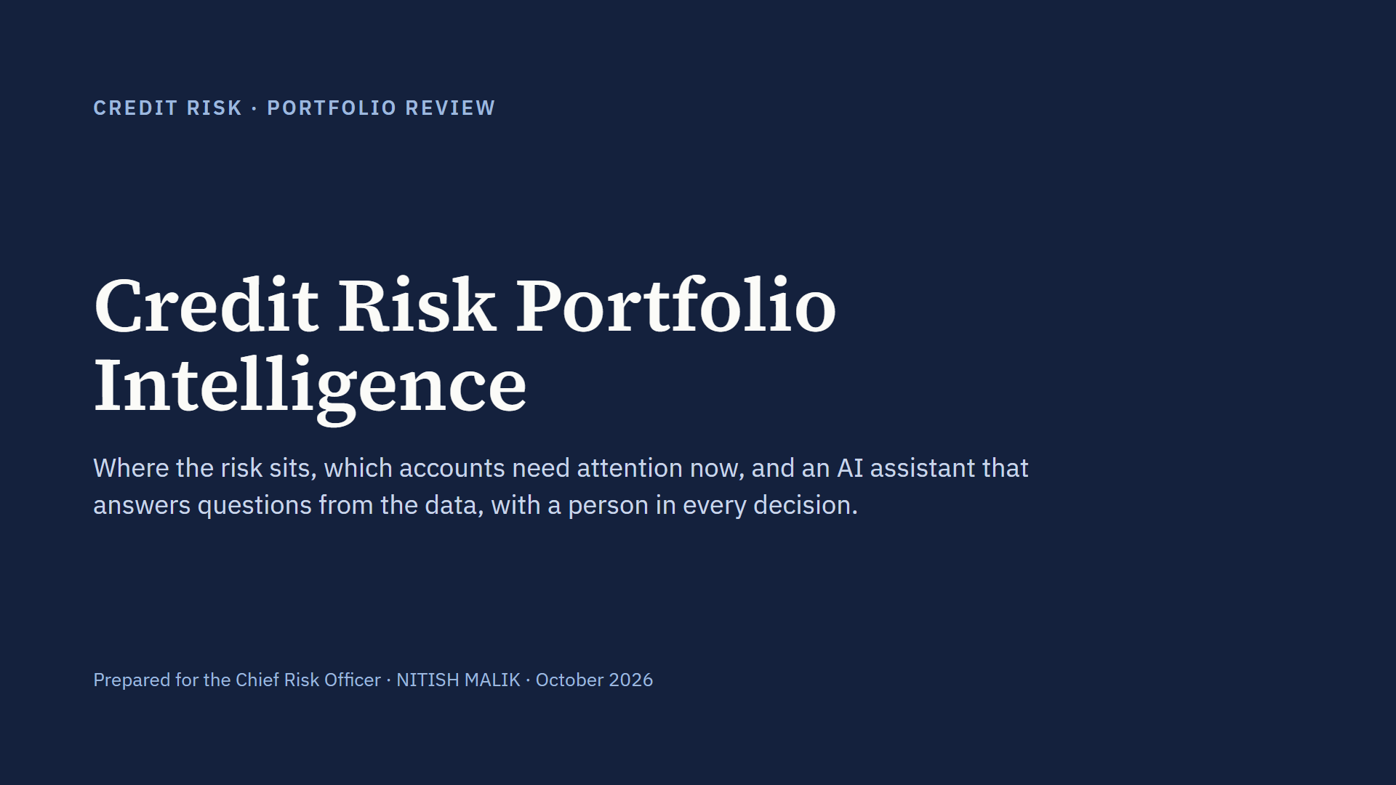
Notes:
Thank you for the time. In the next ten minutes I’ll show you three things: where the risk in this loan book actually sits, a scoring model that explains every account, and an AI feature built for your analysts. I’ll close with the risk and compliance controls, and one decision I’d like from you: a 90-day pilot. Everything I show runs on the five tables provided, 14,685 loan accounts and 10,000 customers, and every number comes from the same code that powers the dashboard.

Slide 2
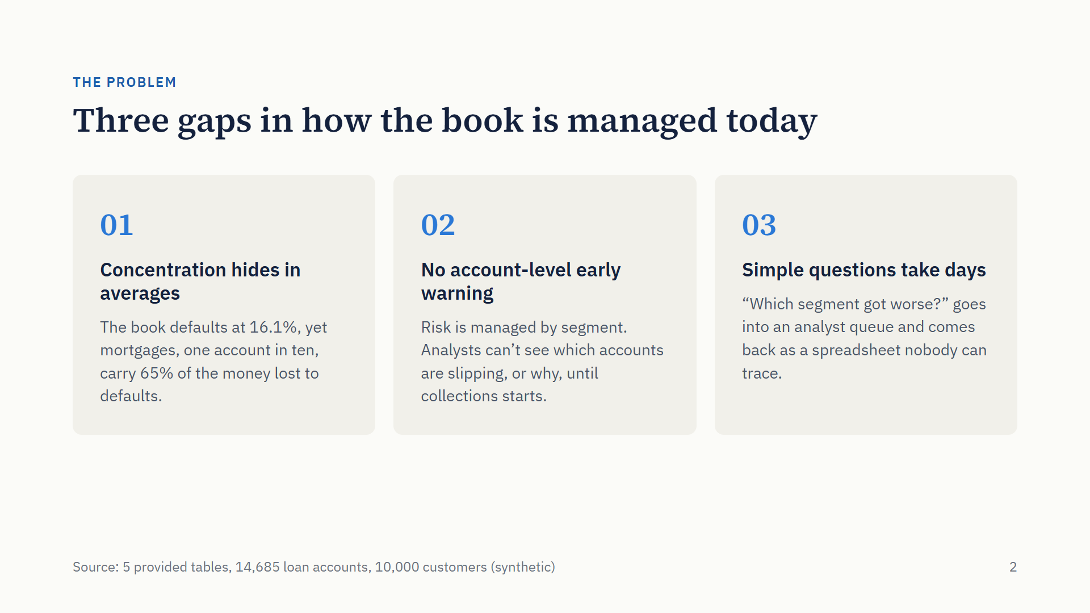
Notes:
Three gaps drive this work. First, concentration hides in averages: the headline default rate is 16.1%, which sounds manageable, but mortgages, one account in ten, carry 65% of the money lost to defaults. Second, there is no account-level early warning: risk is managed by segment, so we only see trouble when collections starts. Third, simple questions take days and the answers can’t be traced back to data. Everything that follows addresses one of these three.

Slide 3
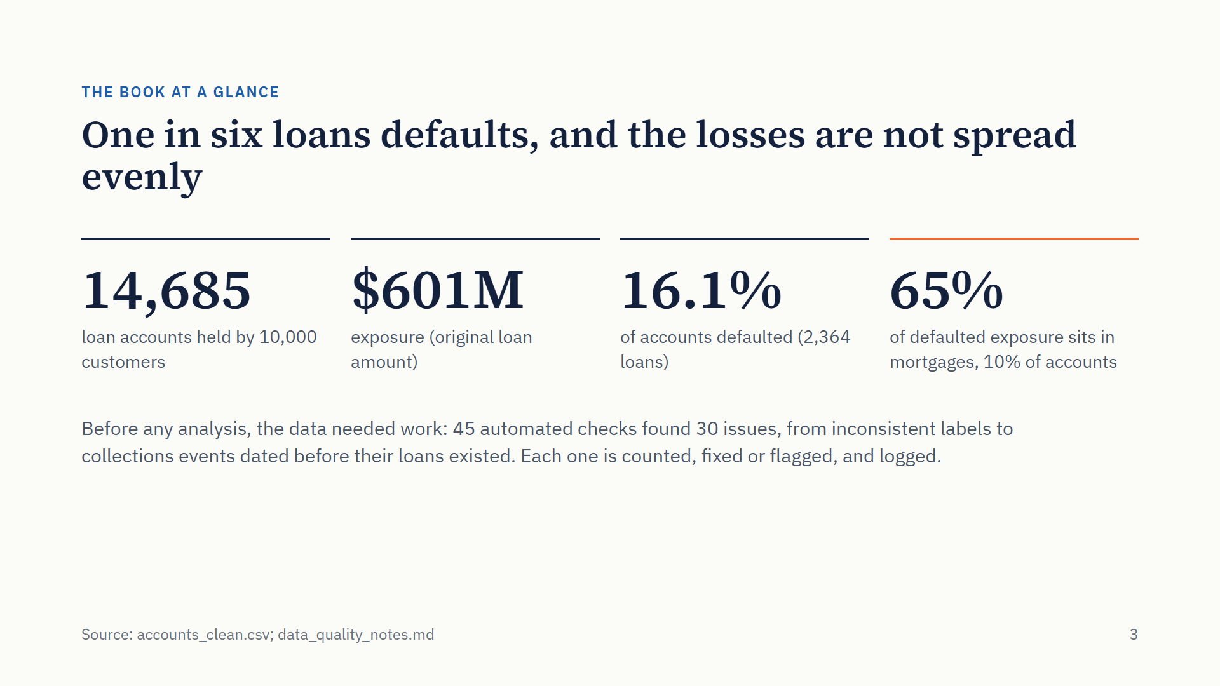
Notes:
Here is the book. 14,685 loans, 601 million dollars of exposure, and 16.1% of accounts defaulted. The number to remember is the last one: 65% of the money lost to defaults sits in mortgages, which are only 10% of accounts. One note on trust: before any analysis, I ran 45 automated data checks. 30 found issues, such as inconsistent gender labels, missing interest rates, and collections events dated before the loan existed. Every issue is counted and handled, not silently dropped, and the full log is in the repository.

Slide 4
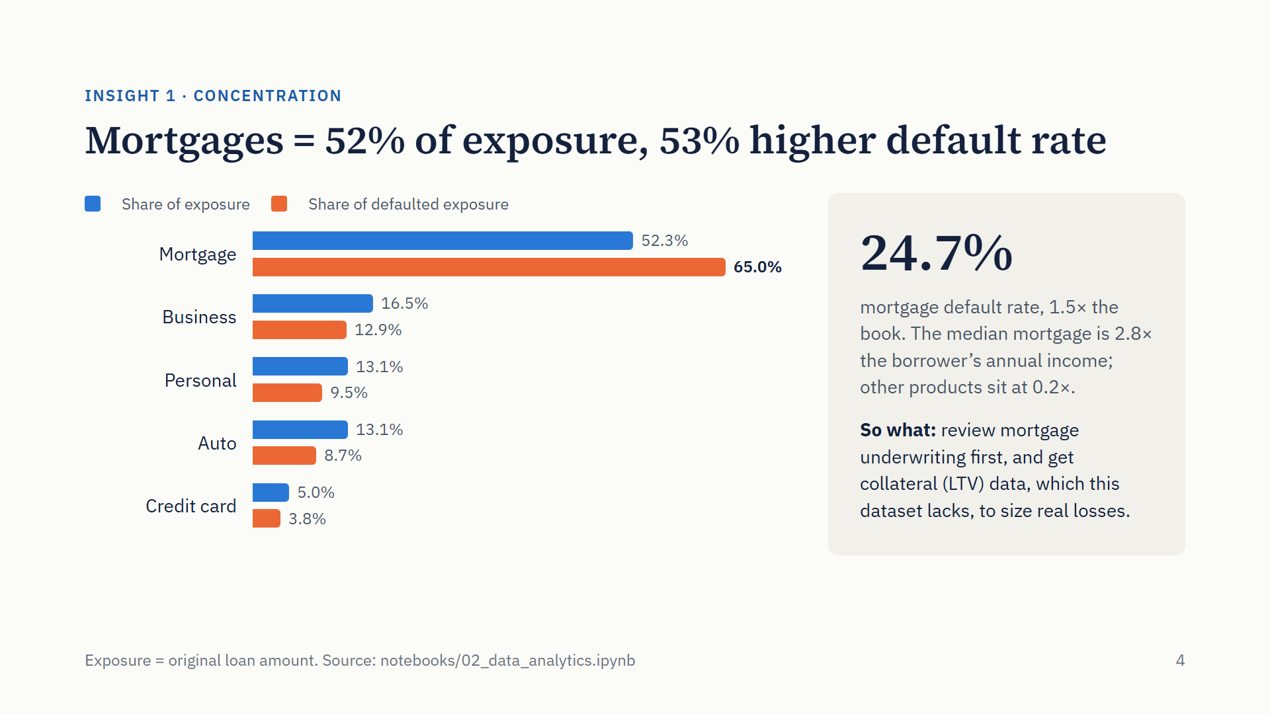
Notes:
The first insight. The blue bars show where the money is; the orange bars show where the money lost to defaults is. For every product except mortgages, orange is shorter than blue: they lose less than their share. Mortgages are the opposite: 52% of exposure, 65% of defaulted exposure, and a 24.7% default rate, one and a half times the book. The reason is size relative to income: the median mortgage is 2.8 times the borrower’s annual income. Counter-intuitively for a secured product, this is where to look first, and we need collateral values to know what those defaults actually cost.

Slide 5
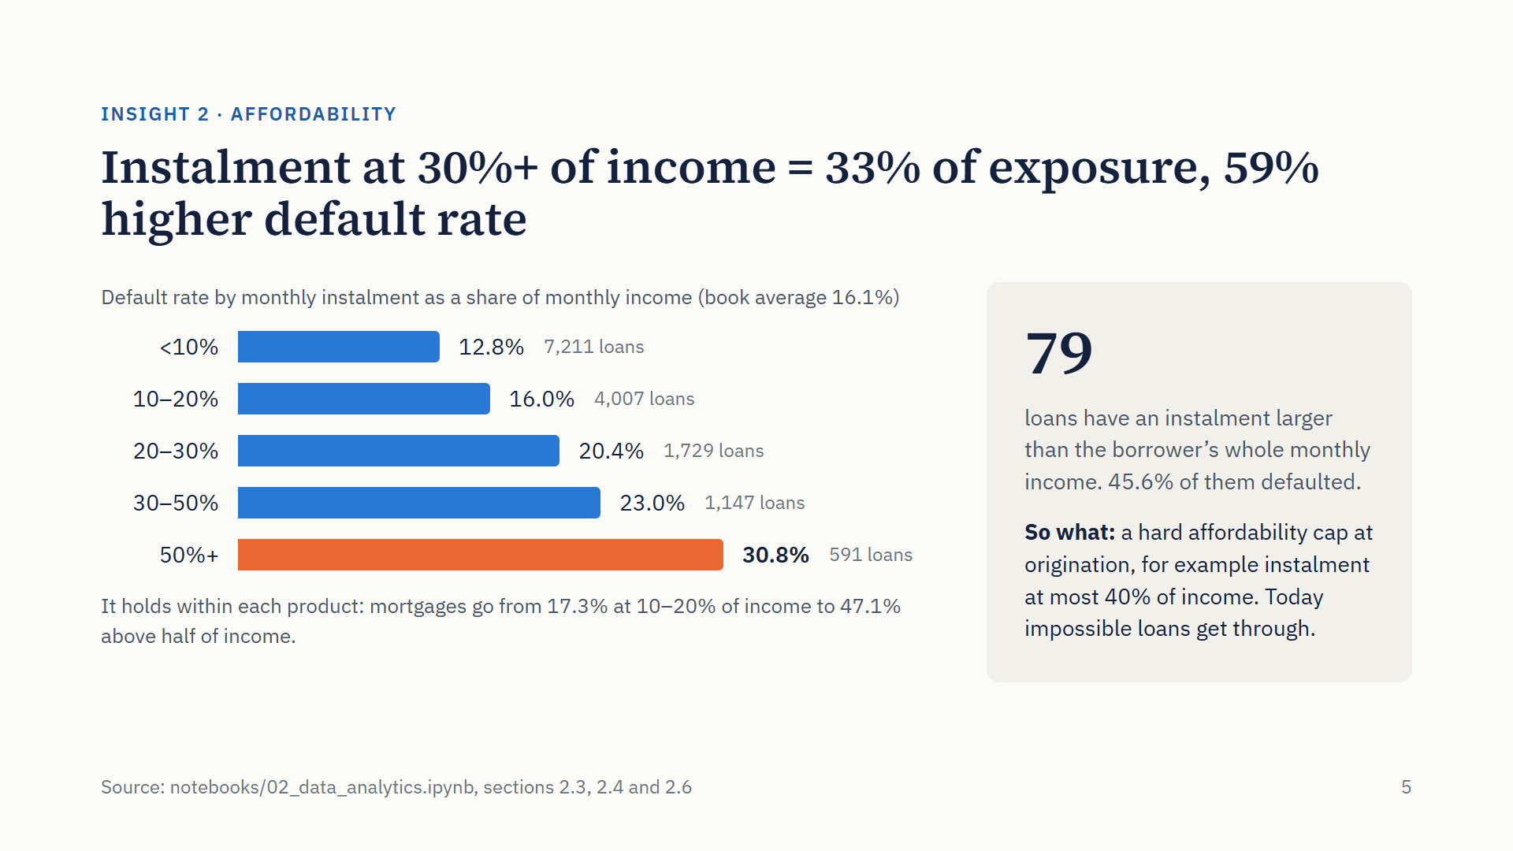
Notes:
The second insight is the most actionable. As the monthly instalment grows against income, the default rate climbs steadily, from 12.8% when it’s under a tenth of income to 30.8% when it’s over half. This is not a product-mix effect: within each product the rate rises with the instalment burden; mortgages, for example, go from 17% when the instalment is a tenth to a fifth of income to 47% when it is over half. And there are 79 loans whose instalment is larger than the borrower’s entire monthly income. Nearly half of them defaulted. These should never have been approved, which tells us the current affordability check is not binding. A hard cap is a cheap, clear policy fix.

Slide 6
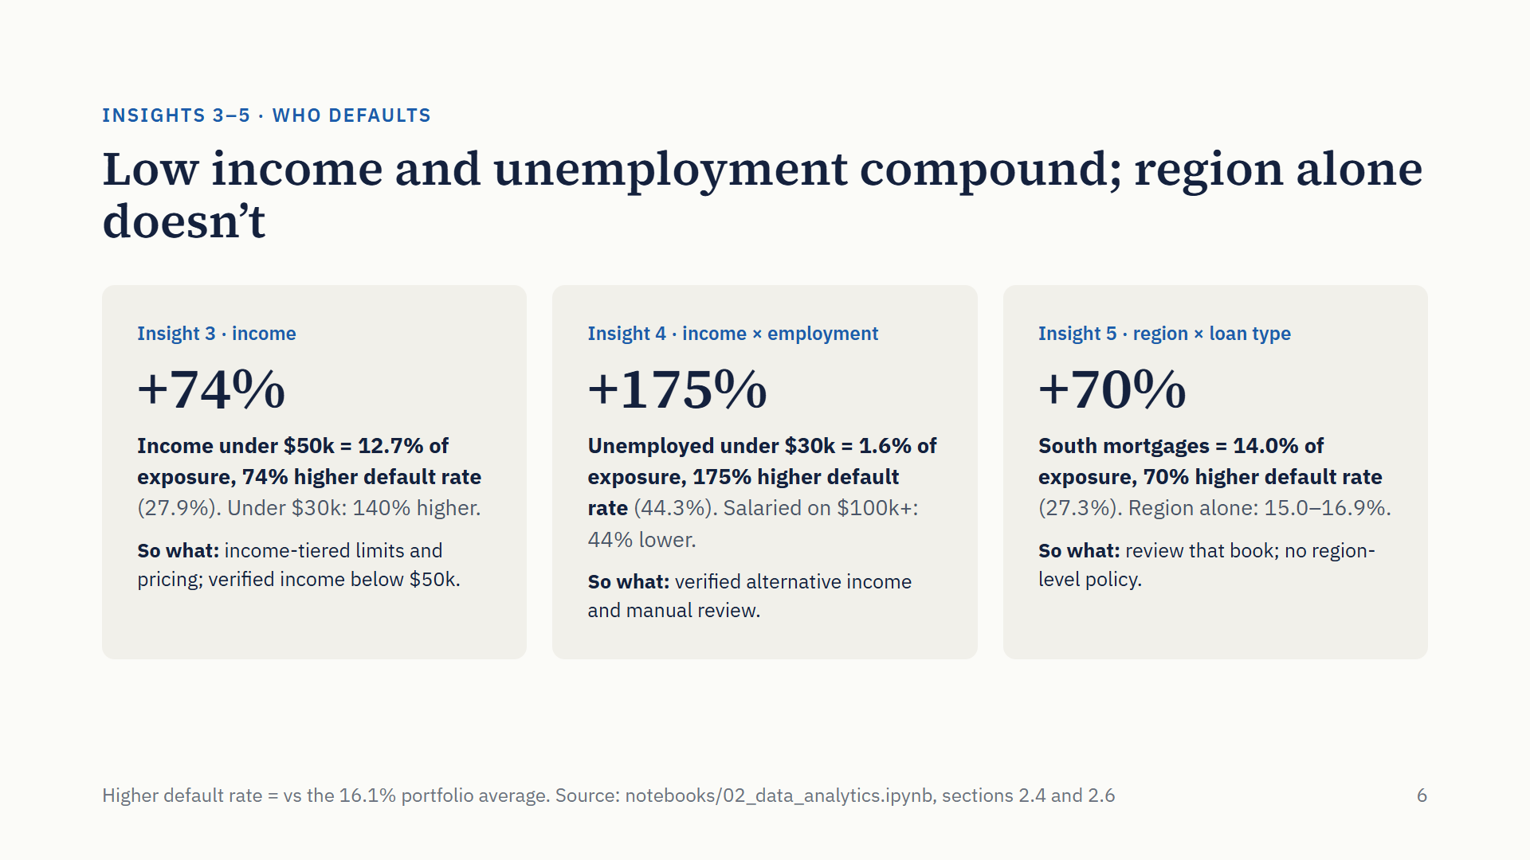
Notes:
Three more insights, two of them from cross-cuts, each in the same form: share of exposure, and how much higher the default rate is than the 16.1% average. Borrowers earning under 50 thousand are 12.7% of exposure with a 74% higher default rate. Crossing income with employment, unemployed customers under 30 thousand are only 1.6% of exposure, but their default rate is 175% higher, while salaried customers on over 100 thousand are 44% lower. Crossing region with product, South-region mortgages are 14% of exposure with a 70% higher default rate, even though region on its own barely matters. So: income-tiered limits, manual review for unemployed applicants, and a review of the South mortgage book rather than regional policy.

Slide 7
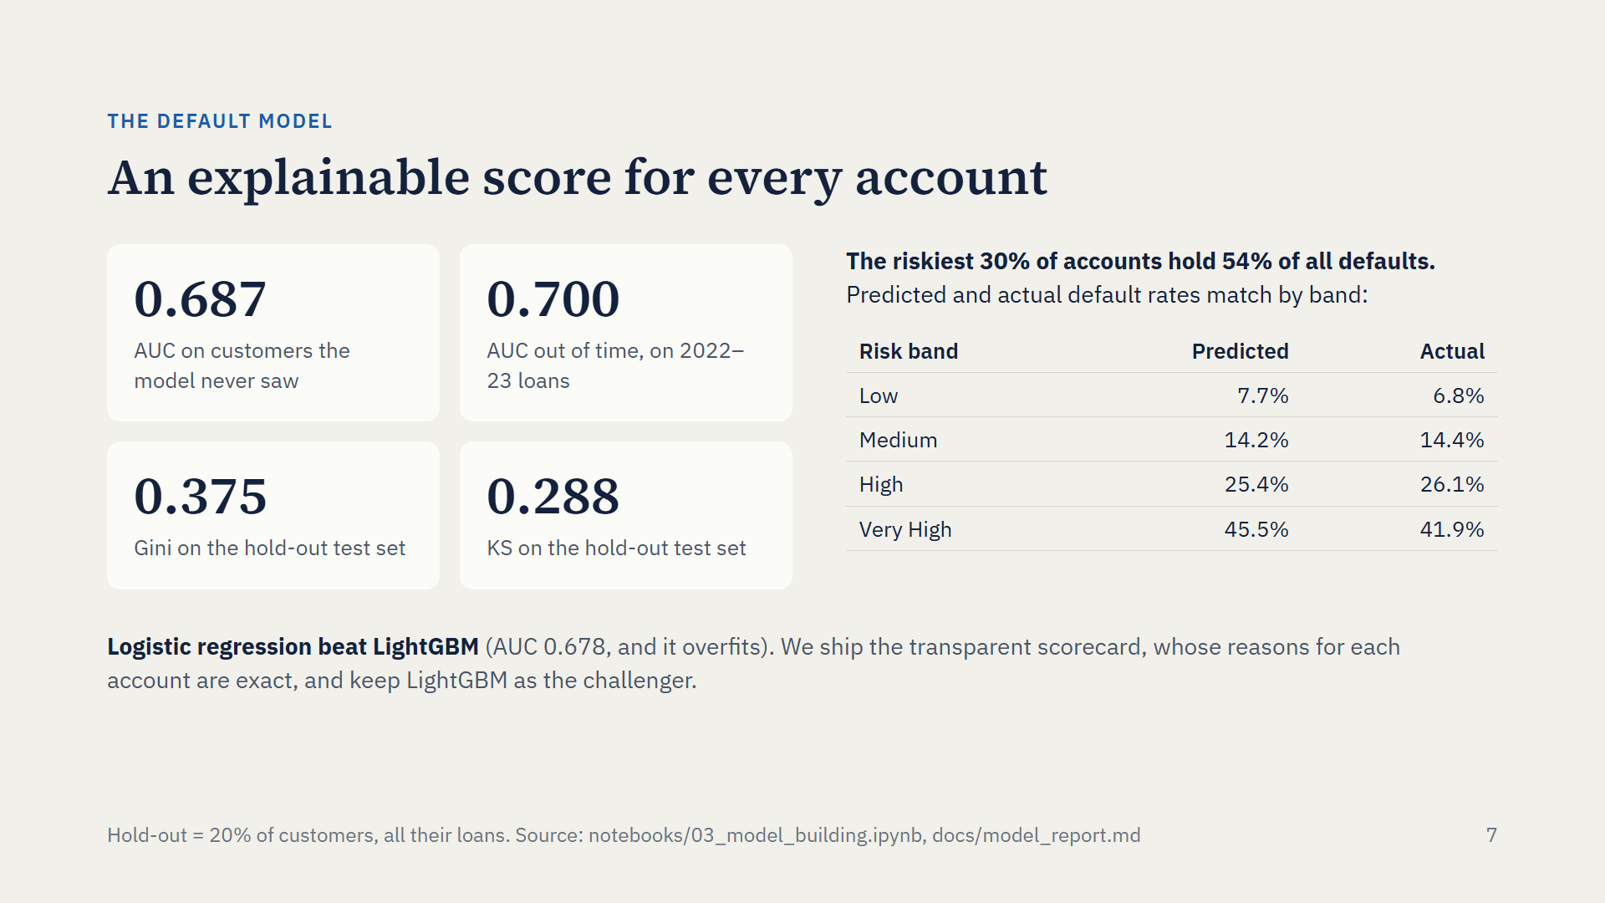
Notes:
The model predicts which accounts will default, using engineered features: each customer’s bureau history and each account’s first twelve months of repayment, summarised, not just application fields. On customers it never saw, AUC is 0.687, Gini 0.375, KS 0.288, and it holds up out of time at 0.700. Those numbers are honest for this data: I found no feature set above about 0.70, so anything much higher would signal leakage. More useful in practice: the riskiest 30% of accounts hold 54% of defaults, and predicted rates match actual rates in every band. We also tested LightGBM. It did worse and overfit, so we ship the logistic scorecard: simpler to validate, and every account’s reasons are exact.

Slide 8
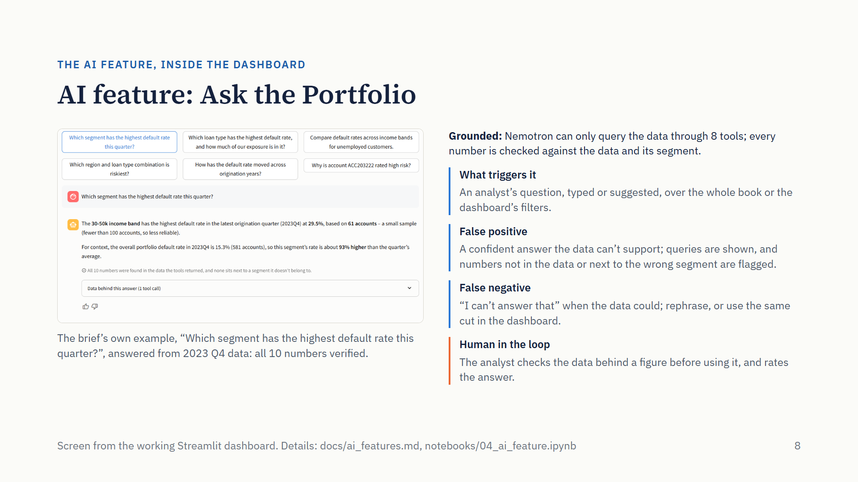
Notes:
The AI feature is Ask the Portfolio: your analysts ask questions in plain English and get answers grounded in the actual data. Here it is answering the brief’s own example, which segment has the highest default rate this quarter. It takes the latest quarter in the data, ranks real business segments, warns that the segment is small, and all ten numbers in the answer are found in the data. That last part is the design point: the language model never sees raw data and never does arithmetic. It can only call eight query tools, and my code checks every number in its reply before you see it, including that each number sits next to the segment it belongs to. What triggers it is simply an analyst’s question. A false positive is a confident answer the data can’t support, so every answer shows the queries behind it and flags any number that isn’t in the data or is attached to the wrong segment. A false negative is a refusal when the data could have answered. And the human step: answers are for exploration; before a figure goes into a decision, the analyst checks the data behind it and rates the answer.

Slide 9
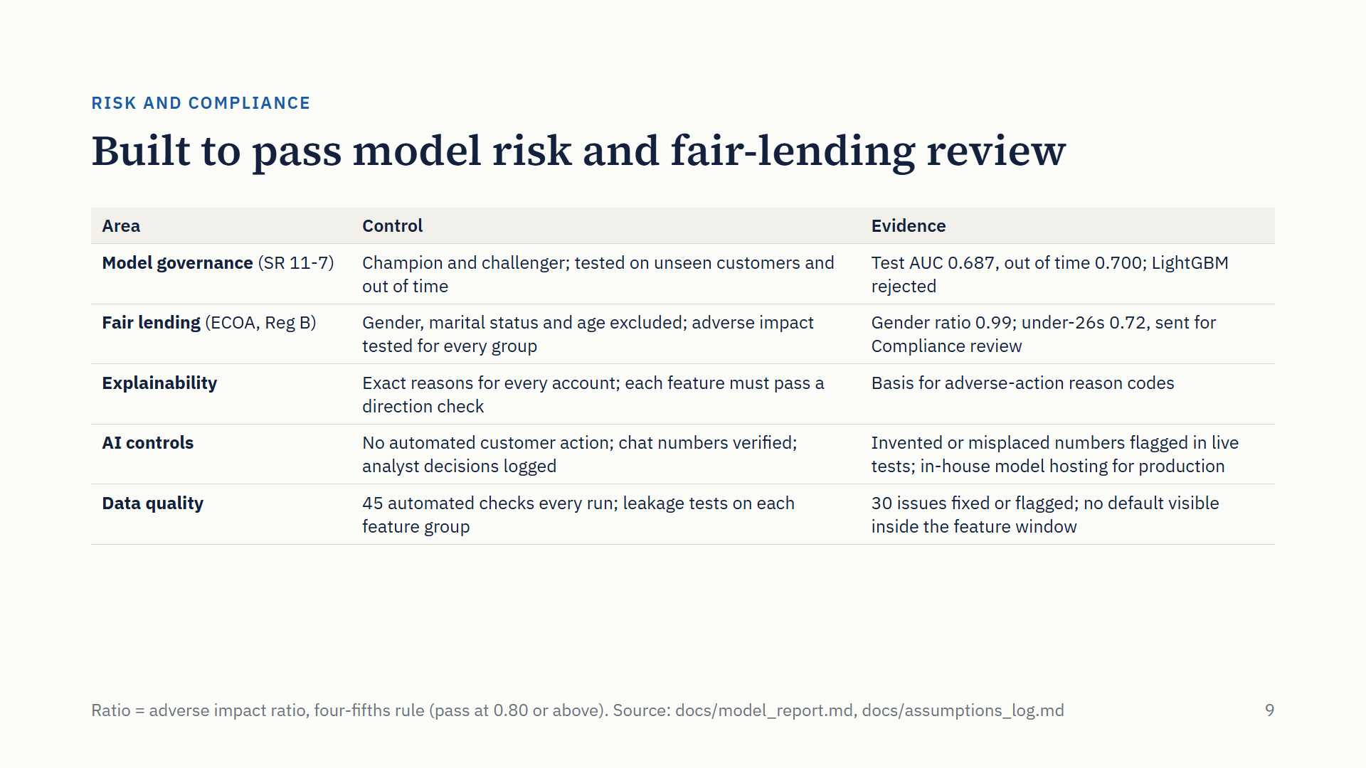
Notes:
This is the slide I’d expect your model risk and compliance teams to test hardest. Governance: there’s a champion and a challenger, validation on customers the model never saw and on later vintages, and every assumption is written down. Fair lending: gender, marital status and age are not inputs. I tested age explicitly; removing it cost no accuracy. Gender passes the four-fifths test at 0.99. One honest open item: borrowers under 26 sit at 0.72, because they earn less and have shorter job tenure, which are legitimate credit factors, but that is Compliance’s call, so it’s flagged rather than hidden. Explainability: every account has exact reasons, the basis for adverse-action notices. And the AI never acts on a customer by itself.

Slide 10
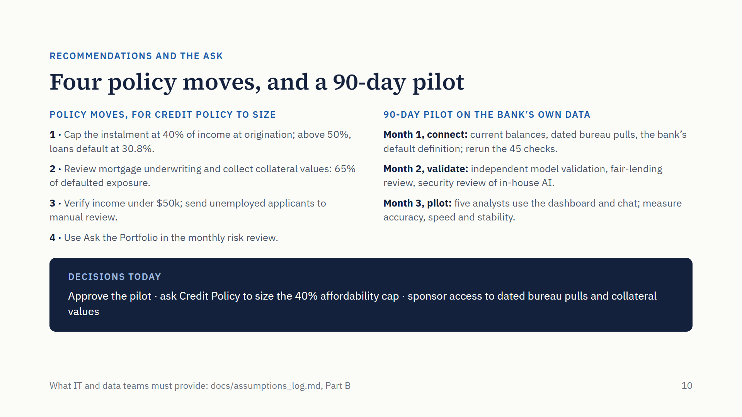
Notes:
To close. The findings support four policy moves: a hard affordability cap at 40% of income; a review of mortgage underwriting with collateral values; verified income below 50 thousand and manual review for unemployed applicants; and using Ask the Portfolio in the monthly risk review. The first three need Credit Policy to size the impact on volumes and revenue; I’m not asking for policy approval today. What I am asking for is a 90-day pilot on the bank’s own data. Month one, connect current balances, bureau pulls dated to each application, and the bank’s default definition, then rerun the 45 data checks. Month two, independent model validation, a fair-lending review and a security review of hosting the AI inside the bank. Month three, five analysts use the dashboard and the chat in real work, and we measure accuracy, speed and stability. Three decisions today: approve the pilot, ask Credit Policy to size the cap, and sponsor data access. Thank you.

Slide 11
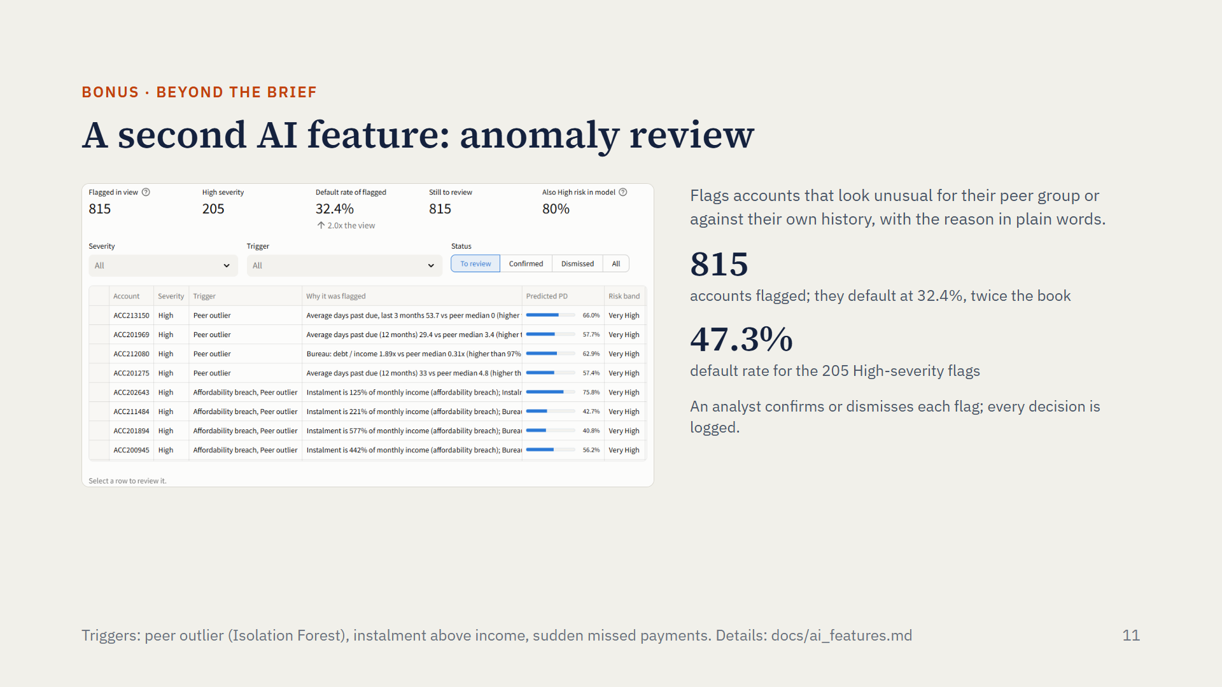
Notes:
One bonus, beyond what the brief asked for. Alongside the chat, the dashboard has a second AI feature: an anomaly review queue. Each month it flags accounts that look unusual against their peers, same product and income band, or against their own history, like a sudden run of missed payments, and every flag says why in plain words. The 815 flagged accounts default at 32%, twice the book, and the most severe flags at 47%. As with the chat, a person decides: an analyst confirms or dismisses each flag, and every decision is logged.

Slide 12
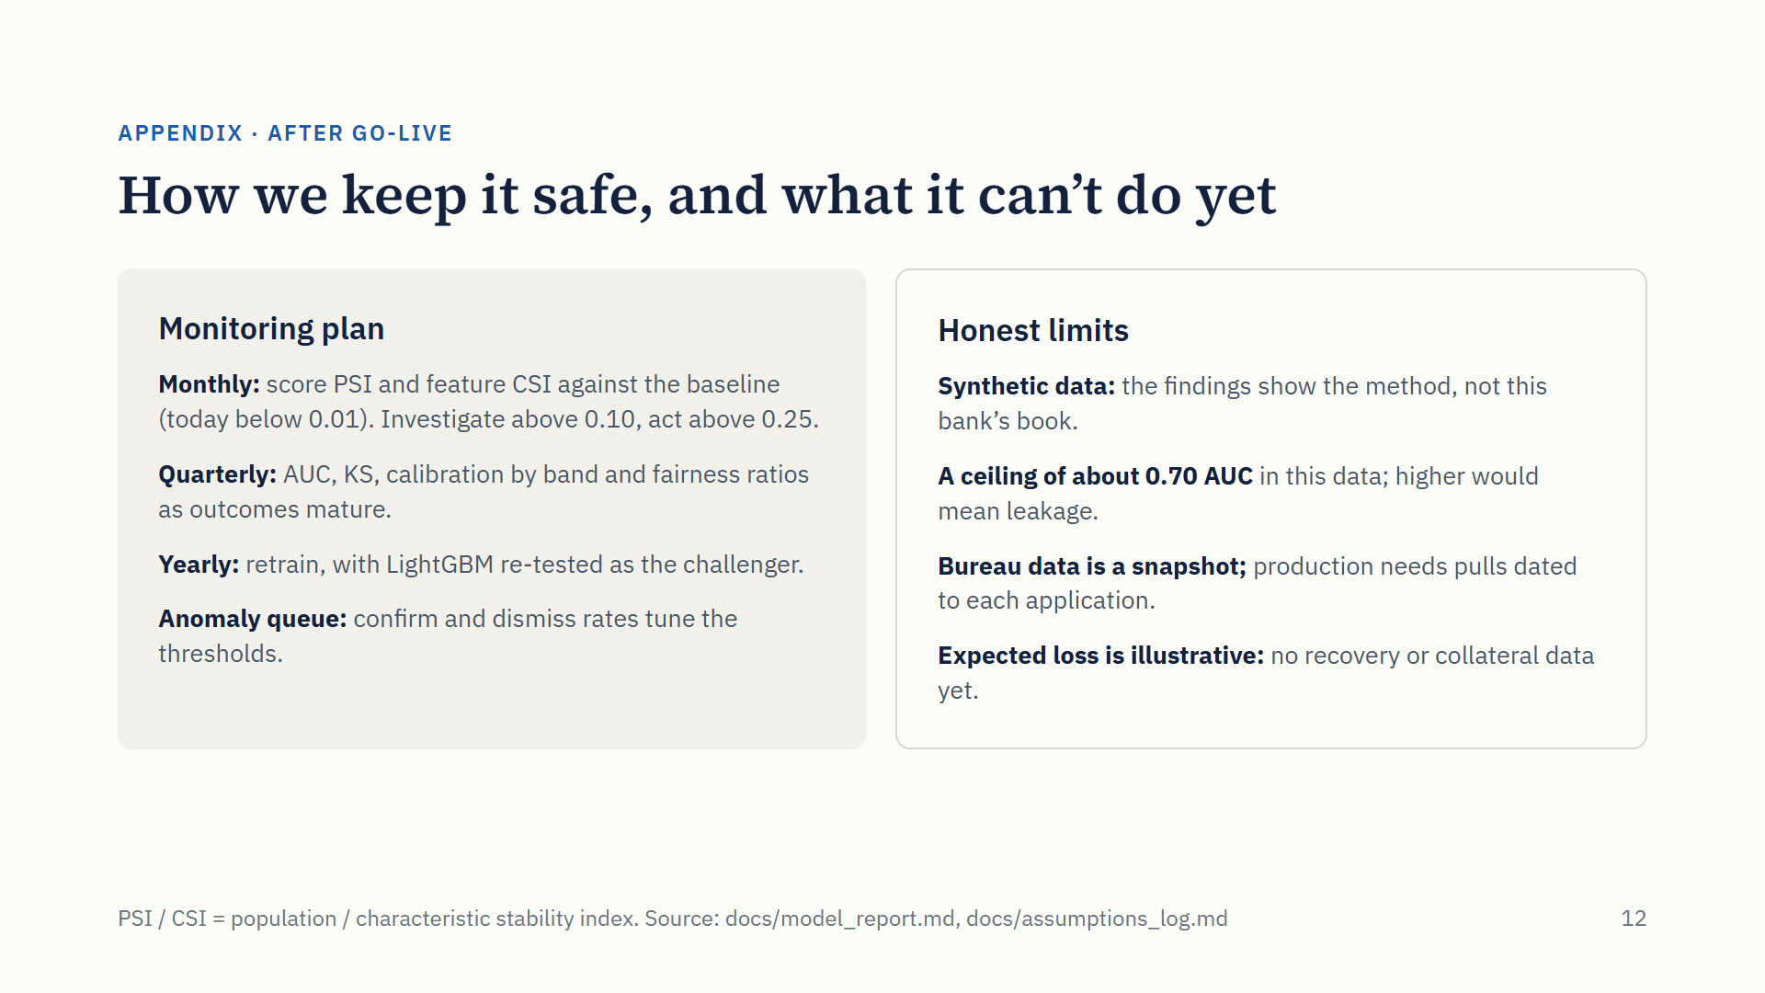
Notes:
After go-live, the model is watched on three clocks. Monthly, we compare the score distribution and the top ten features with the baseline using stability indices; today they are near zero, and anything above 0.10 gets investigated. Quarterly, as outcomes mature, we re-measure accuracy, calibration and the fairness ratios. Yearly we retrain and re-run LightGBM as a challenger. And the analysts’ confirm and dismiss decisions tune the anomaly thresholds. I also want to be clear about limits: this is synthetic data, so the findings illustrate the method; about 0.70 AUC is the ceiling here; the bureau table is a snapshot, so production needs bureau pulls dated to each application; and expected loss uses assumed loss rates until we have recovery and collateral data.

Slide 13
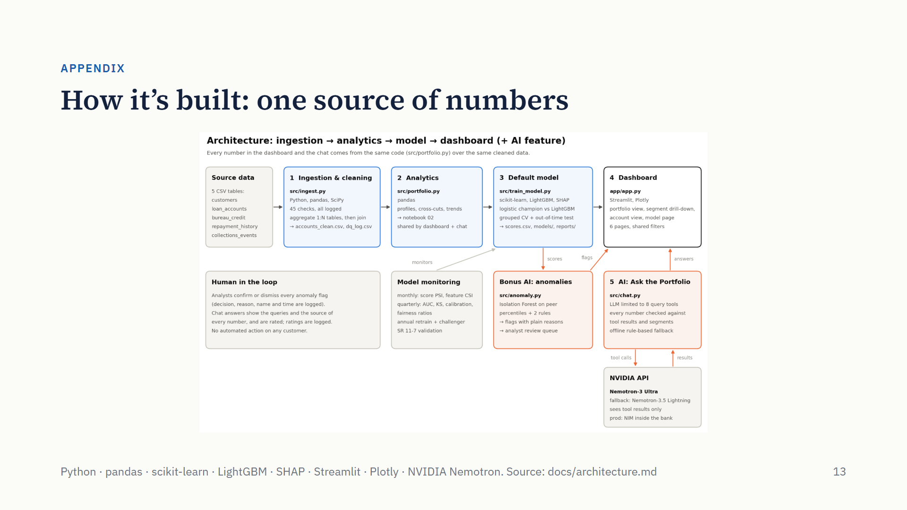
Notes:
For reference, the architecture. Data flows from the five source tables through ingestion and cleaning, the analytics layer, and the default model into the dashboard. The AI feature, Ask the Portfolio, calls NVIDIA’s Nemotron model, which only ever sees results from the query tools; the model’s scores also feed the bonus anomaly detector. The key design choice: the notebook, the dashboard and the chat all use the same analytics code over the same cleaned data, so a number can’t differ between them.

