Slide 1
Javascript (Part 2)
Lecturer
Abdullah Yousaf

Slide 2
Table of Contents
Switch
Loops
Debugging Your JS Code
Advance Concepts/Methods

Slide 3

Switch Statements
<script> var text;
var current_day= new Date().getDay();
switch (current_day) { case 0:
text = "Today is Sunday"; break;
case 1:
text = "Today is Monday"; break;
case 2:
text = "Today is Tuesday";
break; case 3:
text = "Today is Wednesday"; break;
case 4:
text = "Today is Thursday"; break;
case 5:
text = "Today is Friday"; break;
default:
text = “Today is Saturday";
}
document.write(text);
</script>
In this example newDate().getDay() is builtin javascript function which returns the today’s day in integer starting from 0 till 6 (0 is Sunday, 1 is Monday ….6 is Saturday)
The switch cases execution will now depend on value inside current day i.e if today is Wednesday then case 3 will be executed.

Slide 4
Switch Statements
Now How do you change the previous code so that if day is weekday than weekday is printed otherwise weekend is printed
<script> var text;
var current_day= new Date().getDay();
switch (current_day) { case 0:
case 6:
text = "This is Weekend"; break;
default:
text = "Today is Weekday";
}
document.write(text);
</script>
In this case 0 and case 6 are acting like OR operator so either day will be 0 or day will be 6 (Sunday or Saturday) , the statement below these cases will be executed. These are also called compound case conditions

Slide 5
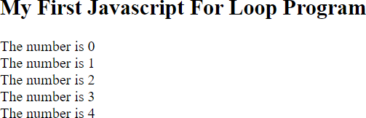
For Loop
Syntax
for (statement 1; statement 2; statement 3) {
// code block to be executed
}
<script>
var text = ""; var i;
for (i = 0; i < 5; i++) {
text += "The number is " + i + "<br>";
}
document.write( text);
</script>

Slide 6
For Loop
Statement 1
Normally you will use statement 1 to initialize the variable used in the loop (i = 0).
This is not always the case, JavaScript doesn't care. Statement 1 is optional.
for (i=0; i < 10; i++) { text += i + "<br>";
}
var i = 0;
var text = "";
for (; i < len; i++) { text += i + "<br>";
}
Both above statements will do same task

Slide 7
For Loop
Statement 2
Often statement 2 is used to evaluate the condition of the initial variable.
This is not always the case, JavaScript doesn't care. Statement 2 is also optional.
for (i=0; i < 10; i++) { text += i + "<br>";
}
for (i=0; ; i++){ text += i + "<br>";
if(i==10)
{
break;
}
}
Both above statements will do same task. However if you are not specifying statement 2 then you must use break inside loop other wise it will run infinitely

Slide 8
For Loop
Statement 3
Often statement 3 increments the value of the initial variable.
This is not always the case, JavaScript doesn't care, and statement 3 is optional.
for (i=0; i < 10; i++) {
text += i + "<br>";
}
for (i=0; ; ){
text += i + "<br>";
i++;
}

Slide 9
For Loop
Do you think the following syntax is correct?
for (; ; ) {
text += i + "<br>";
}
Yes it is however this will lead to infinite loop. So you need to break it inside the loop since condition 2 is not specified

Slide 10
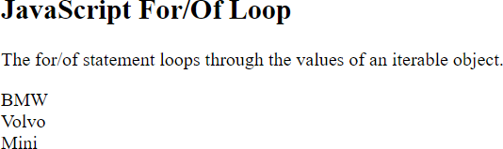
Looping over Array
<script>
var cars = ["BMW", "Volvo", "Mini"];
var x;
for (x of cars) { document.write(x + "<br >");
}
</script>
The loop will iterate over each item inside array starting from index 0 and
automatically ends when all items are iterated
in this example ,for each item it will save the value in x and you can access it anytime through x. you can name this x variable whatever you want.

Slide 11
Looping over String
<script>
var txt = "JavaScript";
var x;
for (x of txt) { document.write(x + "<br >");
}
</script>
The loop will iterate over each character of string starting from index 0 and automatically ends when all characters are iterated
in this example ,for each character it will save the value in x and you can access it anytime through x. you can name this x variable whatever you want.

Slide 12
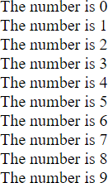
While Loop
Syntax
while (condition) {
// code block to be executed
}
<script> var text=“”;
while (i < 10) {
text += "The number is " + i; i++;
}
document.write( text);
</script>

Slide 13
Do While Loop
Syntax
do {
// code block to be executed
}
while (condition);
<script>
var text=“”;
do {
text += "The number is " + i; i++;
}
while (i < 10);
document.write( text);
</script>

Slide 14
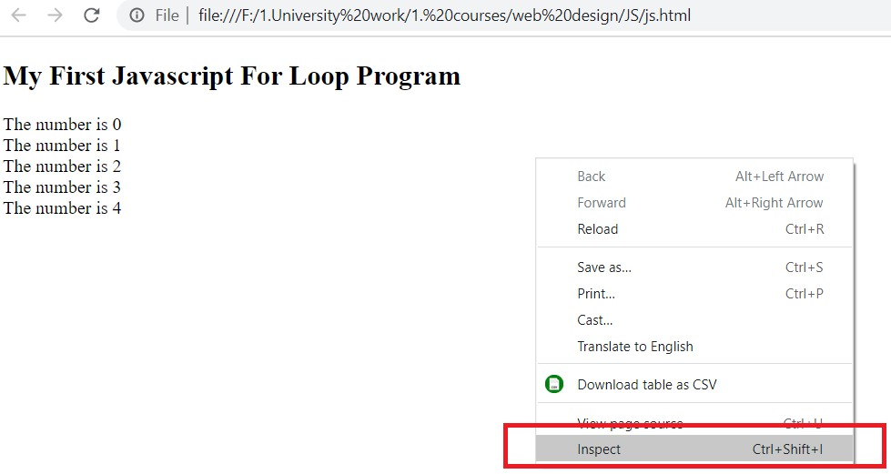
Debugging Your Javascript Code
Open Html file containing your javascript code in google chrome/ firefox
Right click on page when its loaded and click
inspect

Slide 15
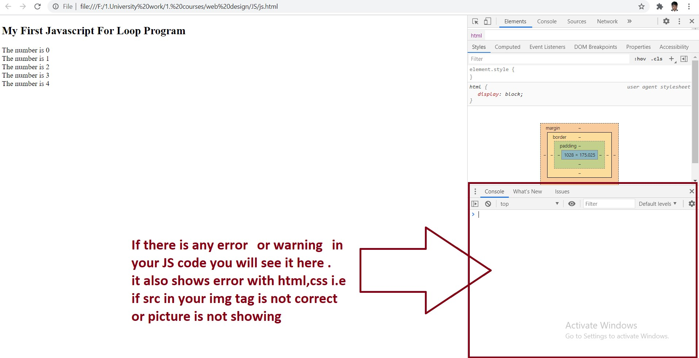
Debugging your JS code

Slide 16
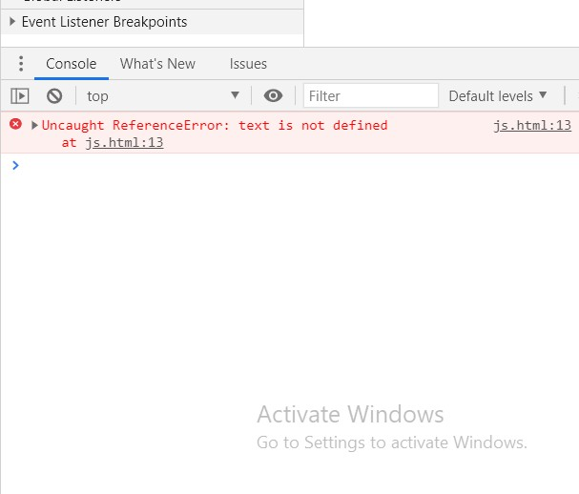
Debugging your JS code
<script>
var i;
for (i = 0; i < 5; i++) {
text += "The number is " + i + "<br>";
}
document.write( text);
</script>
In this code we didn’t define text variable but we are using it inside for loop so JS threw error that text is not defined

Slide 17
Date Type
Built-in JavaScript data type that let us works us with dates/times
Dates are important in most of web programming tasks i.e think of quiz JS app where timer is running .
JavaScript provides a wide range of functions to get current date/time in different formats

Slide 18
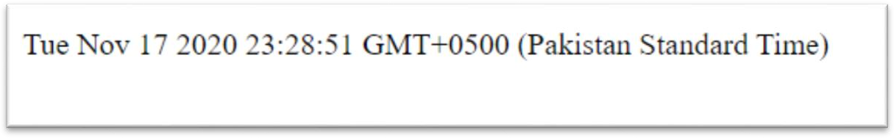
Date Type
<script>
var d = new Date(); document.write(d);
</script>

Slide 19
Date Type
<script>
var d = new Date(); document.write(d);
</script>

Slide 20
Date Type (Initializing Dates)
<script>
var d = new Date("2015-03-25"); document.write(d);
</script>
<script>
var d = new Date("2015-03"); document.write(d);
</script>

Slide 21
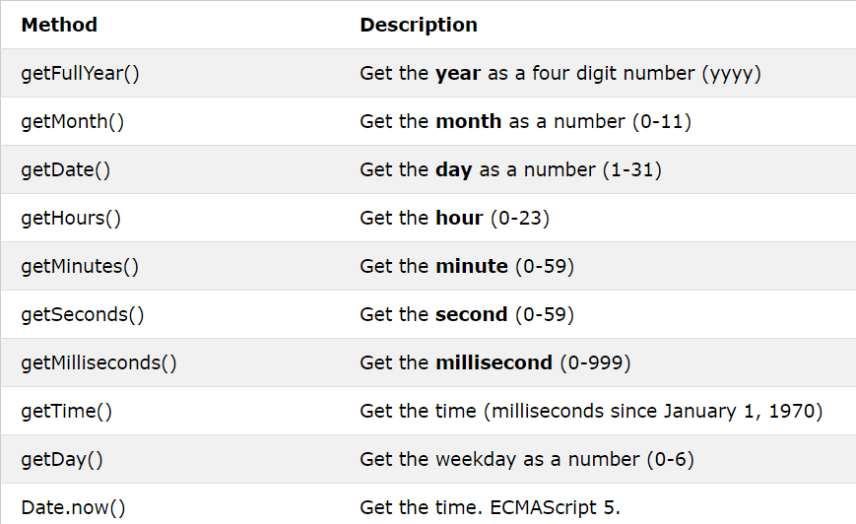
Date Type (Get Date Methods)

Slide 22
Date Type (Date Get Methods)
<script>
var d = new Date(); document.write(d.getTime());
</script>
<script>
var d = new Date(); document.write("Current Year is :"); document.write(d.getFullYear());
</script>

Slide 23
Date Type (Date Get Methods)
<script>
var d = new Date(); document.write("Current Date is :"); document.write(d.getDate());
</script>
<script>
var d = new Date();
document.write("Current Time (HH:MM:SS) is :"); document.write(d.getHours()+":"+d.getMinutes()+":"+d.getSe conds());
</script>

Slide 24
Date Type
Lets Write A small clock program in javascript that refresh the clock every second
Also Find Issues in following code. We will discuss in next class how will we solve this issue?

Slide 25
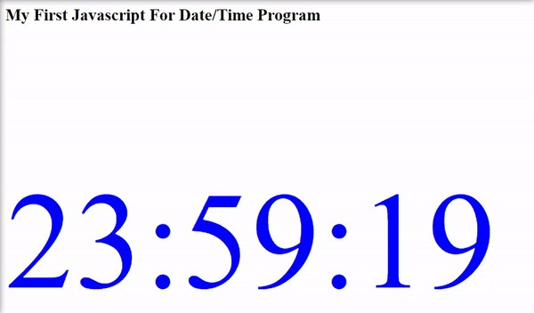
<html>
<meta http-equiv="refresh" content="1" /> <-- Automatically Refreshes the page every second -->
<body>
<h2>My First Javascript For Date/Time Program</h2>
<p id="demo" style="font-size:200px;color:blue;"></p>
<script>
var d = new Date();
var str=d.getHours()+":"+d.getMinutes()+":"+d.getSeconds();
document.getElementById("demo").innerHTML = str;
</script>
</body>
</html>

