Slide 1
Introduction to
Kivy

Slide 2
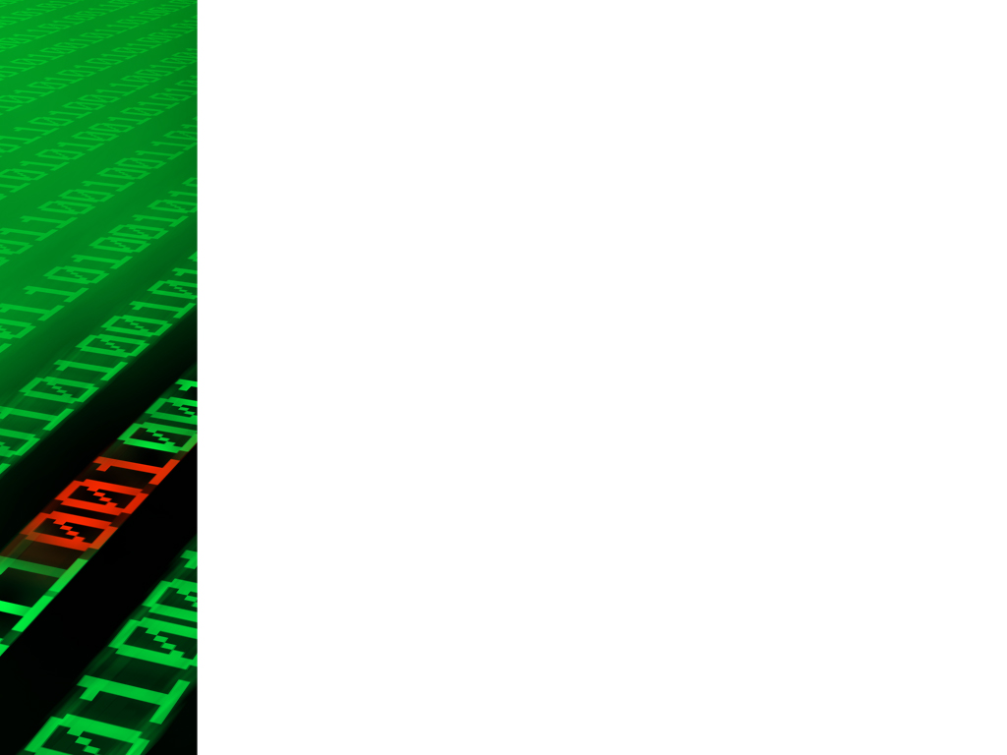
What is Kivy?
Kivy is an open-source Python framework for developing multitouch applications. It is particularly well-suited for applications with graphical user interfaces (GUIs) and is designed to be cross-platform, supporting Windows, macOS, Linux, Android, and iOS.

Slide 3
Why do we use Pandas?
Cross-Platform
Open Source
Pythonic
Multitouch Support
Rich Set of Widgets
Customizable
Event-Driven Programming
Support for hardware Sensors
Graphics Engine
Community & Support

Slide 4
Kivy Layouts
Box Layout
Grid Layout
Float Layout
Relative Layout
Stack Layout
Anchor Layout

Slide 5
Explaining Layouts
BoxLayout: arranges widgets either horizontally or vertically in a single line. Widgets are added one after another in the specified orientation.
GridLayout: arranges widgets in a grid, allowing you to specify the number of rows and columns. Widgets are added sequentially and fill the grid from left to right, top to bottom.
FloatLayout: allows precise positioning of widgets using x and y coordinates. Widgets are placed relative to the layout's size and can overlap if coordinates overlap.
RelativeLayout: allows widgets to be positioned relative to the layout boundaries or to each other. Widgets are placed based on their positions and size hints, allowing for flexible and dynamic layouts.
StackLayout: stacks widgets horizontally or vertically, allowing for easy layering. Widgets are placed one on top of the other, and the layout expands to accommodate all the widgets.

Slide 6
Choosing right Layout
Use BoxLayout when you need a simple linear arrangement of widgets either horizontally or vertically.
Use GridLayout when you have a grid-based layout or need precise control over rows and columns.
Use FloatLayout when you need exact positioning of widgets using coordinates.
Use RelativeLayout when you want to position widgets relative to the layout boundaries or to each other.
Use StackLayout when you need to stack widgets on top of each other either horizontally or vertically.
Use AnchorLayout when you want to anchor widgets to specific positions within the layout, such as the center or edges of the screen.

Slide 7
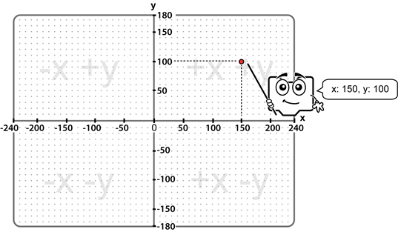
Explaining Coordinates

Slide 8
Class Activity: Layout Practice
How to import Layouts
How to add widgets in layouts
How to place widgets in different positions
Exploring Unique Behavior of Layouts
Understanding why we have multiple layouts

Slide 9
Explaining Widgets
Label: Displays text.
Button: Triggers actions when clicked.
TextInput: Allows user input through the keyboard.
Slider: Lets users select a value from a range by sliding a thumb.
Image: Displays images in various formats.
CheckBox: Represents a binary choice.
ToggleButton: A button that toggles between an 'on' and 'off' state.
Switch: Represents a binary switch that can be toggled on or off.
ProgressBar: Shows the progress of a task.
Spinner: A drop-down list for selecting one option from many.

Slide 10
Explaining Widgets
DropDown: Provides a dropdown menu of options.
Video: Displays video content.
ScrollView: Allows scrolling of content that is larger than the screen.
BoxLayout: Arranges widgets in a horizontal or vertical box.
GridLayout: Arranges widgets in a grid with specified rows and columns.
StackLayout: Stacks widgets horizontally or vertically.
FloatLayout: Allows precise positioning of widgets using x and y coordinates.
RelativeLayout: Positions widgets relative to the layout boundaries or to each other.
AnchorLayout: Anchors widgets to specific positions within the layout.
Scatter: Allows transformation and movement of widgets with multitouch gestures.

Slide 11
Explaining Widgets
Accordion: A collapsible content area with multiple sections.
ActionBar: Provides a bar with contextual actions.
Bubble: Displays information when touched and released.
Carousel: Allows swiping between multiple panels.
FileChooser: Allows selecting files and directories.
TreeView: Represents data in a tree-like structure.
VideoPlayer: Plays video content with controls.
CodeInput: Allows input and editing of code.
DatePicker: Allows selecting a date.
TimePicker: Allows selecting a time.
Note: Read this documentary to know about all widgets Widgets — Kivy 2.2.1 documentation

Slide 12
Touch Event & Binding
Events: in Kivy are user interactions like touch, keyboard input, or system events. Widgets can respond to these events, enabling interactive applications.
Bindings: allow you to associate a function with an event, ensuring that when the event occurs, the specified function is executed.

Slide 13
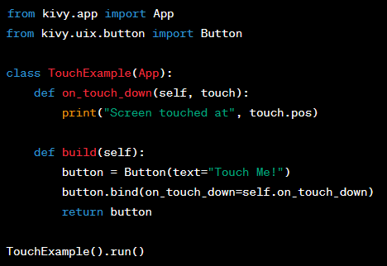
Example: Touch Event & Binding

Slide 14
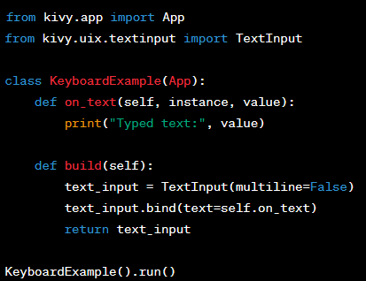
Example: Touch Event & Binding
https://kivy.org/doc/stable/guide/basic.html#events-and-properties

Slide 15
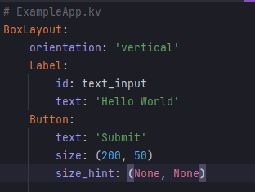
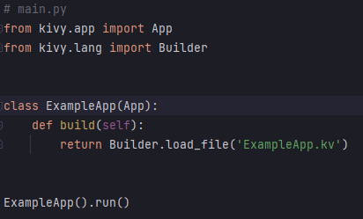
Kivy Application Structure:
Kivy applications follow a specific structure, separating the UI design (usually in a .kv file) from the application logic (in a Python script)
In the Python script, the ExampleApp class is defined, which inherits from App. The submit_name method prints a greeting with the entered name. The build method returns the root widget, which is an instance of BoxLayout.

