Slide 1
CSS

Slide 2
Contents
CSS Introduction
CSS Selectors
Ways to Insert CSS
CSS Properties Summary
Text Formatting
Lengths

Slide 3

CSS Introduction
Take control of the style of your pages, including the colors and size of fonts, the width and colors of lines, and the amount of space between items on the page.
Allow you to specify rules that say how the content of elements within your document should appear.
CSS rule made up of two parts:
The selector , which indicates which element or elements the declaration applies to (if it applies to more than one element, you can have a comma - separated list of several elements)
The declaration , which sets out how the elements referred to in the selector should be styled
The declaration has two parts, separated by a colon:
A property , which is the property of the selected element(s) that you want to affect, in this case the width property.
A value , which is a specification for this property; in this case it is that the table cells should be 36 pixels wide.

Slide 4
CSS Introduction
HTML was NEVER intended to contain tags for formatting a document, it was intended to define the content of a document
The style definitions are normally saved in external .css files.
A CSS declaration always ends with a semicolon, and declaration groups are surrounded by curly braces:

Slide 5
CSS Selectors
CSS selectors are used to "find" (or select) HTML elements based on their id, class, type, attribute, and more.
Universal Selector
The universal selector is an asterisk; it is like a wildcard and matches all element types in the document e.g.
*{ }
The element/Type Selector
Based on the element name e.g.
p { text-align: center; color: red; }
All <p> elements will be center-aligned, with a red text color
The id Selector
Uses the id attribute of an HTML element
The following applied to the HTML element with id="para1”
#para1 { text-align: center; color: red; }

Slide 6
CSS Selectors
The class Selector
Selects elements with a specific class attribute
All HTML elements with class="center" will be center-aligned
Grouping Selectors
You can group the selectors, to minimize the code.
To group selectors, separate each selector with a comma.
.center { text-align: center; color: red; }
h1 { text-align: center; color: red; } | h2 { text-align: center; color: red; } | p { text-align: center; color: red; }
h1, h2, p { text-align: center; color: red; }

Slide 7
Ways to Insert CSS
There are three ways of inserting a style sheet:
External Style Sheet
Ideal when the style is applied to many pages
The file should not contain any html tags. The style sheet file must be saved with a .css extension.
Each page must include a link to the style sheet with the <link> tag.
Internal Style Sheet
Used when a single document has a unique style
Define internal styles in the head section of an HTML page, inside the <style> tag
Inline Styles
Loses many of the advantages of a style sheet (by mixing content with presentation).
Use this method sparingly!
The style attribute can contain any CSS property
<head> <link rel="stylesheet" type="text/css" href="mystyle.css"> </head>
<head> <style> body { background-color: linen; } h1 { color: maroon; margin-left: 40px; } </style> </head>
<h1 style="color:blue;margin-left:30px;">This is a heading.</h1>

Slide 8
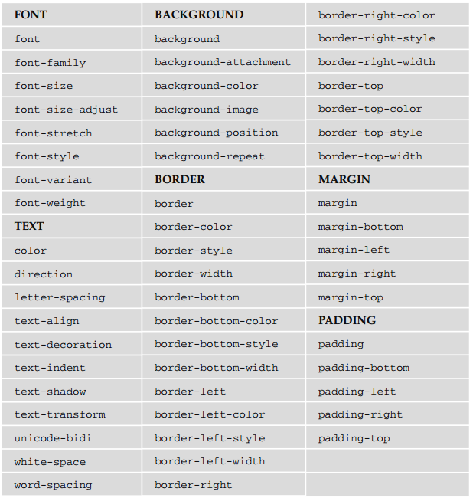
CSS Properties Summary
The properties are grouped together into related functionality
for example, there are properties that allow you to control the presentation of tables, lists, and backgrounds

Slide 9
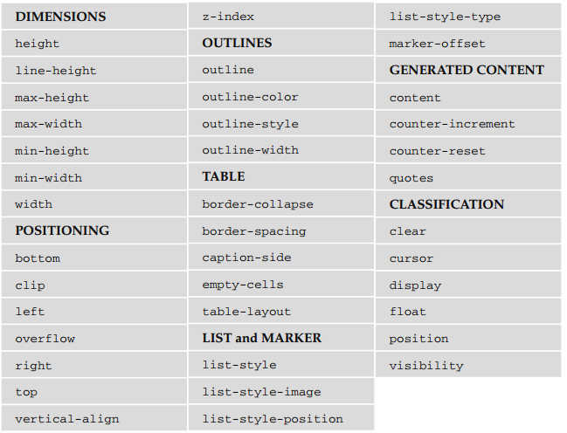

Slide 10
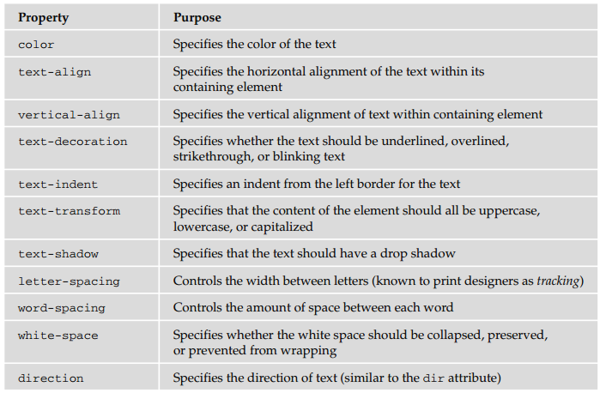
Text Formatting

