Slide 1
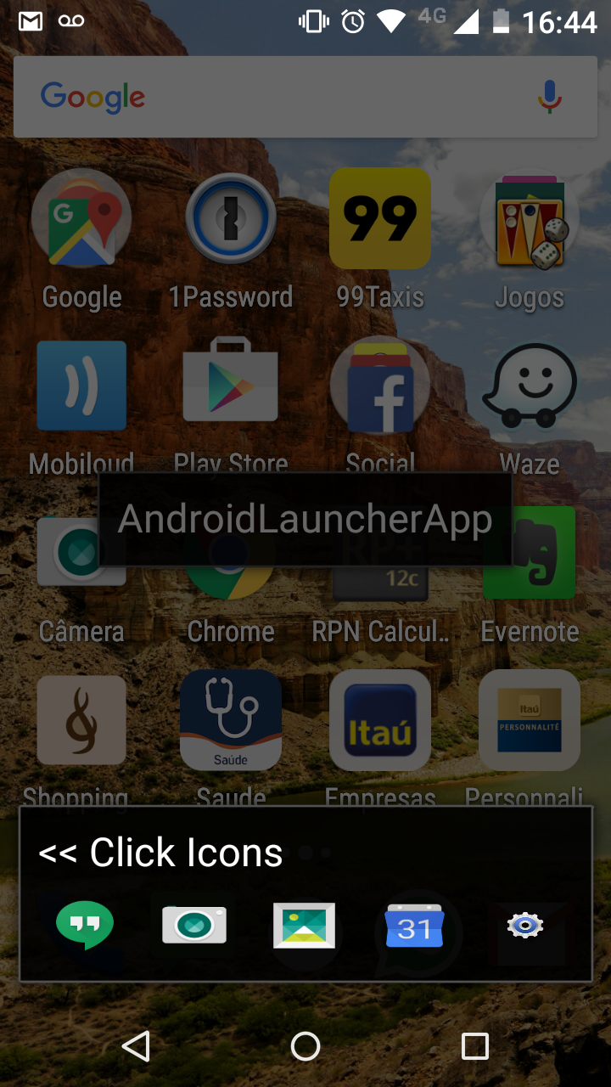







Home screen background must be reset to
user’s configured WALLPAPER and a BLANK screen
Remove “<< Click Icons”
Please implement the following design/layout:
Transparent background (shows user wallpaper);
AppDrawer icon must open a list of installed apps (as per default launchers);
4 App Icons (per configured bar);
“Cog Icon” to display other bars;
Size icons accordingly and proportionately;
(essentially, you need to copy a standard launcher bar and add the cog and the appdrawer)

Slide 2
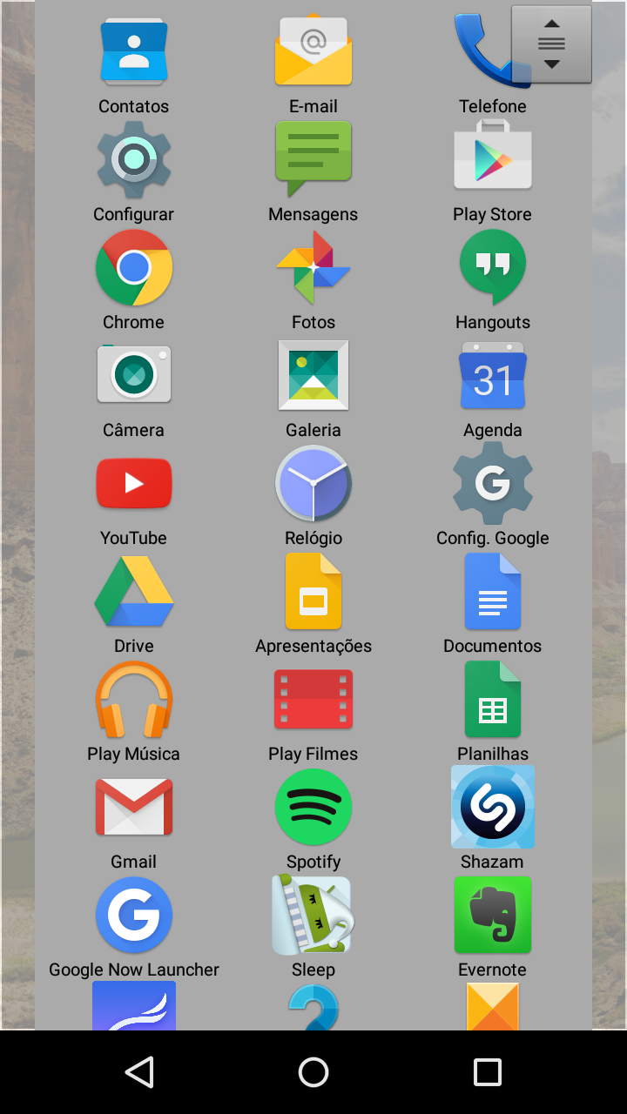
When selecting icons in the config screen, please ORDER Grid by APP NAME. Check if you can display a Grid with 4 columns to use space more effectively.
1010!, 1Password, 99Problems, 99Taxis
ACCamargo, Alert, AndroidLauncher, Atomas
(…)
(…)

Slide 3
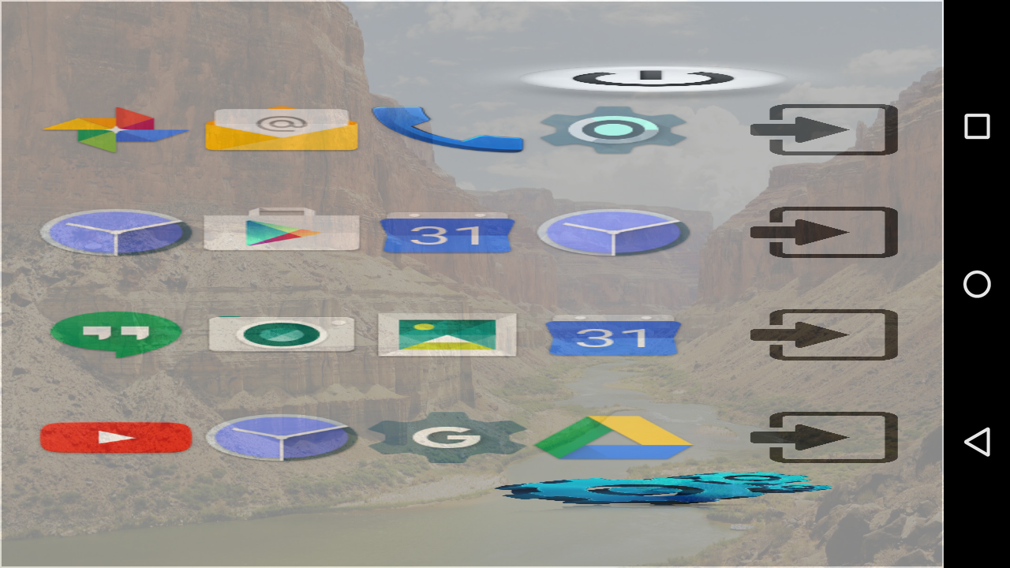
EITHER:
Disable screen orientation
OR:
Resize/Rescale Icons

Slide 4
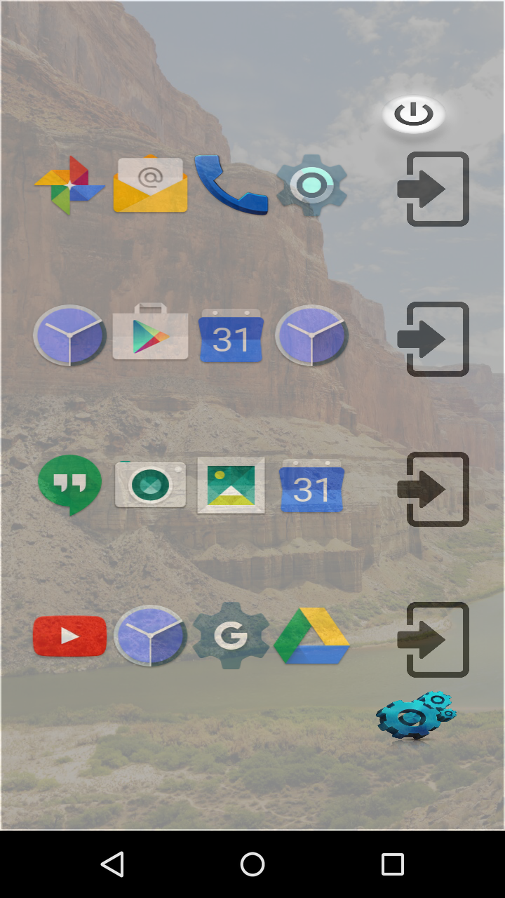

Please IMPROVE design and make it as close to mockup as possible.
Remove top “Power” icon;
Replace “Blue Cogs” for this: (“Green OK”)
Align “Enter door” icons with “Green OK”
Rescale all icons to improve design (“Enter door” is larger than App Icons);
Place App NAME under App Icon;
Adjust LONG PRESS to system default (500ms); it feels longer…
CHANGED BEHAVIOUR:
When pressing “Enter Door”, launcher returns to home screen displaying selected bar (see use case in next slide)

Slide 5
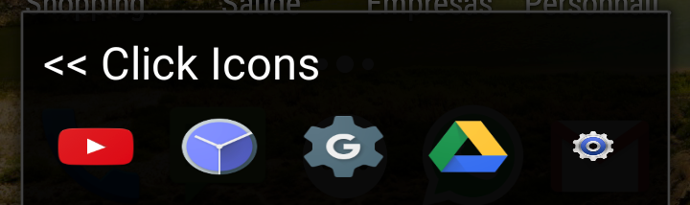

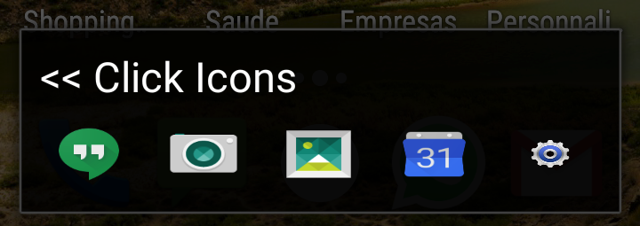
1. I am at HOME screen with this bar
2. I press “cog”, enter config screen and select this bar and click “Enter Door”
3. App returns to HOME screen with new bar selected

Slide 6
Since the entire desktop will be free, please allow Home Screen Activity to add widgets to that screen ONLY
Google reference “for starters”:
https://www.google.com.br/search?q=android+add+widget+to+activity&ie=utf-8&oe=utf-8&gws_rd=cr&ei=BxRzVprlC8O6wATAiYTgBw
SO:
http://stackoverflow.com/questions/9999584/android-adding-appwidgets-to-an-activity
https://www.google.com.br/search?q=android+add+widget+to+activity&ie=utf-8&oe=utf-8&gws_rd=cr&ei=BxRzVprlC8O6wATAiYTgBw#q=how+to+programmatically+run+widget+home+button+click+android
http://stackoverflow.com/questions/15038385/how-to-create-android-app-with-app-widget-in-single-application
http://stackoverflow.com/questions/4756835/how-to-launch-home-screen-programmatically-in-android
https://www.google.com/?gws_rd=ssl#q=how+to+programmatically+get+a+list+of+home+launchers+in+android
http://stackoverflow.com/questions/18887636/how-to-record-phone-calls-in-android
http://coderender.blogspot.com/2012/01/hosting-android-widgets-my.html

Slide 7
Other bugs and “misbehaviours”
Ensure that when App is started, the “Back” (Triangle) button “log” is “cleared” somehow; on occasions, if press “Back” a lot, I eventually go back to the “prior” launcher.
EXAMPLE: (using Moto X)
Go to Configuration / Home;
Select “Android Launcher” (“our” launcher);
Press Home (Circle) Button (you get to “our” launcher);
Press Back (Triangle) Button (you get to “original” launcher….);

