Slide 1
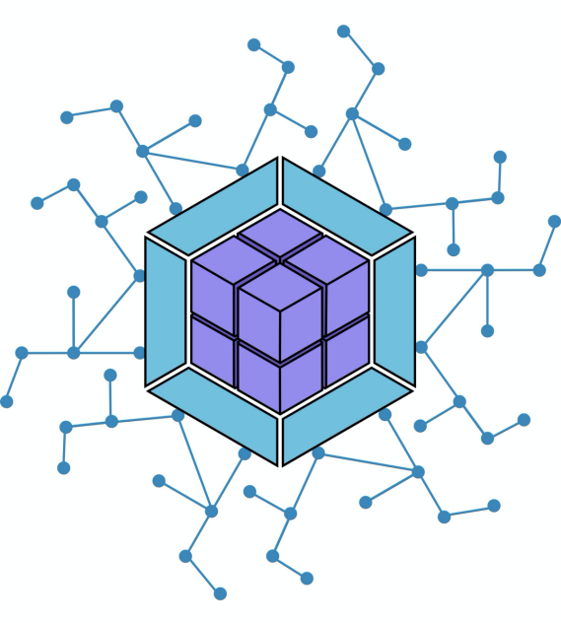
Module Federation
Team: Binary Brains
Team Members:
Arun Bikash Mohanty (154865)
Sourav Kumar Paul (399270)
Prasanta Bhuin (797256)
Tanmoy Chowdhury (797429)
Suman Mondal (420186)

Slide 2
Problem Statement
While building web application for enterprise, with time the application gets bigger with lots of features and lots of dependent packages. While using of existing packages make life easier at the same time it increases the build time and test time. This is unavoidable for a big application.
Following are some problems that we find very common:
Increase build time.
Increase bundle size.
Hence increases time for unit test to run.
Download dependency even if its required only in one page.
Problem when multiple teams working in a same codebase.
Makes a single codebase gigantic.
A big codebase is difficult understand and debug for a new team member.
Increases the possibility of becoming unmanageable codebase.

Slide 3
Solution Approach
This problem would be solved if we can somehow split the codebase and make them independent. So that each codebase/project will be managed, developed and build by separate team. Each project developed and run in their complete isolation. Expose the module/component for others to use. So that the main project can use this project but cannot modify.
This way we can handle separate codebase and build for each feature without effecting other section of the main project.
We should also eliminate the need of downloading the child package/ project on every update from child project. Unlike npm packages.
But… the problem is how to achieve this kind of flexible implementation and how can we avoid lots of configuration changes in both the projects to make modules shareable?

Slide 4
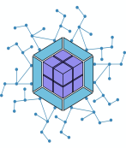
Module Federation
Webpack’s module federation can be a life saver to solve the problem and achieve all the benefits mentioned above.
Surprisingly it requires very minimum changes in fact few lines of changes and only in one file.
Expose the module and use that module.
That’s all it requires…..

Slide 5
Control flow
Host App
Remote App 1
Exposes
Module 1
Host Module 1
Module 1
Remote App 2
Host Module 2
Module 1
Module 2
Exposes
Module 2

Slide 6
Architectural Diagram
Develop/Source control
Build and Test Pipeline
Production
All 3 Apps combined
Micro frontend A
Micro frontend B
Actual Production App
Micro frontend C

