Slide 1
MOHAMMED SHAFIUDDIN KEN WU
CS 480 Presentation
BY

Slide 2
Non relational database Management system
NoSQL is a NRDBMS referred to as “Not Only SQL”
Schema less data that can be stored in multiple collections and nodes
Collections are Tables
Documents are Rows
Fields are Columns
Notes:
Schema less: does not have fixed table schemas and mixed data type can be stored

Slide 3
Maintenance
NoSQL designed to expand horizontally scalable which makes it less expensive to maintain
When load increases this can be accommodated by adding more machines to NoSQL, while for RDBMS you need to add multiple severs.
Adding more machines is cheaper than adding more servers.

Slide 4
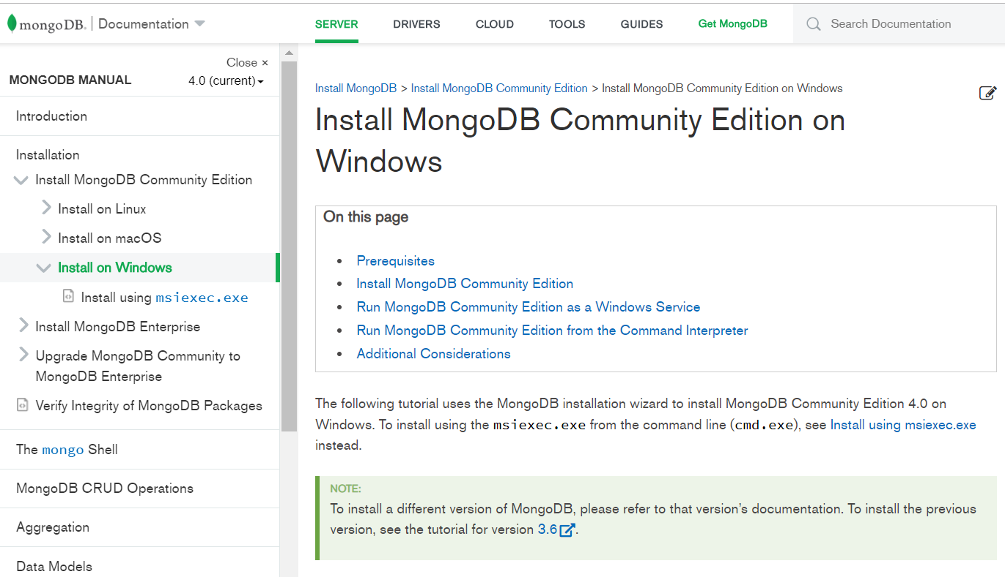
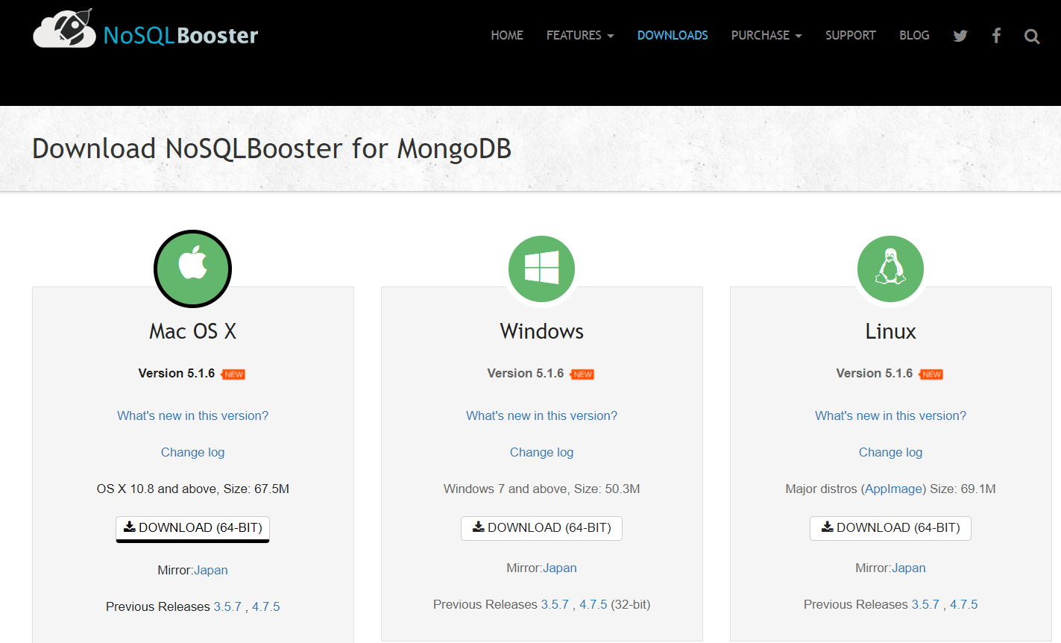
DOWNLOAD AND INSTALL
NoSQL can be downloaded from the link below:
Database MongoDB:
https://docs.mongodb.com/manual/administration/install-community/
NoSQLBooster for MongoDB:
https://nosqlbooster.com/downloads
Download page has options to download on different platforms (Window, Mac, or Linux):

Slide 5
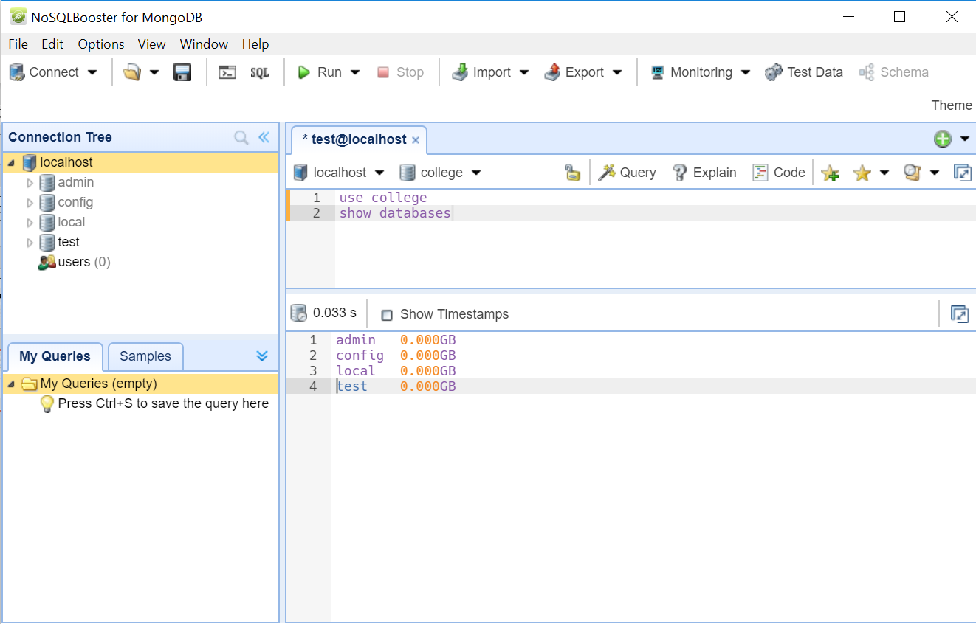
“USE” KEYWORD CREATES DATABASE ENVIRONMENT
NoSQL will not create database unless implemented
USE keyword only creates an environment for the database
For example on the right “use college” has not created the college database, “show databases” displaying the list of existing database and it does not have the college database.

Slide 6

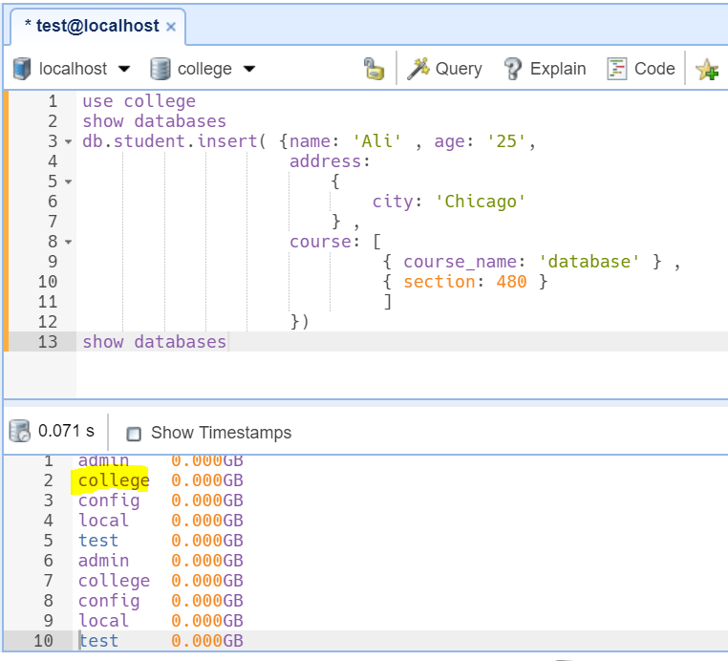
IMPELEMENTATION CREATES A DATABASE
Only After inserting a “student” as collection and creating a document creates the “college” database. As shown in the image on right.

Slide 7
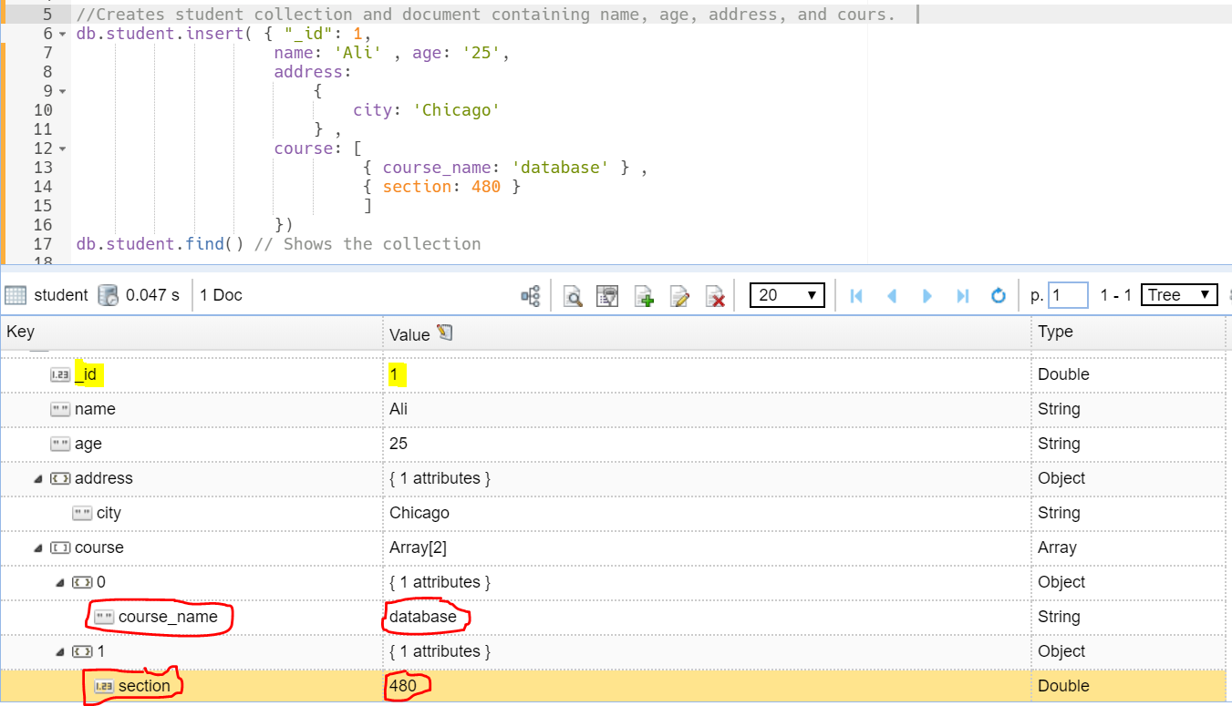
MIX DATA DOCUMENT
NoSQL allows mix data in the document. The course document shown below has the mixed data attributes outlined in red “ course_name ” and “ section ”.

Slide 8
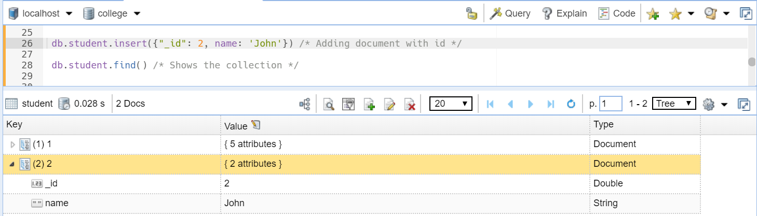
DOCUMENT inserted WITH custom ID
Document inserted in the collection with the custom Id value of 2, as show in the image below:

Slide 9
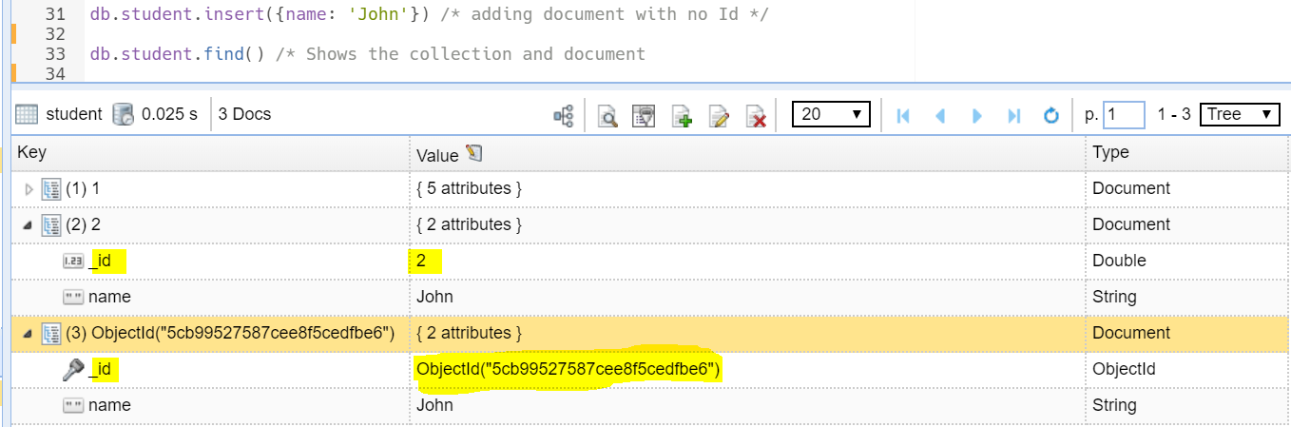
DOCUMENT inserted WITH DEFAULT ID
When the ID is not specified while inserting a document the system generates the default ID as shown in the image below with Alphanumeric letters for document containing the name John.

Slide 10
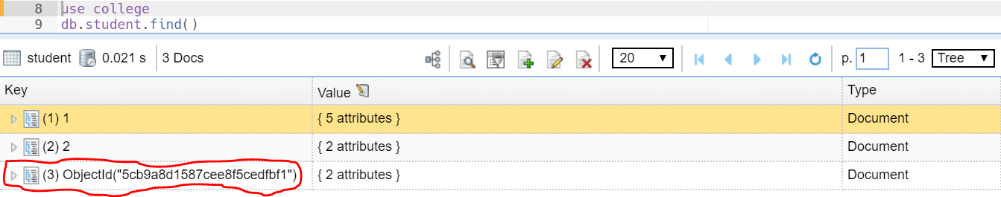
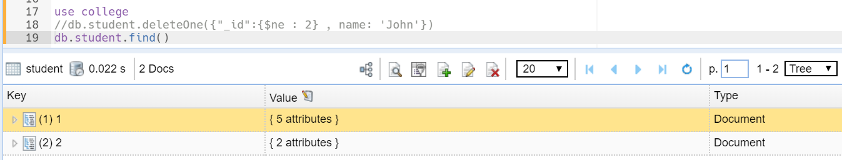
DELETING THE DOCUMENT WITH DEFAULT ID
Before deletion
After deletion

Slide 11
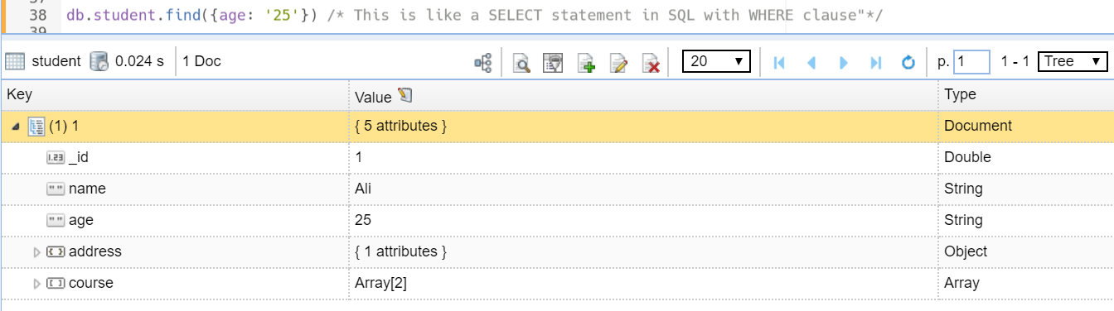
SELECT A DOCUMENT AS IN SQL WHERE CLAUSE
Finding the specific document using a specific attribute “age”, similar to the WHERE clause implementation in SQL.

Slide 12
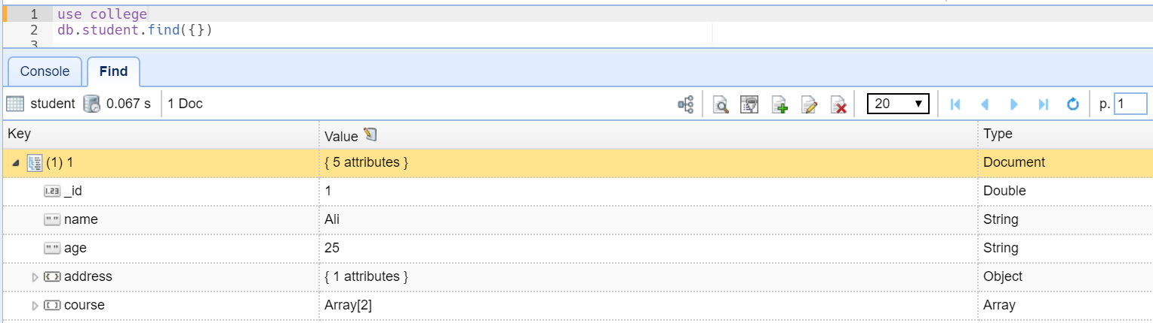
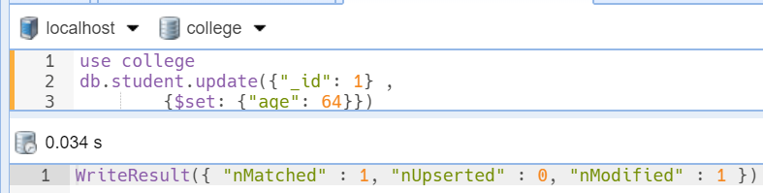
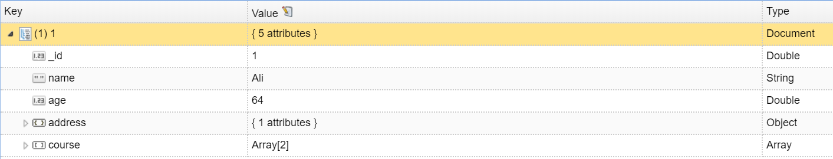
UPDATING COLLECTION
BEFORE UPDATING “age”
AFTER UPDATING “age”

Slide 13
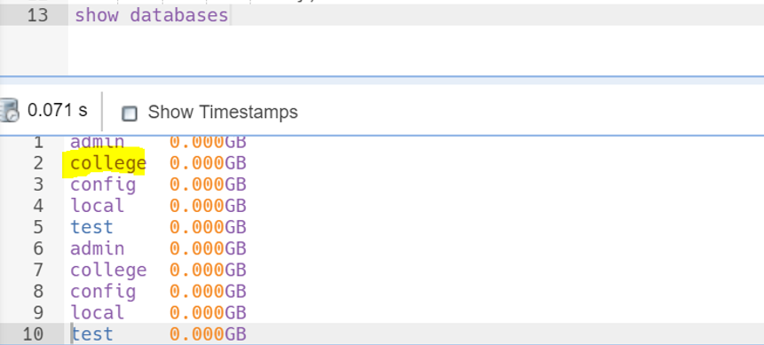
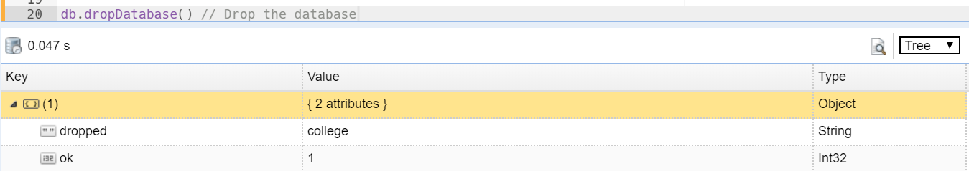
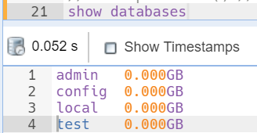
DROP THE DATABASE
Before Drop
After Drop

Slide 14
conclusion
In conclusion NoSQL will be better choice for large data implementation.

