Slide 1
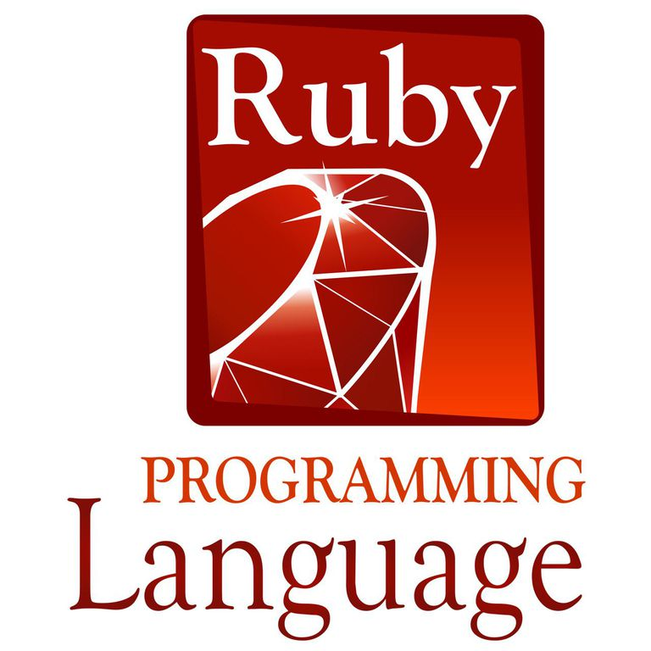
Ruby
CS 474 Final Presentation
Ken Wu
Mohammed Shafiuddin

Slide 2

Introduction
Designed and Developed in Japan- Mid 1990s
By Yukihiro “Matz” Matsumoto
Object Oriented
Dynamically Typed
Garbage Collection

Slide 3


Quick Start
Set UP
Linux: apt-get install ruby
Window: https://rubyinstaller.org/
Create Program
Any text editor or IDE
Save as filename.rb
Run Program
In Command Prompt: Ruby filename.rb

Slide 4
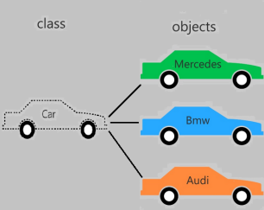
Class
Constructor
Use keyword “initialize”, e.g def initialize
Can setup default arguments
The later “initialize” will be called if more than 1
Instance Variable
Start with “@”, e.g @instVariable = 0
Delimiter
Keyword “end”

Slide 5
Class Example
class Parent
def initialize # Constructor keyword: "initialize"
@name = "First Parent" # instance varable: @variableName
@numberChildren = 2 # instance varable: @variableName
puts "First Parent initialize!"
end
#This will be call when we initialleze an instance
def initialize(a=0)
@name = "second Parent"
@numberChildren = a
puts "Second Parent initialize!"
end
def intro()
puts "This is #{@name}, I have #{@numberChildren} children"
end
end
p= Parent.new
p.intro()
p2 = Parent.new 3
p2.intro()
Output:
Second Parent initialize!
This is second Parent, I have 0 children
Second Parent initialize!
This is second Parent, I have 3 children

Slide 6

Inheritance
Not Support Multi Inheritance
Syntax:
child_class_name < parent_class_name
Access Control
Only apply to methods
Public: accessible by anyone
Protected: accessible by defined class & its subclasses
Private: accessible defined class
Default is public

Slide 7
Inheritance Example
class Parent
def intro()
puts “I am Parent”
secret()
end
private
def secret()
puts “I have a secret”
end
protected
def familySecret()
puts “I know the secret of our family”
end
public
def noSecret()
puts “I won’t tell you our secret”
end
end
class Child < Parent
def intro()
puts “I am Child”
familySecret()
noSecret()
end
end
P = Parent.new
p.intro()
c = Child.new
c.intro()
c.noSecret()
Output:
I am Parent
I have a secret
I am Child
I know the secret of our family
I won't tell you our secret
I won't tell you our secret

Slide 8
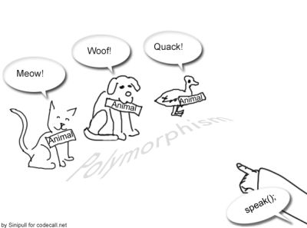
Polymorphism
Auto dynamic cast
Not naturally support abstract/interface class
Don’t needed

Slide 9
Polymorphism Example
class Parent
def intro()
puts “I am Parent”
secret()
end
end
class ChildA < Parent
def intro()
puts “I am Child A”
end
end
class ChildB < Parent
def intro()
puts “I am Child B”
end
end
arr = Array.new
arr.push(Parent.new)
arr.push(ChildA.new)
arr.push(ChildB.new)
for i in arr
i.intro()
end
Output:
I am Parent
I am Child A
I am Child B

Slide 10
Conclusion
Class
Access Control
Inheritance
Polymorphism

Slide 11

Questions

