Slide 1
Getting Serious with the Perl DBI
Making simple things easy and difficult things possible
Tim Bunce
August 1998

Slide 2
Why Perl for Databases?
Ideally suited to data processing:
  parsing, cleansing / filtering / merging and formatting
Applications
  Data Migration
  Data acquisition and reporting
  Web Page creation (static and dynamic)
Perl lets you build sharper tools faster
Notes:
Commercial tools for these tend to lack the flexibility of Perl (in breadth and depth).
You can find yourself wasting time working around the limitations of blunt commercial tools.

Slide 3
What Is the Perl DBI?
The standard Database Interface for Perl
“A perl module and specification that defines a consistent database interface, independent of the actual database being used”

Slide 4
What drives the design of the DBI?
Goals of the DBI
  Be simple to use for simple applications
  Have sufficient flexibility to accommodate unusual functionality and non-SQL databases
  Conform to applicable standards (ODBC etc.)
  Enable the creation of database-independent Perl scripts without being limited to the lowest functionality
  Be free with open source code
A ‘higher-level’ interface than ODBC/JDBC

Slide 5
Where does the DBI fit?
Perl Application
DBI Module
DBD::Oracle
DBD::Informix
DBD::Other
Oracle Server
Informix Server
Other Server

Slide 6
A Simple Example
use DBI;
$dbh = DBI->connect('dbi:ODBC:PRICE', 'user', 'password',
{ RaiseError => 1, AutoCommit => 0 });
$upd = $dbh->prepare('UPDATE prices SET price=? WHERE prod=?');
$ins = $dbh->prepare('INSERT INTO prices(prod,price) VALUES (?,?)');
while ($line = <COST>) {
chop $line;
($prod, $price) = split /,/, $line;
$rows = $upd->execute($price, $prod);
$ins->execute($prod,$price) if $rows == 0;
}
$db->commit;
Notes:
Very few lines of code.
Very simple to learn and use.

Slide 7
So why use the Perl DBI?
Because...
  It delivers what it promises
  It’s simple and quick to use
  It’s fast, flexible and well proven
  It’s here, there and everywhere
  It’s free, with source
  Drivers available for many databases
  Commercial support is available
  It has a large user base and a strong future

Slide 8
Comparing DBI and Alternatives
(Attempting the Impossible!)
“Power”
DBI
and
Drivers
Sybase::DBlib
Win32::ODBC
Native API
ODBC/
JDBC
and
drivers
Command Line
Precompilers
TCL
(oratcl, sybtcl)
Please note: This chart is correct only for some values of correct!
“Effort”
Notes:
Native API’s will generally offer the most power, e.g., Oracle OCI.
But take a lot of effort to learn and use.
Knowledge is rarely portable to other APIs
Generic application language interfaces: ODBC and JDBC.
Still lots of effort to learn
Knowledge is portable between databases
Power is dependant on quality of ODBC driver
Pre-compilers for C (where SQL is embedded in C and ‘precompiled’)
Simpler than a raw C API but typically less power. Hard to debug.
Command line access - Just type it in!
Generate SQL from scripts etc.
Not robust - hard to check for and respond to errors
Script Languages
TCL (oratcl, sybtcl) generally much slower. Binary data hard.
Win32::ODBC - a bottom-up approach - thin layer over raw ODBC calls. DBI is higher level but DBD::ODBC doesn’t yet have the same breadth of ODBC specific functionality. Recommended for existing users and people who need that degree of control.
DBI+DBD::ODBC can run twice as fast as Win32::ODBC.
Sybase - and other database specific perl extensions
Can gain some performance advantage if well written but loose out on the DBI extras: portable apps & knowledge, tools, subclasses etc.

Slide 9
Under the Hood
DBI defines and implements an interface
Driver modules do much of the real work
DBI provides default methods, functions, tools etc for drivers
Not limited to the lowest common denominator - mechanism provided for driver specific extensions
Designed and built for speed
Valuable detailed call tracing/debugging built-in
Notes:
Similar in concept to an ODBC Driver Manager
DBI provides methods, functions and tools etc
helps ensure conformant implementations
and efficient implementations
and more automatic support for new features

Slide 10
Architecture of the DBI Classes #1
‘’outer’’
‘’inner’’
Base classes
providing
fallback
behavior.
DBD::_::common
DBD::_::dr
DBD::_::db
DBD::_::st
DBI
DBI::dr
DBI::db
DBI::st
DBD::A::dr
DBD::A::db
DBD::A::st
DBI handle classes visible to applications.
These classes are effectively ‘empty’.
DBD::B::dr
DBD::B::db
DBD::B::st
Parallel handle classes implemented by drivers.

Slide 11
Architecture of the DBI Classes #2
Application
makes calls
to methods
using DBI handle
objects
‘’outer’’
‘’inner’’
DBD::A::db
method
method
method
DBI::db
method
DBI::_::db
method
method
method
DBI
method
method
dispatch
method
method
method
method
method
method
method
method
method
DBI::_::common
DBD::B::db
method
DBI::st
DBD::A::st
method
method
method

Slide 12
Anatomy of a DBI Handle
‘’outer’’
‘’inner’’
DBI::db
DBI::db
Handle
Ref.
Tied
Hash
Hash
struct imp_dbh_t {
struct dbih_dbc_t com;
… implementers …
… own data ...
}
struct dbih_dbc_t {
… DBI data ...
}
Tie
Magic
DBI
Magic

Slide 13
Method call walk-through
Consider a simple prepare call:
$dbh->prepare(...)
$dbh is reference to a DBI::db object (regardless of driver)
DBI::db::prepare is an alias for DBI dispatch method
Dispatch calls driver’s prepare method something like this:
my $inner_hash_ref = … # from tie magic
my $implementor_class = … # from DBI magic data
$inner_hash_ref->$implementor_class::prepare(…)
Since driver code gets inner hash it has fast access to the hash contents

Slide 14
Give me SPEED!
DBI designed for speed from day one.
DBI dispatch written in hand-crafted XS/C.
Dispatch to XS driver methods optimized.
Cached attributes returned by dispatch.
Placeholders give maximum server performance.
Binding columns and/or fetchrow_arrayref give maximum client-side fetch performance.
DBI overhead is generally insignificant.

Slide 15
What's the difference?
while(@row = $sth->fetchrow_array) { }
  one field: 3100 fetches per cpu second
  ten fields: 1000 fetches per cpu second
while($row = $sth->fetchrow_arrayref) { }
  one field: 5300 fetches per cpu second
  ten fields: 4000 fetches per cpu second
Notes:
  Timings made on an old Sparc 10 using DBD::Oracle.
  Timings assume instant record fetch within driver.
  Fields all one char. @row would be even slower for more/bigger fields.

Slide 16
Give me SAFETY!
A recipe for safety
  Use transactions (don't use AutoCommit)
  Use RaiseError
  Use eval { … } to catch errors and rollback
Notes:
Classic example:
bank account transfer:
debit one account
credit another account
must be an ‘atomic’ operation.
Can’t allow debit without the credit.
Server-side errors: disk crash etc
Client side errors: program die()’s or is killed

Slide 17
Safety by example
use DBI;
use Text::Wrap;
$dbh = DBI->connect(…, …, …, {
AutoCommit => 0, RaiseError => 1
});
eval {
$sth = $dbh->prepare('insert into table values (?)');
foreach (@array_of_long_strings) {
$text = wrap($_);
$sth->execute($test);
}
};
$@ ? $dbh->rollback : $dbh->commit;
Notes:
Classic example:
bank account transfer:
debit one account
credit another account
must be an ‘atomic’ operation.
Can’t allow debit without the credit.
Server-side errors: disk crash etc
Client side errors: program die()’s or is killed

Slide 18
Give me (a vague impression of ) SAFETY!
Safety on the cheap (without transactions)
  push change information onto an array
  undo in reverse order, in place of rollback
  consider signals etc.
Notes:
Classic example:
bank account transfer:
debit one account
credit another account
must be an ‘atomic’ operation.
Can’t allow debit without the credit.
Server-side errors: disk crash etc
Client side errors: program die()’s or is killed

Slide 19
Wheels within wheels
Watching the DBI in action
DBI has detailed call tracing built-in
The trace be very helpful in understanding application behavior and for debugging
Shows parameters and results
Trace information can be written to a file
Not used often enough!

Slide 20
Our program for today...
1: #!/usr/bin/perl -w
2:
3: use DBI;
4:
5: $dbh = DBI->connect('user', 'passwd', { RaiseError => 1 });
6:
7: $upd = $dbh->prepare("UPDATE prices SET price=? WHERE prod=?");
8: $ins = $dbh->prepare("INSERT INTO prices (prod,price) VALUES(?,?)");
9: $rows = $upd->execute(42, "Widgets");
10: $ins->execute("Widgets", 42) if $rows == 0;
11:
12: $dbh->disconnect;

Slide 21
Trace Level 1
Trace Level 1 shows results only:
<- connect= DBI::db=HASH(0xe0abc) at DBI.pm line 356.
<- STORE('PrintError', 1)= 1 at DBI.pm line 382.
<- STORE('AutoCommit', 1)= 1 at DBI.pm line 382.
<- STORE('RaiseError', 1)= 1 at DBI.pm line 382.
<- prepare= DBI::st=HASH(0xe1238) at test.pl line 7.
<- prepare= DBI::st=HASH(0xe1504) at test.pl line 8.
<- execute= '0E0' at test.pl line 9.
<- execute= 1 at test.pl line 10.
<- disconnect= 1 at test.pl line 11.
<- DESTROY= undef
<- DESTROY= undef
<- DESTROY= undef

Slide 22
Trace Level 2
Trace Level 2 shows calls with parameters and more:
-> connect for DBD::ODBC::dr (DBI::dr=HASH(0x13dfec)~0xe14a4
'demo' 'user' 'passwd' HASH(0xe0a10))
<- connect= DBI::db=HASH(0xe0ab0) at DBI.pm line 356.
-> STORE for DBD::ODBC::db (DBI::db=HASH(0xe0abc)~INNER 'PrintError' 1)
<- STORE= 1 at DBI.pm line 382.
-> prepare for DBD::ODBC::db (DBI::db=HASH(0xe0ab0)~0xe0abc
'UPDATE prices SET price=? WHERE prod=?')
dbd_preparse scanned 2 distinct placeholders
<- prepare= DBI::st=HASH(0xe1274) at test.pl line 7.

Slide 23
Trace Level 2 (continued)
-> execute for DBD::ODBC::st (DBI::st=HASH(0xe1274)~0xe110c 42 'Widgets')
bind 1 <== 42 (size 2/3/0, ptype 5, otype 1)
bind 2 <== 'Widgets' (size 7/8/0, ptype 4, otype 1)
dbd_st_execute (for sql f1499360 after)...
dbd_describe sql 1499360: num_fields=0
dbd_describe skipped (no result cols) (sql f1499360)
<- execute= '0E0' at test.pl line 9.
-> execute for DBD::ODBC::st (DBI::st=HASH(0xe10d0)~0x142e6c 'Widgets' 42)
bind 1 <== 'Widgets' (size 7/8/0, ptype 4, otype 1)
bind 2 <== 42 (size 2/3/0, ptype 5, otype 1)
dbd_st_execute (for sql f1511752 after)...
dbd_describe sql 1511752: num_fields=0
dbd_describe skipped (no result cols) (sql f1511752)
<- execute= 1 at test.pl line 10.

Slide 24
Trace Level 2 (concluded)
-> disconnect for DBD::ODBC::db (DBI::db=HASH(0xe0ab0)~0xe0abc)
<- disconnect= 1 at test.pl line 11.
(outer handle DESTROY ignored)
(outer handle DESTROY ignored)
-> DESTROY for DBD::ODBC::st (DBI::st=HASH(0xe110c)~INNER)
<- DESTROY= undef
(outer handle DESTROY ignored)
-> DESTROY for DBD::ODBC::st (DBI::st=HASH(0x142e6c)~INNER)
<- DESTROY= undef
-> DESTROY for DBD::ODBC::db (DBI::db=HASH(0xe0abc)~INNER)
<- DESTROY= undef

Slide 25
State of the Nation
DBI builds and runs on many systems
  Unix, Windows, VMS etc.
DBI has many available drivers
  ODBC, Oracle, Informix, Ingres, mSQL, mysql, DB2, Adabas, Illustra, Solid, Sybase, Xbase, Postgress, Quickbase, Empress, Fulcrum, Altera, ...
Merging the ODBC/JDBC ‘inheritance’
  data types, meta-data etc.
Specifying the unspecified
  Documenting the undocumented… at last!
Notes:
Porting
All Unix variants - (not heard of any it won’t build on)
Windows 95, Windows NT, VMS
Builds out-of-the-box
Drivers
ODBC, Oracle, Informix, DB2, Ingres, Solid, …
enhancements to the DBI (inc. docs) will make it easier
ODBC/JDBC
Standard ways of specifying (data types, meta-data, options etc)
and ways of doing
The DBI won’t re-invent these wheels - but may make them easier to steer! (by offering higher-level interfaces to them).
First is data types and meta-data
Specifying the unspecified
Documenting features once they’ve stabilized
such as placeholders and bind variables

Slide 26
What's New in the DBI?
Methods
  $sth->prepare_cached($statement)
  $dbh->table_info and $dbh->tables
  $dbh->type_info
Attributes
  $sth->{TYPE} (Standards based type values)
  $sth->{SCALE}
  $sth->{PRECISION}
And finally… Version 1.00!

Slide 27
The Interactive DBI::Shell
Starting the shell
  The long way:
perl -MDBI::shell -e shell dsn user passwd
perl -MDBI::shell -e shell
  The short way:
  dbish ...
Interactive DSN selection
Command and Result History (uses ReadLine)
Output Redirection for all commands

Slide 28
DBD::Proxy & DBI::ProxyServer
Networking for Non-networked databases
DBD::Proxy driver forwards calls over network to remote DBI::ProxyServer
Proxy can be made transparent by setting DBI_AUTOPROXY environment variable
DBI::ProxyServer doesn't work on Win32 yet (work in progress)

Slide 29
DBD::Proxy & DBI::ProxyServer
Application
DBI::ProxyServer
RPC::pServer
IO:Socket
Storable
DBI
Network
DBI
DBD::Proxy
DBD::Foo
RPC::pClient
Storable
IO::Socket

Slide 30
What Next?
was
SQL for Non-SQL data sources
Networking for Non-Networked data sources
Template driver for command line interfaces
Data types, especially date/time/interval
Non-blocking (method calls return at once)
Multi-threading
Binding In/Out Variables
Binding Arrays

Slide 31
So What's Next Now?
Extend the Shell (batch mode, plug-ins etc)
Driver catch-up to DBI version 1.00
Common test suite for all drivers
Multi-threading (at least thread safety)
Binding In/Out Variables (for DBD::ODBC)
Binding Arrays (for DBD::Oracle)
Non-blocking (method calls return at once)
fetch_scroll (next, previous, first, last etc)
SQL Parser (ODBC) for greater script portability

Slide 32
What's new in DBD::Oracle?
Some, but not all, of DBI 1.00 is supported.
Should catch up in the next release or so.
Now bundles Alan Burlison's explain tool.

Slide 33
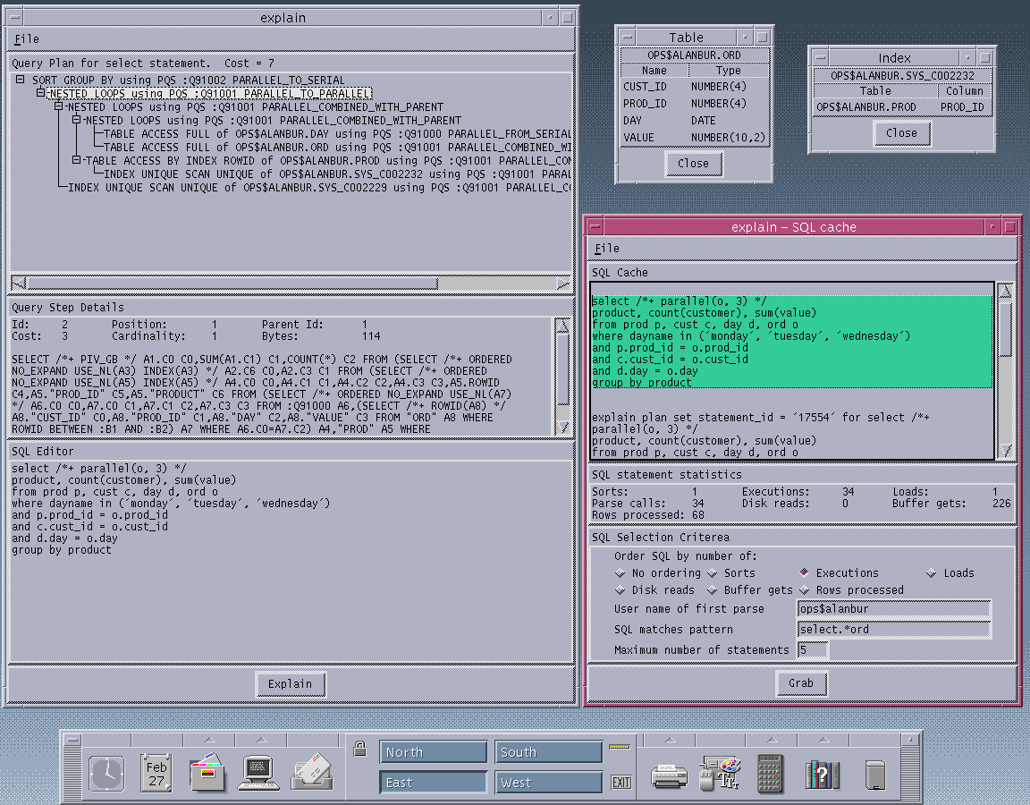
Notes:
Screenshot of the explain tool in action.

Slide 34
The end.
Till next year...

