Slide 1



纯免费PPT即点即下载，无注册、无套路
http://gitppt.com
不信你试试（狗头）
Juliet
Romeo
&
PPT模板下载：www.1ppt.com/moban/ 行业PPT模板：www.1ppt.com/hangye/
节日PPT模板：www.1ppt.com/jieri/ PPT素材下载：www.1ppt.com/sucai/
PPT背景图片：www.1ppt.com/beijing/ PPT图表下载：www.1ppt.com/tubiao/
优秀PPT下载：www.1ppt.com/xiazai/ PPT教程： www.1ppt.com/powerpoint/
Word教程： www.1ppt.com/word/ Excel教程：www.1ppt.com/excel/
资料下载：www.1ppt.com/ziliao/ PPT课件下载：www.1ppt.com/kejian/
范文下载：www.1ppt.com/fanwen/ 试卷下载：www.1ppt.com/shiti/
教案下载：www.1ppt.com/jiaoan/
Wedding Album
GALLERIES
VIDEOS
OUR WEDDING
ABOUT US

Slide 2




纯免费PPT即点即下载，无注册、无套路
http://gitppt.com
不信你试试（狗头）
Juliet
Romeo
&
Wedding Album
Romeo is here
Forever love1
Forever love2
Juliet is here
GALLERIES
VIDEOS
OUR WEDDING
ABOUT US

Slide 3



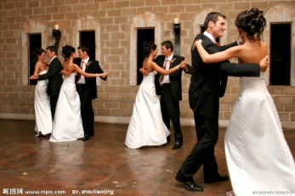
纯免费PPT即点即下载，无注册、无套路
http://gitppt.com
不信你试试（狗头）
Juliet
Romeo
&
Wedding Album
Romeo is here
Forever love1
Decorate
Waiting
Ring to wear
Dance
Forever love2
Juliet is here
Romantic garden
October 23(rd),1562
GALLERIES
VIDEOS
OUR WEDDING
ABOUT US

Slide 4


纯免费PPT即点即下载，无注册、无套路
http://gitppt.com
不信你试试（狗头）
Juliet
Romeo
&
Wedding Album
Decorate
Waiting
Ring to wear
Dance
Romeo
Juliet
Romantic garden
October 23(rd),1562
GALLERIES
VIDEOS
OUR WEDDING
ABOUT US

Slide 5







纯免费PPT即点即下载，无注册、无套路
http://gitppt.com
不信你试试（狗头）
Juliet
Romeo
&
Wedding Album
GALLERIES
VIDEOS
OUR WEDDING
ABOUT US

