Slide 1

纯免费PPT即点即下载，无注册、无套路
http://gitppt.com
不信你试试（狗头）
Roles in Beijing Opera
Name:Tang Ying
Major:educational technology

Slide 2

纯免费PPT即点即下载，无注册、无套路
http://gitppt.com
不信你试试（狗头）
Sheng
laosheng,xiaosheng,wusheng
Dan
laodan,wudan,damadan,qingyi,huadan
Jing
Painted face male role
Chou
A male clown role

Slide 3
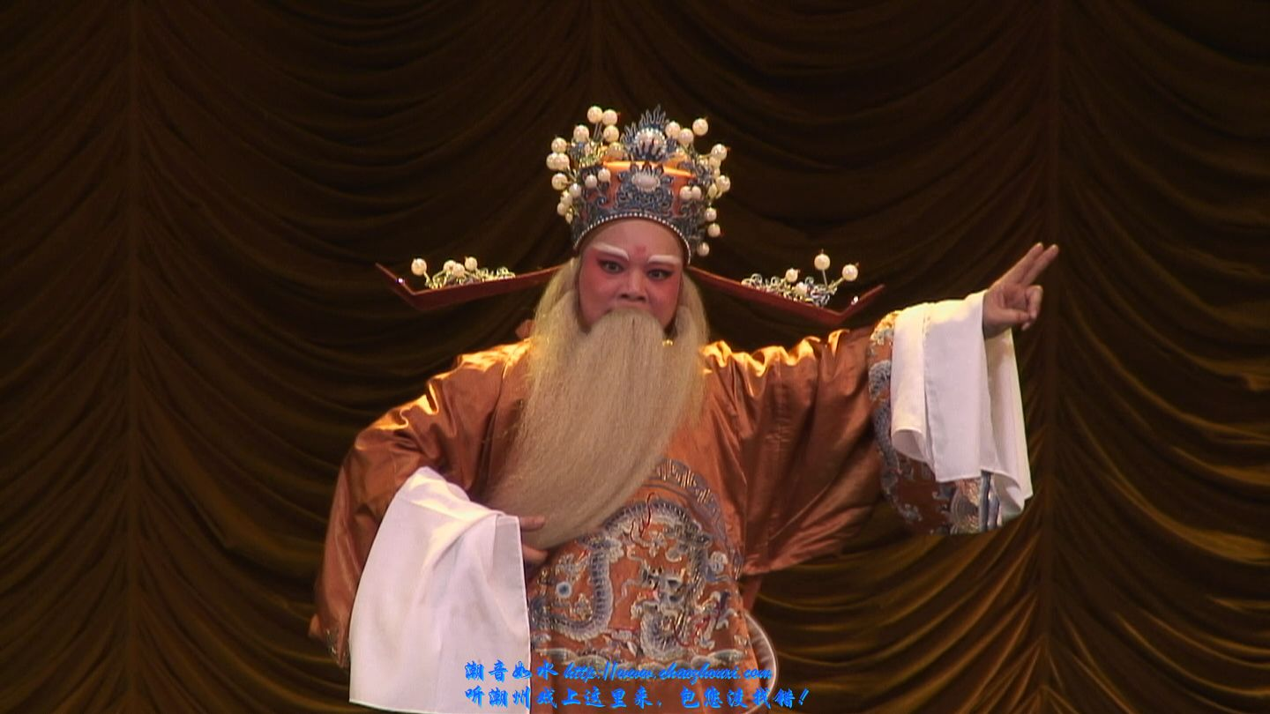
纯免费PPT即点即下载，无注册、无套路
http://gitppt.com
不信你试试（狗头）
Sheng
Laosheng:
The laosheng is a dignified older role. These characters have a gentle and cultivated disposition and wear sensible costumes.

Slide 4
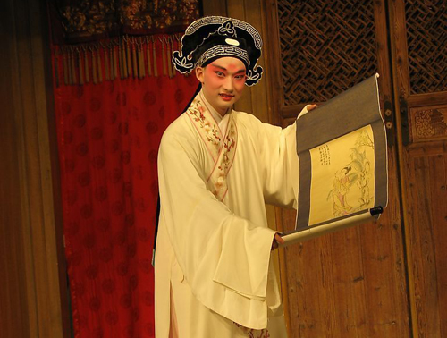
纯免费PPT即点即下载，无注册、无套路
http://gitppt.com
不信你试试（狗头）
Sheng
Xiaosheng:
Young male characters are known as xiaosheng. These characters sing in a high, shrill voice with occasional breaks to represent the voice changing period of adolescence.

Slide 5
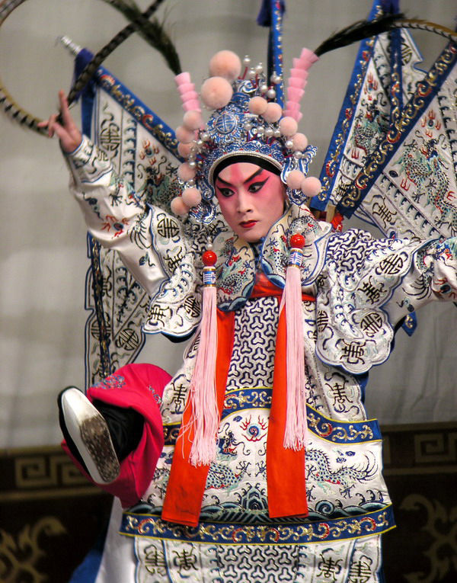
纯免费PPT即点即下载，无注册、无套路
http://gitppt.com
不信你试试（狗头）
Sheng
Wusheng:
The wusheng is a martial character
for roles involving combat. They
are highly trained in acrobatics,
and have a natural voice when
singing.

Slide 6
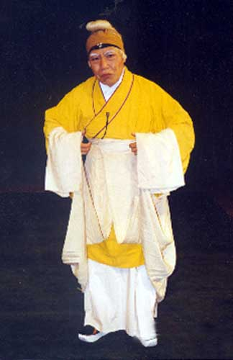
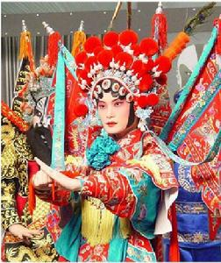
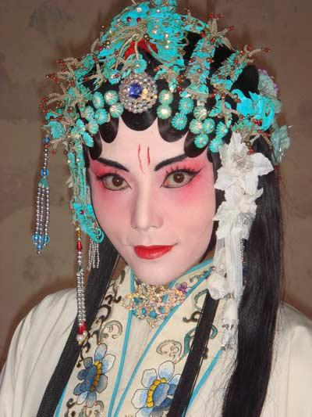
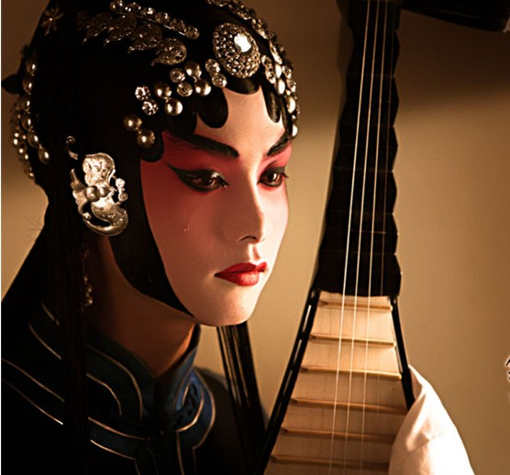
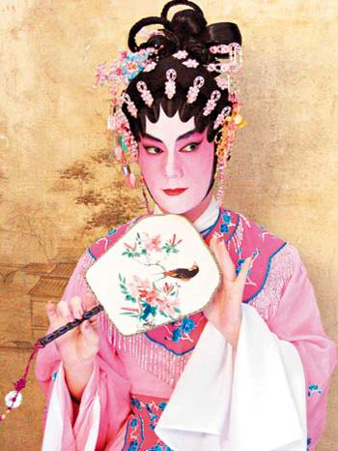
纯免费PPT即点即下载，无注册、无套路
http://gitppt.com
不信你试试（狗头）
Dan
Laodan
Wudan
Daomadan
Qingyi
Huadan
o
The Dan refers to any female role in Beijing opera. Dan roles were originally divided
into five subtypes. Old women were played by laodan, martial women were wudan,
young female warriors were daomadan, virtuous and elite women were qingyi,
and vivacious and unmarried women were huadan.

Slide 7
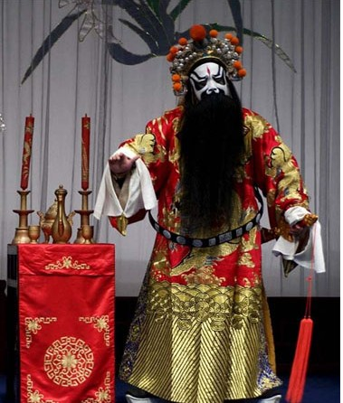
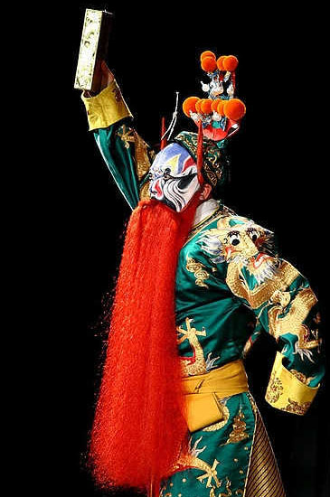
纯免费PPT即点即下载，无注册、无套路
http://gitppt.com
不信你试试（狗头）
Jing
The Jing is a painted face male role. Depending on the repertoire of the particular
troupe, he will play either primary or secondary roles.This type of role will
entail a forceful character, so a Jing must have a strong voice and be able to
exaggerate gestures.

Slide 8
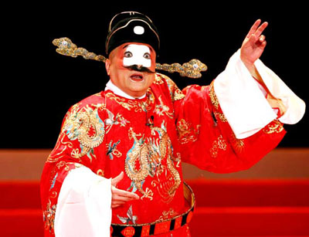
纯免费PPT即点即下载，无注册、无套路
http://gitppt.com
不信你试试（狗头）
chou
PPT下载：www.1ppt.com/xiazai/
The Chou is a male clown role. The Chou usually plays secondary roles in a troupe.Indeed, most studies of Beijing opera classify the Chou as a minor role.Chou roles can be divided into Wen Chou, civilian roles such as merchants and jailers, and Wu Chou, minor military roles.

Slide 9
纯免费PPT即点即下载，无注册、无套路
http://gitppt.com
不信你试试（狗头）
Thank you

