Slide 1

Title Slide 32 pt.
Arial Font Up to 3 lines in length
纯免费PPT即点即下载，无注册、无套路
http://gitppt.com
不信你试试（狗头）
Name, Date and/or Title
22 pt. Arial (RGB = 255, 0, 42)
Notes:
BEA Confidential

Slide 2
Presentation Guidelines
纯免费PPT即点即下载，无注册、无套路
http://gitppt.com
不信你试试（狗头）
Use this template to create your presentation
Ensure graphics and text do not exceed the ¼-inch
border of the slide
Use the provided color palette, box and arrow graphics,
and chart styles
Instructions are provided to assist you in using this presentation template effectively and consistently
At all times, strive to maintain the BEA look and feel
Bulleted text should be left aligned with the title, not centered on the slide
BEA Confidential. | <number>
Notes:
BEA Confidential

Slide 3
Develop Readable Slides
纯免费PPT即点即下载，无注册、无套路
http://gitppt.com
不信你试试（狗头）
Titles of slides are 32 pt. Arial (R: 255, G: 0, B: 42)
Bulleted copy is 22 pt. Arial; use no less than 16 pt. font size
Recommended line spacing for bulleted text is 0.9”
By default, PowerPoint will automatically reduce font size and line spacing when you exceed the pre-defined bullet text area
Content that does not fit onto one slide as shown in the template should be broken into two slides or shortened
Content should never cover the logo
Use only one graph, chart, or table per slide
Spell out “and” rather than use an ampersand (&)
BEA Confidential. | <number>
Notes:
BEA Confidential

Slide 4
Capitalization
纯免费PPT即点即下载，无注册、无套路
http://gitppt.com
不信你试试（狗头）
Title and graphic labels are initial caps – two-to-three letter articles are not capped (e.g., This is the Title)
Bulleted text is sentence caps—initial cap on first word only—no period at end (e.g., This is the bulleted copy)
Proper names are initial caps and acronyms are all caps
BEA Confidential. | <number>
Notes:
BEA Confidential

Slide 5

Bullet Slide With Two Columns
纯免费PPT即点即下载，无注册、无套路
http://gitppt.com
不信你试试（狗头）
Heading is 20 pt. Arial Bold
Multi-column bullet items are 20 pt. Arial
  Second level bullet is
  16 pt. Arial
  Second level bullet
First level bullet
  Second level bullet
  Second level bullet
  Second level bullet
Heading is 20 pt. Arial Bold
Multi-column bullet items are 20 pt. Arial
  Second level bullet is
  16 pt. Arial
  Second level bullet
First level bullet
  Second level bullet
Instructions:
When using a two column bulleted slide, you should never use 3rd level bullets.
BEA Confidential. | <number>
Notes:
BEA Confidential

Slide 6
Highlighting Bullet Points
纯免费PPT即点即下载，无注册、无套路
http://gitppt.com
不信你试试（狗头）
Sample bullet point
Use blue (R: 0, G: 114, B: 234) to highlight specific bullet points within your slide copy
Sample bullet point
Sample bullet point
Sample bullet point
Use this box to highlight callout text which is not included in your bullet copy
BEA Confidential. | <number>
Notes:
BEA Confidential

Slide 7
Agenda Slide
纯免费PPT即点即下载，无注册、无套路
http://gitppt.com
不信你试试（狗头）
Topic One
Topic Two
Topic Three
Topic Four
Topic Five
Topic Six
Topic Seven
BEA Confidential. | <number>
Notes:
BEA Confidential

Slide 8
Agenda Slide
纯免费PPT即点即下载，无注册、无套路
http://gitppt.com
不信你试试（狗头）
Topic One
Topic Two
Topic Three
Topic Four
Topic Five
Topic Six
Topic Seven
Instructions:
To deemphasize agenda items use gray color
(178, 180, 179)
BEA Confidential. | <number>
Notes:
BEA Confidential

Slide 9

Numbered Lists
纯免费PPT即点即下载，无注册、无套路
http://gitppt.com
不信你试试（狗头）
1
List content is 20 pt. Arial
2
List content is 20 pt. Arial
3
List content is 20 pt. Arial
4
List content is 20 pt. Arial
5
List content is 20 pt. Arial
BEA Confidential. | <number>
Notes:
BEA Confidential

Slide 10
One Big Point
纯免费PPT即点即下载，无注册、无套路
http://gitppt.com
不信你试试（狗头）
Add text to support your main point for this slide. The text box will scale to fit within the gray box.
Header 24 pt. Arial
BEA Confidential. | <number>
Notes:
BEA Confidential

Slide 11
Using Subtitles and
Adjusting the Bullet Text Box
纯免费PPT即点即下载，无注册、无套路
http://gitppt.com
不信你试试（狗头）
Subtitles are 28 pt. Arial (R: 122, G: 128, B: 131)
Select the subtitle text box above, Copy then Paste it on to the slide that requires a subtitle
  This ensures that subtitles and bulleted text will be in the exact position (as show on this slide) throughout the presentation and will not jump from slide-to-slide
Bulleted text is sentence caps—initial cap on first word only—no period at end (e.g., This is the bulleted copy)
Subtitles never have a period at the end
BEA Confidential. | <number>
Notes:
BEA Confidential

Slide 12
Slide Transition Guidelines
纯免费PPT即点即下载，无注册、无套路
http://gitppt.com
不信你试试（狗头）
The default PowerPoint slide transition setting (found under the Slide Show Menu options) is “No Transition”
The slide transitions while interesting often detract from communicating your message
The “Random Transition” should never be used in a presentation
To adjust the slide transitions, go to “Slide Show” > “Slide Transition…”
BEA Confidential. | <number>
Notes:
BEA Confidential

Slide 13
Slide Animation Guidelines
纯免费PPT即点即下载，无注册、无套路
http://gitppt.com
不信你试试（狗头）
The purpose of slide animation and builds is to enhance the message, not detract from it
Because of this, it is important to use slide animation sparingly and only when necessary
To adjust the slide animations, select “Custom Animation” under the Task Pane
Use “Appear” option for the animation
BEA Confidential. | <number>
Notes:
BEA Confidential

Slide 14
Setting Black and White
Printing Preferences
纯免费PPT即点即下载，无注册、无套路
http://gitppt.com
不信你试试（狗头）
To set the black and white printing preferences:
  Select grayscale or pure black and white view
    View > Color/Grayscale > Grayscale
    This will display the slide in grayscale mode and will allow you to
    see how the slide will print
Click on a slide object and select ‘Grayscale Setting’ from
the menu
  You will see a listing of options to choose from
  ‘Automatic’ is the default and is acceptable
  Experiment with alternate Grayscale settings to ensure optimum printing
  Select ‘View’ > Color/Grayscale > Color’ to return to the color
  slide mode
Continued on slide 15
BEA Confidential. | <number>
Notes:
BEA Confidential

Slide 15
Setting Black and White
Printing Preferences (Cont.)
纯免费PPT即点即下载，无注册、无套路
http://gitppt.com
不信你试试（狗头）
If you are using transparency (for highlights, etc.), you
will need to turn the black and white printing settings to
“don’t show”
To set the black and white printing settings to “don’t show”
  Select View > Color/Grayscale > Grayscale
  Right-click on the transparent object
  Select Grayscale Setting > Don’t Show
The highlight box below is included as an example of an object with properly set black and white printing settings
This process accommodates for a printing bug within PowerPoint application
BEA Confidential. | <number>
Notes:
BEA Confidential

Slide 16
Saving This Template as Your Default Design Template
纯免费PPT即点即下载，无注册、无套路
http://gitppt.com
不信你试试（狗头）
Open the BEA Corporate Template
Go to the File menu and select “Save as”
At the bottom of the Save As dialog box, click “Save as type,” and choose “Design Template”
In the “File name” box, type the word “Blank”
Click “Save”
The file will be saved as “Blank.pot,” which PowerPoint recognizes as a default template file
BEA Confidential. | <number>
Notes:
BEA Confidential

Slide 17
Applying the Corporate Template Slide Design to an Existing Presentation
纯免费PPT即点即下载，无注册、无套路
http://gitppt.com
不信你试试（狗头）
Open an existing presentation, select all slides from the slide sorter view and select Edit > Copy
Open a copy of the new BEA template and “paste” the slides into the slide sorter view
  A “paste options” clipboard icon will appear
    Roll your mouse over the icon and follow the down arrow
  Select “Use design template formatting”
Select each slide and apply a design template
  Right-click on slides in the slide sorter view and select “Slide Design”
  In the Slide Design pane, roll your mouse over the BEA style you want to apply, click the arrow inside the thumbnail and select “apply to selected slides”
Continued on slide 18
BEA Confidential. | <number>
Notes:
BEA Confidential

Slide 18
Applying the Corporate Template Slide Design to an Existing Presentation (Cont.)
纯免费PPT即点即下载，无注册、无套路
http://gitppt.com
不信你试试（狗头）
Next, each slide will need to have the appropriate slide
layout applied
  Right-click on slides in the slide sorter view and select “Slide Layout”
  In the Slide Layout pane, mouse over the desired layout thumbnail and select “apply to selected slides”
Graphic elements on the slides may need to be adjusted to reflect the new color palette
Some slide elements will need layout adjustments to conform to the new template design
BEA Confidential. | <number>
Notes:
BEA Confidential

Slide 19
Importing Slides from
Another Presentation
纯免费PPT即点即下载，无注册、无套路
http://gitppt.com
不信你试试（狗头）
Open the presentation you are converting and a copy of the BEA template in Slide Sorter View
Select the slide(s) you would like to import, and choose
Edit > Copy
Select the BEA Corporate template
Select the slide you want the imported slide(s) to follow, and choose Edit > Paste
  The imported slides should take on the BEA template
Ensure each slide has the appropriate slide layout applied
  Right-click on slides in the slide sorter view and select “Slide Layout”
  In the Slide Layout pane, mouse over the desired layout thumbnail and select “apply to selected slides”
BEA Confidential. | <number>
Notes:
BEA Confidential

Slide 20
Quote Slide
纯免费PPT即点即下载，无注册、无套路
http://gitppt.com
不信你试试（狗头）
“ Use this format for quotes. Text size should be a minimum of 22 pt. and can be as large as 32 pt. Text should not be center aligned. Please do not resize the gray box around the quote.”
- Source Name
BEA Confidential. | <number>
Notes:
BEA Confidential

Slide 21
Color Palette and Sample Charts
纯免费PPT即点即下载，无注册、无套路
http://gitppt.com
不信你试试（狗头）
Notes:
BEA Confidential

Slide 22
Color Palette
纯免费PPT即点即下载，无注册、无套路
http://gitppt.com
不信你试试（狗头）
R: 0
G: 114
B: 234
R: 32
G: 195
B: 30
R: 182
G: 70
B: 184
R: 255
G: 0
B: 42
R: 178
G: 180
B: 179
R: 101
G: 174
B: 255
R: 0
G: 60
B: 12
R: 138
G: 202
B: 136
R: 36
G:124
B: 34
R: 210
G: 144
B: 212
R: 117
G: 45
B: 119
R: 255
G: 91
B: 91
R: 158
G: 0
B: 26
R: 211
G: 211
B: 211
R: 122
G: 128
B: 131
BEA Confidential. | <number>
Notes:
BEA Confidential

Slide 23
Flow Diagram Using Corporate Colors
纯免费PPT即点即下载，无注册、无套路
http://gitppt.com
不信你试试（狗头）
Step 1
Step 2
Step 3
Supporting bullet copy here
Supporting bullet copy here
Supporting bullet copy here
Supporting bullet copy here
Supporting bullet copy here
Supporting bullet copy here
Supporting bullet copy here
BEA Confidential. | <number>
Notes:
BEA Confidential

Slide 24
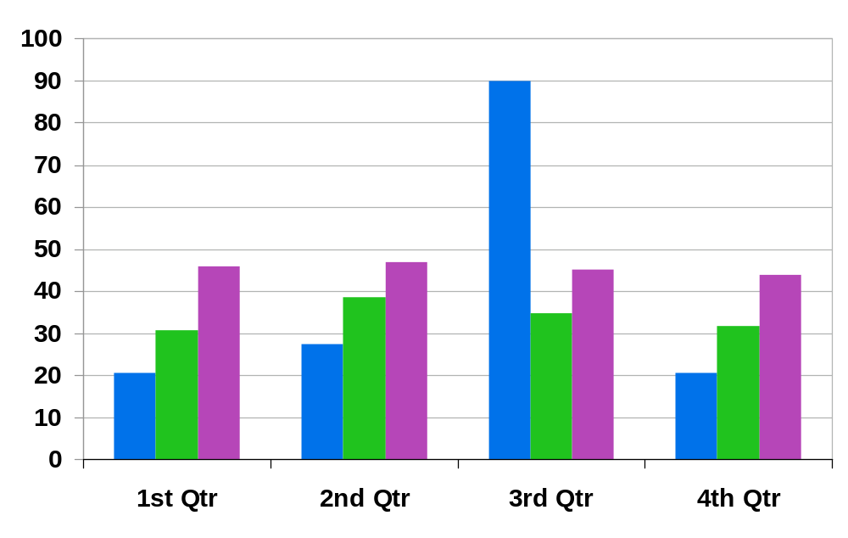
Sample Bar Chart
纯免费PPT即点即下载，无注册、无套路
http://gitppt.com
不信你试试（狗头）
Instructions:
The color palette has been set in this chart. To create a new chart, copy this chart onto your slide. To update the data, double-click on the chart to bring up the PPT chart editor.
For additional information on working with the PPT charting feature, follow this link
http://office.microsoft.com/en-us/assistance/CH063509351033.aspx
BEA Confidential. | <number>
Notes:
BEA Confidential

Slide 25
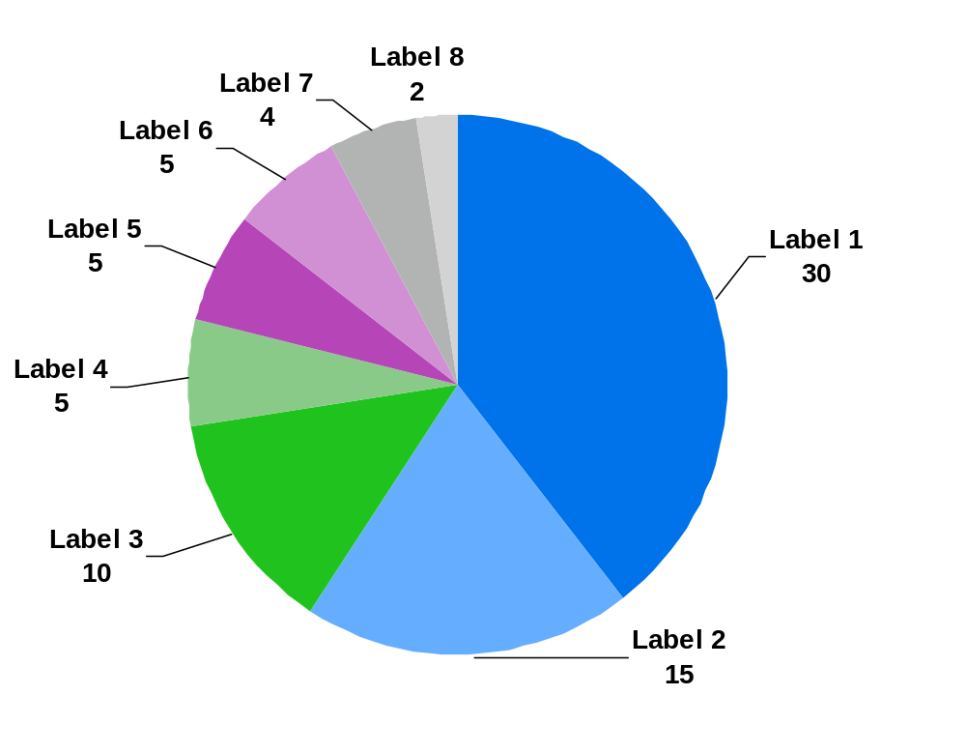
Sample Pie Chart
纯免费PPT即点即下载，无注册、无套路
http://gitppt.com
不信你试试（狗头）
Instructions:
The color palette has been set in this chart. To create a new chart, copy this chart onto your slide and update the data to suit your needs
BEA Confidential. | <number>
Notes:
BEA Confidential

Slide 26
Sample Table Slide
纯免费PPT即点即下载，无注册、无套路
http://gitppt.com
不信你试试（狗头）
Instructions:
This table was created using PowerPoint’s built-in table program. The table will dynamically adjust to the content. To enter or edit the data, simply click on the table.
Keep format colors as is.
Row Head | Head | Head | Head
Column Head | Data | Data | Data
Column Head | Data | Data | Data
Column Head | Data | Data | Data
Column Head | Data | Data | Data
Column Head | Data | Data | Data
Column Head | Data | Data | Data
Column Head | Data | Data | Data
BEA Confidential. | <number>
Notes:
BEA Confidential

Slide 27
Sample Table Slide With Highlight
纯免费PPT即点即下载，无注册、无套路
http://gitppt.com
不信你试试（狗头）
Row Head | Head | Head | Head
Column Head | Data | Data | Data
Column Head | Data | Data | Data
Column Head | Data | Data | Data
Column Head | Data | Data | Data
Column Head | Data | Data | Data
Column Head | Data | Data | Data
Column Head | Data | Data | Data
BEA Confidential. | <number>
Notes:
BEA Confidential

Slide 28
Sample Table Slide With Bullet Text
纯免费PPT即点即下载，无注册、无套路
http://gitppt.com
不信你试试（狗头）
Row Head | Head | Head
Column Head | Bullet text is 16 pt. Arial Bullet text | Bullet text is 16 pt. Arial Bullet text
Column Head | Bullet text is 16 pt. Arial | Bullet text is 16 pt. Arial Bullet text
Column Head | Bullet text | Bullet text is 16 pt. Arial
Column Head | Bullet text is 16 pt. Arial | Bullet text
BEA Confidential. | <number>
Notes:
BEA Confidential

Slide 29
Alternative Agenda Slide
纯免费PPT即点即下载，无注册、无套路
http://gitppt.com
不信你试试（狗头）
Time | Topic | Speaker | Room
08.30 – 09.00 | Registration |  | Reception
09.00 – 11.00 | UK Business Update | Peter Stanley | Thames
10.00 – 12.00 | Customer References | Lucille Cloney | Thames
13.00 – 14.00 | Lunch |  | Loire
14.00 – 15.00 | RFID Break-out Session | Ian Broughton | Danube
14.00 – 15.00 | Government Break-out Session | Suzannah Darlow | Rhine
15.00 – 15.30 | Summary and AOB | Peter Stanley | Thames
BEA Confidential. | <number>
Notes:
BEA Confidential

Slide 30
Standard Boxes, Arrows, and Shapes
纯免费PPT即点即下载，无注册、无套路
http://gitppt.com
不信你试试（狗头）
Notes:
BEA Confidential

Slide 31
Standard Arrow Styles
纯免费PPT即点即下载，无注册、无套路
http://gitppt.com
不信你试试（狗头）
BEA Confidential. | <number>
Notes:
BEA Confidential
BEA AquaLogic Data Services Platform has been built from the ground up for SOA. It provides automation for creating and maintaining enterprise data services which can help customers achieve greater productivity, business optimization and faster time to value.
BEA AquaLogic Data Services Platform offers a single location to capture logic that is relevant to data access and data updates. A data services layer provides reusable, simplified access to relevant, real-time heterogeneous data. BEA AquaLogic Data Services Platform is based on a metadata-driven approach with a declarative definition of services. This helps eliminate the need for application developers to build workflows or code Java by hand, resulting in the automation of data service creation and maintenance. Furthermore, the declarative approach helps optimize data access, improving overall system performance.

Slide 32
Standard Blue Box Styles
纯免费PPT即点即下载，无注册、无套路
http://gitppt.com
不信你试试（狗头）
w/ shadow
Box w/Shadow
BEA Confidential. | <number>
Notes:
BEA Confidential

Slide 33
Standard Green Box Styles
纯免费PPT即点即下载，无注册、无套路
http://gitppt.com
不信你试试（狗头）
w/ shadow
Box w/Shadow
BEA Confidential. | <number>
Notes:
BEA Confidential

Slide 34
Standard Purple Box Styles
纯免费PPT即点即下载，无注册、无套路
http://gitppt.com
不信你试试（狗头）
w/ shadow
Box w/Shadow
BEA Confidential. | <number>
Notes:
BEA Confidential

Slide 35
Standard Gray Box Styles
纯免费PPT即点即下载，无注册、无套路
http://gitppt.com
不信你试试（狗头）
w/ shadow
Box w/Shadow
BEA Confidential. | <number>
Notes:
BEA Confidential

Slide 36
Example of a Diagram
纯免费PPT即点即下载，无注册、无套路
http://gitppt.com
不信你试试（狗头）
Service Infrastructure
Composite Applications
Presentation Services
Services Management
Service Bus
Common Services
Shared Business Services
Information Access Services
BEA Confidential. | <number>
Notes:
BEA Confidential

Slide 37
Photography
纯免费PPT即点即下载，无注册、无套路
http://gitppt.com
不信你试试（狗头）
Use of photography should be minimal
  Never mix-and-match black and white and color images on
  the same page
  Never use clipart
  A defined collection of stock photography is available at http://inweb.beasys.com/marketing/resource/graphics/
  Right click on the URL, select Open Hyperlink to open the Photo Library in the browser
Because Liquid naturally calls to mind strong visual imagery, there might be a desire to use different types of water imagery (e.g., waves, rivers, waterfalls, droplets, etc.). However, in order to maintain a consistent look-and-feel, we recommend not using this type of imagery
BEA Confidential. | <number>
Notes:
BEA Confidential

Slide 38

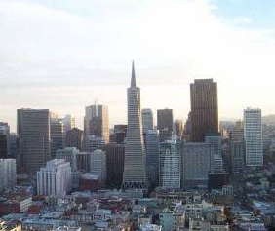
Example Use of Photography
纯免费PPT即点即下载，无注册、无套路
http://gitppt.com
不信你试试（狗头）
Application Infrastructure
Application Development
Service Enablement
Execution Environment
Reliability
Service Infrastructure
Composite Application Framework
Business Service Orchestration
Cross-platform management
Governance and control
Service discovery, publishing and security
Message routing and transformation
Resource allocation
BEA Confidential. | <number>
Notes:
BEA Confidential
Four Strategic Pillars
Script: How does BEA’s deliver the industry’s leading SOA infrastructure software platform? What is our strategy to deliver Business Liquidity? What are BEA’s core differentiators? Today every software company on the planet is claiming that they are the leading enterprise SW company, that they are different. What makes BEA special? The answer can be found in these four Strategic Pillars which form the basis of our technology and product vision.
Notes:
The four strategic differentiators are; Embracing Heterogeneity, Seamless Innovation, Blended Development and Deployment and a Sensible Approach to SOA. The next four sections will cover each of these four strategic pillars in detail. The combination for strategic pillars are core to what differentiates BEA from every other enterprise SW company large or small.

Slide 39
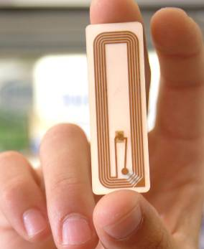


Example Use of Photography
纯免费PPT即点即下载，无注册、无套路
http://gitppt.com
不信你试试（狗头）
Edge Computing
Converged Communications
Real-Time Transactions
BEA Confidential. | <number>
Notes:
BEA Confidential
Script: Seamless Innovation is ultimately measured by the business results it enables. Clear examples of BEA’s forward thinking can be seen in many areas including: Edge Computing, Converged Communications and Real-time deterministic transaction oriented systems. Its about aiming our technology to solve real world business problems. For example real-time services in Financial Services community, next generation IP based converged communication in telecommunications or RFID based edge computing for supply chain management
Notes:
Edge Computing – Creating the leading J2EE infrastructure designed to take advantage of the real-time picture of a companies supply-chain through RFID (Radio Frequency Identification)
Converged Communications _ The first SIP enabled internet communication platform which enables carriers and enterprise to converge traditional IT with telecommunication services to deliver next generation of advanced IP based services
Real-Time Transactions – The first J2EE platform to deliver deterministic response time that can be measured in the milliseconds. Necessary for applications where response time must be guaranteed such as the worlds banking trading systems.

Slide 40
Special Needs
纯免费PPT即点即下载，无注册、无套路
http://gitppt.com
不信你试试（狗头）
Notes:
BEA Confidential

Slide 41

Remove the Liquid Background for Slides With Large Graphics
纯免费PPT即点即下载，无注册、无套路
http://gitppt.com
不信你试试（狗头）
Service Infrastructure
Applications
Shared Services
A
1
2
3
1
2
3
Composite Applications
Instructions:
This is the sample slide with a large complex graphic.
To hide background elements from a slide, right-click on the background of the slide and select “Background.” At the bottom of the pop-up dialogue box, click on “Omit background graphics from master” and select Apply. This will hide all background graphics.
For this example, the logo and footer have been copied onto the slide for consistency with the remainder of the template.
B
Low
1
High
1
3
3
4
5
5
Presentation Services
C
5
5
6
7
7
Unshared
5
5
8
8
D
2
2
7
7
8
8
9
9
Shared
Services Management
E
Service Bus
Common Services
7
7
10
10
11
Shared Business Services
11
F
8
8
9
9
10
10
11
9
10
11
11
12
9
10
11
12
G
1
3
7
9
11
1
3
7
9
11
Information Access Services
Services Catalog
2
4
6
2
1
2
3
4
5
6
1
2
3
5
7
8
9
10
11
12
1
3
7
7
8
9
10
11
1
3
7
BEA Confidential. | <number>
Notes:
BEA Confidential

Slide 42
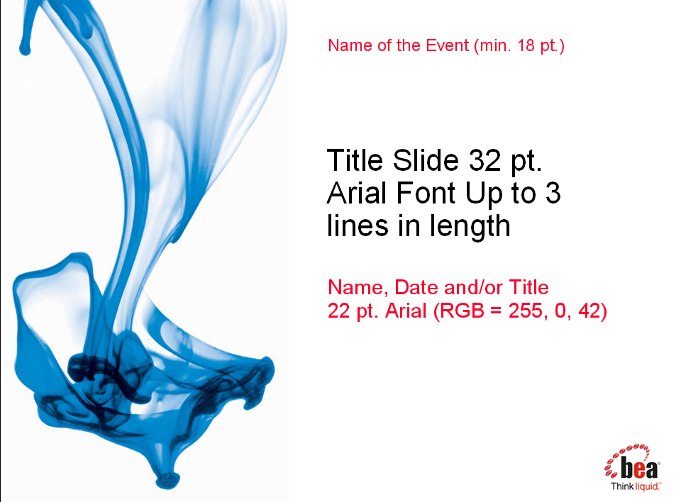
Template for Special Event
纯免费PPT即点即下载，无注册、无套路
http://gitppt.com
不信你试试（狗头）
You can use this layout for special events which require designation, but do not require a custom template
Insert a text box with the name of the event to the Title Master as shown in the screenshot and the bottom of the Slide Master as shown below
Name of the Event (min. 14 pt.)
BEA Confidential. | <number>
Notes:
BEA Confidential

