Slide 1

纯免费PPT即点即下载，无注册、无套路
http://gitppt.com
不信你试试（狗头）
future web trends
innovation series 2007 with jimmy wales
Matthew Buckland
www.matthewbuckland.com
GM: New Media, M&G Online
IMG SRC: Flickr

Slide 2

the thing about predictions...
纯免费PPT即点即下载，无注册、无套路
http://gitppt.com
不信你试试（狗头）
IMG SRC: Flickr

Slide 3
"Computers in the future may weigh no more than 1.5 tons."
Popular Mechanics, forecasting the relentless march of science, 1949
纯免费PPT即点即下载，无注册、无套路
http://gitppt.com
不信你试试（狗头）

Slide 4
"I think there is a world market for maybe five computers."
Thomas Watson, chairman of IBM, 1943
纯免费PPT即点即下载，无注册、无套路
http://gitppt.com
不信你试试（狗头）

Slide 5
"640K ought to be enough for anybody."
Bill Gates, 1981 apocryphal
纯免费PPT即点即下载，无注册、无套路
http://gitppt.com
不信你试试（狗头）

Slide 6
"There is no reason anyone would want a computer in their home."
Ken Olson, president, chairman and founder of Digital Equipment Corp., 1977
纯免费PPT即点即下载，无注册、无套路
http://gitppt.com
不信你试试（狗头）

Slide 7
internet connectivity
纯免费PPT即点即下载，无注册、无套路
http://gitppt.com
不信你试试（狗头）
Dirt cheap, lightening fast & “always on” internet
Computers light, dumb terminals: need net connection to work
Most applications web-based for best efficiency
IMG SRC: Flickr

Slide 8
all digital devices will be connected & networked
纯免费PPT即点即下载，无注册、无套路
http://gitppt.com
不信你试试（狗头）
From your car, radio, phone, fridge... “always on”
An unconnected digital device will be a strange thing
WiMax connected sunglasses with voice prompted HUD?

Slide 9
rise of the mobile internet
纯免费PPT即点即下载，无注册、无套路
http://gitppt.com
不信你试试（狗头）
Rapid improvements in connectivity & screens
Mobile to be dominant platform for connecting to net worldwide
Japan: happened already (mostly surf web through phones)
Voice calls powered by internet & SMS/Texts -> IM
Cellphones electronic wallets & banks = main method of payment
Citizens vote for first time in elections via mobile phones?

Slide 10
rise of individual
& entrepreneur
纯免费PPT即点即下载，无注册、无套路
http://gitppt.com
不信你试试（狗头）
Open source = unprecedented access to code & applications
Cheap to create business online & make own media
Teenager in basement same opp. as worker in big company
EXAMPLE: New mobile operating system (Android)?

Slide 11
strides against digital divide
纯免费PPT即点即下载，无注册、无套路
http://gitppt.com
不信你试试（狗头）
Developing world joins digital ecosystem via mobile phones
Also become part of economy via cellphone wallet
Mobile phones cheap & broadband ubiquitous
Illiteracy issues overcome by video & audio streams
Creates new areas of collaboration and education

Slide 12
almost no privacy on the web
纯免费PPT即点即下载，无注册、无套路
http://gitppt.com
不信你试试（狗头）
Your data will be out there
It will be ok because everyone will be in the same boat
Seeing already with soc. networking services like FB

Slide 13
the rise of the virtual universe
纯免费PPT即点即下载，无注册、无套路
http://gitppt.com
不信你试试（狗头）
Virtual worlds like Second life go mainstream
Come to fore as graphic cards & broadband improve
Potentially a visual alternative to the world wide web
Standards: different worlds connect to each other seamlessly
Virtual coup d’etat by SL citizens?
Linden Labs cedes SL to democratically elected virtual govt

Slide 14
information pollution & overload
纯免费PPT即点即下载，无注册、无套路
http://gitppt.com
不信你试试（狗头）
Next big challenge is how to manage masses of information
People will complain about "digital fatigue“ & digital noise
Focus on developing filters & aggregators
“Switch-off" holidays regularly prescribed by your doctor
Rise of anti-digital movements urging “get back to basics”
In response to clutter, a second world wide web announced

Slide 15
more googles
& facebooks
纯免费PPT即点即下载，无注册、无套路
http://gitppt.com
不信你试试（狗头）
Google & Facebook finally get good competition
Microsoft releases OS code and goes open source
MS makes revenue by selling advertising & giving support
Advertising is main bus. model (connecting sellers & buyers)
Facebook becomes a virtual OS/desktop, with MS influence

Slide 16
decline of the nation state?
纯免费PPT即点即下载，无注册、无套路
http://gitppt.com
不信你试试（狗头）
Govt has less influence & control than ever before
Technologies threaten existing power & economic relationships
Also: music industry has resisted digital audio and Napster
But oppressive regimes clamp down on internet
Some countries regress into dark ages

Slide 17
...and media?
纯免费PPT即点即下载，无注册、无套路
http://gitppt.com
不信你试试（狗头）

Slide 18
media distribution
& production
纯免费PPT即点即下载，无注册、无套路
http://gitppt.com
不信你试试（狗头）
MEDIA MEDIA MEDIA MEDIA MEDIA MEDIA MEDIA MEDIA MEDIA MEDIA MEDIA MEDIA MEDIA
All media eventually delivered via internet
Hardly any specialist print, tv, radio media companies left
All fully converged, broadcasting & publishing via the net
Media on many digital platforms

Slide 19
fragmented media environment
纯免费PPT即点即下载，无注册、无套路
http://gitppt.com
不信你试试（狗头）
MEDIA MEDIA MEDIA MEDIA MEDIA MEDIA MEDIA MEDIA MEDIA MEDIA MEDIA MEDIA MEDIA
Non-media players become de facto media companies
Media world filled with new competitors
Cellphone operators, handset makers -> media companies
Vodacom stop aggregating, start producing own content
Operators already big media companies (Voda: 1,4m users)
Battle between media & cellphone companies looming

Slide 20
now everyone is a media player
纯免费PPT即点即下载，无注册、无套路
http://gitppt.com
不信你试试（狗头）
MEDIA MEDIA MEDIA MEDIA MEDIA MEDIA MEDIA MEDIA MEDIA MEDIA MEDIA MEDIA MEDIA
Barrier to entry drops even more dramatically
Rise of the reader and the consumer
Readers: publishers, broadcasters: competitors & collaborators
Small, converged media challenge media conglomerates

Slide 21
role of media changes
纯免费PPT即点即下载，无注册、无套路
http://gitppt.com
不信你试试（狗头）
MEDIA MEDIA MEDIA MEDIA MEDIA MEDIA MEDIA MEDIA MEDIA MEDIA MEDIA MEDIA MEDIA
Also content aggregators, facilitators
Business model: capture audience via all means
Media companies look to own channels: deals for own phones?
Content portals -> web applications & services
Social networks as well as content hubs

Slide 22
is this the end of print?
纯免费PPT即点即下载，无注册、无套路
http://gitppt.com
不信你试试（狗头）
MEDIA MEDIA MEDIA MEDIA MEDIA MEDIA MEDIA MEDIA MEDIA MEDIA MEDIA MEDIA MEDIA
Books, newspapers magazines...
Read on flexible digital boards, always connected
Websites & digital newspapers become “same thing”
Newspapers smaller & niched, but not extinct
Newspapers become expensive, luxury items
A lifestyle item: buying an “experience”, part of “offtime”

Slide 23
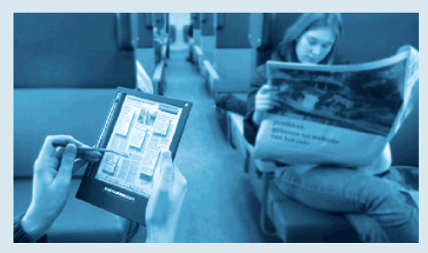
纯免费PPT即点即下载，无注册、无套路
http://gitppt.com
不信你试试（狗头）
IMG SRC: WANN

Slide 24
...other developments
纯免费PPT即点即下载，无注册、无套路
http://gitppt.com
不信你试试（狗头）

Slide 25
other trends for now & the future
纯免费PPT即点即下载，无注册、无套路
http://gitppt.com
不信你试试（狗头）
Semantic web entrenched
Artificial intelligence
Attention economy in full swing
Sophisticated personalisation of content
Location-based/mapping services common & mobile
Virtualisation eg: Amazon’s EC2 & S3 services
Web 14.0???... ;-)
SRC: Read Write/Web, Jaxon Rice, My blog

Slide 26
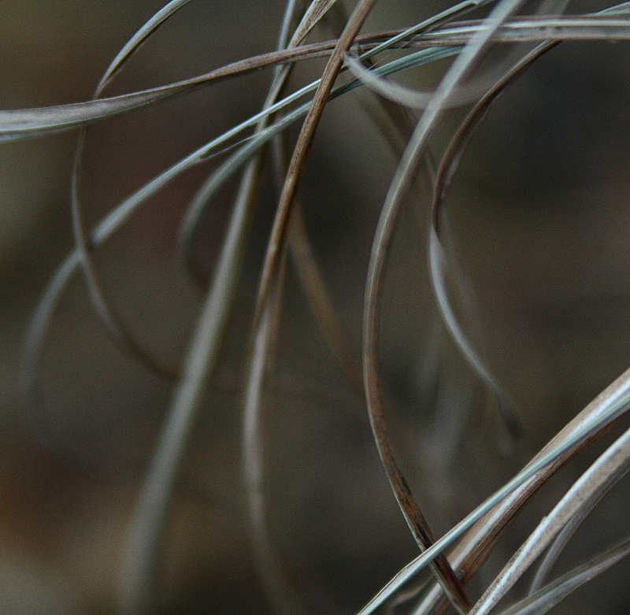
Forget capitalism and the class struggle... the digital revolution is changing things far more dramatically than the hypemongers ever imagined... the move from a society dominated by print and broadcast mass media to the age of interactivity is at least as dramatic as the move from feudalism to capitalism.
Netocracy, by Jan Söderqvist and Alexander Bard (2001)
纯免费PPT即点即下载，无注册、无套路
http://gitppt.com
不信你试试（狗头）
IMG SRC: Flickr

Slide 27
Driven by internet and mobile communications, networks are turning into the major means of doing business... Simply put, networks will make the world go round. So controlling the networks of this world will soon count for more than controlling the capital.
Netocracy, by Jan Söderqvist and Alexander Bard (2001)
纯免费PPT即点即下载，无注册、无套路
http://gitppt.com
不信你试试（狗头）

