Slide 1
纯免费PPT即点即下载，无注册、无套路
http://gitppt.com
不信你试试（狗头）
INDIA’S
FUTURE
R B Roy Choudhury Memorial lecture
Mumbai
29 January 2007

Slide 2
Even though the world has just discovered it, the India growth story is not new. It has been going on for 25 years old
纯免费PPT即点即下载，无注册、无套路
http://gitppt.com
不信你试试（狗头）

Slide 3
What is the India story?
纯免费PPT即点即下载，无注册、无套路
http://gitppt.com
不信你试试（狗头）

Slide 4
1) Rising GDP growth
纯免费PPT即点即下载，无注册、无套路
http://gitppt.com
不信你试试（狗头）
India Story
% average annual GDP growth
1900 – 1950 1.0
1950 – 1980 3.5
1980 – 2002 6.0
2002 – 2006 8.0
Sources: 1900-1990: Angus Maddison (1995), Monitoring the World Economy, 1990-2000:Census of India (2001), 2000-2005 Finance Ministry

Slide 5
2) Population growth is slowing
纯免费PPT即点即下载，无注册、无套路
http://gitppt.com
不信你试试（狗头）
India Story
% average annual growth
1901 – 1950 1.0
1951 – 1980 2.2
1981 – 1990 2.1
1991 – 2000 1.8
2001 – 2010 1.5
Sources: 1900-1990: Angus Maddison (1995), Monitoring the World Economy, 1990-2000:Census of India (2001)

Slide 6
3. Literacy is rising
纯免费PPT即点即下载，无注册、无套路
http://gitppt.com
不信你试试（狗头）
India Story
%
1950 17
1990 52
2000 65
2010 (proj) 80
Source: Census of India (2001)

Slide 7
4. Middle class is exploding
纯免费PPT即点即下载，无注册、无套路
http://gitppt.com
不信你试试（狗头）
India Story
% Million
People
1980 8 65
2000 22 220
2010 (proj) 32 368
Source: The Consuming Class, National Council of Applied Economic Research, 2002

Slide 8
5. Poverty is declining
纯免费PPT即点即下载，无注册、无套路
http://gitppt.com
不信你试试（狗头）
India Story
1980 46%
2000 26%
2010 (proj) 16%
1% of the people have been crossing poverty line each year for 20 years. Equals ~ 200 million.

Slide 9
6. Productivity is rising
纯免费PPT即点即下载，无注册、无套路
http://gitppt.com
不信你试试（狗头）
India Story
30% to 40% of GDP growth is due to
rising productivity

Slide 10
7. Per capita income gains
纯免费PPT即点即下载，无注册、无套路
http://gitppt.com
不信你试试（狗头）
India Story
(US$ ppp)
1980 1178
2000 3051
Source: World Bank

Slide 11
8. India is now the 4th largest economy
纯免费PPT即点即下载，无注册、无套路
http://gitppt.com
不信你试试（狗头）
India Story
And it will cross Japan between 2012 and 2014 to become the 3rd largest

Slide 12
THE INDIA MODEL IS UNIQUE
纯免费PPT即点即下载，无注册、无套路
http://gitppt.com
不信你试试（狗头）

Slide 13
DRIVERS OF GROWTH
纯免费PPT即点即下载，无注册、无套路
http://gitppt.com
不信你试试（狗头）
India East and S.E. Asia
Domestic Exports

Slide 14
DRIVERS OF GROWTH
纯免费PPT即点即下载，无注册、无套路
http://gitppt.com
不信你试试（狗头）
India East and S.E. Asia
Domestic Exports
Services Manufacturing

Slide 15
DRIVERS OF GROWTH
纯免费PPT即点即下载，无注册、无套路
http://gitppt.com
不信你试试（狗头）
India East and S.E. Asia
Domestic Exports
Services Manufacturing
Consumption Investment

Slide 16
DRIVERS OF GROWTH
纯免费PPT即点即下载，无注册、无套路
http://gitppt.com
不信你试试（狗头）
India East and S.E. Asia
Domestic Exports
Services Manufacturing
Consumption Investment
High tech, capital Low tech, labour
intensive industry intensive industry

Slide 17
IMPLICATIONS OF INDIA MODEL
纯免费PPT即点即下载，无注册、无套路
http://gitppt.com
不信你试试（狗头）
Domestic led
Insulation from global downturns
Less volatility

Slide 18
IMPLICATION OF INDIA MODEL
纯免费PPT即点即下载，无注册、无套路
http://gitppt.com
不信你试试（狗头）
Services led
Have we skipped the industrial revolution?
How do we take people from farms to cities?

Slide 19
IMPLICATION OF INDIA MODEL
纯免费PPT即点即下载，无注册、无套路
http://gitppt.com
不信你试试（狗头）
Consumption led
People friendly: Consumption as % of GDP
India 64
Europe 58
China 42
Less inequality – GINI INDEX
India 33
U.S 41
China 45
Brazil 59
The world needs another big consuming economy after the U.S.

Slide 20
Reasons for Success
India’s success is market led whereas China’s is state induced. The entrepreneur is at centre of the Indian model
纯免费PPT即点即下载，无注册、无套路
http://gitppt.com
不信你试试（狗头）

Slide 21
纯免费PPT即点即下载，无注册、无套路
http://gitppt.com
不信你试试（狗头）
Rise of globally competitive
Indian companies:
Reliance, Jet Airways, Infosys, Wipro,
Ranbaxy, Bharat Forge, Tata Motors,
TCS, Bharati, ICICI and HDFC Banks

Slide 22
India has a vibrant private space
纯免费PPT即点即下载，无注册、无套路
http://gitppt.com
不信你试试（狗头）
> 100 Indian Companies have market
cap of US$ 1 billion

Slide 23
India has a vibrant private space
纯免费PPT即点即下载，无注册、无套路
http://gitppt.com
不信你试试（狗头）
> 100 Indian Companies have market
cap of US$ 1 billion
> 1000 Indian Companies have
received foreign institutional
investment

Slide 24
India has a vibrant private space
纯免费PPT即点即下载，无注册、无套路
http://gitppt.com
不信你试试（狗头）
> 100 Indian Companies have market
cap of US$ 1 billion
> 1000 Indian Companies have
received foreign institutional
investment
> 125 Fortune 500 companies have
R&D bases in India

Slide 25
India has a vibrant private space
纯免费PPT即点即下载，无注册、无套路
http://gitppt.com
不信你试试（狗头）
> 100 Indian Companies have market
cap of US$ 1 billion
> 1000 Indian Companies have
received foreign institutional
investment
> 125 Fortune 500 companies have
R&D bases in India
> 390 Fortune 500 companies have
outsourced software development to India.

Slide 26
India has a vibrant private space
纯免费PPT即点即下载，无注册、无套路
http://gitppt.com
不信你试试（狗头）
> 100 Indian Companies have market
cap of US$ 1 billion
> 1000 Indian Companies have
received foreign institutional
investment
> 125 Fortune 500 companies have
R&D bases in India
> 390 Fortune 500 companies have
outsourced software development to India.
< 2% bad loans in Indian banks (vs ~ 20% in China)

Slide 27
India has a vibrant private space
纯免费PPT即点即下载，无注册、无套路
http://gitppt.com
不信你试试（狗头）
> 100 Indian Companies have market
cap of US$ 1 billion
> 1000 Indian Companies have
received foreign institutional
investment
> 125 Fortune 500 companies have
R&D bases in India
> 390 Fortune 500 companies have
outsourced software development to India.
< 2% bad loans in Indian banks (vs ~ 20% in China)
> 80% credit goes to private sector (vs~10% in
China)

Slide 28
But public space is a problem
纯免费PPT即点即下载，无注册、无套路
http://gitppt.com
不信你试试（狗头）
Although we have a:
+ Dynamic democracy with honest elections

Slide 29
Public space is a problem
纯免费PPT即点即下载，无注册、无套路
http://gitppt.com
不信你试试（狗头）
Although we have a:
+ Dynamic democracy
+ Free, lively media and press

Slide 30
Public space is a problem
纯免费PPT即点即下载，无注册、无套路
http://gitppt.com
不信你试试（狗头）
+ Dynamic democracy with
+ Free, lively media and press
But there is:
- Poor governance

Slide 31
Public space is a problem
纯免费PPT即点即下载，无注册、无套路
http://gitppt.com
不信你试试（狗头）
+ Dynamic democracy
+ Free, lively media and press
- Poor governance
- High populist subsidies, which results in a high fiscal deficit

Slide 32
Public space is a problem
纯免费PPT即点即下载，无注册、无套路
http://gitppt.com
不信你试试（狗头）
+ Dynamic democracy
+ Free, lively media and press
- Poor governance
- High subsidies High fiscal deficit
- No money for infrastructure

Slide 33
Public space is a problem
纯免费PPT即点即下载，无注册、无套路
http://gitppt.com
不信你试试（狗头）
+ Dynamic democracy
+ Free, lively media and press
- Poor governance
- High subsidies High fiscal deficit
- Creaky infrastructure
- Inefficient government companies

Slide 34
Earlier we had world class institutions, but they are now failing
纯免费PPT即点即下载，无注册、无套路
http://gitppt.com
不信你试试（狗头）
Bureaucracy
Judiciary
Police

Slide 35
Contrast between public and private space raises the question :
纯免费PPT即点即下载，无注册、无套路
http://gitppt.com
不信你试试（狗头）
Is India rising despite the state ?

Slide 36
Economy grows at night when government is asleep
纯免费PPT即点即下载，无注册、无套路
http://gitppt.com
不信你试试（狗头）

Slide 37
What explains India’s economic success?
纯免费PPT即点即下载，无注册、无套路
http://gitppt.com
不信你试试（狗头）
Even slow reforms add up
- state getting out of the way
- every government has reformed since 1991

Slide 38
纯免费PPT即点即下载，无注册、无套路
http://gitppt.com
不信你试试（狗头）
Key Reforms
Opened economy to trade and investment
Dismantled controls
Lowered tariffs
Dropped tax rates
Broke public sector monopolies

Slide 39
What explains India’s economic success?
纯免费PPT即点即下载，无注册、无套路
http://gitppt.com
不信你试试（狗头）
Even slow reforms add up-state
getting out of the way
2) Young minds are liberated

Slide 40
纯免费PPT即点即下载，无注册、无套路
http://gitppt.com
不信你试试（狗头）
Mental Revolution
- ‘I want to be Bilgay’
- Raju’s secret of success
- Banianisation of society
- 100 cable channels for $3
- Hinglish

Slide 41
What explains India’s economic success?
纯免费PPT即点即下载，无注册、无套路
http://gitppt.com
不信你试试（狗头）
Even slow reforms add up-state
getting out of the way
Young minds are liberated
3) India has found its competitive
advantage in the knowledge economy

Slide 42
纯免费PPT即点即下载，无注册、无套路
http://gitppt.com
不信你试试（狗头）
Looking Forward
7% - 8% economic growth
Democracy will not permit more than 8%
1.5% Population growth

Slide 43
This means a per capita income roughly of (on a ppp basis):
纯免费PPT即点即下载，无注册、无套路
http://gitppt.com
不信你试试（狗头）
($)
2000 2100
2005 3050
2020 5800
2040 16,800
2066 37,000

Slide 44
纯免费PPT即点即下载，无注册、无套路
http://gitppt.com
不信你试试（狗头）
Why will growth continue?
Demographic dividend

Slide 45
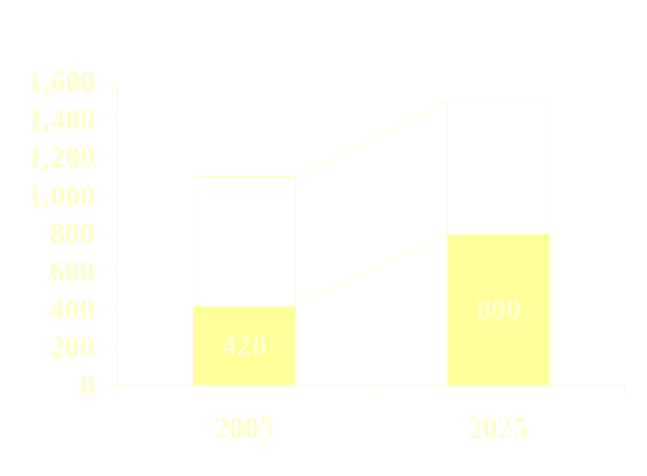
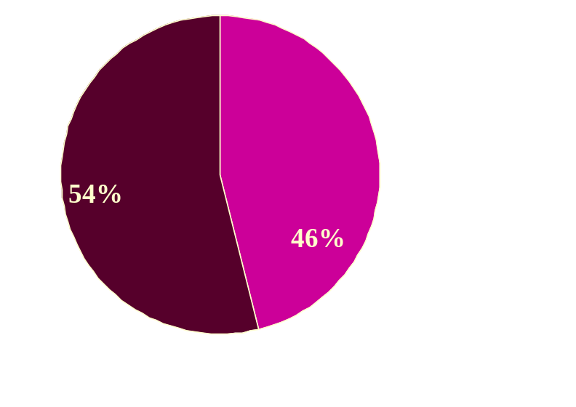
纯免费PPT即点即下载，无注册、无套路
http://gitppt.com
不信你试试（狗头）
Demographic trend points to sharp increases in input factors
Demographic Split
1.5 bn
1.1 bn
0-25 yrs
Labor Force
25+ yrs
Labor Force will double in the next 20 years

Slide 46
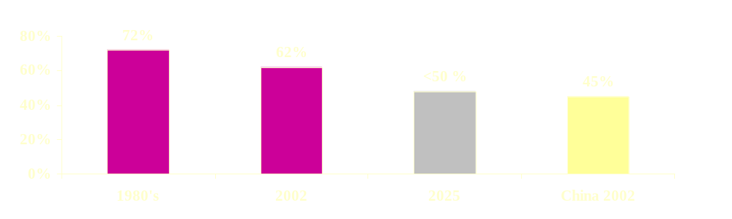
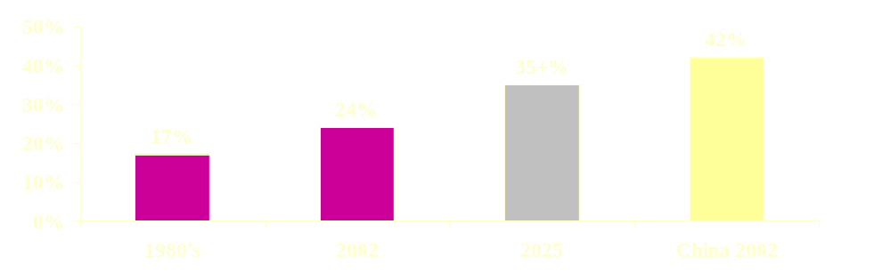
纯免费PPT即点即下载，无注册、无套路
http://gitppt.com
不信你试试（狗头）
Demographic trend points to sharp increases in input factors
Age Dependency
Savings Rate
Higher savings and investment rate will translate into higher GDP growth

Slide 47
India’s demographic advantage means that its high growth will continue longer term while China will slow
纯免费PPT即点即下载，无注册、无套路
http://gitppt.com
不信你试试（狗头）

Slide 48
INDIA WILL GRADUALLY TURN MIDDLE CLASS
纯免费PPT即点即下载，无注册、无套路
http://gitppt.com
不信你试试（狗头）
%
1980 8
2000 22
2010 32
2020 50 West of the Kanpur-Chennai line
2040 50 East of the Kanpur-Chennai line

Slide 49
“By 2010 India will have world’s largest number of English speakers”
“When 300 million Indians speak a word in a certain way, that will be the way to speak it.”
-Prof. David Crystal, Cambridge Encyclopedia of the English Language
纯免费PPT即点即下载，无注册、无套路
http://gitppt.com
不信你试试（狗头）

Slide 50
What could stop the show?
纯免费PPT即点即下载，无注册、无套路
http://gitppt.com
不信你试试（狗头）
Fiscal deficit
Infrastructure
Bad governance
Nuclear war

Slide 51
REFORM SCHOOL
纯免费PPT即点即下载，无注册、无套路
http://gitppt.com
不信你试试（狗头）
Labour

Slide 52
REFORM SCHOOL
纯免费PPT即点即下载，无注册、无套路
http://gitppt.com
不信你试试（狗头）
Labour
Agriculture

Slide 53
纯免费PPT即点即下载，无注册、无套路
http://gitppt.com
不信你试试（狗头）
Second Green Revolution
technologically led, based on GM seeds
labor intensive
needs reforms

Slide 54
REFORM SCHOOL
纯免费PPT即点即下载，无注册、无套路
http://gitppt.com
不信你试试（狗头）
Labour
Agriculture
Power

Slide 55
REFORM SCHOOL
纯免费PPT即点即下载，无注册、无套路
http://gitppt.com
不信你试试（狗头）
Labour
Agriculture
Power
Red tape

Slide 56
REFORM SCHOOL
纯免费PPT即点即下载，无注册、无套路
http://gitppt.com
不信你试试（狗头）
Labor
Agriculture
Power
Red tape
Governance

Slide 57
纯免费PPT即点即下载，无注册、无套路
http://gitppt.com
不信你试试（狗头）
Corporate Governance
- High in India
- Low in China

Slide 58
纯免费PPT即点即下载，无注册、无套路
http://gitppt.com
不信你试试（狗头）
Bottom Line
Indian prosperity is on auto pilot
Can’t do without government. But governance reform will take time, till middle class is dominant.
Human capital will continue to flower based on private initiative, and drive the nation

Slide 59
India has law, China has order
-India got democracy before capitalism and this has made all the difference
-It will be slower than China but its path will be surer
-India more likely to preserve its way of life
纯免费PPT即点即下载，无注册、无套路
http://gitppt.com
不信你试试（狗头）

