Slide 1
Digital Brand Management Services
纯免费PPT即点即下载，无注册、无套路
http://gitppt.com
不信你试试（狗头）
March, 2003

Slide 2


Brands are critical assets to a company
纯免费PPT即点即下载，无注册、无套路
http://gitppt.com
不信你试试（狗头）
Brand Value in Billions
50%+
Of Mkt. Cap
Coca-Cola 70
Microsoft 64
IBM 51
Disney 29
McDonalds 25
Ford 20
Apple 5
Amazon 3
Brands in many cases can represent on average 35% of a company’s market capitalization
Is your Digital Brand Protected?

Slide 3
Domain Names Management Challenges
纯免费PPT即点即下载，无注册、无套路
http://gitppt.com
不信你试试（狗头）
Growing complexity of domain name registrations drives customer towards outsourced services
Corporate Digital Assets
Restricted
106 countries
Brands
+
Services
+
Products
+
Divisions
Domain Names
243 Country Code top level domains
+
Existing gTLD’s
+
New gTLD’s
+
Multilingual
Unrestricted
86 countries
192 Registries
3 Commercial
.com, .net, .org
x
4 Restricted
.edu, .gov, .mil, int.
2 Unrestricted
.info, .biz
5 Restricted
name, pro, aero, museum, coop
MultiLingual gTLD
130 Languages
Registration Requirements, Language Barrier, Time Zones, Currencies, Renewal Dates
Multilingual ccTLD
130 Languages

Slide 4

Digital Brand Management Services
纯免费PPT即点即下载，无注册、无套路
http://gitppt.com
不信你试试（狗头）
Best Practice…..
Strategy
“Domain Names –
The E-Sign to Your Business” …
Ted Chamberlin
Gartner, Inc.
Aug 22, 2001
Monitor
Search
Build
Manage

Slide 5
Digital Brand Management Services
纯免费PPT即点即下载，无注册、无套路
http://gitppt.com
不信你试试（狗头）
Best Practice
>>> Research…..
Global Search on Domains – gTLDs / cCTLDs?
Trade Marks, Service Marks, Brands, Domains, Slogans?
Registrant Search?
Brand Presence?
Home Page Content?

Slide 6
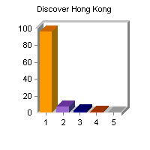
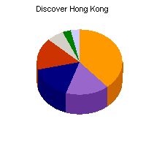
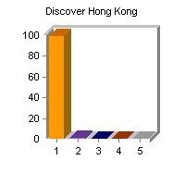
Online Brand Analysis Report:
Discover Hong Kong
纯免费PPT即点即下载，无注册、无套路
http://gitppt.com
不信你试试（狗头）
….. May 22, 2003
Brand Presence
Domains
Brand name is present within the following parts
of home pages.
Brand name appears on the following number of domains.
(aggregated by TLD)
Count
Percent
Count
Percent
body
1617
96%
COM
12
39%
link
120
7%
CN
5
16%
meta
50
3%
ORG
5
16%
image
13
1%
NET
5
16%
title
1
0%
INFO
2
6%
CO
1
3%
UK
1
3%
1680 Total Home Pages
31 Total Domain Names
Home Page Content
Search Mechanism:
Crawling 40 million+ registered domains and 20 million+ home pages.
Search each domain and analyze the content of the sites to determine if the site conducting eCommerce, contain objectionable content, site alive, etc…
Monitor if the brand name appears in either the domain, site title, meta tags, text/ link/ logo on the home page for each of the sites. If there is a hit, one count is recorded for that specific category (i.e. porn, hate, gambling, ....).
These are highly relevant information.
Brand name appears on the following number of home pages.
(aggregated by site category)
Count
Percent
conventional
1661
99%
porn
12
1%
violence
6
0%
gambling
5
0%
hate
0
0%
1680 Total Home Pages

Slide 7
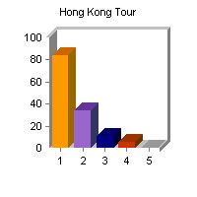
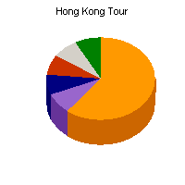
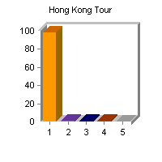
Online Brand Analysis Report:
Hong Kong Tour
纯免费PPT即点即下载，无注册、无套路
http://gitppt.com
不信你试试（狗头）
….. May 22, 2003
Brand Presence
Domains
Brand name is present within the following parts
of home pages.
Brand name appears on the following number of domains.
(aggregated by TLD)
Count
Percent
Count
Percent
body
5000
84%
COM
23
61%
link
2033
34%
INFO
3
8%
meta
631
11%
UK
3
8%
image
306
5%
KR
3
8%
title
14
0%
NET
3
8%
ORG
3
8%
5922 Total Home Pages
38 Total Domain Names
Home Page Content
Search Mechanism:
Crawling 40 million+ registered domains and 20 million+ home pages.
Search each domain and analyze the content of the sites to determine if the site conducting eCommerce, contain objectionable content, site alive, etc…
Monitor if the brand name appears in either the domain, site title, meta tags, text/ link/ logo on the home page for each of the sites. If there is a hit, one count is recorded for that specific category (i.e. porn, hate, gambling, ....).
These are highly relevant information.
Brand name appears on the following number of home pages.
(aggregated by site category)
Count
Percent
conventional
5791
98%
porn
78
1%
violence
54
1%
gambling
31
1%
hate
6
0%
5922 Total Home Pages

Slide 8

Digital Brand Management Services
纯免费PPT即点即下载，无注册、无套路
http://gitppt.com
不信你试试（狗头）
Best Practice
>>> Manage…..
Domain Renewal Management
Lock Down Domains and Standardize
Manage DNS

Slide 9

Global Registration -
Local Presence Qualification
纯免费PPT即点即下载，无注册、无套路
http://gitppt.com
不信你试试（狗头）
More than 100 countries have a restricted domain registration
process, including 7 of the top 10 markets (as measured by GDP)
VRSN Local Presence can help you to satisfy this requirements.
Australia (.au)
Ireland (.ie)
Boliva (.bo)
Italy (.it)
Brazil (.br)
Japan (.jp)
Canada (.ca)
Jordan (.jo)
Chile (.cl)
Malaysia (.my)
China (.cn)
Netherlands (.nl)
Colombia (.co)
Paraguay (.py)
Czech Republic (.cz)
Norway (.no)
El Savador (.sv)
Portugal (.pt)
Finland (.fi)
Saudi Arabia (.sa)
France (.fr)
South Korea (.kr)
Germany (.de)
Singapore (.sg)
Hong Kong (.hk)
Spain (.es)
Hungary (.hu)
Sweden (.se)
Iceland (.is)
Taiwan (.tw)
India (.in)
Vietnam (.vn)

